Slide 1
NDP Announcement for HE Sequence
Date: 2015-11-09
Authors:

Slide 2
Abstract
This presentation questions the necessity of signaling in the NDP Announcement frame, the presence of trigger frame for HE DL sounding sequence.

Slide 3
VHT DL Sounding Sequence
9.31.5.2 [1]
  If the STA’s AID is in the first (or only) STA Info field, then it shall transmit the feedback a SIFS after the VHT NDP. The other STAs in the STA Info field will be polled.
VHT NDP-A
SIFS
NDP
SIFS
SIFS
Beamforming Report Poll
SIFS
SIFS
Beamforming Report Poll
SIFS
AP
STA 1
VHT Compressed Beamforming
STA 2
VHT Compressed Beamforming
STA 3
VHT Compressed Beamforming

Slide 4
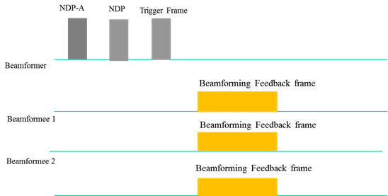
HE DL Sounding Sequence
We have the following in the current SFD [2]:
As there seems no need to sound both VHT STAs and HE STAs in the same sequence, this can be an HE NDP-A, not VHT NDP-A.
Figure 14 -- Illustration of DL Sounding Sequence

Slide 5
Trigger frame in HE DL Sounding Sequence
If inclusion of the trigger frame is the only choice, we don’t need to further discuss.
But the AP may also want to get the feedbacks one-by-one, i.e. similar to use the VHT sequence, because the combination of target STAs may not be proper for UL-MU.
To allow such sequence, a signaling bit is necessary in HE NDP Announcement frame.
HE
NDP-A
SIFS
HE NDP
SIFS
SIFS
Beamforming Report Poll
SIFS
SIFS
Beamforming Report Poll
SIFS
AP
STA 1
HE Compressed Beamforming
STA 2
HE Compressed Beamforming
STA 3
HE Compressed Beamforming

Slide 6
Summary
The necessity to enable one-by-one feedback response in HE DL sounding sequence was considered.
In order to do this, a signaling bit in the HE NDP Announcement frame to distinguish between the sequence with a trigger frame is necessary.

Slide 7
References
[1] IEEE Std 802.11ac-2013
[2] 802.11-15/0132r9 “Specification Framework for TGax”

Slide 8
Straw Poll 1
Do you agree to add a sequence similar to the VHT sounding sequence that does not include a trigger frame and where the sounding feedbacks are sent in SU PPDUs for HE DL sounding sequence?
Y:N:A =

Slide 9
Straw Poll 2
Do you agree to add the following text to the SFD?:
4.6 The amendment shall define a mechanism to signal the presence of a trigger frame, a SIFS interval after an NDP, in the HE DL sounding sequence. When there is no trigger frame, the sounding feedbacks are sent in SU PPDUs same as in the VHT sounding sequence.
Y:N:A =

