Slide 1
11ay Functional Requirements for Multi-Hop, Backhaul, and Fronthaul
Date: 2015-11-09
Authors:

Slide 2
Abstract
The IEEE 802.11 TGay backhaul and data center use
cases support multi-hop transmissions. Fronthaul and
backhaul use cases are included in the usage models
document. However specific requirements for these use
cases are lacking. This document includes specifications
for multi-hop transmissions for fronthaul and backhaul
and we propose that the functional requirements
document include these.

Slide 3
Growing Momentum for Wireless Backhaul and Fronthaul
  There is growing interest in providing wireless backhaul and fronthaul as evidenced by the following:
  Dense small cells, C-RAN architecture, etc. are demanding higher capacity, lower cost, and ease of deploying transport to the network edge.
  Multiple ongoing international projects and standardization activities are focusing on fronthaul and backhaul:
    3GPP (5G Workshop had several presentations on fronthaul and backhaul).^{[1]}
    The EU 5GPPP CrossHaul project. ^{[2]}
    The EU iJOIN project.^{[3]}
    The ETSI mWT ISG.^{[4]}

Slide 4
Backhaul Range Support
The backhaul use case^{[10]} must support typical small-cell inter-node distances.
  Small-cells are typically installed on street furniture at street corners/intersections. The size of city blocks is generally less than 750’ (250m),
  with some exceptions.^{[5]}
  Inter-cell distances greater than 200m are more economical according to a Signals Research Group white-paper (See figure). ^{[6]}
Field testing at mmWave frequencies has successfully closed the link at 200m range and extending this to 300m is considered feasible.^{[7]}
Proposed range for outdoor backhaul is 250m, whereas current functional specification indicates 100m
Note for figure: Base = 300m

Slide 5
Fronthaul Latency Support
The Small Cell Forum (SCF) has recommendations on required Fronthaul latencies to support various split architectures^{[8]}:
Split Architectures | Bi-directional Data Rate | Minimum latency type that supports split architecture
PDCP – RLC | 250 Mbps | Non Ideal – 30 ms
Split MAC | 250 Mbps | Sub Ideal – 6 ms
MAC – PHY | 250 Mbps | Near Ideal – 2 ms
Split PHY (III/IIIb: sub-frame symbol) | 2/5 Gbps | Near Ideal – 2 ms
Proposed data rate and latency requirements are 5 Gbps and 2msec, respectively. This will satisfy all listed functional splits.

Slide 6
Proposed text on 11ay functional requirement for multi-hop wireless transmissions
Multi-hop Wireless Transmissions
The TGay amendment provides a means of supporting multi-hop wireless transmissions with coverage extension scenarios for backhaul and fronthaul requirements for data rate, range and latency.

Slide 7
Proposed text on 11ay functional requirement for backhaul and fronthaul
System performance requirements for backhaul and fronthaul use cases are summarized in the following table:
Parameter | Value | Description
Data rate | 250 Mbps – 5 Gbps | Backhaul, Fronthaul (Above MAC, Intra MAC, MAC-PHY, Intra PHY) splits, with QoS support.
Range | 250 m – 1 km
Latency | 2 msec (one-way, end-to-end)
Max. hops | 5

Slide 8
References (1/2)
[1] RAN 5G Workshop – The Start of Something, Available: http://www.3gpp.org/news-events/3gpp-news/1734-ran_5g.
[2] Xhaul: The 5G Integrated Fronthaul/Backhaul, Available: http://xhaul.eu/.
[3] Interworking and Joint Design of an Open Access and Backhaul Network Architecture for Small Cells based on Cloud Networks, Available: http://www.ict-ijoin.eu/.
[4] ETSI Millimeter Wave Transmission (mWT) ISG Portal: https://portal.etsi.org/tb.aspx?tbid=833&SubTB=833.
[5] https://en.wikipedia.org/wiki/City_block.
[6] “Street Light Small Cells – A Revolution in Mobile Operator Network Economics,” White Paper by Signals Research Group, Oct. 2014, Available: http://www.interdigital.com/white_papers/street-light-small-cells?r=y.

Slide 9
References (2/2)
[7] Theodore S. Rappaport, Wonhil Roh, Kyungwhoon Cheun, “Smart Antennas Could Open Up New Spectrum for 5G,” IEEE Spectrum, Aug. 2014, Available: http://spectrum.ieee.org/telecom/wireless/smart-antennas-could-open-up-new-spectrum-for-5g
[8] “Small Cell Virtualization Functional Splits and Use Cases,” Small Cell Forum (SCF), June 2015, Available: http://scf.io/en/documents/159_-_Small_Cell_Virtualization_Functional_Splits_and_Use_Cases.php.
[9] 802.11ad-2012: Wireless LAN Medium Access Control (MAC) and Physical Layer (PHY) Specifications Amendment 3: Enhancements for Very High Throughput in the 60 GHz Band.
[10] IEEE 802.11-2015/0625r3, IEEE TGay Use Cases, Rob Sun et al, Sep. 2015.

Slide 10
Appendix – Outdoor Link Budget
Link budget using current 802.11ad parameters^{[9]}:
Parameter | Symbol | EU V-band min. gain and Tx power requirements | Relaxed gain requirements
Range | d | 250m | 250m
Path Loss @ d | PL | 116 dB | 116 dB
Transmit power | PT | 10 dBm | 10 dBm
Tx Antenna Gain | GT | 30 dBi | 24 dBi
Rx Antenna Gain | GR | 30 dBi | 24 dBi
Supported data rate SC/OFDM* (MCS)^{[8]} | R | 4.6/6.7 Gbps (12/24) | 2.5/2.7 Gbps (9/18)
*Max. 802.11ad MCS for which PT+GT+GR-PL > Rx sensitivity
NOTE: 802.11ad values assume NF = 10dB. For fronthaul/backhaul a smaller NF may be appropriate.

Slide 11
Backup

Slide 12
TGay Use Cases Involving Multi-Hop Transmissions
Usage Model 4: Data Center 11ay Inter-Rack Connectivity
  Current specs. ^{[5]}: Range: 20” – 60”, Data Rate: 20-40 Gbps, Max. hops <= 5
Usage Model 7: Mobile Fronthauling
  Current specs. ^{[5]}: Data rate: ~20Gbps, Range: 200m, 99.99% availability, QoS
  Proposed parameters:
    Latency: <2ms (Near-Ideal), Data Rate: 5 Gbps at 250m (single hop), Range: <1km over multiple hops, QoS support.
Usage Model 8: Wireless Backhauling
  Current specs. ^{[5]}: Data Rate: 2-20Gbps, Range: 1km(single hop) or multiple hops of 150m, Total latency: 35msec, QoS/QoE.
  Proposed parameters: < 1km over multiple hops, Data Rate: 1 Gbps at 250m (single hop), Total latency: <5ms (one-way, overall), QoS support.

Slide 13
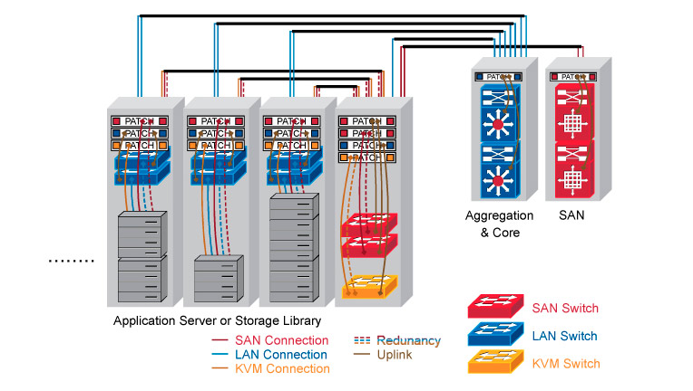
Multi-hop Transmissions in Usage Model 4: Data Center Inter-Rack Connectivity
Links | Link Capacity | Link Description | PER< [3] | Distance | Link Setup time | Security (Confidentiality/Integrity)
A<->B | >10Gbps | ToR connects to EoR | 10^-2 | 20’’ [5] | <100ms | C/I
A<->C | >10Gbps | ToR connects to EoR | 10^-2 | 40’’ | <100ms | C/I
A<->D | >10Gbps | ToR connects to EoR | 10^-2 | 60’’ | <100ms | C/I
A<->E | >20Gbps | EoR to Aggregated Switch (Multi-hop) | 10^-2 | 4 ‘ | <100ms | C/I
E<->F | >20Gpbs | Aggregated Switch to SAN switch | 10^-2 | 4’ | <100ms | C/I
E
F
D
C
B
A
11ay interfaces are best suit for backup interfaces when the fiber links are failed during emergency or network devices maintenances,
As back up interfaces, no active link up are needed all the time but when the failure is occurred, the backup links are required to be quickly setup (<100 msec [4] setup time)
Some of 11ay interfaces function as multi-hop links, i.e A<->E, Maximum # of hops <=5

Slide 14



Multi-hop Transmissions in Usage Model 8: Wireless Backhauling
Requirements
 | Single Hop Wireless Backhauling | Multiple Hop Wireless Backhauling
# of hops | 1 | <5
Distance per link | <1km | <150m
Data Rate | ~2-20Gbps | ~2-20Gbps
Latency | <35ms | <35ms (total )
QoS/QoE | Yes | Yes
Availability | 99.99% | 99.99%
Backhaul @60GHz
Backhaul @60GHz
Backhaul @60GHz
11ay AP
11ay AP
11ay AP
11ay AP
N-LOS Access
N-LOS Access
BUS STOP
BUS STOP
POP
Wireless backhauling with Multiple hops

