Slide 1
BSS Color Field Size Measurements
Date: 2015-11-08
Authors:

Slide 2
Abstract
At September meeting, BSS coloring was motioned into the SFD. However, there was debate about the minimum size of the BSS color field in HE-SIG-A. PHY Motion #50 failed to pass (Y-52/N-18/A-24)
Several companies presented simulation results in [1] based on SS#3 that “the number of BSS Color bits should be at least 6.”
In [2] we presented data from a medium size stadium showing >130 audible APs in 5-GHz and >180 audible APs in 2.4-GHz. We also presented a list of 11 stadiums with over 100 physical APs deployed per channel in reuse=3 plan (e.g. 2.4 GHz).
This contribution presents additional field measurements of APs from several large real-world WLANs.
Based on these measurements, a BSS color field of 8 bits is highly recommended.

Slide 3
Measurement Summary
CentralWorld Mall, Bangkok Thailand – 3 locations
BKK Airport, Bangkok Thailand – 2 locations
Dubai World Trade Center, GITEX Conference – floor
Hong Kong International Airport Food Court
Levi’s Stadium
All captures post-processed to count unique physical APs separately from virtual APs

Slide 4
Assumptions
All virtual APs on a single physical radio can share the same BSS color value.
Color values must either be unique in an ESS or the ESS must have a method to ensure that colors are not reused within a collision domain.
Colors used by overlapping ESS (“OESS”) operated by different service providers must be detected and be unique across all co-located ESSes that share the same collision domain.
OESS will include non-802.11 systems that employ CTS-to-self for protection from 802.11 (e.g. LTE-U / LAA)

Slide 5
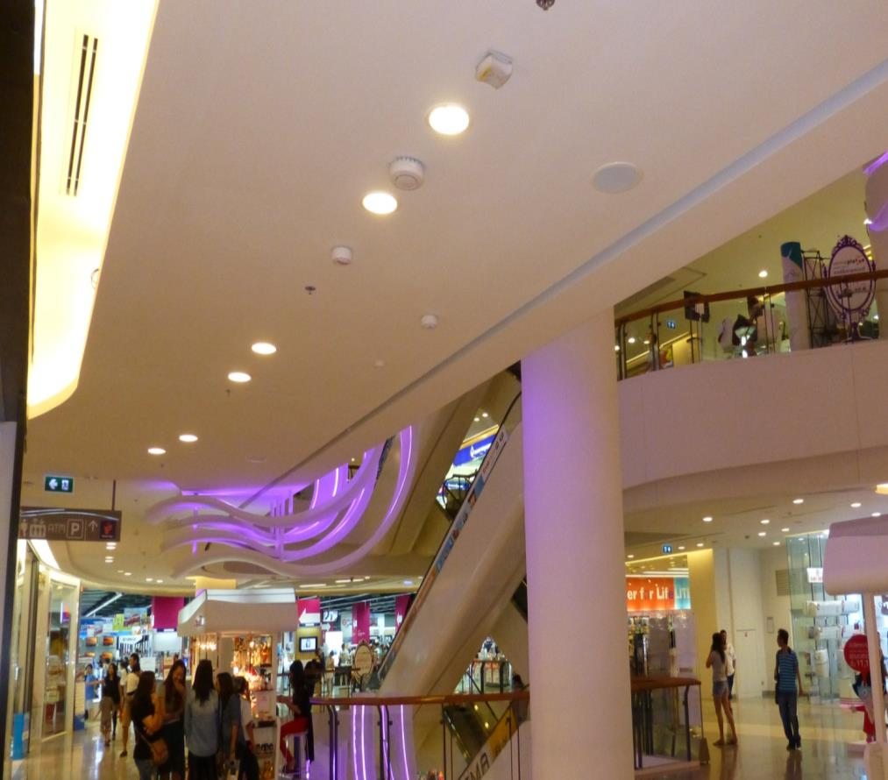
Multi-Operator WLAN Overlays
4 network operators
3 Wi-Fi vendors
1 AP cluster every ~15 meters
Common across most countries in Asia and Middle East

Slide 6
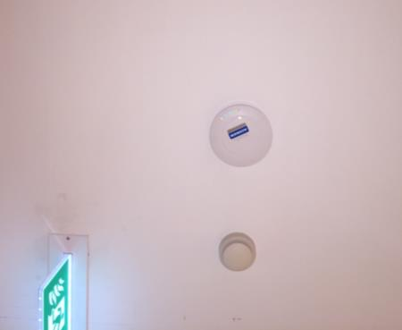
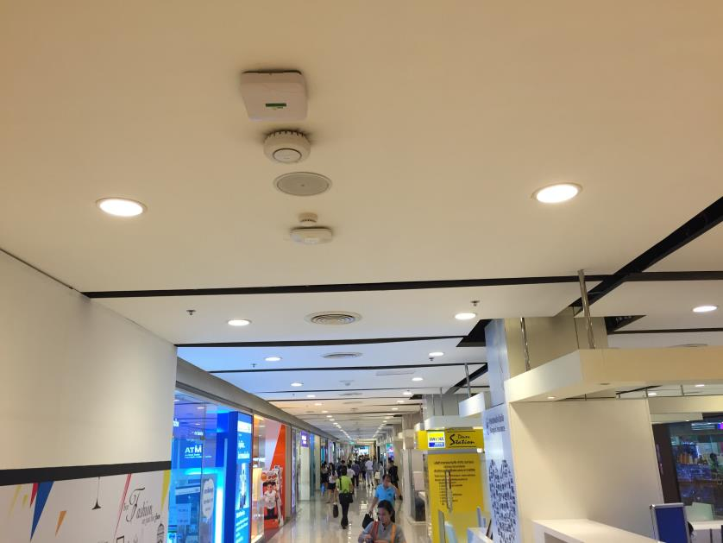
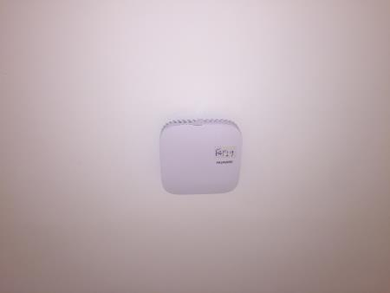
CentralWorld – 5 Operators w/Discrete APs
Vendor A
Vendor D
Vendor B
Vendor C
Vendor E

Slide 7
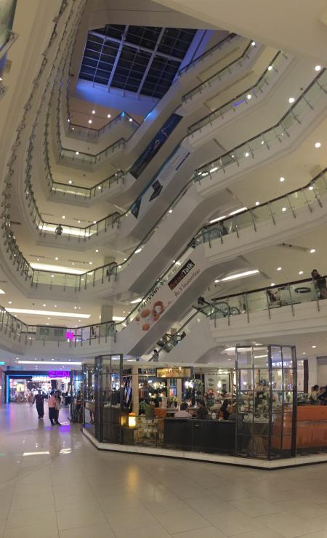
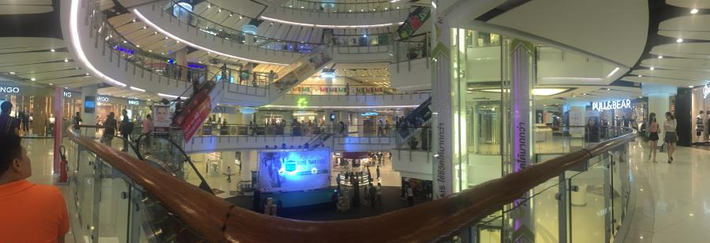
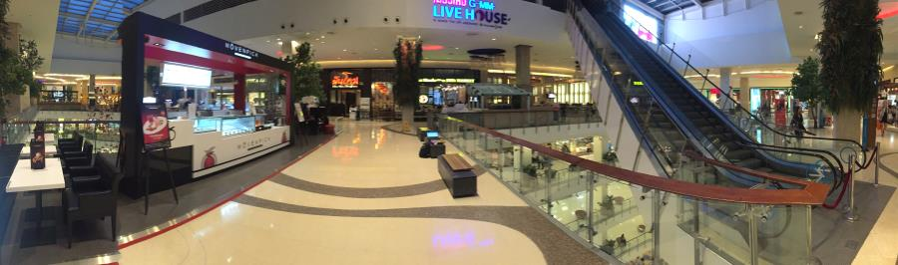
CentralWorld Mall Capture Sites
2nd Floor Above Bicycle Exhibit
(photo taken from capture location)
Capture location
1st Floor @ Twinings
7th Floor In Center of Mall Wing

Slide 8
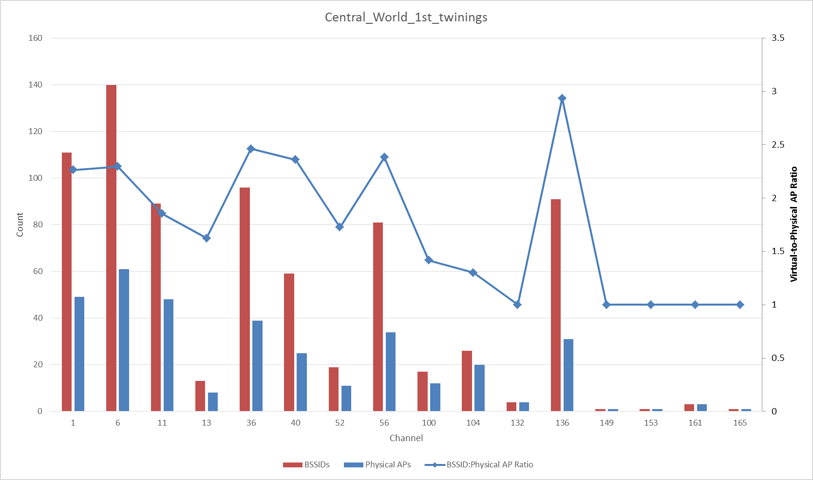
CentralWorld - 1st Floor Twinings
Channel | AP count | BSSID count
1 | 49 | 111
6 | 61 | 140
11 | 48 | 89
13 | 8 | 13
36 | 39 | 96
40 | 25 | 59
52 | 11 | 19
56 | 34 | 81
100 | 12 | 17
104 | 20 | 26
132 | 4 | 4
136 | 31 | 91
149 | 1 | 1
153 | 1 | 1
161 | 3 | 3
165 | 1 | 1
2.4G TOTAL | 166 | 353

Slide 9
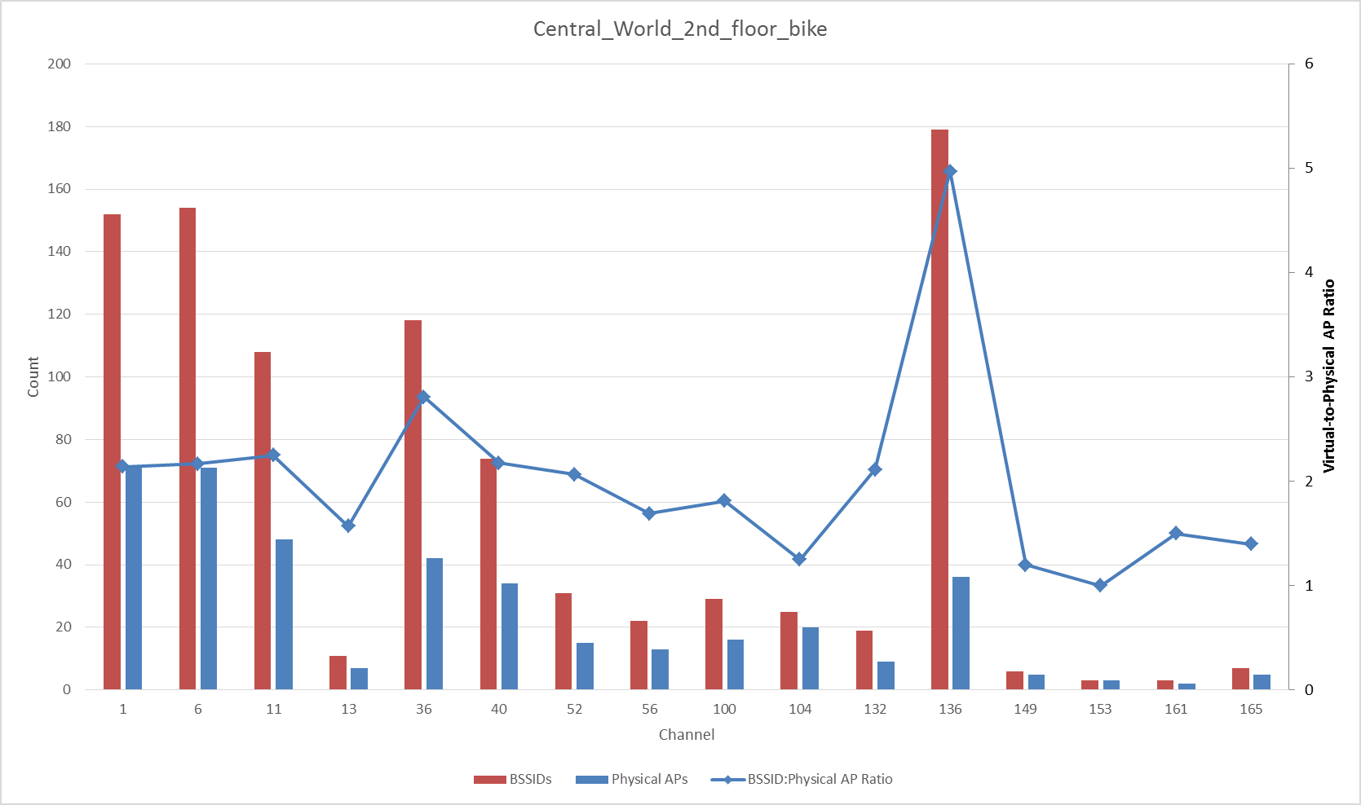
CentralWorld - 2nd Floor
Channel | AP count | BSSID count
1 | 71 | 152
6 | 71 | 154
11 | 48 | 108
13 | 7 | 11
36 | 42 | 118
40 | 34 | 74
52 | 15 | 31
56 | 13 | 22
100 | 16 | 29
104 | 20 | 25
132 | 9 | 19
136 | 36 | 179
149 | 5 | 6
153 | 3 | 3
161 | 2 | 3
165 | 5 | 7
2.4G TOTAL | 197 | 425

Slide 10
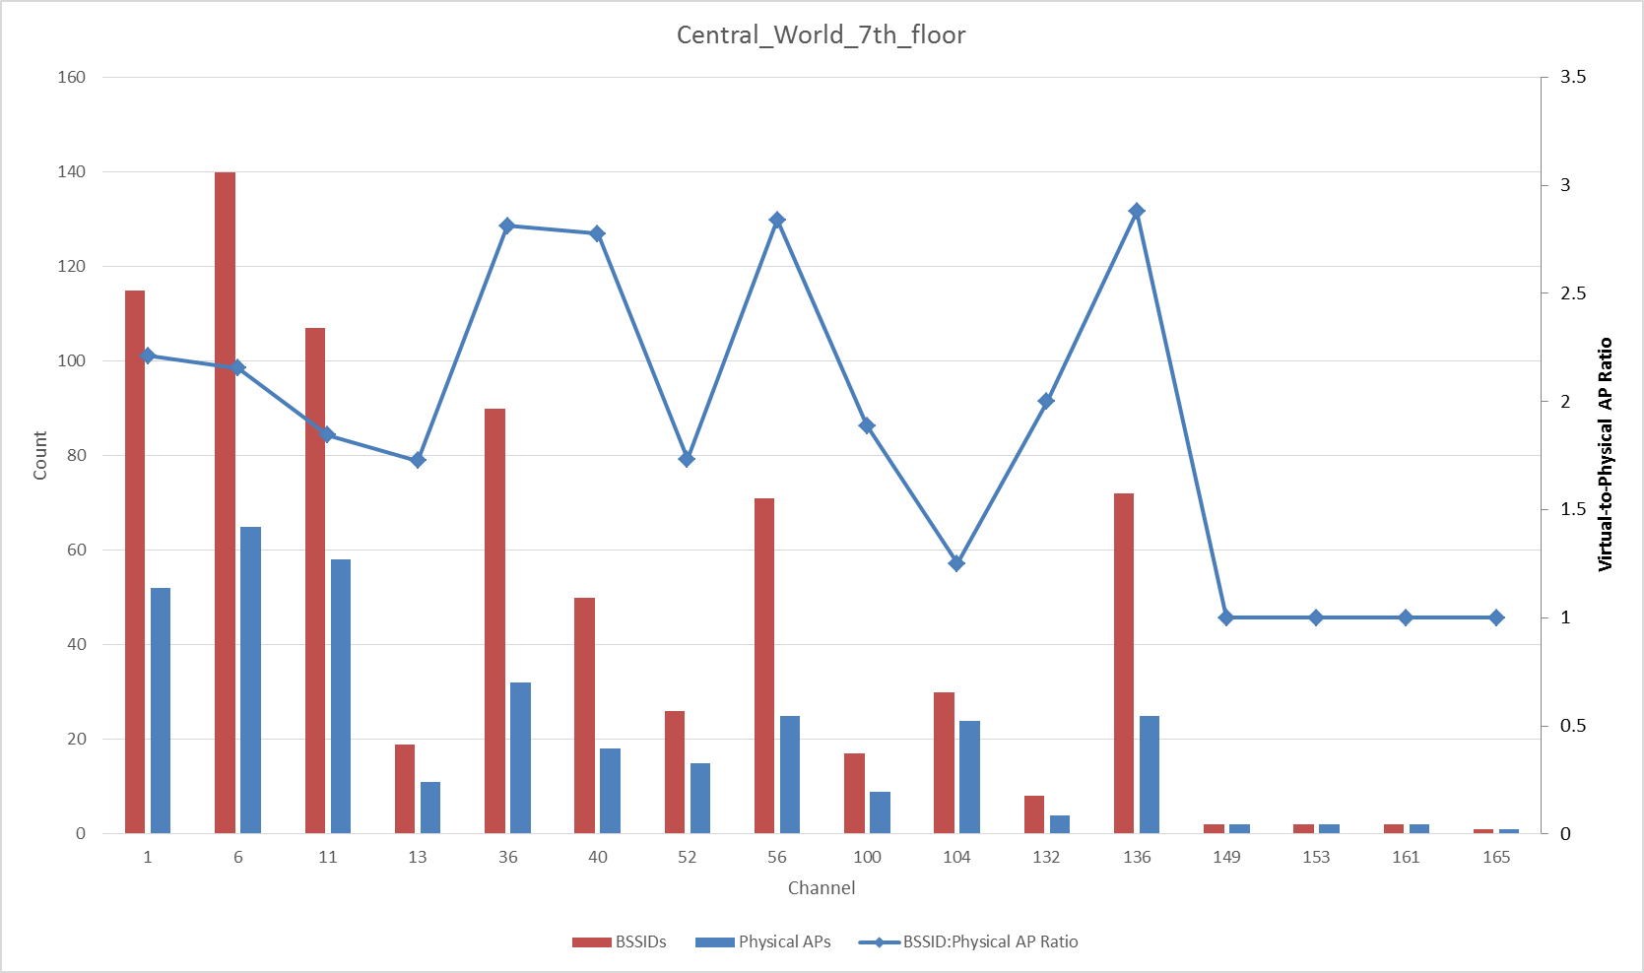
CentralWorld - 7th Floor
Channel | AP count | BSSID count
1 | 52 | 115
6 | 65 | 140
11 | 58 | 107
13 | 11 | 19
36 | 32 | 90
40 | 18 | 50
52 | 15 | 26
56 | 25 | 71
100 | 9 | 17
104 | 24 | 30
132 | 4 | 8
136 | 25 | 72
149 | 2 | 2
153 | 2 | 2
161 | 2 | 2
165 | 1 | 1
2.4G TOTAL | 186 | 381

Slide 11
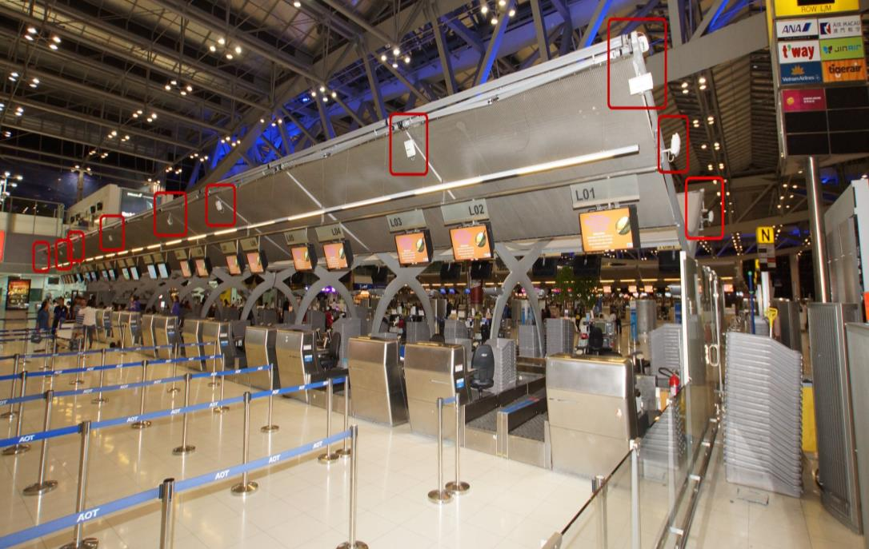
Suvarnabhumi Airport, Bangkok
20 physical APs per check-in counter (1 per queue)
23 counters = 460 APs
2 Wi-Fi vendors
5 Wi-Fi operators

Slide 12
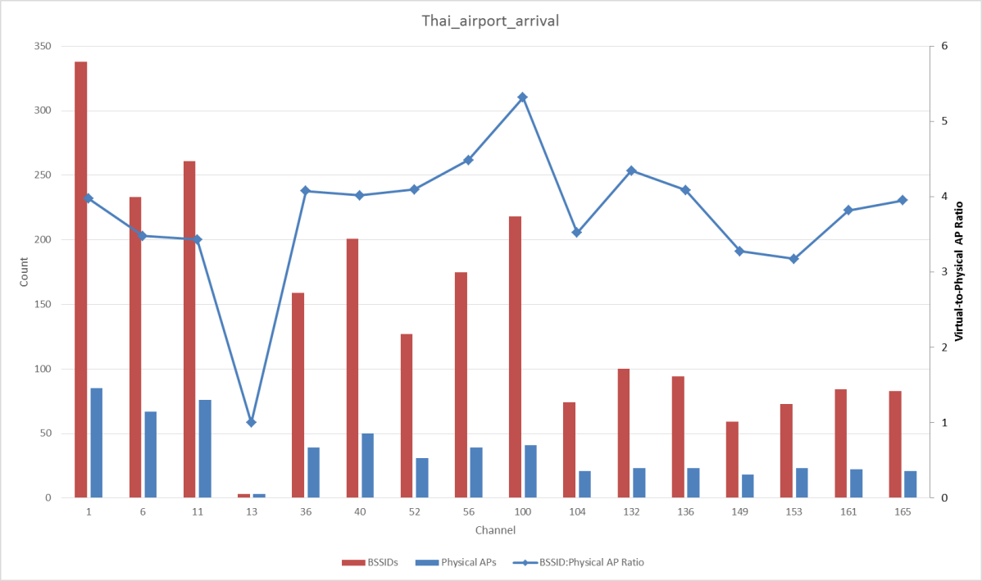
BKK Arrival Hall
Channel | AP count | BSSID count
1 | 85 | 338
6 | 67 | 233
11 | 76 | 261
13 | 3 | 3
36 | 39 | 159
40 | 50 | 201
52 | 31 | 127
56 | 39 | 175
100 | 41 | 218
104 | 21 | 74
132 | 23 | 100
136 | 23 | 94
149 | 18 | 59
153 | 23 | 73
161 | 22 | 84
165 | 21 | 83
2.4G TOTAL | 231 | 835

Slide 13
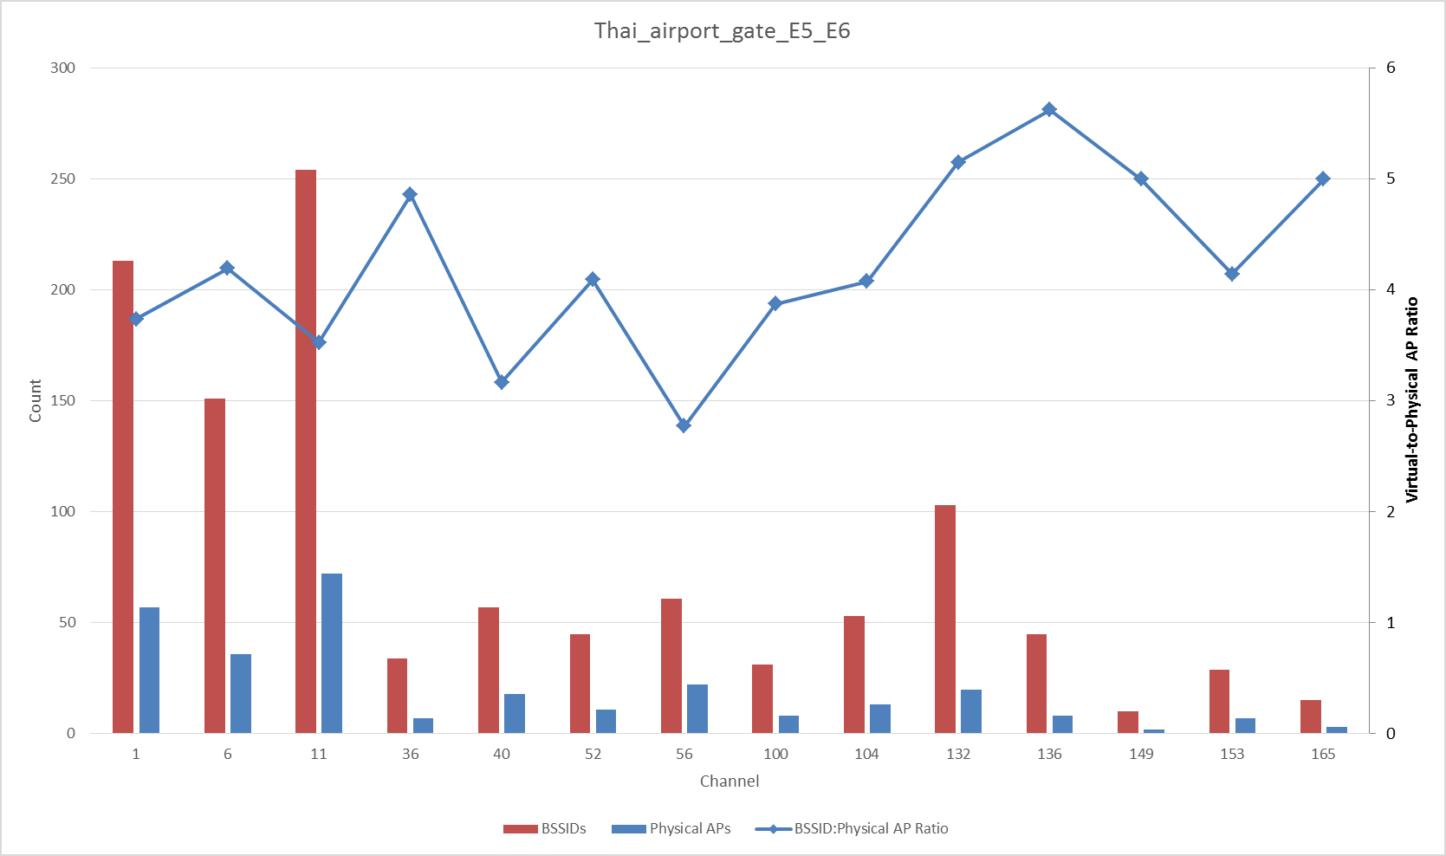
BKK Gates E5-E6
Channel | AP count | BSSID count
1 | 57 | 213
6 | 36 | 151
11 | 72 | 254
36 | 7 | 34
40 | 18 | 57
52 | 11 | 45
56 | 22 | 61
100 | 8 | 31
104 | 13 | 53
132 | 20 | 103
136 | 8 | 45
149 | 2 | 10
153 | 7 | 29
165 | 3 | 15
2.4G TOTAL | 165 | 618

Slide 14
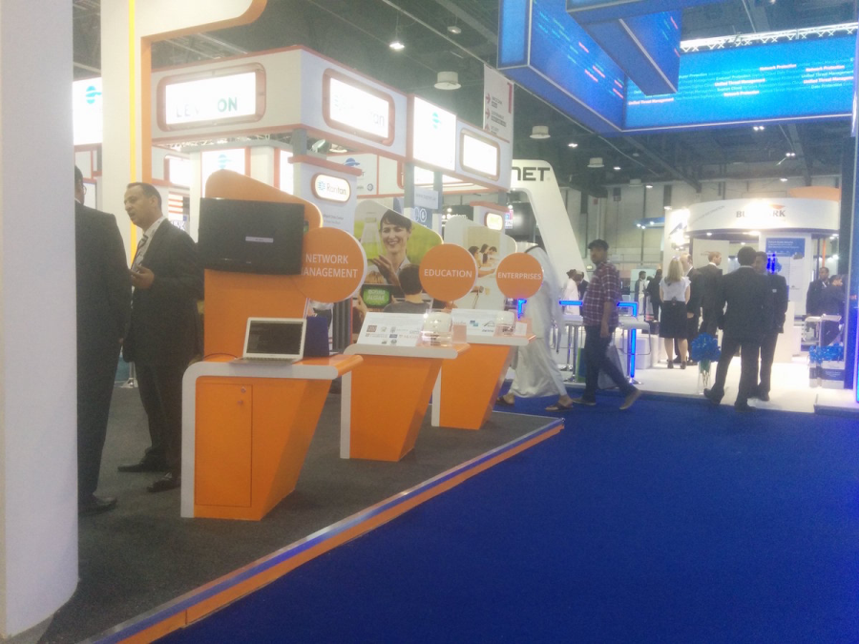
GITEX 2015 @ Dubai World Trade Center
130,000 attendees, largest IT trade show in Middle East
31,000 m² main hall, largest in Middle East
300 APs in ceiling
Capture location

Slide 15
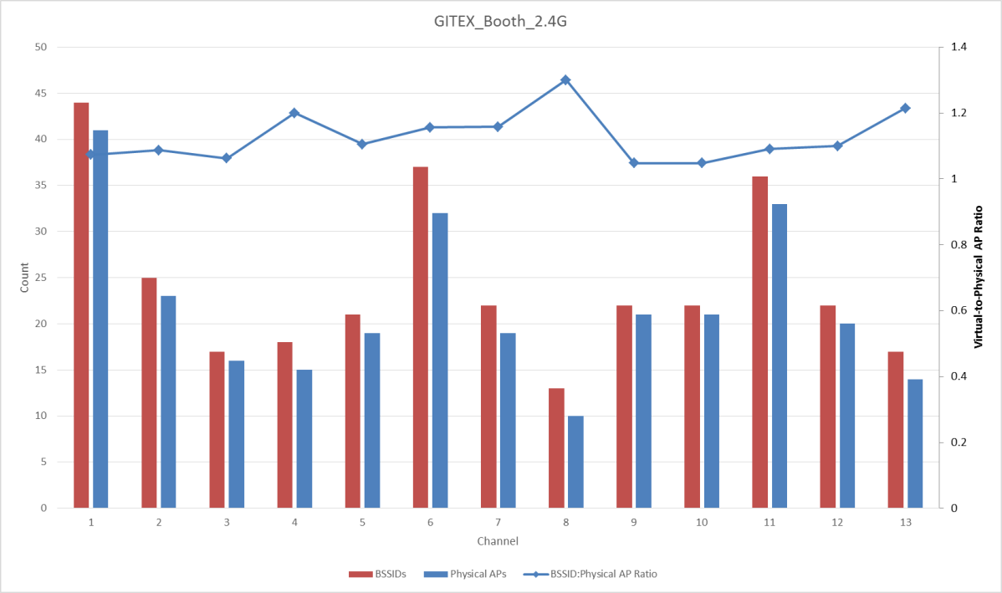
GITEX 2015 Show Floor (2.4 GHz Only)
Channel | AP count | BSSID count
1 | 41 | 44
2 | 23 | 25
3 | 16 | 17
4 | 15 | 18
5 | 19 | 21
6 | 32 | 37
7 | 19 | 22
8 | 10 | 13
9 | 21 | 22
10 | 21 | 22
11 | 33 | 36
12 | 20 | 22
13 | 14 | 17
2.4G TOTAL | 284 | 316
Would be 94 APs/channel with 3 channel plan

Slide 16
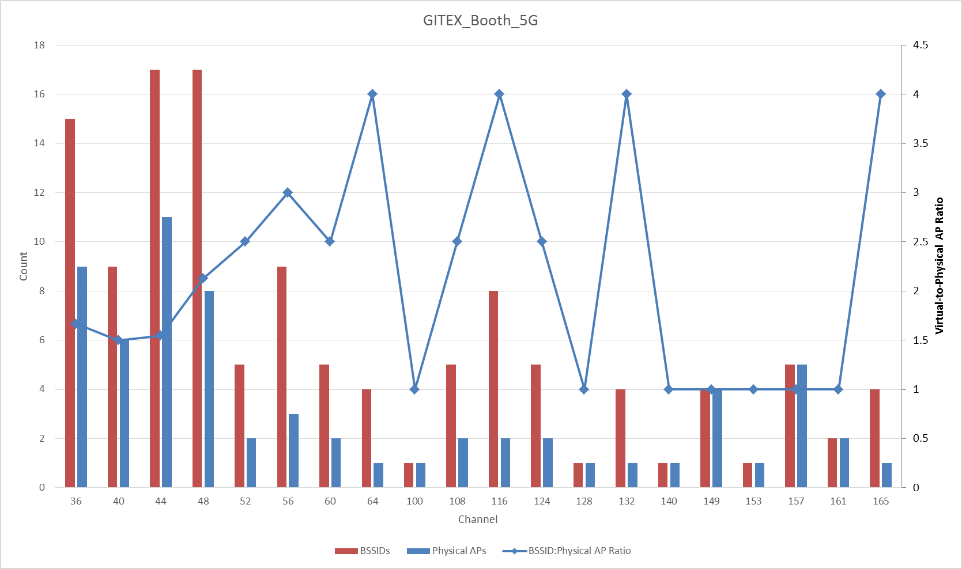
GITEX 2015 Floor Booth (5-GHz Only)
Channel | AP count | BSSID count
36 | 9 | 15
40 | 6 | 9
44 | 11 | 17
48 | 8 | 17
52 | 2 | 5
56 | 3 | 9
60 | 2 | 5
64 | 1 | 4
100 | 1 | 1
108 | 2 | 5
116 | 2 | 8
124 | 2 | 5
128 | 1 | 1
132 | 1 | 4
140 | 1 | 1
149 | 4 | 4
153 | 1 | 1
157 | 5 | 5
161 | 2 | 2
165 | 1 | 4

Slide 17
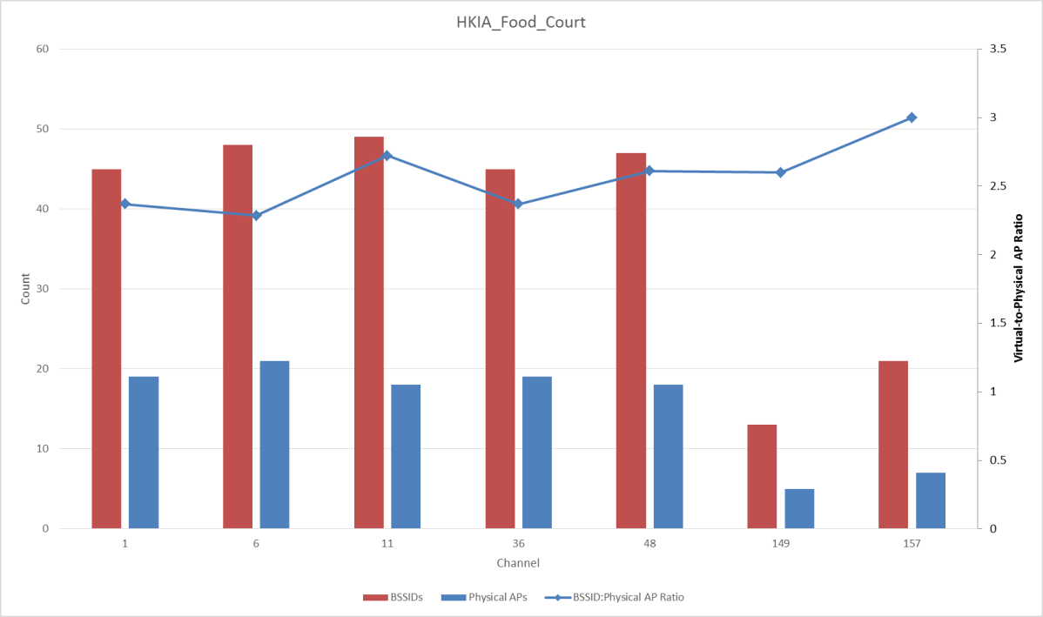
Hong Kong International Food Court
Channel | AP count | BSSID count
1 | 19 | 45
6 | 21 | 48
11 | 18 | 49
36 | 19 | 45
48 | 18 | 47
149 | 5 | 13
157 | 7 | 21

Slide 18
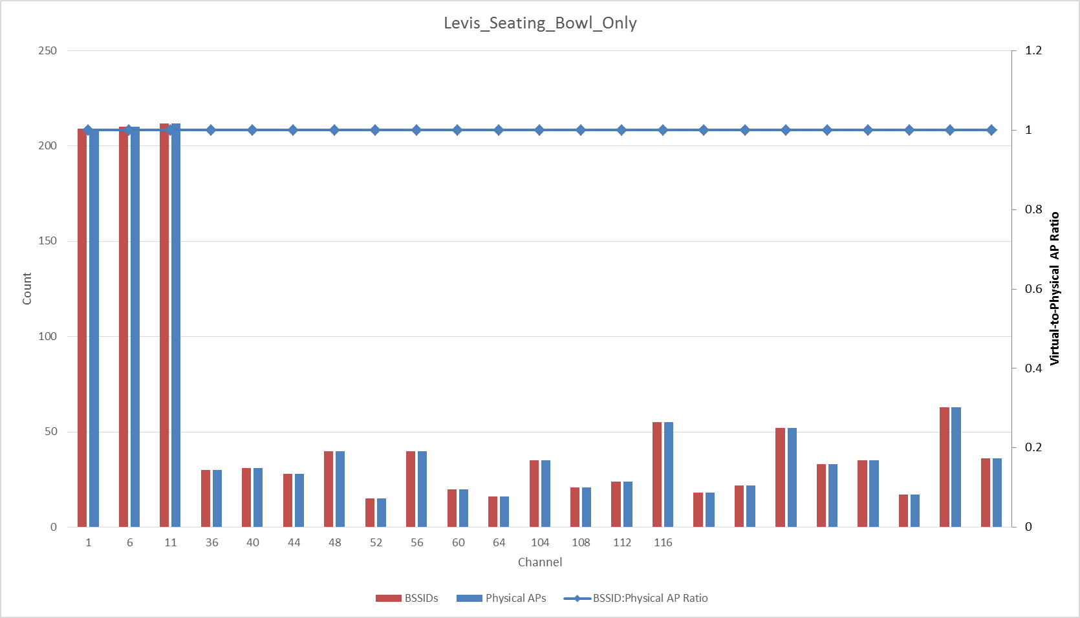
Levi’s Stadium (Seating Bowl Only)
Channel | AP count | BSSID count
1 | 209 | 209
6 | 210 | 210
11 | 212 | 212
36 | 30 | 30
40 | 31 | 31
44 | 28 | 28
48 | 40 | 40
52 | 15 | 15
56 | 40 | 40
60 | 20 | 20
64 | 16 | 16
104 | 35 | 35
108 | 21 | 21
112 | 24 | 24
116 | 55 | 55
132 | 18 | 18
136 | 22 | 22
140 | 52 | 52
149 | 33 | 33
153 | 35 | 35
157 | 17 | 17
161 | 63 | 63
165 | 36 | 36
2.4G TOTAL | 631 | 631

Slide 19
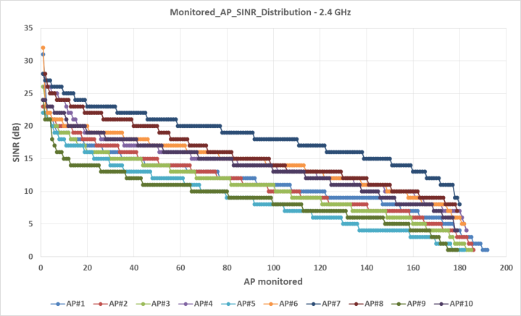
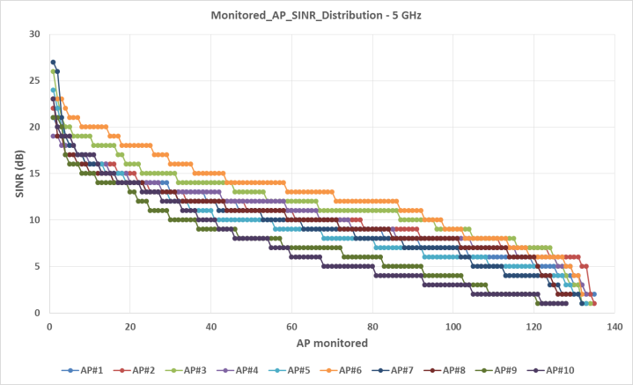
Levi’s Stadium – Top 10 APs
Data from 10 most heavily-loaded 2.4-Ghz and 5-GHz radios
Charts show SINR for all APs that are audible from each of the 10 APs
On 2.4-GHz, each of the top 10 can hear >180 other APs
On 5-GHz, each of the top 10 can hear >130 other APs

Slide 20
Real World Stadium AP Counts
Venue | City | Seats | APs | Seats/AP | 2.4G APs / Channel | Ref
Dodger Stadium | Los Angeles, CA | 56,000 | > 1,000 | 56 | > 333 | [3]
Lambeau Field | Green Bay, WI | 80,735 | > 1,000 | 81 | > 333 | [4]
M&T Bank Stadium | Baltimore, MD | 71,000 | ~ 800 | 89 | ~ 265 | [5]
Levi’s Stadium | San Jose, CA | 70,000 | > 1,200 | 58 | > 400 | [8]
AT&T Stadium | Dallas, TX | 80,000 | > 1,600 | 50 | > 533 | [8]
AT&T Park | San Francisco, CA | 42,000 | 1,700 | 25 | > 566 | [6]
Kaufmann Stadium | Kansas City, KS | 32,903 | 576 | 57 | 192 | [7]
Kyle Field, Texas A&M | College Station, TX | 102,500 | > 1,600 | 64 | > 533 | [9]
Univ. Phoenix Stadium | Phoenix, AZ | 63,400 | > 750 | 85 | > 250 | [10]
Baylor Univ. Stadium | Waco, TX | 45,140 | > 300 | 150 | > 100 | [11]
CenturyLink Field | Seattle, WA | 67,000 | 757 | 89 | ~ 252 | [12]

Slide 21
Two Ways to Look at Data
6 bits is fine
We are not designing 11ax for stadiums or high density venues
We do not expect further densification of 802.11 networks
Overlapping multi-operator ESS are not expected to grow in any global region
Impact of duplicate color in same collision domain is limited
6 bits is not enough
Simulations in [1] used only -82 dBm, and did not consider multiple OESS
Multiple high density venues types are already exceeding 64 physical APs in 2015
5-GHz data only looks OK because it uses 20-MHz channels. Future HE80 would resemble 2.4-GHz today.
Densification is increasing. Wi-Fi hotspots growing at 13% CAGR out to 2018 (11ax ratification) [13]

Slide 22
Conclusions
TGax should adopt a BSS color field of 8 bits.
This is a safe compromise between resource consumption and future effectiveness
Many WLANs in high-density areas already exceed 6 bits within a single collision domain (e.g. not ESS-wide)
The largest stadium WLANs require 10 bits in 2.4-GHz or for a reuse=3 plan.
Densification will increase before 11ax is ratified, and by end of 11ax lifetime…

Slide 23
Straw Poll
Do you support to assign 8 bits for BSS Color?
  Y:
  N:
  A:

Slide 24
References
15/1075r1 – “Number of BSS Color bits”, Yasuhiko Inoue et al, Sep 2015
15/1083r3 – “Cost/Benefit Analysis of SR Techniques”, C. Lukaszewski et al, Sep 2015
http://www.mobilesportsreport.com/2015/09/stadium-tech-report-los-angeles-dodgers-hit-it-out-of-the-park-with-cisco-aruba-wi-fi/
http://www.mobilesportsreport.com/2015/08/wi-fi-for-the-frozen-tundra-extreme-verizon-bring-wi-fi-to-green-bay-packers-lambeau-field/
http://www.mobilesportsreport.com/2015/08/baltimore-ravens-pick-extreme-networks-for-mt-bank-stadium-wi-fi/
http://www.mobilesportsreport.com/2015/07/stadium-tech-report-world-series-set-new-wireless-records-at-att-park/
http://www.mobilesportsreport.com/2015/06/stadium-tech-report-kauffman-stadium-gets-a-royal-wi-fi-upgrade/
http://www.mobilesportsreport.com/2015/01/stadium-tech-report-att-stadiums-massive-antenna-deployment-delivers-solid-wi-fi-das-performance/
http://www.mobilesportsreport.com/2015/01/stadium-tech-report-corning-ibm-bringing-fiber-based-wi-fi-and-das-to-texas-ams-kyle-field/
http://www.mobilesportsreport.com/2014/12/stadium-tech-report-phoenix-cardinals-get-stadium-ready-for-super-bowl-with-wi-fi-upgrade/
http://www.mobilesportsreport.com/2014/12/stadium-tech-report-phoenix-cardinals-get-stadium-ready-for-super-bowl-with-wi-fi-upgrade/
http://www.geekwire.com/2015/wifi-analytics-seahawks-front-office-sees-gameday/
Miravedis Rethink, Carrier Wi-Fi State of the Market, December 2014

