Slide 1
Feasibility of SU-MIMO under Array Alignment Method
Date: 2015-11-09
Authors:

Slide 2
Abstract
This presentation investigates the feasibility of SU-MIMO using array alignment method based on the channel models adopted in 802.11ad.
A simulation methodology is proposed for evaluating the performance of SU-MIMO in an 802.11ay environment.
The condition number of the MIMO channel, the achievable capacity, and the distribution of the capacity are investigated.
The effect of antenna array separation and link distance is considered.

Slide 3
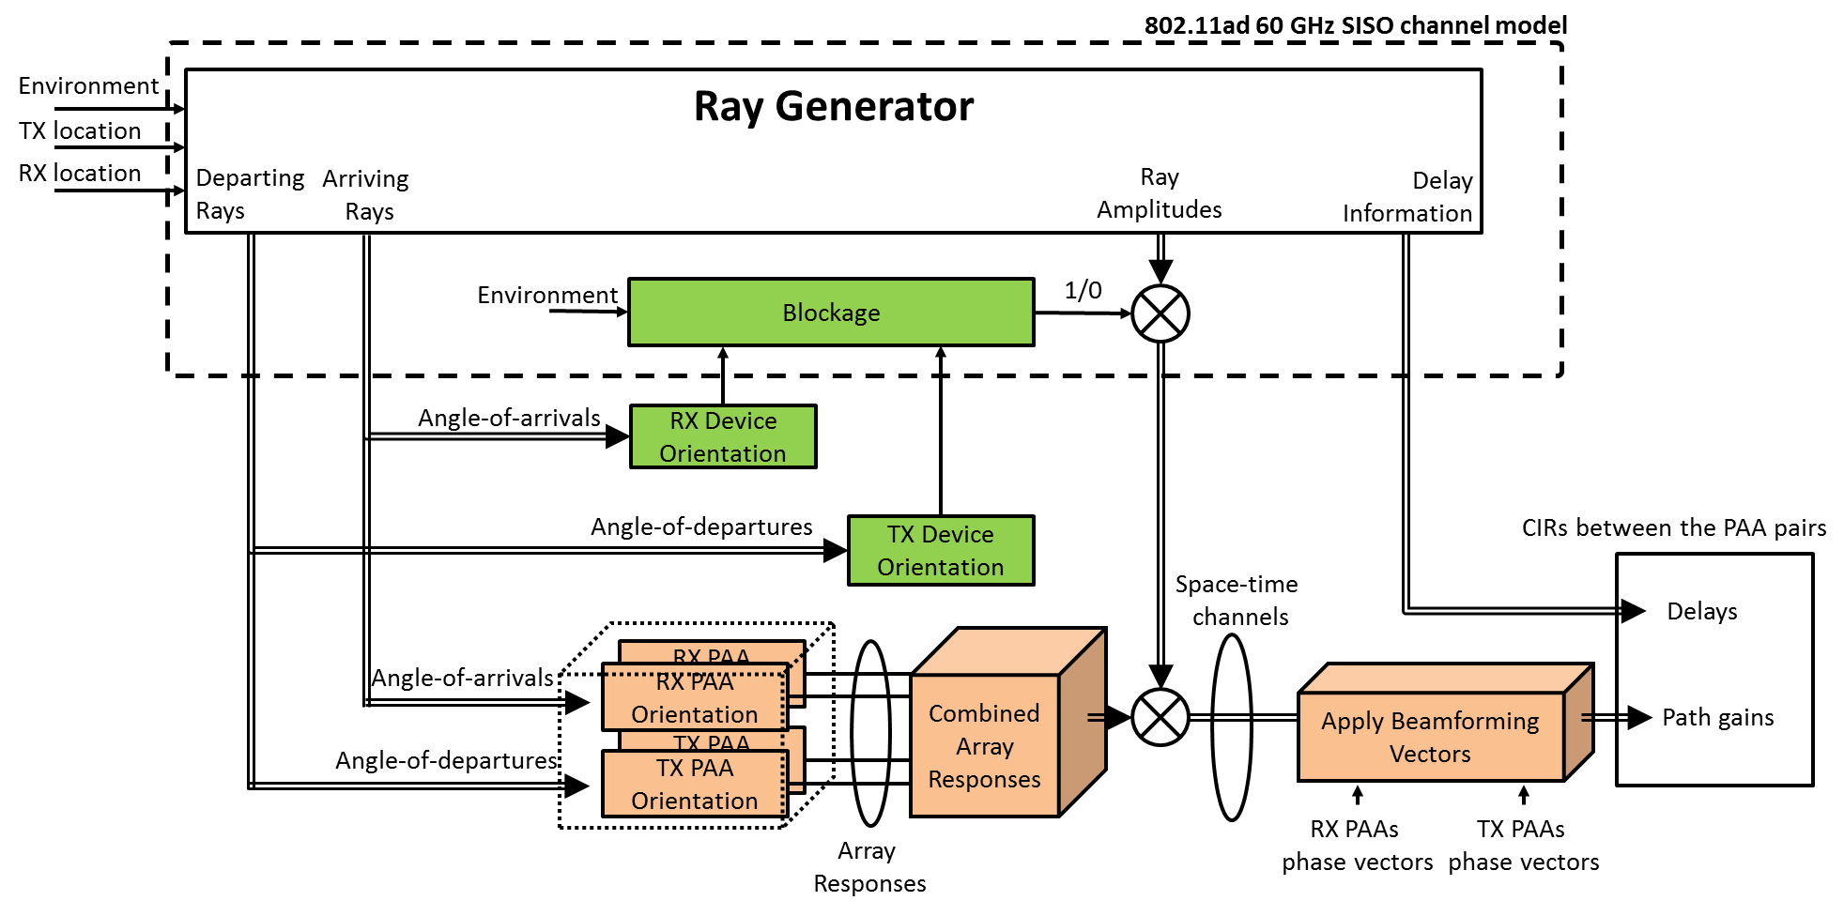
Methodology for SU-MIMO Analysis
Performance metrics:
Channel capacity
Condition number
Received signal strength indicator (RSSI)
The channel models developed for 802.11ad [1] are utilized to generate channel impulse responses between the phased antenna arrays (PAAs).
Independent channel impulse responses are generated for each TX and RX PAA link. It is assumed the rays departing or arriving from the backside of the devices are blocked.
The array responses of TX and RX PAAs are calculated using the angle-of-arrival (AoA) and angle-of-departure (AoD) of the rays.
After applying phase vectors for each PAA, the channel impulse response is calculated and the performance metrics are determined.

Slide 4







Array Alignment Method
z
TX
Boresight
RX
TX PPA 1
RX PPA 1
$$θ$$
RX PPA 2
$$dx$$
$$φ$$
y
TX PPA 2
$$dy$$
Isotropic antenna
element
Boresight
x
Boresight
Boresight
$θ=0^{∘}$ and $φ=0^{∘}$.
$θ={45}^{∘}$ and $φ=0^{∘}$.
$θ={45}^{∘}$ and $φ={20}^{∘}$.
Antenna patterns for $2×8$PAA where $dx=dy=λ/2$
For the array alignment method, the boresights of each pair of TX PAA and RX PAA are aligned with each other.
It is achieved by adjusting the phase of each antenna element [1].

Slide 5
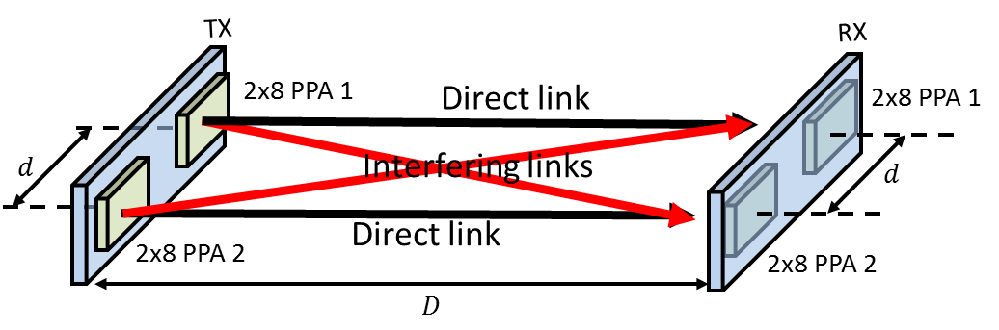
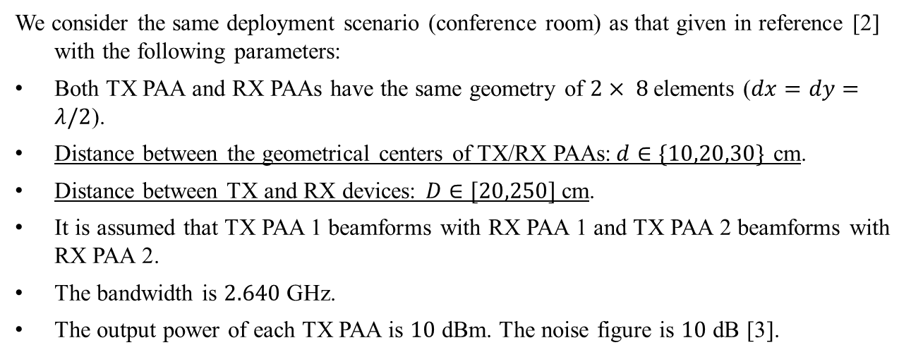
Simulation Setup for STA-STA Scenario
d: Antenna (Array) Distance
D: Link Distance
We consider the same deployment scenario (conference room) as that given in reference [2] with the following parameters:
Both TX PAA and RX PAAs have the same geometry of $2× 8$elements ($dx=dy=λ/2$).
Distance between the geometrical centers of TX/RX PAAs:$d∈\{10,20,30\}$ cm.
Distance between TX and RX devices: $D∈[20,250]$cm.
It is assumed that TX PAA 1 beamforms with RX PAA 1 and TX PAA 2 beamforms with RX PAA 2.
The bandwidth is $2.640$ GHz.
The output power of each TX PAA is $10$ dBm. The noise figure is $10$ dB [3].

Slide 6
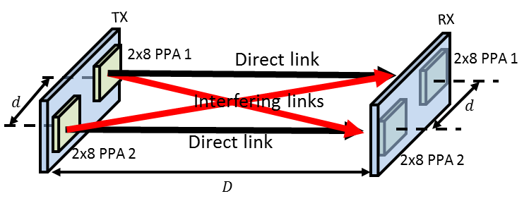
Result: RSSI & Condition Number in LOS
Channel vectors are orthogonal
Isolated links
The RSSI results follow the measurement results provided in reference [2].
Low condition number is achievable in a LOS condition if there is a sufficient amount of isolation between the links. This is enabled through high gain beamforming.
Low condition number may also be achieved in a LOS condition if the channel vectors are configured or designed to be orthogonal.

Slide 7
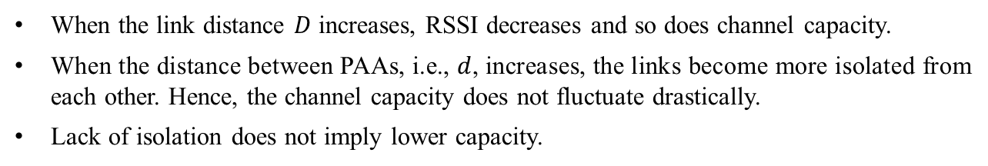
Result: Channel Capacity in LOS
When the link distance $D$ increases, RSSI decreases and so does channel capacity.
When the distance between PAAs, i.e., $d$, increases, the links become more isolated from each other. Hence, the channel capacity does not fluctuate drastically.
Lack of isolation does not imply lower capacity.

Slide 8
Result: Condition Number in LOS+NLOS
Scenario: Conference room
Subscenario: STA-STA
The average RSSI and average condition number are calculated based on the wideband response. For each link distance, the averaged results are provided over 500 realizations.
The impact of NLOS components on the condition number seems negligible due to the heavy beamforming on the LOS component.

Slide 9
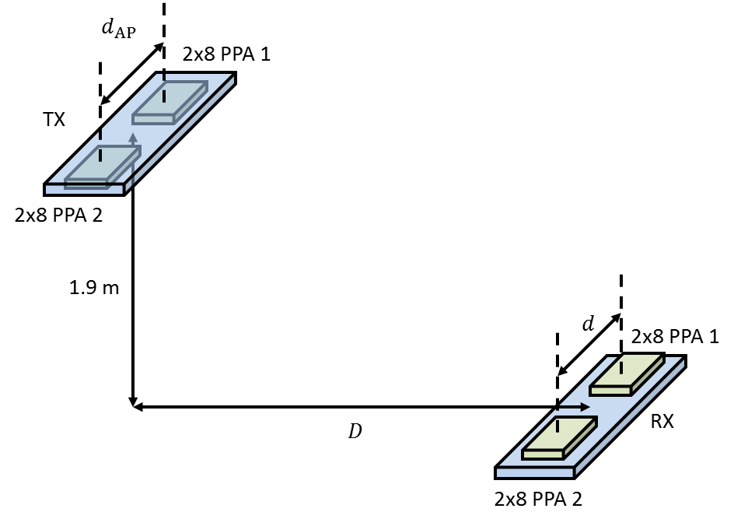
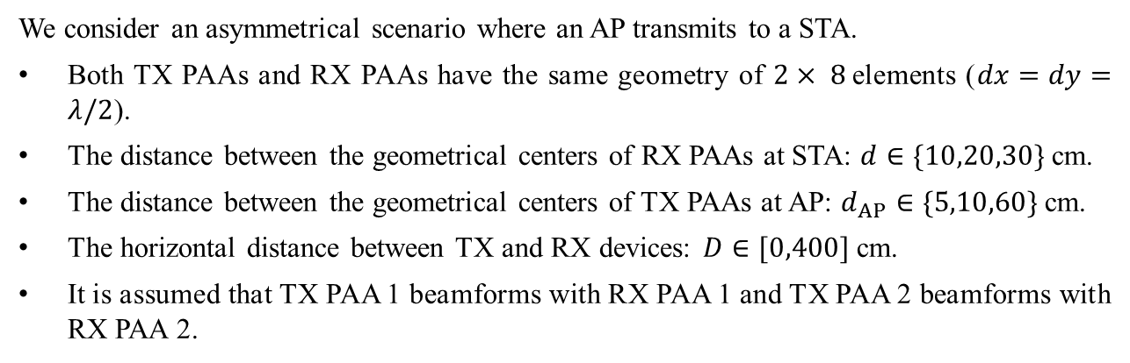
Simulation Setup for STA-AP Scenario
AP
d: STA Antenna (Array) Distance
d_{AP}: AP Antenna (Array) Distance
D: (Horizontal) Link Distance
STA
We consider an asymmetrical scenario where an AP transmits to a STA.
Both TX PAAs and RX PAAs have the same geometry of $2× 8$elements ($dx=dy=λ/2$).
The distance between the geometrical centers of RX PAAs at STA: $d∈\{10,20,30\}$ cm.
The distance between the geometrical centers of TX PAAs at AP: $d_{AP}∈\{5,10,60\}$ cm.
The horizontal distance between TX and RX devices: $D∈[0,400]$cm.
It is assumed that TX PAA 1 beamforms with RX PAA 1 and TX PAA 2 beamforms with RX PAA 2.

Slide 10



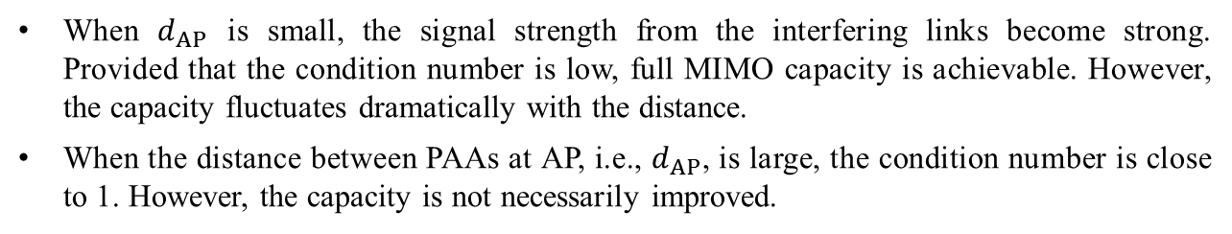
Result: Channel Capacity in LOS
$$d_{AP}=0.05 m$$
$$d_{AP}=0.1 m$$
$$d_{AP}=0.6 m$$
Less
Isolation
More
When $d_{AP}$ is small, the signal strength from the interfering links become strong. Provided that the condition number is low, full MIMO capacity is achievable. However, the capacity fluctuates dramatically with the distance.
When the distance between PAAs at AP, i.e., $d_{AP}$, is large, the condition number is close to 1. However, the capacity is not necessarily improved.

Slide 11
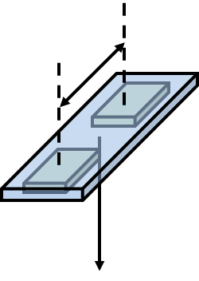
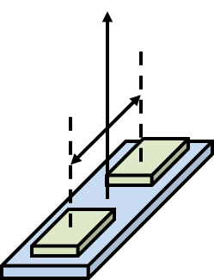

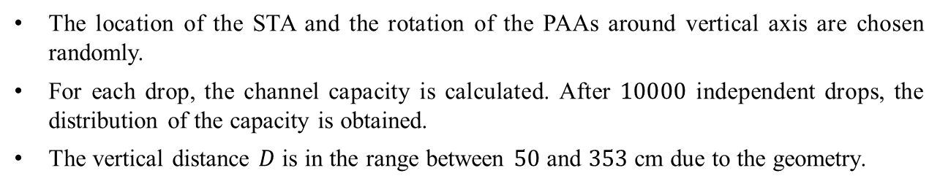

Distribution of the Capacity in LOS
Fixed location
and orientation
$$d_{AP}$$
TX
Scenario: Conference room
Subscenario: STA-AP
2x8 PPA 1
2x8 PPA 2
Directions of PAAs at AP
Directions of PAAs at STA
$$d$$
2x8 PPA 1
Random location
and orientation
RX
2x8 PPA 2
The location of the STA and the rotation of the PAAs around vertical axis are chosen randomly.
For each drop, the channel capacity is calculated. After $10000$ independent drops, the distribution of the capacity is obtained.
The vertical distance $D$ is in the range between $50$ and $353$ cm due to the geometry.

Slide 12
Result: Distribution of the Capacity
Isolated
links
Isolated
links
It is more likely to have better SU-MIMO performance when the links are not isolated. This is due to the fact that the receiver can exploit the energy from the interfering link if the condition number is low.

Slide 13
Summary
In this study, we analyze the feasibility of SU-MIMO under the strategy of array alignment method.
Given the PAA configuration presented, when the links are isolated by decreasing the link distance or increasing the distance between PAAs at TX and RX, the condition number gets closer to 1.
When the arrays are aligned with each other, the links may not be isolated. In this case, the condition number of the MIMO channel fluctuates depending on the link distance and the physical separation of the PAAs at TX and RX.
When the links are not isolated AND the condition number is close to 1, the SU-MIMO channel capacity can be achieved.

Slide 14
References
A. Maltsev, et al, “Channel Models for 60 GHz WLAN Systems,” IEEE doc. 11-09/0334r8.
A. Maltsev, et al, “Experimental Measurements for Short Range LOS SU-MIMO,” IEEE doc. 11-15/0632r1.
G. Venkatesan, et al, “TGay Evaluation Methodology,” IEEE doc. 11-15/0866.

