Slide 1
Diversity Mode in OFDMA
Date: 2015-11-09
Authors:

Slide 2
Background
OFDMA numerology is optimized considering tradeoff between OFDMA gain and signaling overhead for 11ax
In this submission, diversity gain is shown to discuss about feasibility for non-contiguous resource allocation

Slide 3
Need for Robust Transmission in OFMDA
DL MU
UL MU
preamble
STA 1
(Data+unicast TR)
preamble
STA 1
(BA+Data)
Multicast TR
STA 2 (BA)
…
STA 2
(Data+unicast TR)
STA 4
(Data)
…
STA 3
(Data+unicast TR)
STA 5
(Data)
STA 3
(BA + Data)
Multicast Trigger Frame is used in cascaded MU operation.
  Given the small payload size of TR (compared with Data frames) it is likely to be allocated with small RU (e.g. 26 or 52 RU).
  The nature of multi-cast creates difficulty in obtaining frequency selective gain since it will be difficult to choose a channel that has good link conditions for multiple STAs simultaneously.
  The narrow RU size and random selection of frequency position makes the Trigger frame susceptible to packet reception loss from channel deep fading. Currently, narrow RUs have no diversity gain.

Slide 4
Non-Contiguous Resource Allocation
Diversity gain can be achieved by non-contiguous resource allocation spread over frequency
Design complexity can be reduced by configuring some limitation on non-contiguous allocation
  Keep the number of data/pilots tones identical to contiguous RUs
  No introduction of new BCC/LDPC interleaver sizes
For example)
N/2-tones
IFFT
Channel
coding
N-tones
MOD
N/2-tones

Slide 5
Simulation Parameters
Bandwidth : 80MHz
Multi-antenna transmission : 1x1 and 4x1
MCS: 0, 3 (code rate ½) and 4 (code rate ¾ )
Payload Size: 100 bytes
Channel: TGac ChD
Carrier frequency offset (CFO): fixed at 40 ppm (@ 5GHz)
Phase noise (both at Tx/Rx): -41dBc
Real timing estimation & synchronization
Diversity tested using evenly spaced subblocks
  Examples shown in next slide

Slide 6
Examples of Sub-blocks Used for Simulation
Subblocks of a Non-contiguous RU is chosen to be equally spaced apart within 10/20/40/80 MHz.
Number of pilots for a given RU is split equally between subblocks.
  1 pilot per subblock, 2 subblocks for 26 RU
  2 pilot per subbblock, 2 subblock for 52 RU
  etc
N
N
N/2
N/2
N/4
N/4
N/4
N/4
10/20/40/80 MHz
10/20/40/80 MHz

Slide 7
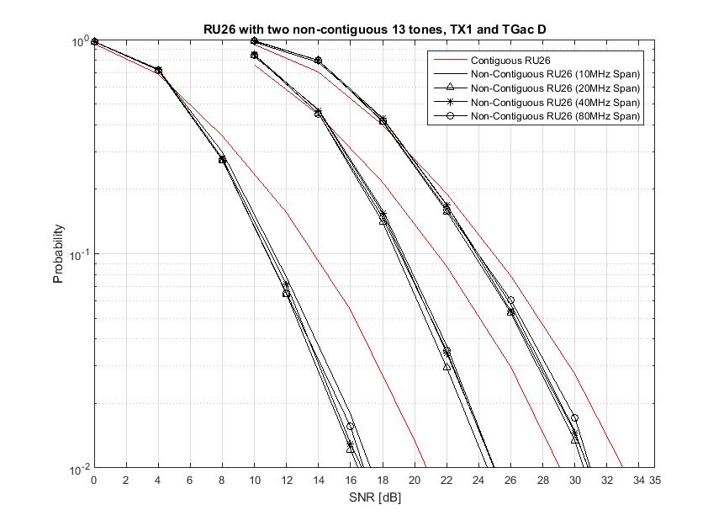
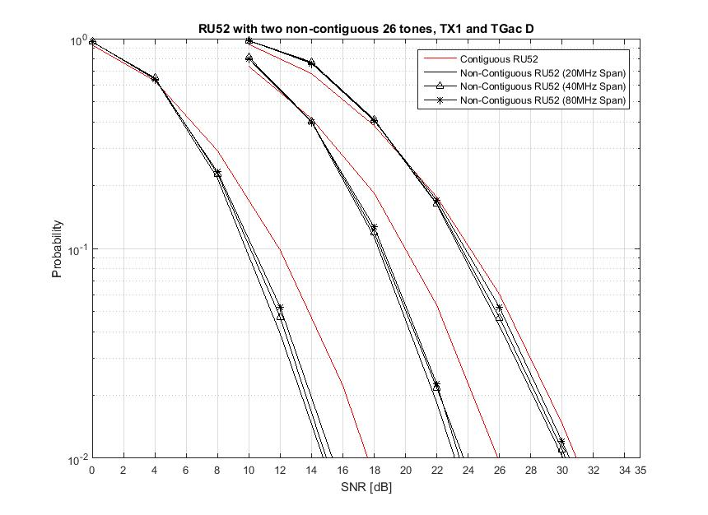
Two Sub-block 26/52 RU
- 1x1 Tx-Rx, MCS 0/3/4
2-3 dB
2 dB
1 dB
2dB
1.7 dB
0.7 dB
MCS 4
MCS 4
MCS 0
MCS 3
MCS 0
MCS 3
Diversity gain is expected to be the largest when code rate is ½ or when DCM is used.
  Around 2 dB gain observed even with 10MHz separation
  Performance saturated after 10MHz separation

Slide 8
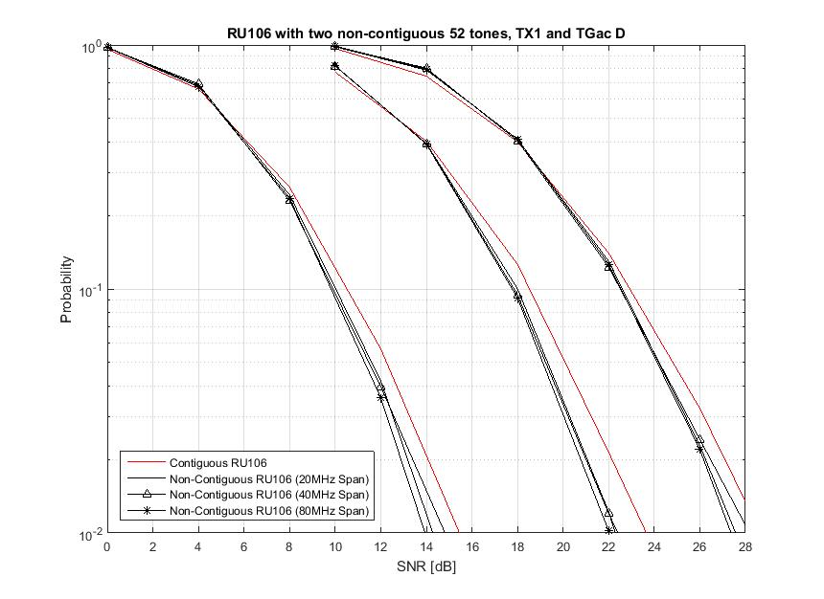
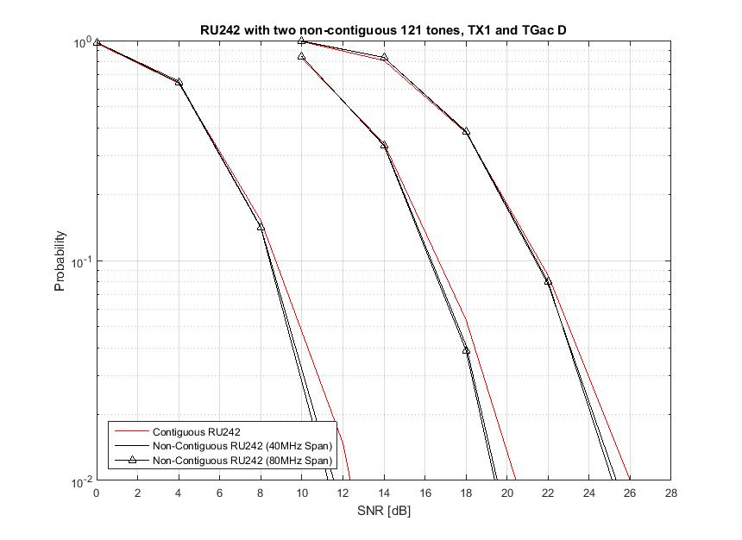
Two Sub-block 106/242 RU
- 1x1 Tx-Rx, MCS 0/3/4
MCS 4
MCS 4
MCS 0
MCS 3
MCS 0
MCS 3
Two sub-blocks for 106 RU & 242 RU
Diversity gain are smaller for 106 RU and 242 RU (compared with 26 and 52 RU).

Slide 9
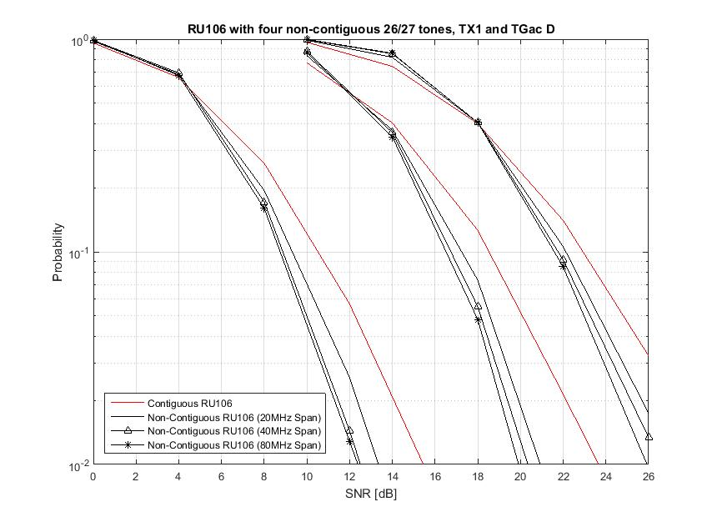
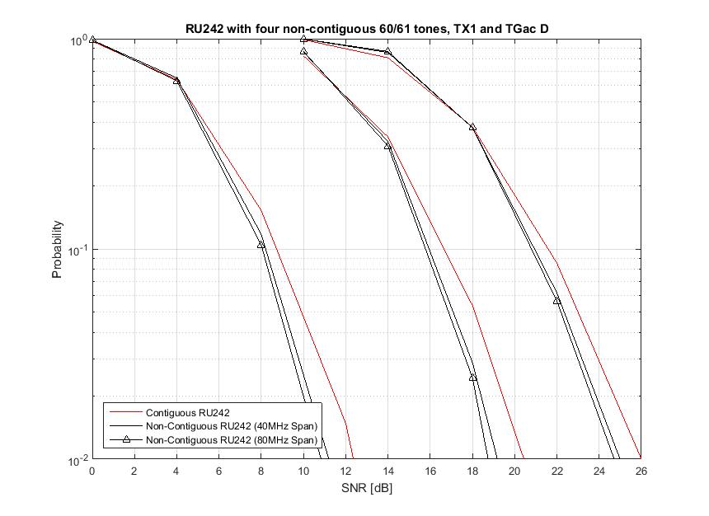
Four Sub-block 106/242 RU
- 1x1 Tx-Rx, MCS 0/3/4
1.5 dB
0.7 dB
MCS 4
MCS 0
MCS 4
MCS 0
MCS 3
MCS 3
Four sub-blocks for 106 RU & 242 RU
1.5 dB performance gain for 106 RU.
Diversity gain seems to be minimal for 242 RU.

Slide 10
Simulation Summary
Diversity Gain at 10% PER* | 26 RU | 52 RU | 106 RU | 242 RU
2 sub-blocks | 1 ~ 3 dB | 0.7 ~ 2 dB | > 0.7 dB | > 0.3 dB
4 sub-blocks | - | 3.5 dB (Appendix) | > 1.5 dB | > 0.7 dB
*Based on 1 Tx, with MCS between 0 ~ 4
With small RU (e.g. 26 RU and 52 RU), up to 3.5 dB gain can be achieved
As expected small RUs have the most diversity gain. Large RUs already span wide enough to capture most of diversity gains.
Given hierarchical structure of OFDMA numerology, 4 sub-blocks may give scheduling limitation (e.g. large fragmentation of the resources)
Limiting the diversity mode to 26 and/or 52 RU may be sufficient.
Example on 40MHz
1
26
26
2
26
26
1
26
1
26
26
2
26
26
1
1
26
26
2
26
26
1
26
1
26
26
2
26
26
1
Once 4 green colored sub-blocks of 26 tones are assigned for a STA, rest red colored 52/106/242 tones cannot be assigned to other STAs in OFDMA
> Results in fragmentation of the resources
1
52
2
52
1
26
1
52
2
52
1
1
52
2
52
1
26
1
52
2
52
1
1
102+4
1
26
1
102+4
1
1
102+4
1
26
1
102+4
1
242
242

Slide 11
Signaling Aspects of Non-Continuous RU
Given that performance benefits of non-continuous RU is focused on 26/52 RU with at least 10MHz or more separation, we can define non-continuous RU allocations with the reserved states.
  For example, only support non-continuous allocation for 26 and/or 52 RU
  Excellent candidates for non-continuous RU are the central 26 RUs in 20/40/80 MHz.
8 bit RU allocation field in SIG-B only may to signal ~180 some states. This means there are additional ~70 states reserved.

Slide 12
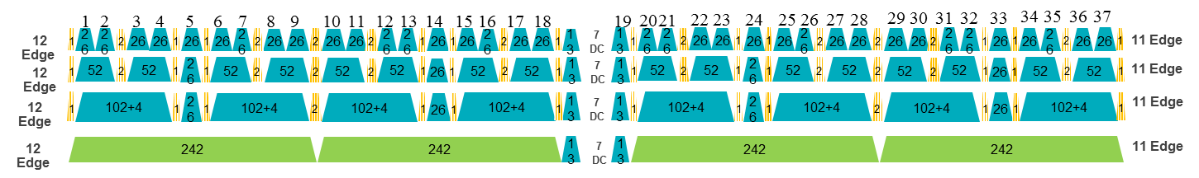
Example Candidates for Non-Continuous RU
Case 1)
Case 2)
Case 3)
52
26
52
HE80
Two separate 26 RUs can be combined into a single non-continuous 52 RU.
Two 13 tones of 26 RUs (i.e. half) can be combined into a single non-continuous 26 RU.
  The other half can form another non-continuous 26 RU.

Slide 13
Straw Poll 1
Do you agree to add the following to the SFD?
Transmission diversity mode (i.e. non-continuous transmission) shall be supported in 11ax.
  Transmission diversity mode divides a single encoded packet in half and maps to 13 + 13 (26 RU) or 26 + 26 (52 RU) tones, that are spaced apart in frequency.
  TBD whether only 26 RU, only 52 RU, or both 26 and 52 RU support transmit diversity mode.
Y/N/A

Slide 14
References
[1] 11-15/0132r9, Specification Framework for TGax
[2] 11-15/1066r0, HE-SIG-B Contents

Slide 15
Appendix

Slide 16
Two Non-Contiguous 13 tones for RU26
(examples for simulation)
10M
20M
40M
80M

Slide 17
Two Non-Contiguous 26 tones for RU52
(examples for simulation)
10M
20M
40M
80M

Slide 18
Four Non-Contiguous 13 tones for RU52
(examples for simulation)
20M
40M
80M

Slide 19
Two Non-Contiguous 53 tones for RU106
(examples for simulation)
20M
40M
80M

Slide 20
Four Non-Contiguous 26/27 tones for RU106
(examples for simulation)
20M
40M
80M

Slide 21
Two Non-Contiguous 121 tones for RU242
Four Non-Contiguous 60/61 tones for RU242
(examples for simulation)
40M
80M
40M
80M

Slide 22
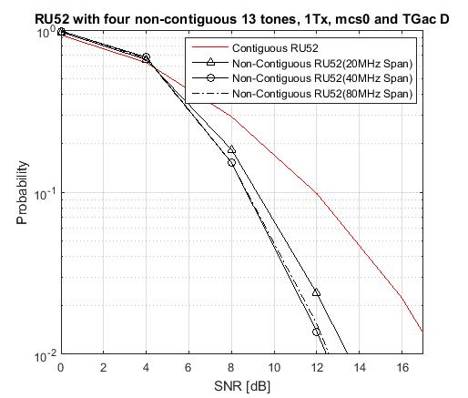
Non-Contiguous RU52
(Tx 1 and MCS 0)
3-3.5 dB

Slide 23
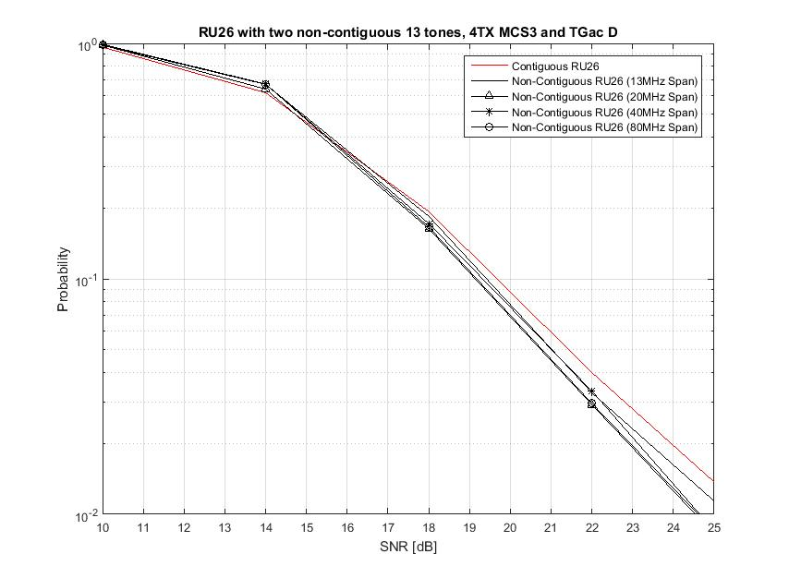
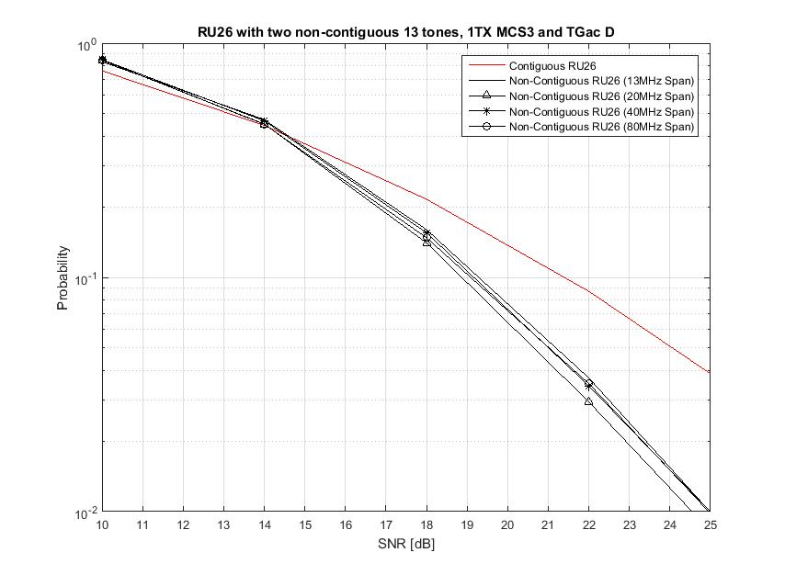
Non-Contiguous RU26
(TX1/Tx4 and MCS 3)
TX 4
TX 1
2 sub-blocks for 26 RU
Diversity gain seems to be decreased with increased number of Tx antenna

Slide 24
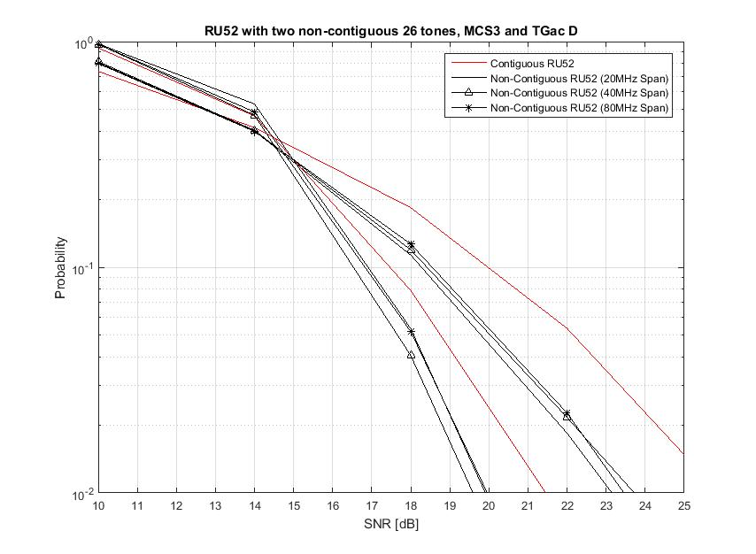
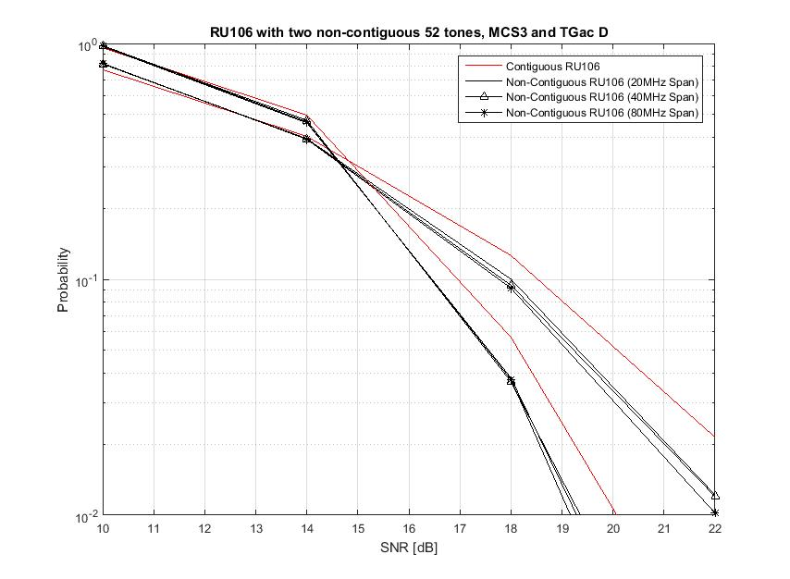
Non-Contiguous RU52 and RU106
(Tx1/Tx 4 and MCS 3)
TX 4
TX 4
TX 1
TX 1

