Slide 1
Channel Estimation Enhancement and Transmission Efficiency Improvement Using Beam-Change Indication and 1x HE-LTF
Date: 2015-11-07
Authors:
Name | Affiliation | Address | Phone | Email
Jianhan Liu | Mediatek USA | 2860 Junction Ave, San Jose, CA 95134, USA | +1-408-526-1899 | jianhan.Liu@mediatek.com
Julia Feng |  |  |  | julia.feng@mediatek.com
Thomas Pare |  |  |  | thomas.pare@mediatek.com
ChaoChun Wang |  |  |  | chaochun.wang@mediatek.com
James Wang |  |  |  | james.wang@mediatek.com
Tianyu Wu |  |  |  | tianyu.wu@mediatek.com
Russell Huang |  |  |  | russell.huang@mediatek.com
James Yee | Mediatek | No. 1 Dusing 1st Road, Hsinchu, Taiwan | +886-3-567-0766 | james.yee@mediatek.com
Alan Jauh |  |  |  | alan.jauh@mediatek.com
Chingwa Hu |  |  |  | chinghwa.yu@mediatek.com
Frank Hsu |  |  |  | frank.hsu@mediatek.com

Slide 2
Authors (continued)
Name | Affiliation | Address | Phone | Email
Hongyuan Zhang | Marvell | 5488 Marvell Lane, Santa Clara, CA, 95054 | 408-222-2500 | hongyuan@marvell.com
Yakun Sun |  |  |  | yakunsun@marvell.com
Lei Wang |  |  |  | Leileiw@marvell.com
Liwen Chu |  |  |  | liwenchu@marvell.com
Jinjing Jiang |  |  |  | jinjing@marvell.com
Yan Zhang |  |  |  | yzhang@marvell.com
Rui Cao |  |  |  | ruicao@marvell.com
Sudhir Srinivasa |  |  |  | sudhirs@marvell.com
Bo Yu |  |  |  | boyu@marvell.com
Saga Tamhane |  |  |  | sagar@marvell.com
Mao Yu |  |  |  | my@marvel..com
Xiayu Zheng |  |  |  | xzheng@marvell.com
Christian Berger |  |  |  | crberger@marvell.com
Niranjan Grandhe |  |  |  | ngrandhe@marvell.com
Hui-Ling Lou |  |  |  | hlou@marvell.com

Slide 3
Authors (continued)
Name | Affiliation | Address | Phone | Email
Peter Loc | Huawei |  |  | peterloc@iwirelesstech.com
Le Liu |  | F1-17, Huawei Base, Bantian, Shenzhen | +86-18601656691 | liule@huawei.com
Jun Luo |  | 5B-N8, No.2222 Xinjinqiao Road, Pudong, Shanghai |  | jun.l@huawei.com
Yi Luo |  | F1-17, Huawei Base, Bantian, Shenzhen | +86-18665891036 | Roy.luoyi@huawei.com
Yingpei Lin |  | 5B-N8, No.2222 Xinjinqiao Road, Pudong, Shanghai |  | linyingpei@huawei.com
Jiyong Pang |  | 5B-N8, No.2222 Xinjinqiao Road, Pudong, Shanghai |  | pangjiyong@huawei.com
Zhigang Rong |  | 10180 Telesis Court, Suite 365, San Diego, CA 92121 NA |  | zhigang.rong@huawei.com
Rob Sun |  | 303 Terry Fox, Suite 400 Kanata, Ottawa, Canada |  | Rob.Sun@huawei.com
David X. Yang |  | F1-17, Huawei Base, Bantian, Shenzhen |  | david.yangxun@huawei.com
Yunsong Yang |  | 10180 Telesis Court, Suite 365, San Diego, CA 92121 NA |  | yangyunsong@huawei.com
Junghoon Suh |  | 303 Terry Fox, Suite 400 Kanata, Ottawa, Canada |  | Junghoon.Suh@huawei.com
Jiayin Zhang |  | 5B-N8, No.2222 Xinjinqiao Road, Pudong, Shanghai | +86-18601656691 | zhangjiayin@huawei.com
Edward Au |  | 303 Terry Fox, Suite 400 Kanata, Ottawa, Canada |  | edward.ks.au@huawei.com
Teyan Chen |  | F1-17, Huawei Base, Bantian, Shenzhen |  | chenteyan@huawei.com
Yunbo Li |  | F1-17, Huawei Base, Bantian, Shenzhen |  | liyunbo@huawei.com

Slide 4
Authors (continued)
Name | Affiliation | Address | Phone | Email
Ron Porat | Broadcom |  |  | rporat@broadcom.com
Sriram Venkateswaran |  |  |  | mfischer@broadcom.com
Matthew Fischer
Leo Montreuil
Andrew Blanksby
Vinko Erceg
Robert Stacey | Intel | 2111 NE 25th Ave, Hillsboro OR 97124, USA | +1-503-724-893 | robert.stacey@intel.com
Shahrnaz Azizi |  |  |  | shahrnaz.azizi@intel.com
Po-Kai Huang |  |  |  | po-kai.huang@intel.com
Qinghua Li |  |  |  | quinghua.li@intel.com
Xiaogang Chen |  |  |  | xiaogang.c.chen@intel.com
Chitto Ghosh |  |  |  | chittabrata.ghosh@intel.com
Laurent Cariou |  |  |  | laurent.cariou@intel.com
Yaron Alpert |  |  |  | yaron.alpert@intel.com
Assaf Gurevitz |  |  |  | assaf.gurevitz@intel.com
Ilan Sutskover |  |  |  | ilan.sutskover@intel.com

Slide 5
Authors (continued)
Name | Affiliation | Address | Phone | Email
Alice Chen | Qualcomm | 5775 Morehouse Dr. San Diego, CA, USA |  | alicel@qti.qualcomm.com
Albert Van Zelst |  | Straatweg 66-S Breukelen, 3621 BR Netherlands |  | allert@qti.qualcomm.com
Alfred Asterjadhi |  | 5775 Morehouse Dr. San Diego, CA, USA |  | aasterja@qti.qualcomm.com
Arjun Bharadwaj |  | 5775 Morehouse Dr. San Diego, CA, USA |  | arjunb@qti.qualcomm.com
Bin Tian |  | 5775 Morehouse Dr. San Diego, CA, USA |  | btian@qti.qualcomm.com
Carlos Aldana |  | 1700 Technology Drive San Jose, CA 95110, USA |  | caldana@qca.qualcomm.com
George Cherian |  | 5775 Morehouse Dr. San Diego, CA, USA |  | gcherian@qti.qualcomm.com
Gwendolyn Barriac |  | 5775 Morehouse Dr. San Diego, CA, USA |  | gbarriac@qti.qualcomm.com
Hemanth Sampath |  | 5775 Morehouse Dr. San Diego, CA, USA |  | hsampath@qti.qualcomm.com
Lin Yang |  | 5775 Morehouse Dr. San Diego, CA, USA |  | linyang@qti.qualcomm.com
Menzo Wentink |  | Straatweg 66-S Breukelen, 3621 BR Netherlands |  | mwentink@qti.qualcomm.com
Naveen Kakani |  | 2100 Lakeside Boulevard Suite 475, Richardson TX 75082, USA |  | nkakani@qti.qualcomm.com
Raja Banerjea |  | 1060 Rincon Circle San Jose CA 95131, USA |  | rajab@qit.qualcomm.com
Richard Van Nee |  | Straatweg 66-S Breukelen, 3621 BR Netherlands |  | rvannee@qti.qualcomm.com

Slide 6
Authors (continued)
Name | Affiliation | Address | Phone | Email
Rolf De Vegt | Qualcomm | 1700 Technology Drive San Jose, CA 95110, USA |  | rolfv@qca.qualcomm.com
Sameer Vermani |  | 5775 Morehouse Dr. San Diego, CA, USA |  | svverman@qti.qualcomm.com
Simone Merlin |  | 5775 Morehouse Dr. San Diego, CA, USA |  | smerlin@qti.qualcomm.com
Tao Tian |  | 5775 Morehouse Dr. San Diego, CA, USA |  | ttian@qti.qualcomm.com
Tevfik Yucek |  | 1700 Technology Drive San Jose, CA 95110, USA |  | tyucek@qca.qualcomm.com
VK Jones |  | 1700 Technology Drive San Jose, CA 95110, USA |  | vkjones@qca.qualcomm.com
Youhan Kim |  | 1700 Technology Drive San Jose, CA 95110, USA |  | youhank@qca.qualcomm.com
Masahito Mori | Sony Corp. |  |  | Masahito.Mori@jp.sony.com
Yusuke Tanaka |  |  |  | YusukeC.Tanaka@jp.sony.com
Yuichi Morioka |  |  |  | Yuichi.Morioka@jp.sony.com
Kazuyuki Sakoda |  |  |  | Kazuyuki.Sakoda@am.sony.com
William Carney |  |  |  | William.Carney@am.sony.com

Slide 7
Authors (continued)
Name | Affiliation | Address | Phone | Email
Jinmin Kim | LG Electronics | 19, Yangjae-daero 11gil, Seocho-gu, Seoul 137-130, Korea |  | Jinmin1230.kim@lge.com
Kiseon Ryu |  |  |  | kiseon.ryu@lge.com
Jinyoung Chun |  |  |  | jiny.chun@lge.com
Jinsoo Choi |  |  |  | js.choi@lge.com
Jeongki Kim |  |  |  | jeongki.kim@lge.com
Dongguk Lim |  |  |  | dongguk.lim@lge.com
Suhwook Kim |  |  |  | suhwook.kim@lge.com
Eunsung Park |  |  |  | esung.park@lge.com
JayH Park |  |  |  | Hyunh.park@lge.com
HanGyu Cho |  |  |  | hg.cho@lge.com
Thomas Derham | Orange |  |  | thomas.derham@orange.com

Slide 8
Authors (continued)
Name | Affiliation | Address | Phone | Email
Fei Tong | Samsung | Innovation Park, Cambridge CB4 0DS (U.K.) | +44 1223 434633 | f.tong@samsung.com
Hyunjeong Kang |  | Maetan 3-dong; Yongtong-Gu Suwon; South Korea | +82-31-279-9028 | hyunjeong.kang@samsung.com
Kaushik Josiam |  | 1301, E. Lookout Dr, Richardson TX 75070 | (972) 761 7437 | k.josiam@samsung.com
Mark Rison |  | Innovation Park, Cambridge CB4 0DS (U.K.) | +44 1223 434600 | m.rison@samsung.com
Rakesh Taori |  | 1301, E. Lookout Dr, Richardson TX 75070 | (972) 761 7470 | rakesh.taori@samsung.com
Sanghyun Chang |  | Maetan 3-dong; Yongtong-Gu Suwon; South Korea | +82-10-8864-1751 | s29.chang@samsung.com
Yasushi Takatori | NTT | 1-1 Hikari-no-oka, Yokosuka, Kanagawa 239-0847 Japan |  | takatori.yasushi@lab.ntt.co.jp
Yasuhiko Inoue |  |  |  | inoue.yasuhiko@lab.ntt.co.jp
Shoko Shinohara |  |  |  | Shinohara.shoko@lab.ntt.co.jp
Yusuke Asai |  |  |  | asai.yusuke@lab.ntt.co.jp
Koichi Ishihara |  |  |  | ishihara.koichi@lab.ntt.co.jp
Junichi Iwatani |  |  |  | Iwatani.junichi@lab.ntt.co.jp
Akira Yamada | NTT DOCOMO | 3-6, Hikarinooka, Yokosuka-shi, Kanagawa, 239-8536, Japan |  | yamadaakira@nttdocomo.com
Fujio Watanabe |  | 3240 Hillview Ave, Palo Alto, CA 94304 |  | watanabe@docomoinnovations.com
Haralabos Papadopoulos |  |  |  | hpapadopoulos@docomoinnovations.com

Slide 9
Authors (continued):
Joonsuk Kim | Apple |  |  | joonsuk@apple.com
Aon Mujtaba |  |  |  | mujtaba@apple.com
Guoqing Li |  |  |  | guoqing_li@apple.com
Eric Wong |  |  |  | ericwong@apple.com
Chris Hartman |  |  |  | chartman@apple.com
Bo Sun | ZTE | #9 Wuxingduan, Xifeng Rd., Xi'an, China |  | sun.bo1@zte.com.cn
Kaiying Lv |  |  |  | lv.kaiying@zte.com.cn
Yonggang Fang |  |  |  | yfang@ztetx.com
Ke Yao |  |  |  | yao.ke5@zte.com.cn
Weimin Xing |  |  |  | xing.weimin@zte.com.cn
Brian Hart | Cisco Systems | 170 W Tasman Dr, San Jose, CA 95134 |  | brianh@cisco.com
Pooya Monajemi |  |  |  | pmonajem@cisco.com

Slide 10
Preamble for Single User (SU) Transmission
Format of preamble for SU Transmission in high efficiency WLAN
For SU transmission, the number of HE-LTFs is equal to Nsts or Nsts+1
  For example, for one spatial stream, there is one HE-LTF; for two spatial streams, there are two HE-LTFs.
BPSK GI=0.8us
BPSK GI=0.8us
BPSK
L-STF
8us
L-LTF
8us
L-SIG 4us
R-LSIG 4us
HE-SIGA1
4us
HE-SIGA2
4us
HE-STF
HE-LTFs
Legacy Preamble
HE-Preamble

Slide 11
Importance of Channel Estimation for High MCSs
The accuracy of channel estimation is essential to receiver performance
  For high modulations such as 256QAM and 1024QAM, enhancing channel estimation accuracy can significantly improve PER performance
  For 1024QAM, enhancing channel estimation accuracy also helps reduce the TX and RX EVM requirement.

Slide 12
Introducing Beam-change indication
Beam-Change Indication: Indicates if the pre-multiplied Q matrix is changed from legacy preamble to HE-STF, HE-LTF and Data Portion
  Beam-change indication bit (adopted in 11ah spec.)
    Value “1” indicates that spatial mapping is changed
    Value “0” indicates that spatial mapping is unchanged
Beam-Change Indication can be used to significantly enhance channel estimation at receiver.
  When there is no beam-change, receiver does not change operation during HE-STF and HE-LTF such that the channel estimations can rely on the combination of L-LTFs, L-SIG. RL-SIG, HE-SIGAs and HE-LTFs.
  Note in 11ax, a STA generally needs to processing more than one 20MHz channels due to HE-SIGB structure.

Slide 13
Channel estimation enhancement for single spatial stream
Usage Scenarios
  No beam-forming
  Within a given TXOP, whole packet (including preamble) is beam-formed.
Channel estimation gain by using beam-change indication
  Channel estimation L-LTFs can be combined if there is a beam-change indication
  4.7dB gain on channel estimation MSE only use L-LTFS and HE-LTFs (3 CE symbols V.S. 1 CE symbol)
  If L-SIG, RL-SIG and two HE-SIGA symbols are also used for channel estimation combination, we can expect about 8dB gains on channel estimations enhancement.
  Interpolation is needed for L-LTFs, L-SIG, RL-SIG and HE-SIGAs when they are used for channel estimation enhancement because the HE-LTF/Data has 4x number of subcarriers.

Slide 14
Channel estimation enhancement for two spatial streams
Usage Scenarios
  No beam-forming: only CSD are applied.
  Beamforming without spatial mapping change
Channel estimation gain by using beam-change indication
  In 11ax, 6 symbols (L-LTF, re-modulated L-SIG, and HE-SIGAs symbols) can be used to update channel estimation
  Gains before interpolation
    For 2 Spatial Streams: Channel estimation noise reduction is 2.37dB
Theoretical analysis on channel estimation enhancement is shown in the back up slides.

Slide 15
Beam-change Indication Enables 1x HE-LTF
Performance improvement of 1x HE-LTF is close to or better than 2x HE-LTF with beam-change indication enabled channel estimation enhancement.
1x HE-LTF also simplifies LTF combining and channel estimation enhancement.
1x HE-LTF achieves higher spectral efficiency, especially for short packet
1x HE-LTF should be added as an optional feature in 11ax SFD

Slide 16
Simulation Assumptions
D-NLOS, 80MHz
4x1 1SS, 4x2 2SS; with or without beamforming.
MCS9, and 1024QAM-5/6
LLTF is beamformed as HELTF
  HELTF 1x/2x

Slide 17
4x1, 1SS
Substantial gain achieved by LLTF combining in all cases.
  1.7dB for all cases (BF on/off, MCS9, 1024QAM)
  LLTF combine with 1x/2x HELTF performs almost the same.

Slide 18
4x2, 2SS
LLTF combining still provide noticeable gain with 2SS.
  LLTF combining with 1x HELTF still provides gain about 0.7dB.
  LLTF combining with 2x HELTF has less gain (0.3dB).

Slide 19
More on 1x HELTF
In many scenarios 1xLTF shows minimum sensitivity loss over 2x/4x LTFs (e.g. SU, indoor short range, peak MCSs, see Appendix B).
  In cases like short range channel and with LLTF+HELTF combining, similar or even better PER performances than longer HE-LTFs.
1xLTF provides very large overhead reduction
  e.g. for 3SS and 4SS, ~12.8us overhead reduction from 2xHELTF
  SLS simulation shows a 7% throughput gain over 4xHELTF (see Appendix C)
Large number of short packets may exist according to [1], making 1xLTF overhead reduction more attractive (see Appendix C).
Propose to define 1xHELTF as an optional feature for 11ax:
  Only allowed for non-OFDMA format

Slide 20
Conclusions
With beam-change indication, L-LTFs can be combined with HE-LTFs.
With beam-change indication and LTF combining, PER performance can be improved by 1.7dB (1SS) or 0.7dB (2SS).
  1x HE-LTF achieves non-negligible throughput gain for short range SU.
LTF combining significantly improve performance of 1x HELTF
Propose 1x HELTF as an optional feature for 11ax.

Slide 21
Straw Poll #1
Do you agree to add 1-bit beam-change indication into HE-SIGA?
    Value “1” indicates that spatial mapping is changed
    Value “0” indicates that spatial mapping is unchanged

Slide 22
Straw poll #2
Do you agree that when beam-change indication is “0”, the pre-HE-STF portion preamble shall be spatially mapped in the same way as HE-LTF1 on each tone?

Slide 23
Straw Poll #3
Do you agree to add 1x HE-LTF as an optional mode in 11ax for SU PPDU (TBD for MU-MIMO)?
  1xLTF + 0.8us GI is one optional combination as indicated by the “GI and LTF size” sub-field in HE-SIG-A.

Slide 24
Backup Slides – A
The theoretical analysis of channel estimation enhancement gain for two spatial streams

Slide 25


From legacy to HE portions
  No beamforming
  CSD Changes from T_{cs-L} to T_{cs-H}
The received legacy symbols are
  s_{i} , i=0, 1 are for L-LTF symbols
  s_{i} , i=2 – 5 are for L-SIG, and HE-SIGA symbols. They can be obtained by re-encode and re-modulate the decoded L-SIG and HE-SIGA symbols.
  After modulation is removed, combine all 6 legacy symbols as,
The received HE-LTF symbols are
  After modulation is removed
Initial HE-CE:
  All n are AWGN with unit power, noise power for initial each estimated channel entry is N_{i0} = N_{i1} = 0.5.

Slide 26



Combining legacy symbols and HE-LTF symbols
Updated HE-CE
  All n are AWGN with unit power, noise power for combined are
  Because of , we can derive that
  It can be shown that for the updated HE-Channel estimation, the noise is reduced by 2.37dB (compared to N_{i0} = N_{i1} = 0.5)
For the case that preamble is also beamformed, it is a special case with

Slide 27
Backup Slides – B
Performance of 1x HELTF vs. 2x/4x HELTF for indoor channels and peak rate

Slide 28
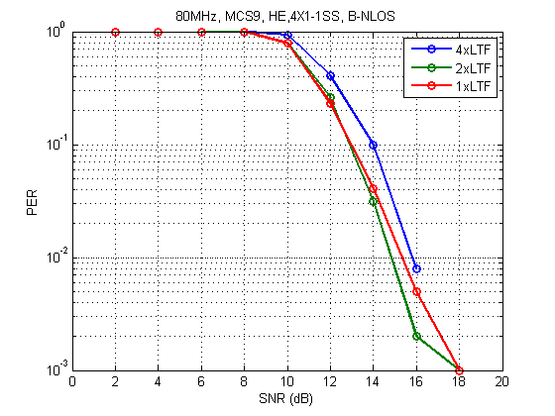
4x1-1SS, BNLOS, 80MHz, MCS9, TxBF

Slide 29
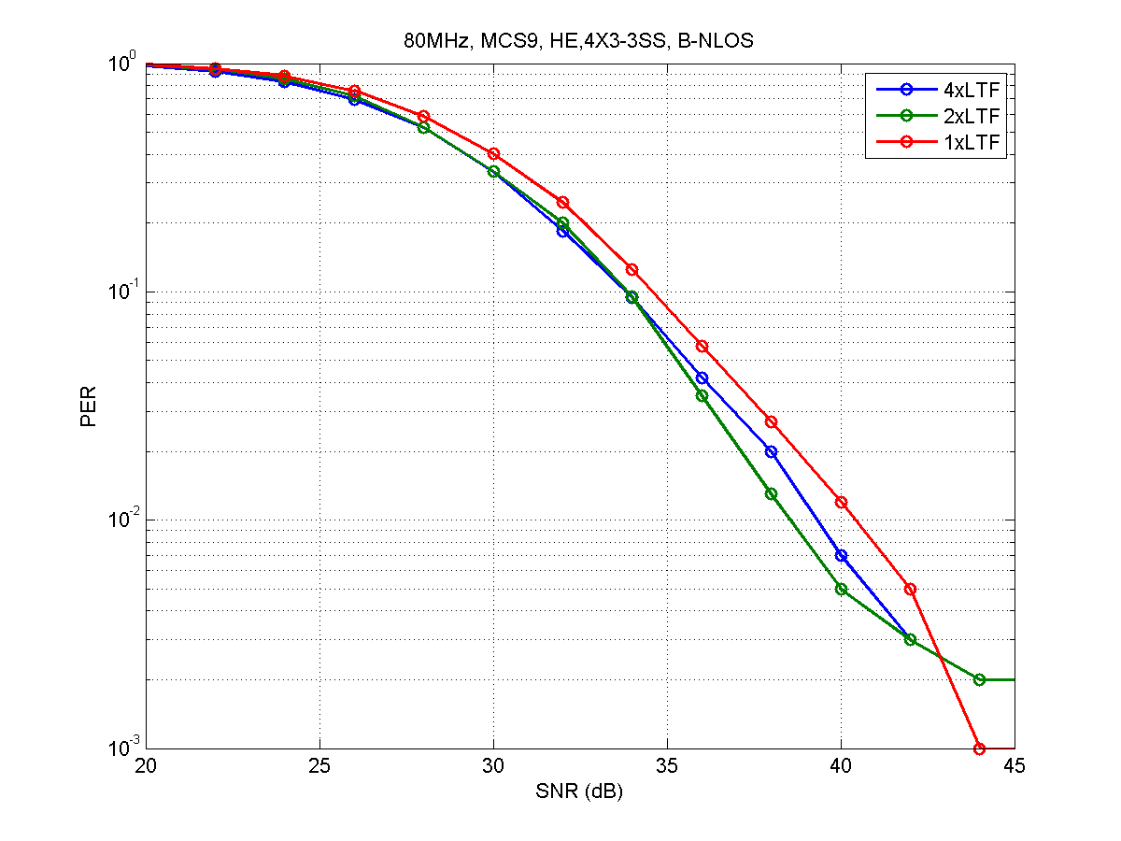
4x3-3SS, BNLOS, 80MHz, MCS9, no TxBF

Slide 30
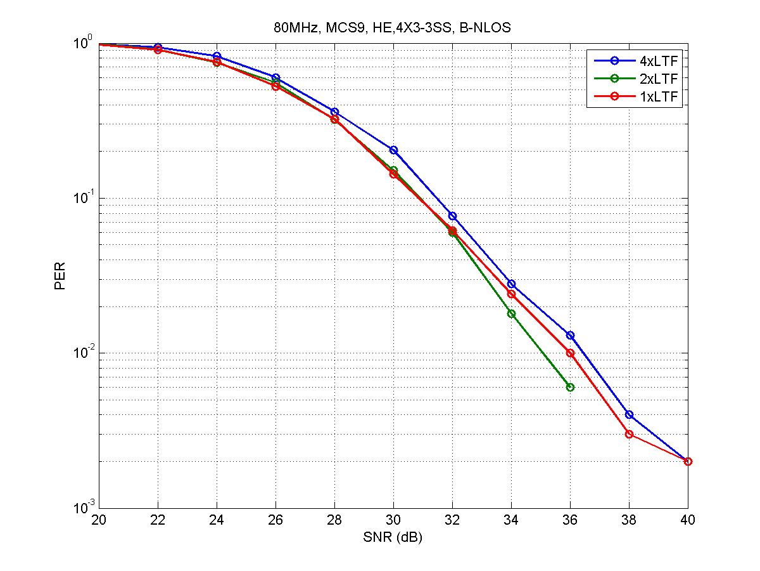
4x3-3SS, BNLOS, 80MHz, MCS9, TxBF

Slide 31
Backup Slides – C
Simulations on Efficiency and System Throughput
for 1x/2x/4x HELTF

Slide 32
HELTF Overhead SLS
DL
AP
5 meters
STA
11nD channel, 3x3-3SS, 80MHz, single link (like in a shield room)
AP txPower = 20 dBm, STA txPower = 15 dBm,
AMPDU size = 64 MPDUs, No AMSDU
Fixed MCS 9, NGI → Peak Data Rate = 1.17 Gbps
Traffic configuration: 1.2 Gbps CBR (AC_BE), constant packet size = 1500 Bytes/MPDU
TCP data packet are transmitted in 11ax frame format, and control packets (ACK) are transmitted in legacy format.

Slide 33
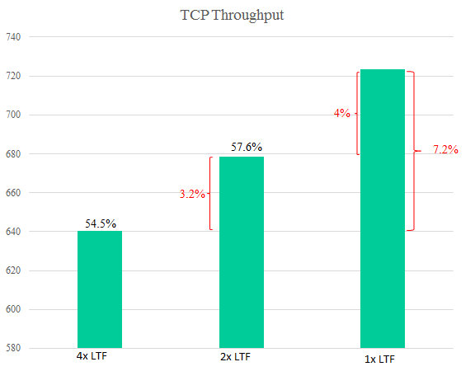
TCP Throughput
61.6%

Slide 34
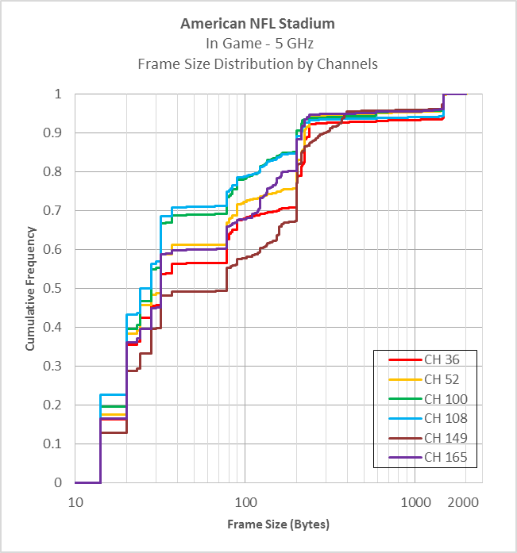
Example of Pkt Size Measurement in [1]
Large payloads
Beacon

Slide 35
Reference
[1] 11-15-0343-01-00ax-in-situ-frame-size-measurements

