Slide 1
Reducing Explicit MIMO Compressed Beamforming Feedback Overhead for 802.11ax
Date: 2015-11-08
Authors:

Slide 2
Outline
Introduction
Extension Schemes
New Schemes
Conclusion

Slide 3
Introduction
In this contribution, we discuss possible methods to reduce explicit MIMO compressed beamforming feedback overhead in 802.11ax.
  802.11ac supports explicit MIMO compressed beamforming feedback with
    (4,2) or (6,4) bits to quantize angle (ϕ, ψ) for single user, and
    (7,5) or (9,7) bits to quantize angle (ϕ, ψ) for multi-user.
  For 802.11ax, the following has been agreed to [1]:
    The amendment shall define a mechanism to reduce the MIMO compressed beamforming feedback overhead. [MU Motion 25, September 17, 2015, see [2]]
We discuss two groups of schemes:
  Extension Schemes: Extension of 802.11ac feedback schemes. We discuss six schemes.
  New Schemes: New (to 802.11) MIMO compressed beamforming feedback schemes. We discuss two schemes.
Our goal is to narrow down possible schemes for further study and design.

Slide 4
Extension Schemes
Extending the current beamforming feedback may be done by
  Large Ng:
    Increase the tone grouping size {Ng} during feedback [3][4]
  ϕ Only Feedback:
    Feedback ϕ only in N x 1 transmission and assume a fixed ψ [5]
  Variable Angle Quantization:
    Use different quantization levels for different Given’s rotation angles (ϕi, ψi).
  Differential Given’s Rotation:
    Feedback time or frequency difference in Given’s Rotation angles.
  Multi-resolution/Multi-stage feedback
    Identify frequency band(s)/Resource Units (RU(s)) based on scalar feedback (e.g. SNR) and feed back full CSI for desired frequency band /RU(s).
  Time Domain Channel Feedback
    Feed back time domain channel

Slide 5
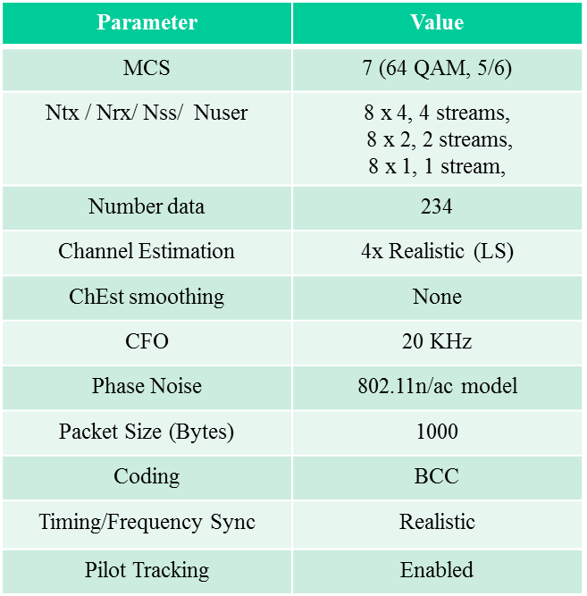
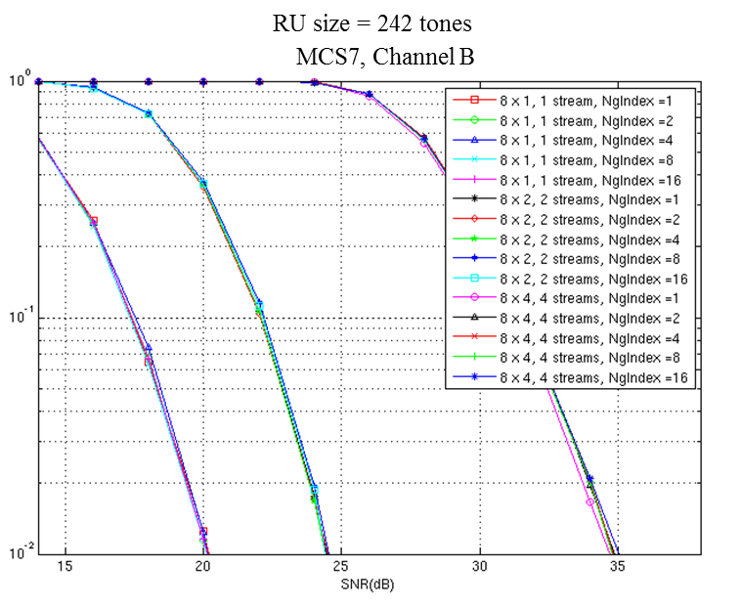
Extension Scheme (1)
  Large Ng: Increase the tone grouping size {Ng} during feedback
    Minimum size has already been increased to 2 [3]
    Maximum size may be increased to 16 with little impact on performance for some scenarios [4]

Slide 6
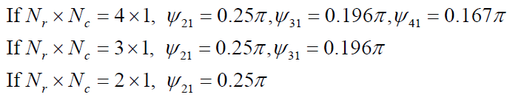
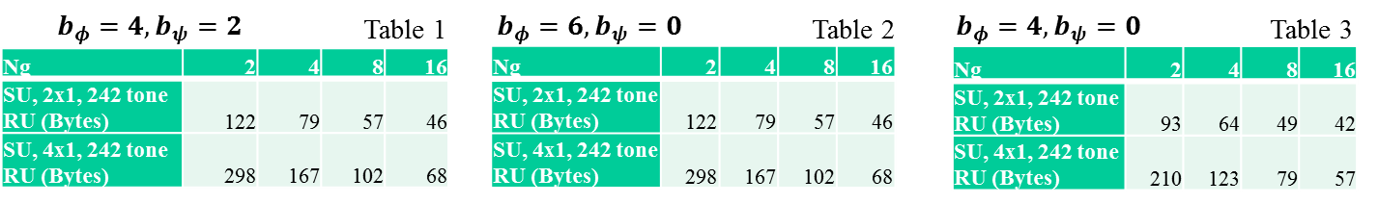
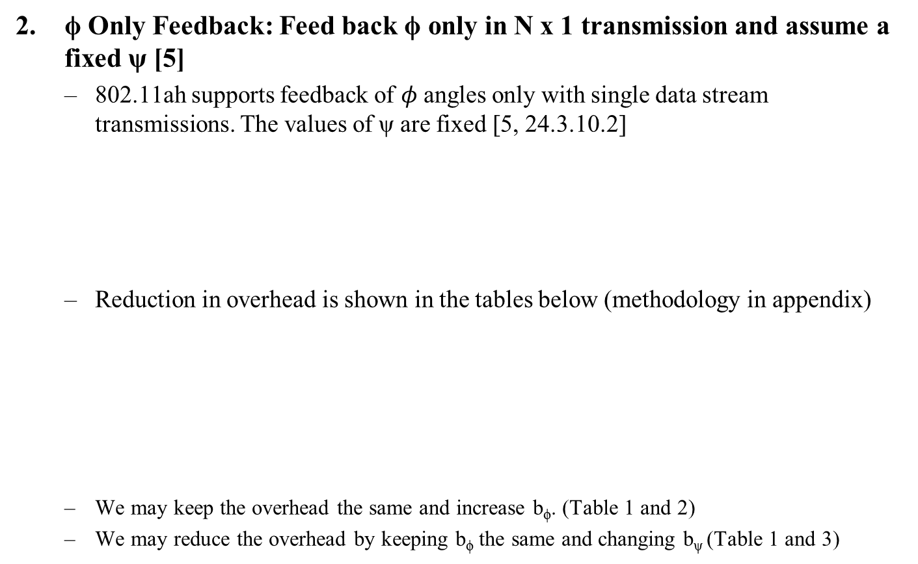
Extension Scheme (2)
ϕ Only Feedback: Feed back ϕ only in N x 1 transmission and assume a fixed ψ [5]
  802.11ah supports feedback of $φ$ angles only with single data stream transmissions. The values of ψ are fixed [5, 24.3.10.2]
  Reduction in overhead is shown in the tables below (methodology in appendix)
  We may keep the overhead the same and increase b_{ϕ}. (Table 1 and 2)
  We may reduce the overhead by keeping b_{ϕ} the same and changing b_{ψ} (Table 1 and 3)

Slide 7
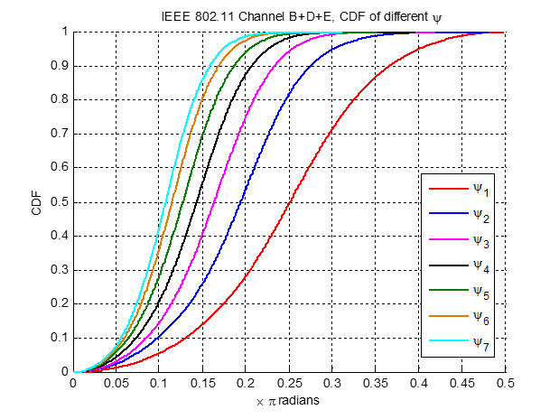
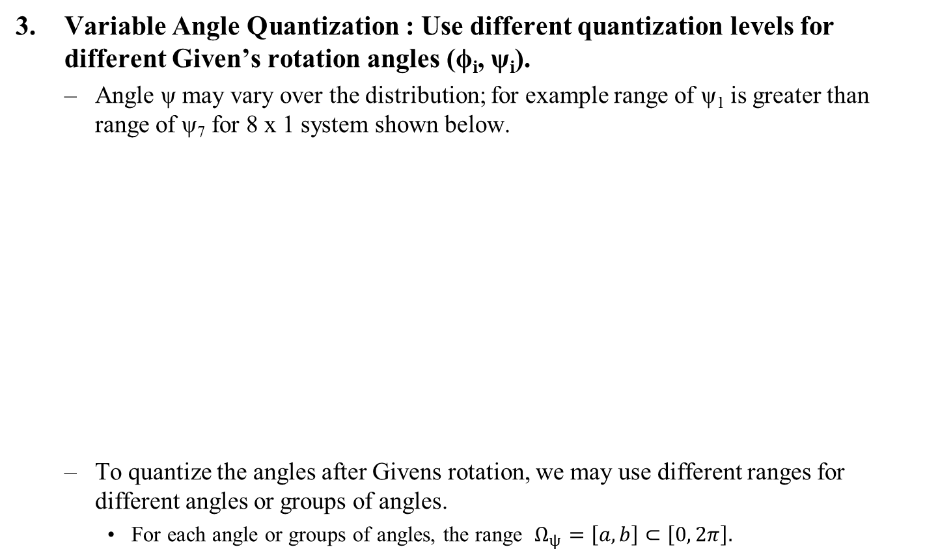
Extension Schemes (3)
Variable Angle Quantization : Use different quantization levels for different Given’s rotation angles (ϕ_{i}, ψ_{i}).
  Angle ψ may vary over the distribution; for example range of ψ₁ is greater than range of ψ₇ for 8 x 1 system shown below.
  To quantize the angles after Givens rotation, we may use different ranges for different angles or groups of angles.
    For each angle or groups of angles, the range $Ω_{ψ}=\left[a,b\right]⊂\left[0, 2π\right].$

Slide 8


Extension Schemes (4)
Differential Given’s Rotation : Feed back time or frequency difference in Given’s Rotation angles
  Send differential information between Given’s rotation angles of ‘baseline’ channel and next channel in time [6] or frequency
  May use scalar difference (subtraction) or vector difference (range/null space overlap).
$δφ$ is approximately distributed within
the range of $\left[−π/2, π/2\right] vs \left[0, 2π\right]$
$δψ$ is approximately distributed
within the range of $\left[−π/8, π/8\right] vs\left[0, π/2\right]$

Slide 9

Extension Schemes (5)
Multi-Resolution/Multi-Stage Feedback : Identify desired band/RU based on scalar feedback (e.g. SNR) then feed back full CSI for specific RU(s).
  This is an example of a scheme enabling a feedback granularity of less than 20 MHz [1]
  The table below shows total feedback per transmission per user, i.e. the amount of feedback needed from a user to enable a successful transmission:
    Can save $≈$90% overhead per user per
  Overhead savings is compared with 242 tone RU case
  Total Feedback/Tx/User = 2 bytes* No. RUs + No. subcarrier per RU * VHT BF report (bytes)
  Additional details in Appendix

Slide 10
Extension Schemes (6)
Time domain channel feedback: Feed back time domain channel
  Number of significant taps may be much less than the number of tones and may result in feedback overhead savings.
  However, may need to feed back U, S and V of time domain channel U to enable transformation of the channel to the frequency domain. i.e. one additional matrix.
  May also need to indicate position of tap
  As such, there may be a trade-off between increasing the feedback per tap and the number of taps fed back.

Slide 11
New Feedback Schemes
Multiple component feedback: splits feedback into multiple components [7]
  One component has a larger size and is fed back at longer intervals.
  One component is smaller and is sent back at shorter intervals.
  The combination of both may reduce the overall feedback
  Examples include
    Feed back long term / short term information
    Feed back wideband / sub-band information
Codebook-based feedback: Feed back codeword from a well designed codebook [8]
  Overall feedback may reduce based on the size of the codebook.

Slide 12
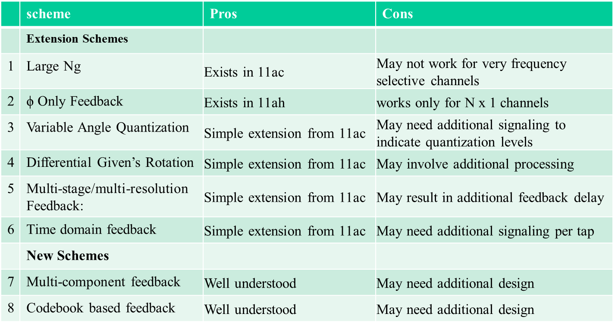
Summary (Pros and Cons)

Slide 13
Conclusions
Multiple schemes may be used to reduce the explicit MIMO compressed beamforming Feedback Overhead for 802.11ax
  They include six schemes that are simple extensions of 802.11ac feedback schemes.
  They include two new (to 802.11) MIMO compressed beamforming feedback schemes.
The performance of these methods should be studied and a combination of them adopted in 802.11ax

Slide 14
References
11-15-0132-09-00ax-spec-framework
11-15-1129-01-00ax-feedback-overhead-in-dl-mu-mimo
11-15-1071-02-00ax-tone-grouping-factors-and-ndp-format-for-802-11ax
11-15-1320-00-00ax-Maximum-tone-grouping-for-802_11ax-feedback
IEEE P802.11ah™/D2.0 Amendment 6: Sub 1 GHz License Exempt Operation
Porat, R.; Ojard, E.; Jindal, N.; Fischer, M.; Erceg, V., "Improved MU-MIMO performance for future 802.11 systems using differential feedback," in Information Theory and Applications Workshop (ITA), 2013 , vol., no., pp.1-5, 10-15 Feb. 2013
Chaiman Lim; Taesang Yoo; Clerckx, B.; Byungju Lee; Byonghyo Shim, "Recent trend of multiuser MIMO in LTE-advanced," in Communications Magazine, IEEE , vol.51, no.3, pp.127-135, March 2013
Love, D.J.; Heath, R.W.; Lau, V.K.N.; Gesbert, D.; Rao, B.D.; Andrews, M., "An overview of limited feedback in wireless communication systems," in Selected Areas in Communications, IEEE Journal on , vol.26, no.8, pp.1341-1365, October 2008.

Slide 15
Straw Poll #1
Do you agree with the following?
The amendment shall define a mechanism to reduce the MIMO compressed beamforming feedback overhead.
  The amendment may consider methods that extend the compressed beamforming feedback ideas in 802.11ac
  Y/ N/ A

Slide 16
Straw Poll #2
Do you agree with the following?
The amendment shall define a mechanism to reduce the MIMO compressed beamforming feedback overhead.
  The amendment may consider new ideas that are different from the compressed beamforming feedback ideas in 802.11ac
  Y/ N/ A

Slide 17
Additional Material

Slide 18
Multi-Resolution/Multi-Stage Feedback Overhead
  Overhead savings is compared with 242 tone RU case
  Total Feedback/Tx/User = 2 bytes* No. RUs + No. subcarrier per RU * VHT BF report (bytes)

Slide 19
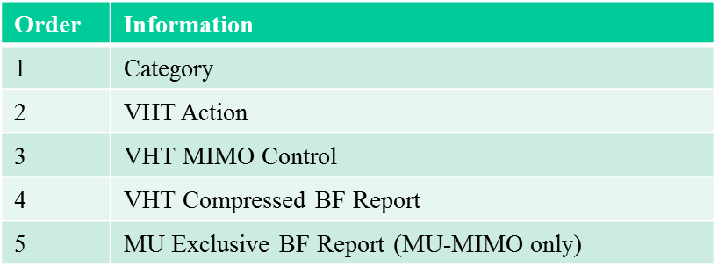
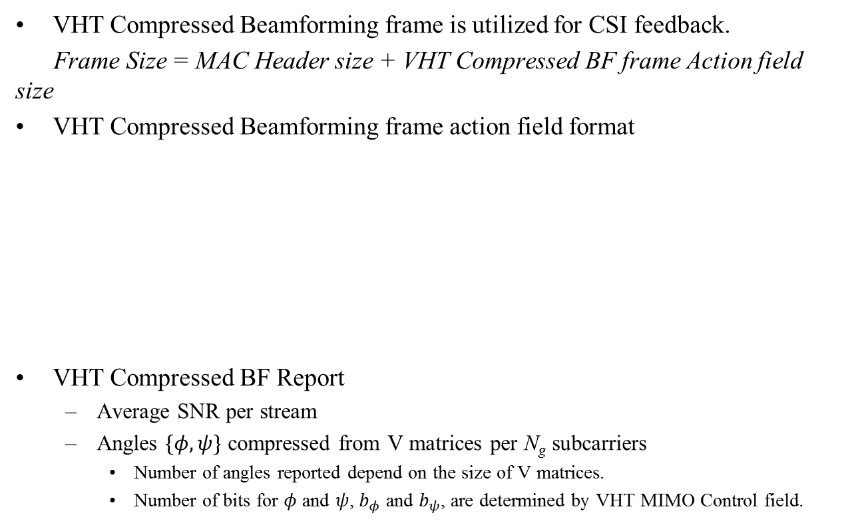
Overhead Calculation Details
VHT Compressed Beamforming frame is utilized for CSI feedback.
Frame Size = MAC Header size + VHT Compressed BF frame Action field size
VHT Compressed Beamforming frame action field format
VHT Compressed BF Report
  Average SNR per stream
  Angles $\{φ,ψ\}$ compressed from V matrices per N_{g} subcarriers
    Number of angles reported depend on the size of V matrices.
    Number of bits for $φ$ and $ψ$, $b_{φ}$ and $b_{ψ}$, are determined by VHT MIMO Control field.

