Slide 1
Maximum Tone Grouping Size for 802.11ax Feedback
Date: 2015-11-08
Authors:

Slide 2
Outline
Introduction
Maximum Tone Grouping in 802.11ax
Overhead Calculations
Link Level Simulation assumptions and results
  SU-MIMO OFDM/OFDMA
Conclusion

Slide 3
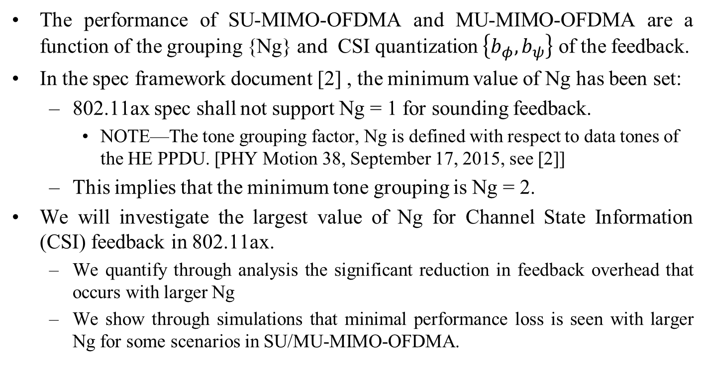
Introduction
The performance of SU-MIMO-OFDMA and MU-MIMO-OFDMA are a function of the grouping {Ng} and CSI quantization $\left\{b_{φ},b_{ψ}\right\}$ of the feedback.
In the spec framework document [2] , the minimum value of Ng has been set:
  802.11ax spec shall not support Ng = 1 for sounding feedback.
    NOTE—The tone grouping factor, Ng is defined with respect to data tones of the HE PPDU. [PHY Motion 38, September 17, 2015, see [2]]
  This implies that the minimum tone grouping is Ng = 2.
We will investigate the largest value of Ng for Channel State Information (CSI) feedback in 802.11ax.
  We quantify through analysis the significant reduction in feedback overhead that occurs with larger Ng
  We show through simulations that minimal performance loss is seen with larger Ng for some scenarios in SU/MU-MIMO-OFDMA.

Slide 4
Maximum Tone Grouping in 802.11ax
Tone grouping in 802.11ac
  Ng = 1 (312.5 kHz), 2 (625 kHz) and 4 (1250 kHz)
Current tone grouping in 802.11ax
  Ng = 2 (156.25 kHz), and 4 (312.5 kHz)
There are two options to increasing the maximum value of Ng
  Option 1: keep number of grouping parameters the same as 11ac (three values):
      2 (156.25 kHz), 4 (312.5 kHz), 8 (625 kHz)
  Option 2: keep maximum frequency spacing the same as 11ac (four values):
      2 (156.25 kHz), 4 (312.5 kHz), 8 (625 kHz), 16 (1250 kHz)
      Note: The grouping subfield in the VHT MIMO control field uses 2 bits to signal Ng with 1 value reserved.
      Thus, we may use up to 4 values without any changes in the field size.
Goal: All we need to demonstrate is that
  there are substantial overhead savings and
  there are some scenarios in which either Ng =8 or 16 is beneficial.

Slide 5
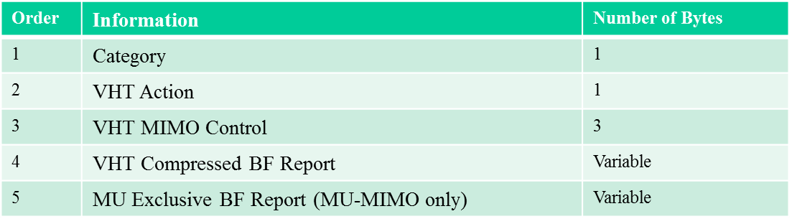
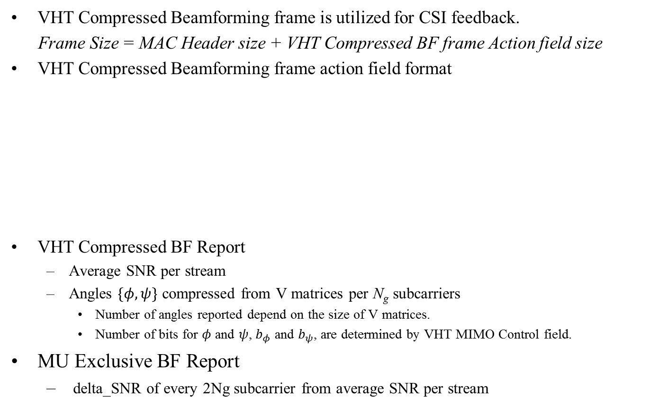
Overhead Calculation Details
VHT Compressed Beamforming frame is utilized for CSI feedback.
Frame Size = MAC Header size + VHT Compressed BF frame Action field size
VHT Compressed Beamforming frame action field format
VHT Compressed BF Report
  Average SNR per stream
  Angles $\{φ,ψ\}$ compressed from V matrices per N_{g} subcarriers
    Number of angles reported depend on the size of V matrices.
    Number of bits for $φ$ and $ψ$, $b_{φ}$ and $b_{ψ}$, are determined by VHT MIMO Control field.
MU Exclusive BF Report
  delta_SNR of every 2Ng subcarrier from average SNR per stream

Slide 6
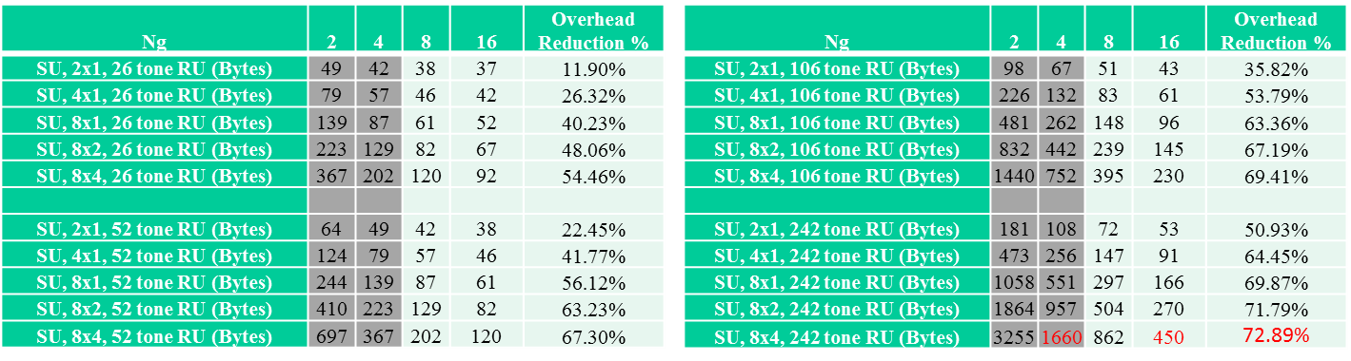

SU-MIMO-OFDMA Overhead Savings
Assume maximum quantization allowed for single user beamforming (6,4)
  up to 73 % savings when comparing Ng = 16 to Ng = 4 for 8 x 4 transmission and 242 tone RUs.
Overhead savings increases with increase in RU feedback size
  If feedback is RU specific CSI, feedback savings may not be as significant.
  Ng = 2, 4 : existing design; Ng = 8, 16 : investigated values
  Overhead comparison between Ng = 4 and Ng = 16
$$b_{φ}=6, b_{ψ}=4$$

Slide 7
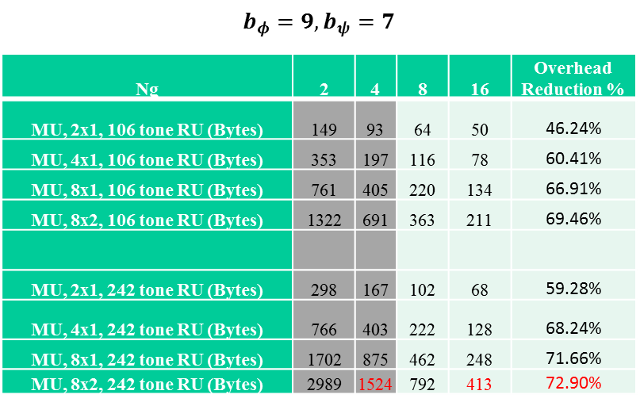
MU-MIMO-OFDMA Overhead Savings
Assume maximum quantization allowed for multiuser MIMO (9,7),
  up to 73 % savings per user when comparing Ng = 16 to Ng = 4 for 8 x 2 transmission with 242 tone RUs.
Higher savings due to increased quantization.
Same conclusions for per user feedback as SU feedback.
*The above table represents antenna setting and BF feedback overhead for each user in the case of a MU-MIMO scenario

Slide 8
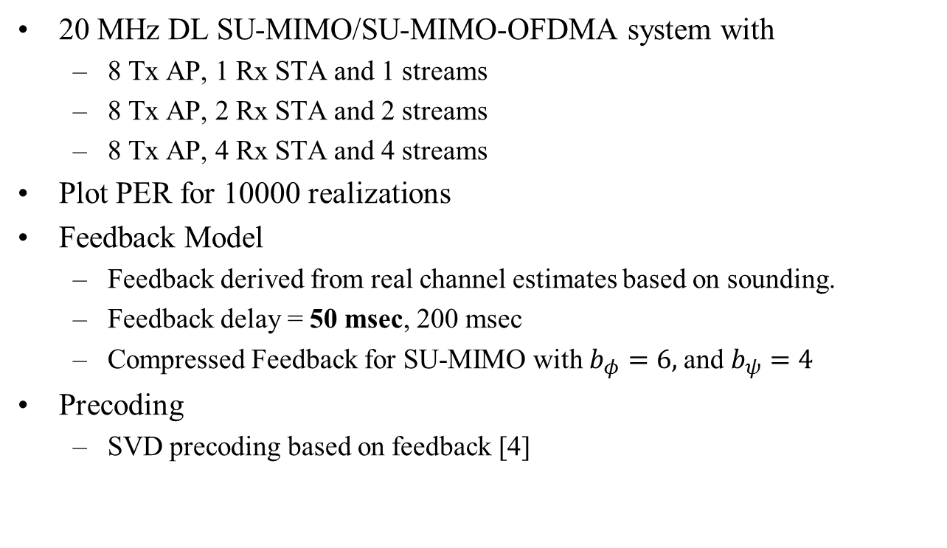
Simulation Assumptions: SU-MIMO
20 MHz DL SU-MIMO/SU-MIMO-OFDMA system with
  8 Tx AP, 1 Rx STA and 1 streams
  8 Tx AP, 2 Rx STA and 2 streams
  8 Tx AP, 4 Rx STA and 4 streams
Plot PER for 10000 realizations
Feedback Model
  Feedback derived from real channel estimates based on sounding.
  Feedback delay = 50 msec, 200 msec
  Compressed Feedback for SU-MIMO with $b_{φ}=6,$and $b_{ψ}=4$
Precoding
  SVD precoding based on feedback [4]

Slide 9
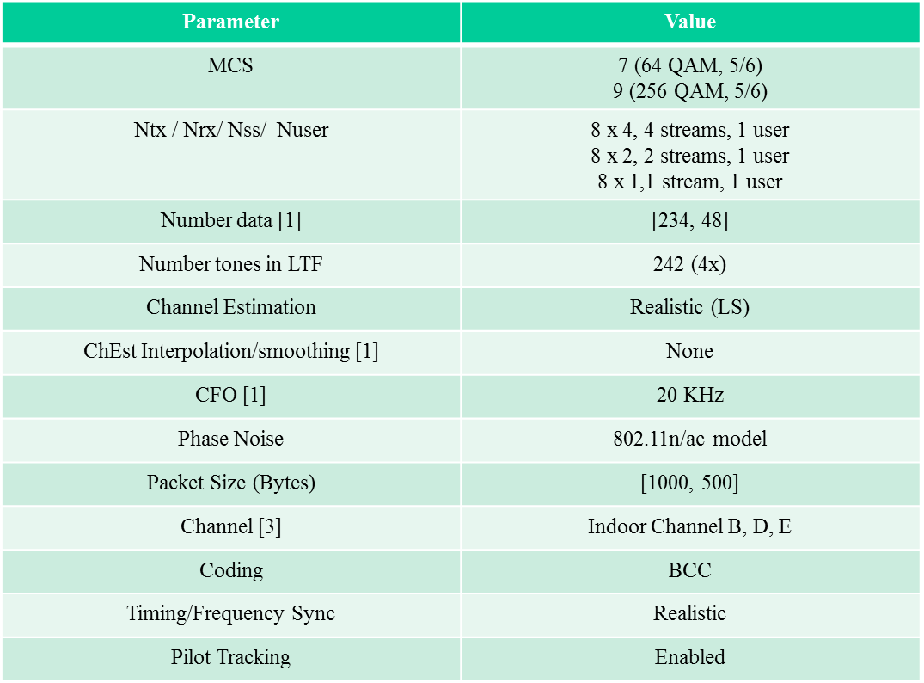
Detailed Assumptions

Slide 10
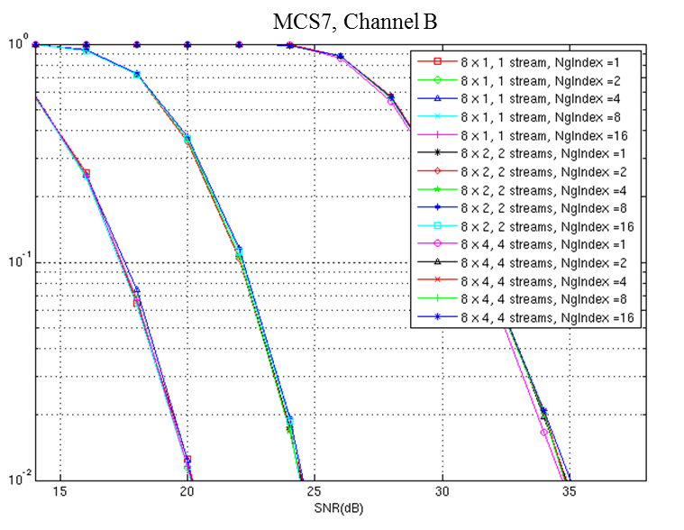
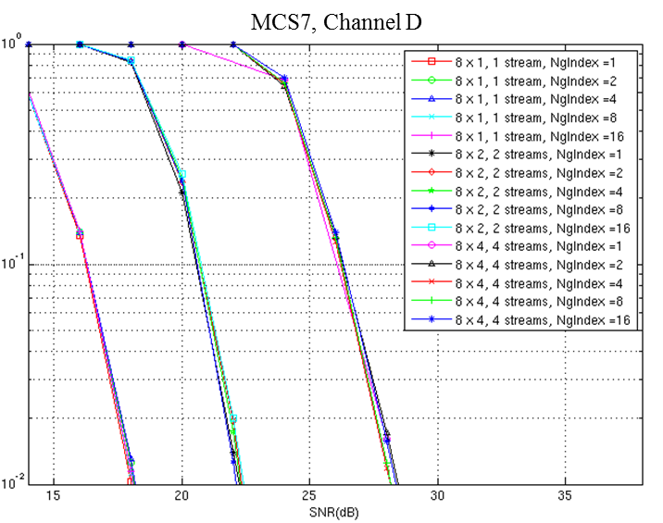
Results for Channel B, D
(MCS7, 242 Tones, 50 msec delay)
Channel B/Channel D:
  No PER difference for 8 x 1, 1 stream and 8 x 2, 2 stream
  < 0.4 dB PER difference between Ng = 1 and Ng = 2, 4, 8, 16 for 8 x 4, 4 stream
  PER difference between Ng = 16 and Ng = 4 is negligible

Slide 11
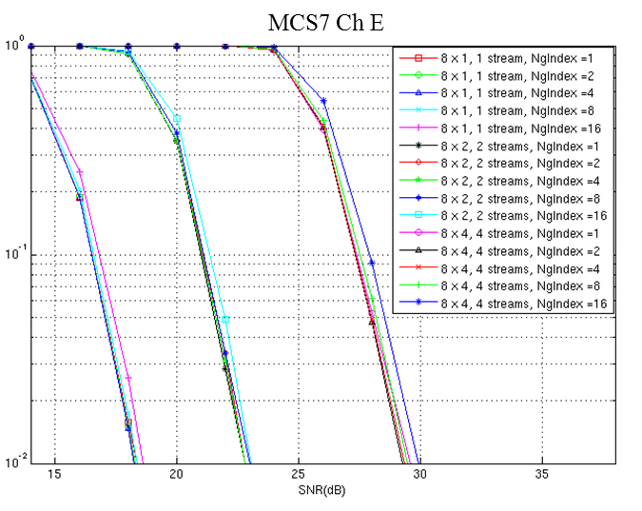
Results for Channel E
(MCS 7, Ch E, 50 msec delay)
Channel E:
  < 1dB difference between Ng = 16 and all others for all cases
  PER difference between Ng = 8 and Ng = 4 is negligible
  We may want to keep Ng = 8 for highly frequency selective channels
Conclusion: Scenarios exist in which CSI feedback of Ng = 16 results in no loss in performance for SU-MIMO and SU-MIMO-OFDMA (see results in appendix).

Slide 12
Conclusions
We investigate the maximum tone grouping parameter {Ng} for 802.11ax
  We show that setting the maximum tone grouping parameter {Ng} to 16 results in a large savings in feedback overhead.
    up to 70 % savings when comparing Ng = 16 to Ng = 4 for 8 x 4 transmission and 242 tone RUs.
  We show that that minimal PER performance differences are seen with Ng = 16 compared with Ng = 4 for channel B/D scenario in SU-MIMO-OFDMA
  We show that that minimal PER performance differences are seen with Ng = 8 compared with Ng = 4 for channel B/D scenario in SU-MIMO-OFDMA
We should allow Ng = 2, 4, 8, or 16

Slide 13
Straw Poll #1
Do you agree with the following?
802.11ax spec shall support Ng = 2, 4, 8 for sounding feedback.
NOTE—The tone grouping factor, Ng is defined with respect to data tones of the HE PPDU.
Y/N/A

Slide 14
Straw Poll #2
Do you agree with the following?
802.11ax spec shall support Ng = 16 for sounding feedback.
NOTE—The tone grouping factor, Ng is defined with respect to data tones of the HE PPDU.
Y/N/A

Slide 15
References
11-15-0132-09-00ax-spec-framework
11-15-1071-02-00ax-tone-grouping-factors-and-ndp-format-for-802-11ax
11-15-0330-05-00ax-ofdma-numerology-and-structure
Eldad Perahia, Robert Stacey; Next Generation Wireless LANs, 802.11n and 802.11ac,, Cambridge University Press, 2013, Online ISBN:9781139061407, ISBN:9781107016767

Slide 16
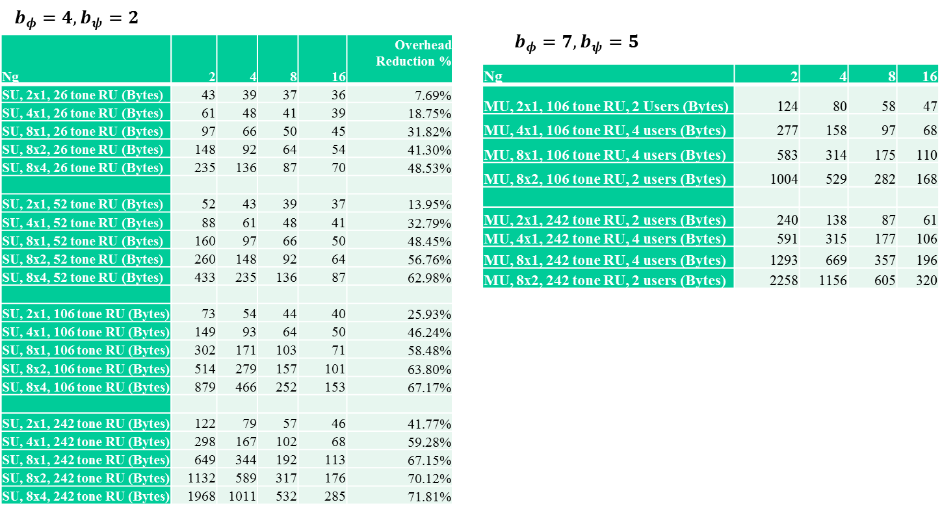
Additional Results

Slide 17
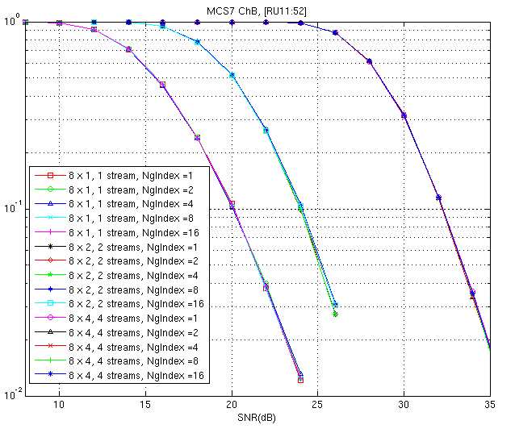
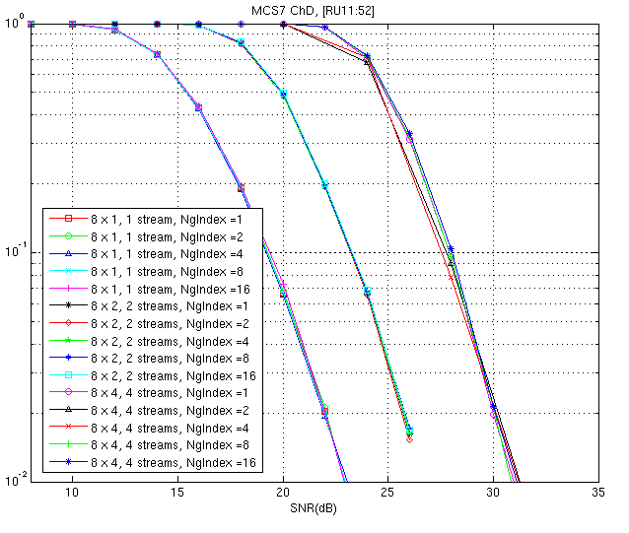
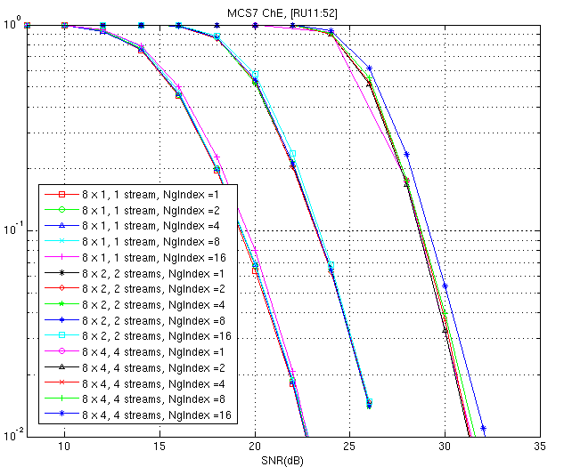
Channel B/D/E for 52 tone RUs
Same trend seen as in MIMO-OFDM i.e tone size = 242

Slide 18
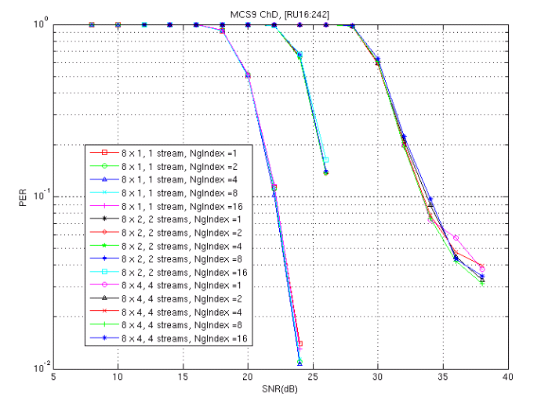
Results for Channel D (MCS9, 242 Tones)

Slide 19
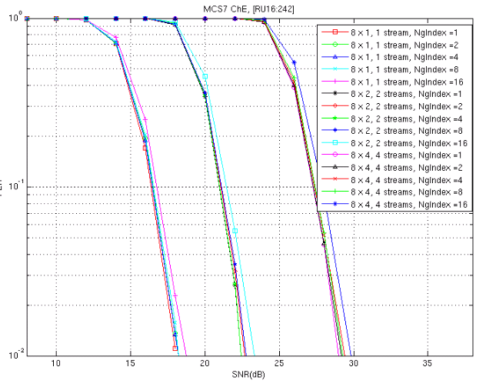
Results for Channel E (MCS 7, Ch E, 200 msec)
Delay of 200 msec does not change conclusion

