Slide 1
DSC calibration results with NS-3
Authors:

Slide 2
Outline
Context
Simulation Environment: NS-3
Simulation scenarios and assumptions
Path loss model calibration
Throughput calibration Results
Conclusions
References

Slide 3
1. Context
As highlighted in [1], many simulation results have been presented by TGax,
However, results are inconsistent due to diverse conditions.
In addition, there is a need to perform “apples-to-apples” comparison so that different simulation tools could be calibrated based on a reference model.
In this submission we,
Present the calibration results of our spatial reuse implementation in NS-3,
By utilizing the simple scenario presented in [1]
We compare our findings with the results presented in [2]
Add to our previous work by comparing DSC with a scenario that utilizes fixed CCA.
We indicate the importance of DSC and compare our finding with the results presented in [3].
Compare DSC with a scheme that utilizes fixed CCA threshold.

Slide 4
2. Simulation Environment: NS-3
NS-3
Allows the study of protocols and network performance of large-scale systems in a controlled and scalable environment.
Main characteristics,
Discrete event simulator
Packet level simulator (layer 2 and above)
Layered architecture
Simplified PHY layer abstraction
Free and open source
Frequent updates ( latest version ns 3.24- release date Sept. 15th, 2015)
Large number of protocol implementations and models available,
TCP, UDP
IPV4, IPV6, static routing
IEEE 802.11 and variants, WiMAX, LTE
IEEE 802 physical layer
Mobility models and routing protocols
Ability to design indoor, outdoor or hybrid networks
etc.

Slide 5
3. Simulation scenarios and assumptions (1/4)
Topology
Two BSS separated with a distance of 30m,
2 stations associated with each AP
AP and stations placed at 1.5m height.
STA1
STA2
3m
30m
3m
AP1
AP2
STA3
STA4

Slide 6
3. Simulation scenarios and assumptions (2/4)
Frequency band: 5GHz,
Traffic: UDP CBR uplink transmission in saturation conditions is considered,
Worst case in terms of contention.
Pathloss model: ThreeLogDistancePropogationLossModel [4],
A log distance path loss propagation model with three distance fields (i.e. near, middle and far) with different exponents.
Within each field the reception power is calculated using the log-distance propagation equation:
$L=Lo+$10×n_{o} log₁₀($\frac{d}{do})$
Detail of parameter values used for pathloss model are presented in table
Extra loss due to shadowing and fading are not considered
Due to the design constraints presented in [1].
The simulation time used was 30 seconds,
Start time was after 5 seconds
Notes:
Hybrid Building propogation loss model
For indoor communication, the model also considers also the type of building in outdoor <-> indoor communication according to some general criteria such as the wall penetration losses of the common materials; moreover it includes some general configuration for the internal walls in indoor communications.
Modifications in NS-3:
We modified the ns-3 simulation package, a) to allow station to measure the received energy level of each beacon frame received from the relevant AP, b) by improving hybrid building pathloss model to accommodate for floor penetration losses.

Slide 7
Physical layer parameters
3. Simulation scenarios and assumptions (3/4)
Parameter | Value
Band Width | All BSSs at 5GHz (Ch 36, 5180) [80MHz, no dynamic bandwidth]
Shadow fading | No shadowing
Data preamble | IEEE 802.11ac VHT
STA TX Power | 15-10 dBm
AP TX Power | 20-15 dBm
AP number of TX/RX antennas | 1/1
STA number of TX /RX antennas | 1/1
AP antenna gain | 0 dBi
STA antenna gain | -2 dBi
Guard interval | 400ns (short guard interval)
CCA threshold | -56/-66/-76 dBm @ 80MHz
CCA-ED | -56 dBm
Link Adaptation | Fixed MCS = 5 (234.0 Mbps)
Channel estimation | ideal
Pathloss Model parameters | d₀ = 1, d₁=10, d₂=30, e₀=2, e₁=3.5, e₂=3.5

Slide 8
MAC layer parameters
3. Simulation scenarios and assumptions (4/4)
Parameter | Value
Access protocol | [EDCA, AC_BE with default parameters] [CWmin = 15, CWmax = 1023, AIFSn=3 ]
Traffic type | UDP CBR with rate 200Mbps
Traffic direction | Uplink only
MPDU size | 1538 Bytes (1472 Data + 28 IP header + 8 bytes LLC + 30 MAC header)
Aggregation | 32 MPDUs with Block Ack.
Max number of retries | 10
Beacons | Disabled
RTS/CTS | Off
Throughput | Per non-AP station (received bits/overall simulation time), measured using flowmonitors [5]
Simulation parameters
Parameter | Value
Simulation time | 30 seconds

Slide 9
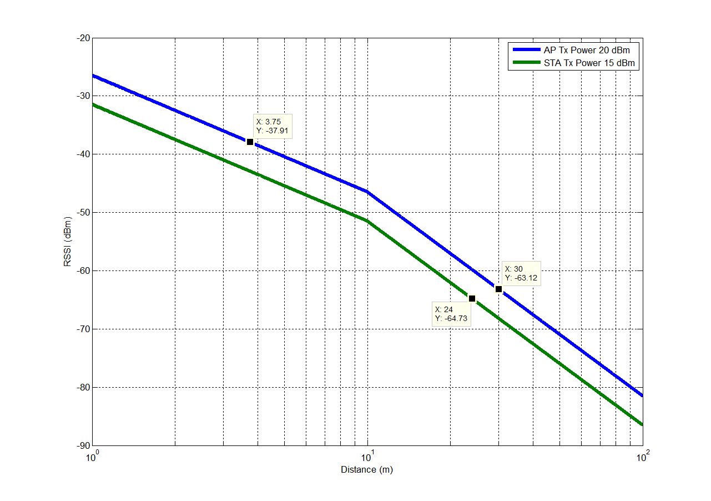
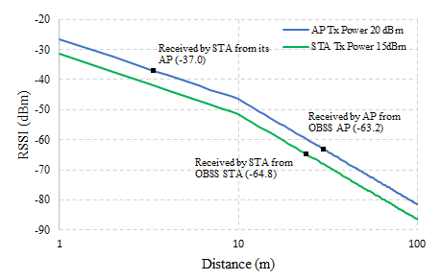
4. Path loss model calibration
MKT [2]
NS-3
Path loss model used in NS-3 simulator, where red dots indicate the received power calculated through simulations

Slide 10
5. Calibration Results (1/4)
TX PWR STA = 15, TX PWR AP = 20
We compare the results with [2] in which the authors used 5dB of shadowing.
CCAthr. (dBm) |  |  | MKT Throughput (Mbps) | NS-3 Throughput (Mbps)
-76 (~1,4%) | BSS1 | STA1 | 50.35 | 51.50
 |  | STA2 | 51.65 | 49.22
 | BSS2 | STA3 | 51.10 | 49.29
 |  | STA4 | 50.41 | 50.56
-66 (~47,8%) | BSS1 | STA1 | 99.57 | 50.76
 |  | STA2 | 99.46 | 52.05
 | BSS2 | STA3 | 99.54 | 52.77
 |  | STA4 | 99.59 | 52.41
-56 (~1,0%) | BSS1 | STA1 | 99.83 | 99.29
 |  | STA2 | 99.80 | 102.41
 | BSS2 | STA3 | 99.82 | 101.29
 |  | STA4 | 99.81 | 100.14

Slide 11
5. Calibration Results (2/4)
TX PWR STA = 15, TX PWR AP = 20
We compare the results with [2] in which the authors used 5dB of shadowing.
CCAthr. (dBm) |  |  | MKT Throughput (Mbps) | NS-3 Throughput (Mbps)
-76 (~1,4%) | BSS1 | STA1 | 50.35 | 51.50
 |  | STA2 | 51.65 | 49.22
 | BSS2 | STA3 | 51.10 | 49.29
 |  | STA4 | 50.41 | 50.56
increased 4dB -62 (~1,4%) | BSS1 | STA1 | 99.57 | 97.87
 |  | STA2 | 99.46 | 98.54
 | BSS2 | STA3 | 99.54 | 97.60
 |  | STA4 | 99.59 | 98.42
-56 (~1,0%) | BSS1 | STA1 | 99.83 | 99.29
 |  | STA2 | 99.80 | 102.41
 | BSS2 | STA3 | 99.82 | 101.29
 |  | STA4 | 99.81 | 100.14

Slide 12
5. Calibration Results (3/4)
Reduce TX PWR 4dB: STA = 11, TX PWR AP = 16.
We compare the results with [2] in which the authors used 5dB of shadowing.
CCAthr. (dBm) |  |  | MKT Throughput (Mbps) | NS-3 (reduced TX PWR) Throughput (Mbps)
-76 (~1.8%) | BSS1 | STA1 | 50.35 | 51.74
 |  | STA2 | 51.65 | 50.60
 | BSS2 | STA3 | 51.10 | 48.10
 |  | STA4 | 50.41 | 49.50
-66 (~1.7%) | BSS1 | STA1 | 99.57 | 97.05
 |  | STA2 | 99.46 | 98.88
 | BSS2 | STA3 | 99.54 | 97.16
 |  | STA4 | 99.59 | 98.32
-56 (~0.5%) | BSS1 | STA1 | 99.83 | 100.52
 |  | STA2 | 99.80 | 101.58
 | BSS2 | STA3 | 99.82 | 99.46
 |  | STA4 | 99.81 | 99.91

Slide 13
5. Calibration Results (4/4)
Reduce TX PWR 5dB: STA = 10, TX PWR AP = 15.
We compare the results with [2] in which the authors used 5dB of shadowing.
CCAthr. (dBm) |  |  | MKT Throughput (Mbps) | NS-3 (reduced TX PWR) Throughput (Mbps)
-76 (~2.3%) | BSS1 | STA1 | 50.35 | 49.02
 |  | STA2 | 51.65 | 50.37
 | BSS2 | STA3 | 51.10 | 49.48
 |  | STA4 | 50.41 | 49.99
-66 (~1.0%) | BSS1 | STA1 | 99.57 | 98.12
 |  | STA2 | 99.46 | 98.52
 | BSS2 | STA3 | 99.54 | 100.90
 |  | STA4 | 99.59 | 96.67
-56 (~0.8%) | BSS1 | STA1 | 99.83 | 100.68
 |  | STA2 | 99.80 | 100.55
 | BSS2 | STA3 | 99.82 | 100.73
 |  | STA4 | 99.81 | 100.39

Slide 14
6. Conclusions
In this presentation, we provide the spatial reuse calibration results of our NS-3 simulator based on 15/0652r1
A-MPDU implementation is unstable in really dense scenarios (due to OBSS interference) and needs work.
Results indicate consistency with the work presented in [2] (MediaTek).
Calibration needed at cell edges

Slide 15
7. References
[1]. Masahito Mori, IEEE 802.11-15-0652r1, Reference simulation model for Dynamic CCA/DSC calibration.
[2]. Chinghwa Yu, IEEE 802.11-15-0886r0, DSC calibration results.
[3]. Masahito Mori, IEEE 802.11-15-1101r0, DSC/DCCA calibration with TGax agreed scenario.
[4]. ThreeLogDistancePropagationLossModel Class : ns-3 design document. [Online]. Available: https://www.nsnam.org/doxygen/classns3_1_1_three_log_distance_propagation_loss_model.html

