Slide 1
Considerations for Spatial Reuse
Date: 2015-11-08
Authors:
Name | Affiliations | Address | Phone | email
Reza Hedayat Amin Jafarian Young Hoon Kwon Yongho Seok Vida Ferdowsi | Newracom | 9008 Research Drive, Irvine, CA 92618 |  | reza.hedayat at newracom.com amin.jafarian at newracom.com younghoon.kwon at newracom.com yongho.seok at newracom.com vida.ferdowsi at newracom.com
Reza Hedayat, Newracom

Slide 2
Outline
The spatial reuse debate has focused mostly on
(a) altering the CCA threshold,
(b) special treatment of OBSS frames, …
This contribution instead focuses on over-protection that current CCA rule has and proposes how to minimize it
Reza Hedayat, Newracom

Slide 3
What is optimum CCA level; -82dBm, -72dBm, etc?
One dominating perspective in majority of spatial reuse contributions is the topic of optimum CCA level
As it’s been identified by some contributions, optimum CCA depends on multiple factors: frequency reuse, topology of BSS/OBSSs deployment, TX power, etc
While there have been so many contributions dedicated on this question, there has not been a unique answer, mostly due to differences in deployment setup and system modeling
In this contribution, we do not focus on the optimum CCA level. However the method provided here works with any CCA threshold
Reza Hedayat, Newracom

Slide 4
Background on Color field and OBSS PD
Spatial reuse motions passed in September 2015 meeting:
  “The STA determines whether the detected frame is an inter-BSS or an intra-BSS frame by using BSS color or MAC address in the MAC header. If the detected frame is an inter-BSS frame, under TBD condition, uses TBD OBSS PD level that is greater than the minimum receive sensitivity level. NOTE–Maybe extra rules need to be added to ensure that all 11ax STAs can make the decision in a consistent manner.”
  “A STA should regard an Inter-BSS PPDU with a valid PHY header and that has a receive power/RSSI below the OBSS PD level used by the receiving STA and that meets additional TBD conditions, as not having been received at all (e.g., should not update its NAV), except that the medium condition shall indicate BUSY during the period of time that is taken by the receiving STA to validate that the PPDU is from an Inter-BSS, but not longer than the time indicated as the length of the PPDU payload. The OBSS PD level is greater than the minimum receive sensitivity level.”
  “An 11ax STA regards a valid OBSS PPDU as not having been received at all (e.g., should not update its NAV), except that the medium condition shall indicate BUSY during the period of time that is taken by the receiving STA to validate that the PPDU is from an Inter-BSS, but not longer than the time indicated as the length of the PPDU payload if the RXPWR of the received PPDU is below the OBSS_PD threshold and TBD conditions are met, noting that the OBSS_PD threshold is accompanied by a TXPWR value and a reduction in the TXPWR may be accompanied by an TBD increase in the OBSS_PD threshold value.”
Reza Hedayat, Newracom

Slide 5
CCA Threshold based in Presence of OBSS
Recently 11ax SFD adopted presence of a Color field in HE SIG-A where STAs can use it to distinguish BSS and OBSS frames, where the STA may apply a less sensitive CCA threshold (OBSS PD) to OBSS frames
Above procedure is most effective when coverage of OBSSs overlap minimally (such as apartment complex, simulation scenario 1), where in such cases boundary STAs back off often unnecessarily
If overlap of the two OBSS is significant, applying less sensitive CCA thresholds (OBSS PD) may cause additional interference
  STAs from one OBSS ignore frames from the other OBSS while they are in close vicinity, hence adding interference to and receiving more interference from the OBSS
That is why in the recent spatial reuse motions there is a consistent reference to a TBD condition under which applying OBSS PD should be allowed
Reza Hedayat, Newracom

Slide 6
Current CCA Rule
Considering relative location of the BSS1 (AP A, STA B; Blue color) and BSS2 (AP C, STA D; Red color) shown in this figure, we realize that the current CCA rule offers:
  Right protection for the cases where OBSS STAs are within vicinity of each other, e.g. the cross-coverage areas
    This is the area where both colors are present
  Overprotection for the cases where an OBSS receiver is far from the transmitter of the other STAs
    This is the area where one color is present
A’s coverage
B
BSS1
A
BSS2
C
D
C’s coverage
Reza Hedayat, Newracom

Slide 7
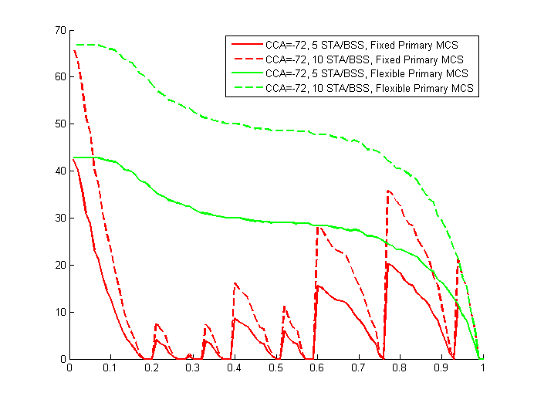
Current CCA Rule
Our previous contribution, 15/588r0, shows that there is a large percentage of reuse that current CCA rule prevents
Even with CCA=-72dBm, there is significant spatial reuse that due to current CCA rule (being based on the received RSSI from the transmitter) is left unachieved
Percentage of spatial reuse that CCA prevents
Normalized distance between primary STAs
Reza Hedayat, Newracom

Slide 8
How to consider potential interference to frames’ recipients?
Currently the measured RSSI of a frame offers an approximate level of interference that a STA would make to the transmitter of the frame if the STA were to send a frame
With a single frame exchange, there is no way to obtain any info about the interference made to the recipient of the frame
However, considering a frame and its response frame it is possible to measure the RSSI of both frames and infer the potential interference made to the recipient of a frame
Based on above concept, in the past IEEE meeting the following motion was passed:
  “The specification to consider a procedure that may revise the NAV depending on TBD conditions at the recipient of the ongoing OBSS frame.”
Reza Hedayat, Newracom

Slide 9
Revising NAV During TXOP
STA A and B exchange frames, e.g. RTS and CTS. STA C receives the frames and record the RSSI and TA/RA from the frame exchange
  During the short frame exchange, e.g. RTS/CTS, STA C may observe the legacy CCA rules and sets the NAV accordingly
Given RSSI AC/BC, STA C may reset the NAV
BSS1
B
Frame
Response Frame
A
RSSI AC
TXOP
RTS
Data
…
RSSI BC
STA A
C
STA B
CTS
ACK/BA
RSSI AC
BSS2
D
RSSI BC
STA C
Legacy CCA rules
Given RSSI AC and BC, Reset NAV?
Reza Hedayat, Newracom

Slide 10
Revising NAV During TXOP
The condition that allows for enhances spatial reuse is when
  RSSI_AC is larger than RSSI_BC plus a TBD delta
    i.e. STA B is farther from STA C compared to STA A to STA C
  RSSI _AC and RSSI_BC are lower than a threshold
    i.e. STAs A and B are far enough from STA C
If some combination of above condition is met STA C may reevaluate the medium status, and/or reset the NAV status
Various combinations of above conditions can be used to allow more spatial reuse
Reza Hedayat, Newracom

Slide 11
Protection of Response Frames
Spatial reuse topics always brings up the issue of protecting the response frames at the transmitter side
  For instance, referring to the previous example, a fair and robust spatial reuse need to make sure that the response frames (such as ACK, BA) at STA A side is affected minimally
One solution is to use transmit power control (TPC) to reduce the amount of interference to STA A (and to STA B)
Another solution is to use robust MCS for response frames (e.g. CTS, ACK, BA etc) which is a common practice
  E.g. MCS 0-2 offer larger than 10dB interference tolerance compared to MCS 6-9
B
Frame
Response Frame
A
C
D
Reza Hedayat, Newracom

Slide 12
Simulation Setup
Consider OBSS situation in previous slide, BSS1 (AP A, STA B) and BSS2 (AP C, STA D), where AP A and AP C are within coverage of each other
Considering STA B’s RSSI into account, we simulate in what percentage of AP A’s coverage, both APs can simultaneously send frames
Simulation parameters
  Path-loss exponent = 2 and after 5-meter breakpoint 3.5
  TX power = 15dBm
  Antenna loss = 2dBi
  -82dBm coverage = 40 meter
Reported measures
  Spectral efficiency without spatial reuse (A and B)
  Spectral efficiency with spatial reuse (A, B and B+D)
  Percentage of STA A’s coverage that would be allowed to do spatial reuse
Reza Hedayat, Newracom

Slide 13
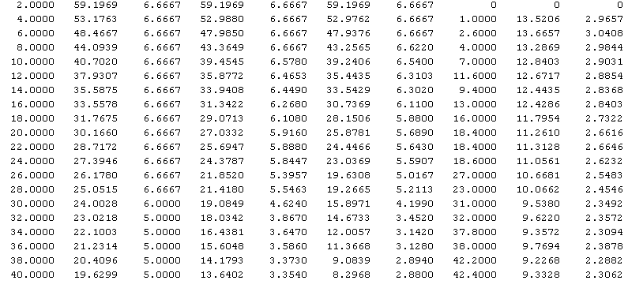
Simulation Results
STA A or STA B
STA A
STA B
STA D
distance
AB (meter)
SNR
wo SR
Spectral Eff.
wo SR
SNR
with SR
Spectral Eff.
with SR
SNR
with SR
Spectral Eff.
with SR
Increased
SR (%)
SNR
with SR
Spectral Eff.
with SR
Reza Hedayat, Newracom

Slide 14
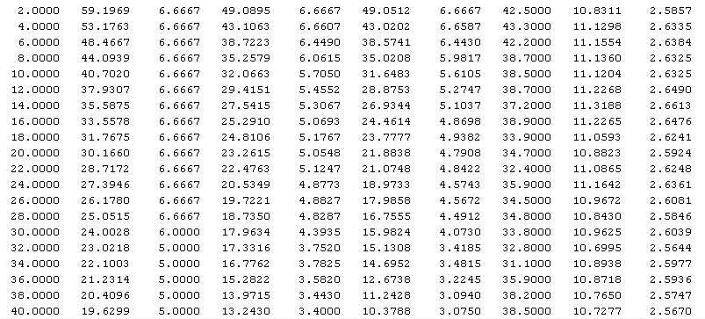
Simulation Results
STA A or STA B
STA A
STA B
STA D
distance
AB (meter)
SNR
wo SR
Spectral Eff.
wo SR
SNR
with SR
Spectral Eff.
with SR
SNR
with SR
Spectral Eff.
with SR
Increased
SR (%)
SNR
with SR
Spectral Eff.
with SR
Reza Hedayat, Newracom

Slide 15
Conclusion
The optimum CCA level has been debated within TGax extensively and it seems it’d depend on the topology of the BSS and presence of OBSS
A different treatment of OBSS frames vs BSS frames, e.g. based on Color field, might be a good solution but it’d also depend on topology and over of BSS and OBSS
Current CCA rule offers needed protection when a set of STAs are within reach of each of each other. But it offers overprotection when some of the recipient STAs are farther from the rest
This contribution proposes to evaluate the status of the medium based on RSSI from a frame and its response frame and revise the status of the medium or NAV
Reza Hedayat, Newracom

Slide 16
Strawpoll
Do you agree that the following to be added to 11ax SFD:
The specification to consider a procedure based on received RSSI of a pair of RTS and CTS frames to avoid updating the NAV after receiving the CTS frame if the measured RSSI of the RTS/CTS frames meet a TBD condition.
Reza Hedayat, Newracom

Slide 17
Appendix
Reza Hedayat, Newracom

Slide 18
Revising NAV During TXOP
Revising the medium status or NAV duration could happen in the middle of a TXOP, when a STA observes the RSSI of a frame and its response frame and checks for the right condition
TXOP
Data
…
Data
STA A
STA B
ACK/BA
ACK/BA
RSSI AC
RSSI BC
STA C
STA C starts sensing the medium
Legacy CCA rules applies
Revise NAV based on RSSI AC and RSSI BC?
Reza Hedayat, Newracom

