Slide 1
Link Budget Analysis
Date: 2015-11-9
Authors:

Slide 2
Abstract
In this presentation, the link budget is analysed for indoor and outdoor environments using IEEE Channel Model B and D and UMi NLOS/LOS channel models in 2.4 GHz.

Slide 3
20 MHz, Indoor Channel Model D [1]
Channel BW: 20MHz, NF and other losses: 7 dB, Tx power: 0, 10, 20dBm
MCS0: 38, 70, 135m, MCS3: 21, 41, 81m
Packet length: 100 Bytes
17dB, MCS3 10% PER
9dB, MCS0 10% PER
MCS3:
21m
41m
81m
MCS0:
38m
70m
135m

Slide 4
2 MHz, Indoor Channel Model D [1]
Channel BW: 2MHz, NF and other losses: 7 dB, Tx power: 0, 10, 20dBm
MCS0: 70, 130, 270m, MCS3: 45, 80, 165m
Packet length: 100 Bytes
9m
(3 floors)
17dB
10% PER
45m
80m
165m
70m
130m
270m

Slide 5
2MHz, Indoor Channel Model B [1]
Channel BW: 2MHz, Tx power: 0, 10, 20dBm
MCS0: 50, 95, 180m, MCS3: 30, 55, 100m
Packet length: 100 Bytes
6m
(2 floors)
21dB
10% PER
12.5dB
10% PER
50m
95m
180m
30m
55m
100m

Slide 6
2MHz, Outdoor UMi NLOS [1]
Channel BW: 2MHz, Tx power: 0, 10, 20dBm
MCS0: 60, 110, 210m, MCS3: 30, 60, 110m
Packet length: 100 Bytes
16.75dB
10% PER
6.75dB
10% PER
60m
110m
210m
30m
60m
110m

Slide 7
2MHz, Outdoor UMi LOS [1]
Channel BW: 2MHz, Tx power: 0, 10, 20dBm
MCS0: 275, 500, 875m, MCS3: 180, 300, 550m
Packet length: 100 Bytes
11.75dB
10% PER
2.75dB
10% PER
275m
500m
875m
180m
300m
550m

Slide 8
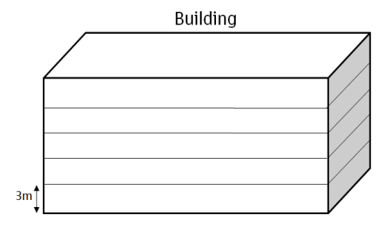
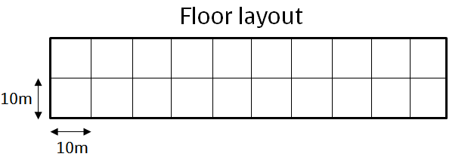
Residential Scenario [2]
Additional attenuation between floors and walls
Tx range for MCS0, Channel Model D:
Number of floors | Distance (m) | Attenuation (dB)
2 | 6 | 18.3
3 | 9 | 33.5
4 | 12 | 43.6
5 | 15 | 51
5th floor
4th floor
Tx range
3rd floor
2nd floor
1st floor
2MHz:
0dBm
20dBm
Number of walls | Distance (m) | Attenuation (dB)
1 | 20 | 5
2 | 30 | 10
… | … | …
9 | 100 | 45
0dBm
20dBm
BW | 20 MHz | 2 MHz
Tx power: 0dBm | 2 floors/2 rooms | 3 floors/3 rooms
Tx power: 20 dBm | 3 floors/4 rooms | 4 floors/5 rooms

Slide 9
Observation
For an indoor NLOS environment, current 20 MHz operation in the 2.4 GHz band can attain 2-3 floors and 2-4 rooms coverage using a Tx power in the range of 0-20dBm for Channel Model D
2MHz operation in the 2.4 GHz band increases the coverage to 3-4 floors and 3-5 rooms
For an outdoor NLOS environment, UMi NLOS results show similar coverage as indoor IEEE Channel Model D (2 MHz, MCS0, Tx power 0-20dBm)
Channel Model D: 70-270 m (without floor/wall attenuation)
UMi NLOS: 60-210 m
For an outdoor LOS environment, UMi LOS results show coverage of 275-875m using MCS0 and 180-550m using MCS3 (2 MHz, Tx power 0-20dBm)

Slide 10
References
[1] IEEE 802.11-14/882r4, IEEE 802.11ax channel model document
[2] IEEE 802.11-14/621r3, TGax simulation scenarios

Slide 11
Backup

Slide 12
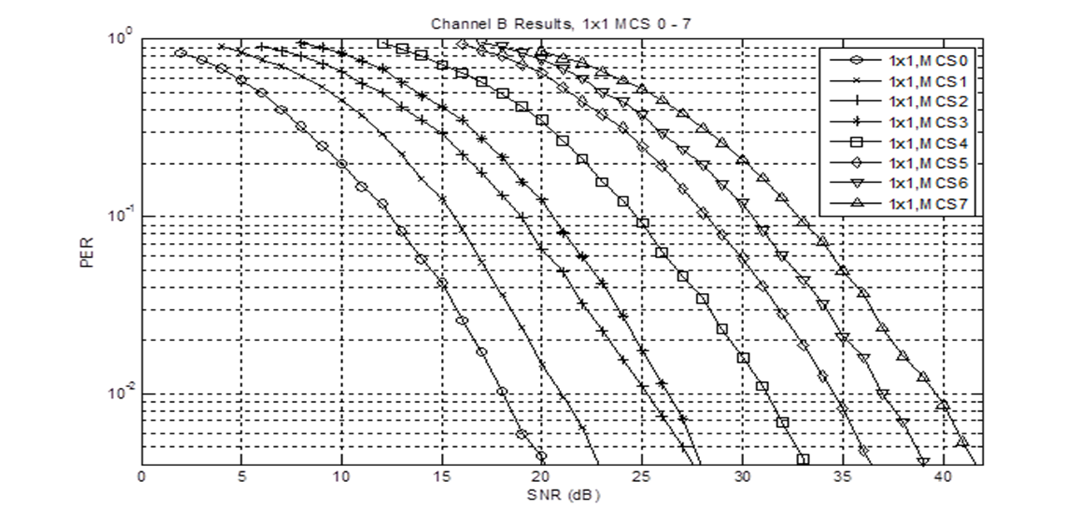
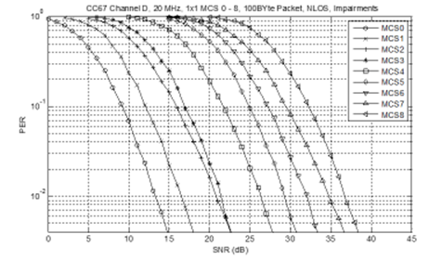
PER - Channel Model B,D
1x1 1-stream, MCS 0-8, 100 byte packet, NLOS, all impairments, 20 MHz
12.5dB
21dB
9dB
17dB
IEEE Channel Model B
IEEE Channel Model D

Slide 13
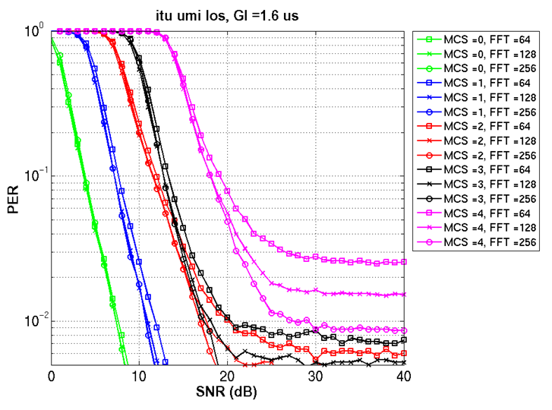
PER - ITU UMi LOS, NLOS
IEEE 802.11-15/0099, “Payload Symbol Size for 11ax”
For this presentation threshold is set to 1.25dB lower to use for100B PER
4dB
13dB
8dB
18dB
LOS
NLOS

