Slide 1
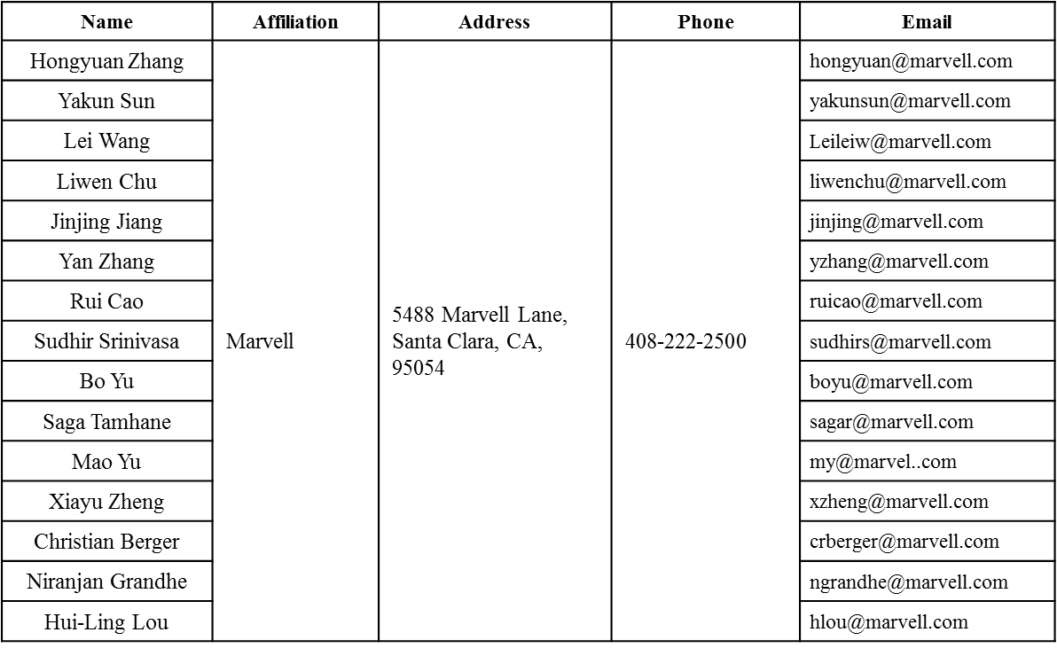
STBC and Padding Discussions
Date: 2015-11-08
Authors:

Slide 2
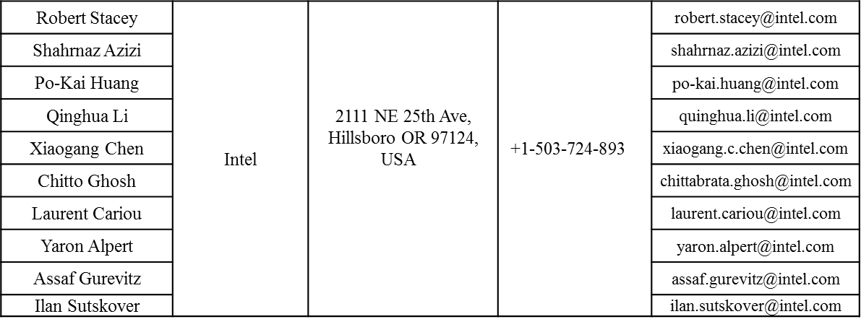
Authors (continued)

Slide 3
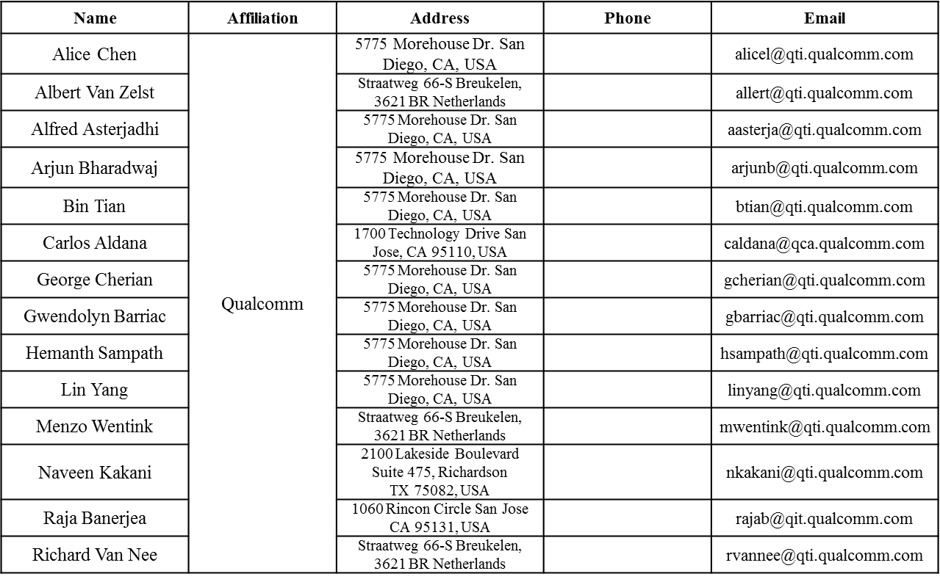
Authors (continued)

Slide 4
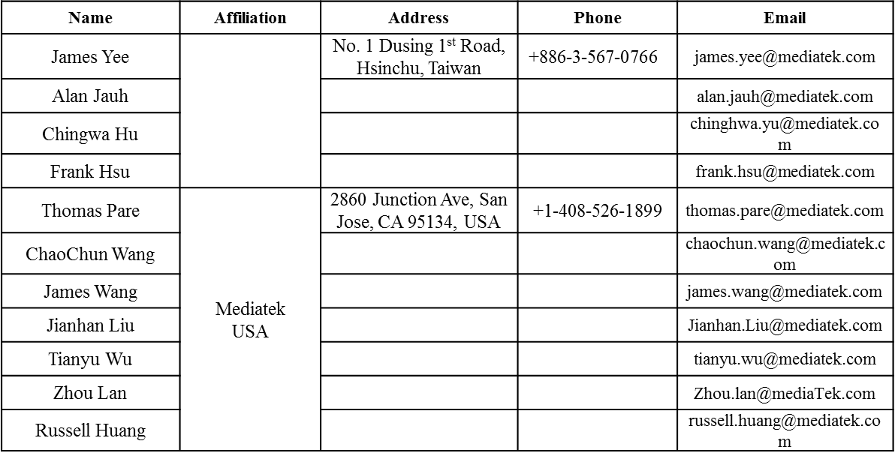
Authors (continued)
Mediatek

Slide 5
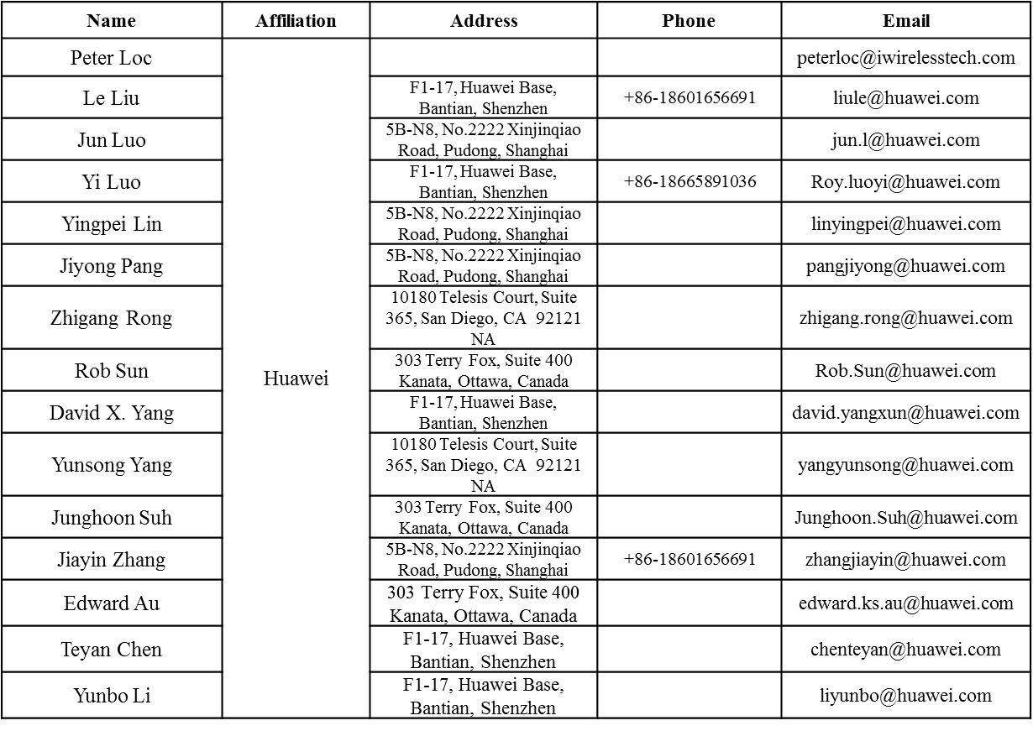
Authors (continued)

Slide 6
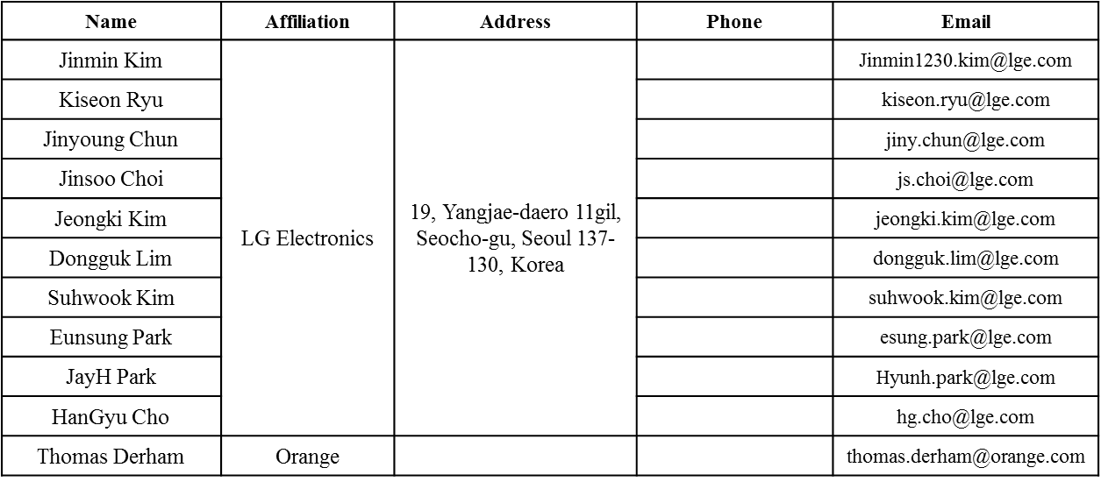
Authors (continued)

Slide 7
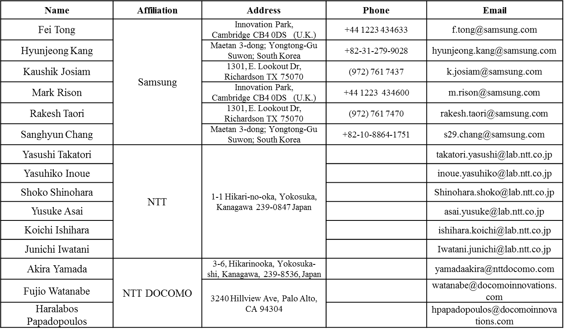
Authors (continued)

Slide 8
I. Discussions On STBC
11n defines STBC with both even and odd number of space-time streams (STS), while 11ac simplified STBC design to only allow even number of STS.
However, when looking back, all the 11n/11ac products in the past 10 yrs practically only implemented single spatial-stream (SS) STBC by all the vendors.
STBC is most effective for 1SS cases (i.e. Alamouti code) within a limited range of SNR (mid to high).
With multiple Tx antennas, beamforming gained more tractions recently, which performances much better than STBC.
Propose that 11ax only defines single stream STBC as an optional feature.

Slide 9
II. Discussions on STBC in OFDMA
As in [1], 11ax applies four symbol-segment padding scheme with packet extension, where in OFDMA case whether STBC setting across different RUs is common or per-RU is still TBD.
Here we list solutions for both choices, and analyze their pros of cons.
Propose to use common STBC setting across all RUs for simplicity

Slide 10
Option-1 Common STBC Setting Across All RUs
All users share the same STBC or non-STBC transmission mode.
Simple math on the padding scheme [1], for both spec-writing and implementation/verification.
A common STBC bit in SIGA (or SIGB Common field) is sufficient, as LDPC extra symbol indication [1]—save overhead.
Following the 11ac rational, if in DL-MU there is at least one RU contains DL-MUMIMO, then all the users shall not conduct STBC.

Slide 11
Option-2: Per RU STBC Setting
Each RU may set STBC or non-STBC separately.
Within each RU, if MUMIMO is applied, then all the users in this RU set STBC or non-STBC together.
For and RU with DL-MUMIMO, always set to non-STBC (like 11ac).
Requires per-RU STBC bit, in SIGB.
Need some non-trivial math revision, especially for DL-OFDMA—see next 2 pages.

Slide 12
Example: Math Changes for DL-MU per-RU STBC (1)
Need to choose the longest user with largest Nsym.init & ainit, regardless of STBC or non-STBC:
i.e. if two users have the same Nsym.init,u, always pick the user with the largest ainit.u
Nsym.init needs to be even number, if there is at least one STBC user.
If LDPC extra symbol happens, update Nsym according to the STBC user (if any), i.e.
For non-STBC & LDPC user, may need to conduct post-FEC padding for more than one long 4x OFDM symbol:

Slide 13
Example: Math Changes for DL-MU per-RU STBC (1)
An Example: DL-MU with Mixture of STBC and Non-STBC, LDPC and BCC,
and LDPC extra symbol:
Add 2 symbols due to mSTBC = 2 &
LDPC Extra Symbol & ainit=4
ainit = 4, LDPC-Extra-Symbol happens
U1 (STBC & LDPC)
…
Nsym.init-th Symbol
a = 1
(post FEC)
a = 1
(post FEC)
U2 (non-STBC & LDPC)
…
Nsym.init-th Symbol
a = 1
(post FEC)
(post FEC)
U3 (STBC & BCC)
…
Nsym.init-th Symbol
a = 1
(post FEC)
a = 1
(post FEC)
U4 (non-STBC & BCC)
…
Nsym.init-th Symbol
Pre-FEC
a = 1
(post FEC)
Notes: 1. There are other ways to handle per-RU STBC, but either similar or more
complex.
2. The performance gain from per-RU STBC is limited, as most 11ax devices
will support TxBF anyway.

Slide 14
Conclusions
We analyze the realistic STBC implementations and propose to have STBC only defined for 1SS in 11ax.
We reviewed the pros and cons of common or per-RU STBC settings and propose to have a common STBC setting across all RUs.

Slide 15
Straw Poll #1
Do you agree to add the following text in 11ax SFD?
STBC is an optional feature in 11ax and it is ONLY defined for single spatial stream (Nss=1 and Nsts=2)
In a MU PPDU all RUs are either STBC or not STBC.

Slide 16
References
[1] 11-15-0810-01-00ax HE PHY Padding and Packet Extension

