Slide 1
An issue of wider bandwidth operation at real denser environment
Date: 2015-11-DD
Authors:

Slide 2
Abstract
This contribution shows real experiences on our public WLAN service at denser environment.
Importance of bandwidth adjustment at such environment is explained from a standpoint of public WLAN operator.
  < Contents >
  Review of channel selection methods
  Examples of channel selection at denser environment
  HT40/HT20 performance at denser environment
  Evaluations in the laboratory
  Considerations and proposal

Slide 3
Channel selection methods for a VHT BSS [1]
(Section 10.40.2, Draft P802.11 REVmc_D4.3)
Before a STA starts a VHT BSS, the STA shall perform a minimum of dot11VHTOBSSScanCount OBSS scan operations to search for existing BSSs.
If an AP or a mesh STA starts a VHT BSS that occupies some or all channels of any existing BSSs, the AP or mesh STA may select a primary channel of the new VHT BSS that is identical to the primary channel of any one of the existing BSSs.
If an AP or a mesh STA selects a primary channel for a new VHT BSS …(abbr.)… , then the selected primary channel meets the following conditions:
  It shall not be identical to the secondary 20 MHz channel of any existing BSSs …(abbr.)
  It should not overlap with the secondary 40 MHz channel of any existing BSSs …(abbr.)
A STA that is an AP or mesh STA should not start a VHT BSS with a 20 MHz operating channel width on a channel that is the secondary 20 MHz channel of any existing BSSs …(abbr.)…, or is overlapped with the secondary 40 MHz channel of any existing BSSs …(abbr.)
NOTE—An AP or a mesh STA operating a VHT BSS with a 40 MHz, 80 MHz, 160 MHz, or 80+80 MHz operating channel width, on detecting an OBSS whose primary channel is the AP’s or the mesh STA’s secondary 20 MHz channel, might switch to 20 MHz BSS operation and/or move to a different channel.

Slide 4
Channel selection methods for a HT BSS [1]
(Section 10.16.3.2, Draft P802.11 REVmc_D4.3)
Before an AP or DO starts a 20/40 MHz BSS, it shall perform a minimum of dot11BSSWidthChannelTransitionDelayFactor OBSS scans to search for existing BSSs.
If the AP or DO starts a 20/40 MHz BSS in the 5 GHz band and the BSS occupies the same two channels as any existing 20/40 MHz BSSs, then the AP or DO shall select a primary channel of the new BSS that is identical to the primary channel of the existing 20/40 MHz BSSs and a secondary channel of the new 20/40 MHz BSS that is identical to the secondary channel of the existing 20/40 MHz BSSs, unless the AP discovers that on these two channels are existing 20/40 MHz BSSs with different primary and secondary channels.
An HT AP or a DO that is also an HT STA should not start a 20 MHz BSS in the 5 GHz band on a channel that is the secondary channel of a 20/40 MHz BSS.
There must be a history which someone pointed out in the past that overlapped channel selection on the secondary channel of an existing BSS would give harmful impact to that BSS.

Slide 5


Typical denser environment in Tokyo
(Side of Shibuya station)
Bird’s eye view
Crowd in the evening (17:00, Oct. 20, Tue )
Point-2
Point-1
Denser square
Train
station
Point-2
Point-1
Real channel selections were monitored at 2 locations.

Slide 6
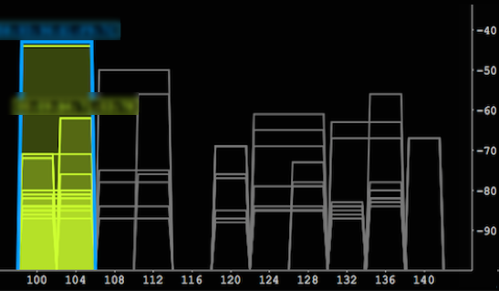
CH selections
(at Point-1)
RSSI
(dBm)
HT40
HT40
HT40
HT40
(CH No.)
5500
5520
5540
5560
5580
5600
5620
5640
5660
5680
5700
(MHz)

Slide 7
CH selections
(at Point-1)
HT20 BSSs were found on the secondary 20M of HT40 OBSSs.
RSSI
(dBm)
HT40
HT40
HT40
HT40
(CH No.)
5500
5520
5540
5560
5580
5600
5620
5640
5660
5680
5700
(MHz)

Slide 8
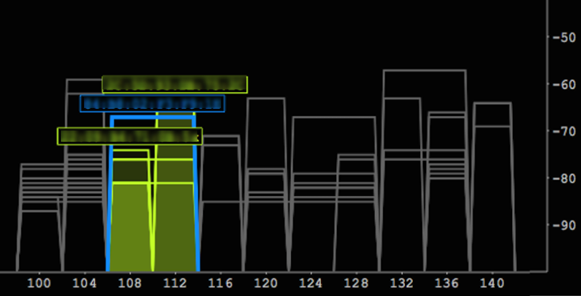
CH selections
(at Point-2)
RSSI
(dBm)
HT40
HT40
HT40
HT40
(CH No.)
5500
5520
5540
5560
5580
5600
5620
5640
5660
5680
5700
(MHz)

Slide 9
CH selections
(at Point-2)
HT20 BSSs were found on the secondary 20M of HT40 OBSSs.
RSSI
(dBm)
HT40
HT40
HT40
HT40
(CH No.)
5500
5520
5540
5560
5580
5600
5620
5640
5660
5680
5700
(MHz)

Slide 10
HT40/HT20 comparison
(TCP throughput CDF)
17:00-19:00, WED in different week at Shibuya
improved
CDF
HT40 (1st week)
HT20 (2nd week)
40%
Measured on the same BSS,
but with different operating BW.
Some measurements
were impossible.
(HT40)
1%
Throughput [Mbps]

Slide 11
Evaluation measurements in the laboratory
TCP throughputs were measured.
Shield box
3m
RSSI : -70〜-80dBm
<Measured 11ac>
desired signal
PC
AP1
PC
Shield box
interference
50cm
PC
AP2
Smart
phone
<Interfering 11ac>

Slide 12
Results
TCP throughput [Mbps]
(Measured system)
Channel selections for measurement
Measured sys.
80MHz
Pri-20M
Interfering
sys.
20M
Case 1:
Case 2:
Case 3:
40kbps
0.4Mbps
Case 4:
2.8Mbps
40M
Case 5:
Case 6:
Pri-20M
80M
No interference
Case 7:
(VHT20)
(VHT40)
(VHT80)
Pri-20M
with interference

Slide 13
Observed frames
Observed QoS Data frames (AP→STA) were counted at each measurement.
Frames were categorized by transmitted band width. (BW in VHT SIG-A)
Inter-ference | Throughput (Mbps) | Total QoS Data frames
 |  | Qtty. | Retries
none | 243 | 342149 | 6%
case1 | 61.3 | 160508 | 23%
case2 | 0.04 | 2464 | 87%
case3 | 2.8 | 17529 | 68%
case4 | 37.6 | 149894 | 51%
case5 | 57.0 | 153500 | 23%
case6 | 0.4 | 6066 | 66%
case7 | 126 | 224568 | 17%
TX BW = 80M |  | TX BW = 1st 40M |  | TX BW = 1st 20M
Qtty. | Retries | Qtty. | Retries | Qtty. | Retries
340331 | 6% | 1818 | 100% | 0 | -
155273 | 23% | 5234 | 46% | 1 | 100%
0 | - | 71 | 76% | 2393 | 87%
268 | 92% | 6753 | 65% | 10508 | 69％
6448 | 64% | 143427 | 51% | 19 | 84%
75799 | 25% | 77701 | 21% | 0 | -
65 | 46% | 1478 | 55% | 4523 | 70%
211266 | 16% | 13302 | 30% | 0 | -
Extremely less
Trying to transmit with narrower band widths→Not well

Slide 14
Bandwidth adjustments
#1 (case 2)
#2 (case 6)
80MHz
80MHz
Before :
(case 2)
Pri-20M
Before :
(case 6)
Pri-20M
20MHz
40MHz
After :
After :
Pri-20M
Throughput was improved.
0.04Mbps → 78.8Mbps
Throughput was improved.
0.4Mbps → 86.7Mbps
Bandwidth adjustment is very effective.

Slide 15
Considerations
The current standards have defined channel selection methods to avoid negative interference impacts among neighboring BSSs.
  →However, implemented adjustment to narrower operating bandwidth doesn’t work well when OBSS is detected on the secondary channel.
LAA-LTE will be deployed in the near future. It will start and operate on channels which WLAN’s beacons were not detected or less detected.
  It may operate on the secondary channels of WLAN BSSs in many cases at denser environment.
  →Wider bandwidth operation of LAA will be discussed at 3GPP in the next phase. In that case, channel overlapped operation between WLANs and LAAs would be more probable.

Slide 16
Mechanism to adjust operating BW
(Current standards)
Some methods for BW adjustment have been already defined.
  Notify Channel Width frame
  Operating Mode Notification frame
  Dynamic Bandwidth Negotiation (by RTS/CTS)
  →However, they doesn’t seem to be much implemented. Is it for simple implementation?
Effectiveness at denser environment is one of HEW objectives. We need to consider to improve WLAN performance at such environment.
  →It is necessary for us to consider dynamic BW adjustment.

Slide 17
Proposals
An AP shall have a mechanism to explicitly adjust its operating bandwidth during the operation based on interference situation at denser environment.
Existing specifications in the current 802.11 standards may be used for control of associated STAs for this operating bandwidth adjustment.
Determination for operating bandwidth adjustment will be on an implementation.

Slide 18
Summary
Channel selection methods in the current standards were reviewed.
Examples of channel selections at the real denser environment were shown.
  →Some BSSs overlapped on the secondary channels of others.
  →Performance improvement was observed by narrower bandwidth operation.
Interference impacts on the secondary channel were evaluated.
  →Severe performance degradations were experienced.
TGax may also need to consider impacts from other radio technologies like LAA.
This submission proposed a mechanism to adjust operating bandwidth to mitigate negative interference impacts.

Slide 19
References
[1] Draft P802.11 REVmc_D4.3
[2] “A First Look at 802.11ac in Action: Energy Efficiency and Interference Characterization”, 2014 IFIP
[3] IEEE802.11-15/0132r8, “Specification Framework for TGax”

Slide 20
Straw Poll
Do you agree to add the following text into 11ax SFD?
An AP shall have a mechanism to explicitly adjust its operating bandwidth during the operation based on interference situation at denser environment.
Note: Existing specifications in the current 802.11 standards may be used for control of associated STAs. Determination for operating bandwidth adjustment will be on an implementation.
Y/N/A =

