Slide 1
Dynamic Environment Use Cases
Date: 2015-11-9
Authors:

Slide 2
General consideration concerning dynamic environments
What are potential dynamic environments?
All transportation with speeds from 3km/h onwards from pedestrian to high-speed trains
IEE802.11 is the basis for V2V and V2x cooperative communication (802.11p)
US: IEEE WAVE
EUROPE: ETSI ITS-G5
Positioning relies mainly on GNSS based methods using GPS
Limited precision (2m – 7m) depending on environment
Enhanced positioning in 802.11 could open up new applications for V2X communications systems
Inclusion of pedestrians, bicycles and motorbikes
High precision lane assistance in dense traffic environments
In-out detection for tolling and parking applications
Enhanced safety application and autonomous driving applications

Slide 3
General requirements
Support of 802.11p modes including 10MHz channel bandwidth
Consideration of highly mobile environment
Update rates of up to 30Hz (C-ACC and Platooning)
Channel models in dynamic environment (?)
Relative positioning using the ad-hoc communication mode of 802.11p
Inclusion infrastructure stations with absolute positioning

Slide 4
Use case 1: Pedestrian detection and warning
User:
Persons participating as pedestrian in urban and suburban road traffic at pedestrian crossing and walkways
Drive of vehicles equipped with cooperative ITS system based on IEEE802 (WAVE, ITS-G5)
Environment:
Dynamic urban and suburban outdoor environments with high road traffic and pedestrian density
Use case:
Pedestrian/Vulnurable road user portable WAVE or ITS-G5 device based on 802.11 technology sends out periodic messages including positon and type information every 0,1sec to 5 sec
Vehicular stations send out messages with period of up to 10Hz
Pedestrian station can be warned from approaching cars
Vehicular user can recognize pedestrian/vulnurable road user in system overview

Slide 5
Key Performance and Attributes
Linear precision and accuracy/reliability and along street
For persons/pedestrians: <0,25m@95% per measurement
Horizontal accuracy with respect to local reference system(e.g. pedestrian crossing):
For pedestrians: <0,25 m@95%,
Vertical accuracy for multi level crossings and roads for motor cycles and vehicles:
For motorcycle/pedestrians: <2 m@95%,
Latency: < 100ms
Refresh Rate: > 1-10 location/sec/user
Number of simultaneous users: < 250

Slide 6
Use case 2: Free-flow tolling operation
User:
Drive of vehicles equipped with cooperative ITS system based on IEEE802 (WAVE, ITS-G5)
Road operator managing roads or parts of roads
Environment:
Highly dynamic urban, suburban and rural outdoor environments with
high road traffic
Use case:
Infrastructure ITS-G5 or WAVE station monitoring a very specific area/section of road
Road toll, City toll, tunnel tolling
Vehicular stations send out messages with period of up to 10Hz
Infrastructure recognizes the crossing of a vehicular station with speeds up to 200km/h (125Miles/h)

Slide 7
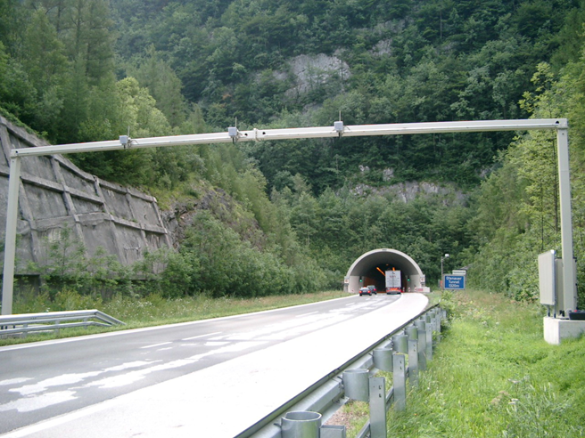
Typical free flow scenario

Slide 8
Key Performance and Attributes
Linear accuracy along street
<1 m@95% per measurement
Differentiation of road users including motobicycles
Horizontal accuracy with respect to local reference system (single lane detection):
Vehicular: <1,00 m@99%,
Differentiation of cars in different lanes
Vertical accuracy: not required, street level only
Latency: < 100ms
Refresh Rate: > 1- 10 locations/sec/user
Number of simultaneous users: < 250

Slide 9
Summary
Two use cases for enhanced positioning in dynamic environments have been presented
The specific requirements of these environments are proposed to be added to the 11az requirement set
Dynamic channel models
High update rate of position information
High number of simultaneous users
High reliability requirements
These use cases are covered by using 11p based system in vehicular environments
Open point: Is 11p covered by the actual 11az PAR?

Slide 10
Straw Poll
Do you agree to add the following use cases to the 802.11az use case working draft?
Use case “Vehicular environment: Pedestrian detection and warning”
Y: N: A:

Slide 11
Straw Poll
Do you agree to add the following use cases to the 802.11az use case working draft?
Use case “Free-flow tolling opertion”
Y: N: A:

Slide 12
Motion
To instruct the use case document editor to add use cases depicted by slides 4 to 5 of submission 11-15-1281r1 to the use case working draft document.
Move:
2nd:
Y: N: A:

Slide 13
Motion
To instruct the use case document editor to add use cases depicted by slides 6 to 8 of submission 11-15-1281r1 to the use case working draft document.
Move:
2nd:
Y: N: A:

