Slide 1
Dynamic Environment Use Cases
Date: 2015-10-28
Authors:

Slide 2
General consideration concerning dynamic environments
What are potential dynamic environments?
  All transportation with speeds from 5km/h onwards
  from pedestrian to high-speed trains
  IEE802.11 is the basis for V2V and V2x cooperative communication (802.11p)
    US: IEEE WAVE
    EUROPE: ETSI ITS-G5
Positioning relies mainly on GNSS based methods using GPS
  Limited precision (2m – 7m) depending on environment
Enhanced positioning in 802.11 could open up new applications for V2X communications systems
  Inclusion of pedestrians, bicycles and motorbikes
  High precision lane assistance in dense traffic environments
  In-out detection for tolling and parking applications
  Enhanced safety application and autonomous driving applications

Slide 3
General requirements
Support of 802.11p modes including 10MHz channel bandwidth
Consideration of highly mobile environment
  Update rates of up to 20Hz
  Channel models in dynamic environment (?)
Relative positioning using the ad-hoc communication mode of 802.11p
Inclusion infrastructure stations with absolute positioning

Slide 4
Use case 1: Pedestrian detection and warning
User:
  Persons participating as pedestrian in urban and suburban road traffic at pedestrian crossing and walkways
  Drive of vehicles equipped with cooperative ITS system based on IEEE802 (WAVE, ITS-G5)
Environment:
  Dynamic urban and suburban outdoor environments with
  high road traffic and pedestrian density
Use case:
  Pedestrian portable WAVE or ITS-G5 device based on 802.11 technology sends out periodic messages including positon and type information every 1sec to 5 sec
  Vehicular stations send out messages with period of up to 10Hz
  Pedestrian station can be warned from approaching cars
  Vehicular user can recognize pedestrian in system overview

Slide 5
Key Performance and Attributes
Linear accuracy along street
  For persons/pedestrians: <0,25m@95% per measurement
Horizontal accuracy with respect to local reference system(e.g. pedestrian crossing):
  For pedestrians: <0,25 m@95%,
Vertical accuracy: not required, street level only
Latency: < 200ms
Refresh Rate: > 1-10 location/sec/user
Number of simultaneous users: < 250

Slide 6
Use case 2: Free-flow tolling operation
User:
  Drive of vehicles equipped with cooperative ITS system based on IEEE802 (WAVE, ITS-G5)
  Road operator managing roads or parts of roads
Environment:
  Highly dynamic urban, suburban and rural outdoor environments with
  high road traffic
Use case:
  Infrastructure ITS-G5 or WAVE station monitoring a very specific area/section of road
  Road toll, City toll, tunnel tolling
  Vehicular stations send out messages with period of up to 10Hz
  Infrastructure recognizes the crossing of a vehicular station with speeds up to 150km/h (93Miles/h) or >200km/h (>125Miles/h)

Slide 7
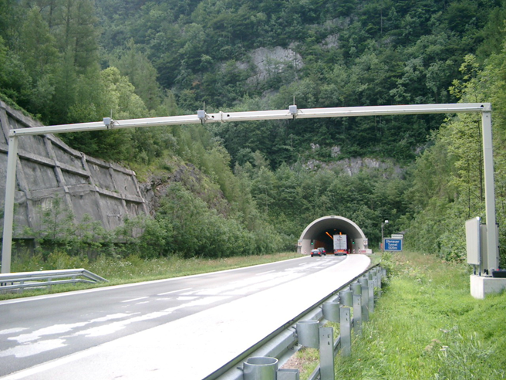
Typical free flow scenario

Slide 8
Key Performance and Attributes
Linear accuracy along street
  : <5 m@95% per measurement
Horizontal accuracy with respect to local reference system(e.g. pedestrian crossing):
  Vehicular: <5,00 m@95%,
Vertical accuracy: not required, street level only
Latency: < 100ms
Refresh Rate: > 1- 10 locations/sec/user
Number of simultaneous users: < 250

Slide 9
Straw Poll
Do you agree to add the following use cases to the 802.11az use case working draft?
  Use case “Vehicular environment: Pedestrian detection and warning”
  Y: N: A:

Slide 10
Straw Poll
Do you agree to add the following use cases to the 802.11az use case working draft?
  Use case “Free-flow tolling opertion”
  Y: N: A:

Slide 11
Motion
To instruct the use case document editor to add use cases depicted by slides 4 to 5 of submission 11-15-1???r0 to the use case working draft document.
Move:
2nd:
Y: N: A:

Slide 12
Motion
To instruct the use case document editor to add use cases depicted by slides 6 to 7 of submission 11-15-1???r0 to the use case working draft document.
Move:
2nd:
Y: N: A:

