Slide 1
HE MU Acknowledgment Procedure
Date: 2015-11-05
Authors:

Slide 2
Introduction
TGax Specification Framework [1]
4.2 DL MU operation In each payload within a DL MU PPDU a Trigger frame may be present that carries the information that enables the recipient of the STA to send its ACK/BA response frame a TBD IFS after the DL MU PPDU. The contents of the scheduling information for an UL OFDMA ACK/BA includes UL PPDU Length (9 bits) and RU Allocation (TBD).

Slide 3
Introduction
TGax Specification Framework [2]
6.1 General In a downlink MU HE PPDU, at most one A-MPDU is allowed to contain one or more MPDUs that solicit an immediate response, except when an immediate response is carried in UL MU PPDU. In such case, one or more A-MPDUs are allowed to contain one or more MPDUs that solicit an immediate response carried in UL MU PPDU.

Slide 4
HE MU Acknowledgment Procedure
HE MU Acknowledgment
Ack Policy elicits an immediate response (SU PPDU)
Responses to DATA within a HE MU PPDU that are not immediate responses to the HE MU PPDU are transmitted in response to explicit Block Ack Request frames by the AP

Slide 5
HE MU Acknowledgment Procedure
HE MU Acknowledgment
Trigger frame elicits immediate responses (MU PPDU)
Trigger Info in MAC Header elicits immediate responses (MU PPDU)

Slide 6
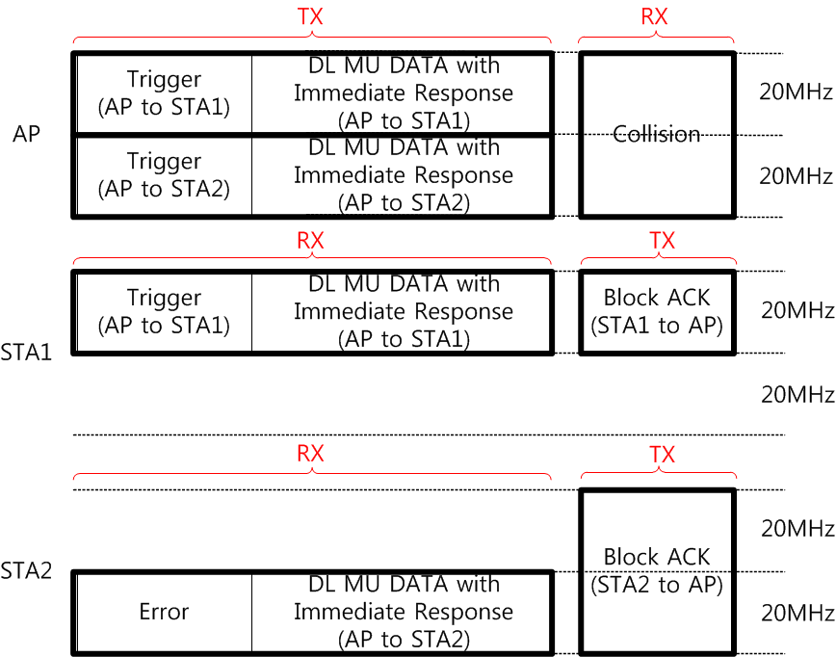
HE MU Acknowledgment Issue
Trigger frame elicits immediate responses carried in MU PPDU
But, if an addressed recipient (e.g., STA2) does not receive a Trigger frame, it can respond with SU PPDU
Collision between immediate responses is problem

Slide 7
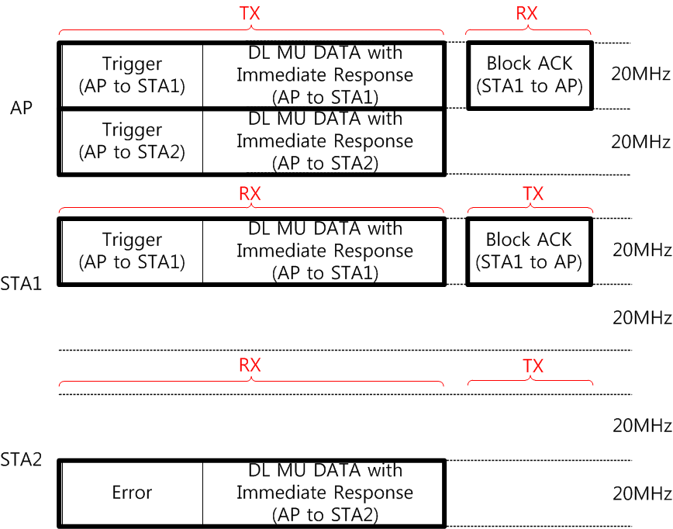
HE MU Acknowledgment Proposal
If an addressed recipient (e.g., STA2) does not receive a Trigger frame, it takes no action upon a receipt of a frame soliciting an immediate response carried in MU PPDU
No immediate response since it does not receive a Trigger frame

Slide 8
HE MU Acknowledgment Proposal
PPDU Type (SU or MU) of an immediate response should be indicated in a frame soliciting an immediate response
One option to indicate PPDU Type of an immediate response is using Ack Policy field
Ack Policy field in a frame soliciting an immediate response carried in SU PPDU is set to 00 (Normal Ack or Implicit Block Ack Request )
Ack Policy field in a frame soliciting an immediate response carried in MU PPDU is set to [Reserved value], not 00 (Normal Ack or Implicit Block Ack Request )

Slide 9
HE MU Acknowledgment Proposal
Possible reserved value of ACK Policy field is as the following:
01: No explicit acknowledgment or PSMP Ack or Trigger based Ack [In a frame that is the Trigger based Ack context] i) The addressed recipient that receives the Trigger frame returns an Ack/BlockAck frame, either individually or as part of an A-MPDU starting a SIFS after the PPDU carrying the frame, according to the UL MU scheduling information specified in the Trigger frame ii) The addressed recipient that does not receive the Trigger frame takes no action upon the receipt of the frame except for recording the state

Slide 10
HE MU Acknowledgment Proposal
When Trigger Info in MAC Header elicits immediate responses carried in MU PPDU, same issue can be occurred
If an addressed recipient does not receive a Trigger Info in MAC Header, it can respond with SU PPDU
But, the same solution from slide 7-9 can be applied
Otherwise, alternative solution is that MAC headers of all MPDUs in an A-MPDU carry the same Trigger Information
Cons: Increased MAC overhead by a redundant Trigger Information

Slide 11
Conclusion
In this presentation, HE MU Acknowledgment Procedure has been proposed
Trigger frame elicits immediate responses (MU PPDU)
Trigger Info in MAC Header elicits immediate responses (MU PPDU)

Slide 12
References
[1] https://mentor.ieee.org/802.11/dcn/15/11-15-0132-09-00ax-spec-framework.docx
[2] https://mentor.ieee.org/802.11/dcn/15/11-15-1033-00-00ax-data-field-in-he-ppdu.pptx

Slide 13
Straw Poll 1
Do you agree to add the TGax SFD:
4.2 DL MU operation The addressed recipient that receives a frame soliciting an immediate response carried in UL MU PPDU but that does not receive a Trigger frame takes no action upon the receipt of the A-MPDU

Slide 14
Straw Poll 2
Do you agree to add the TGax SFD:
4.2 DL MU operation PPDU Type (SU or MU) of an immediate response is indicated in a frame soliciting an immediate response

Slide 15
Straw Poll 3
Do you agree to add the TGax SFD:
4.2 DL MU operation Ack Policy field in a frame soliciting an immediate response is set to 00 (Normal Ack or Implicit Block Ack Request ) if the immediate response is carried in SU PPDU, or it is set to 01 (Trigger based Ack) if the immediate response is carried in MU PPDU

Slide 16
Straw Poll 4
Do you agree to add the TGax SFD:
4.2 DL MU operation Ack Policy field set to 01 (Trigger based Ack) has the following normative behavior i) The addressed recipient that receives the Trigger frame returns an Ack/BlockAck frame, either individually or as part of an A-MPDU starting a SIFS after the PPDU carrying the frame, according to the UL MU scheduling information specified in the Trigger frame ii) The addressed recipient that does not receive the Trigger frame takes no action upon the receipt of the frame except for recording the state

