Slide 1
Packet Appending for BICM-ID
Date: 2015-11-10
Author:
Notes:
September 2012

Slide 2
Outline
A glance at Bit-interleaved Coded Modulation with Iterative Decoding (BICM-ID)
Proposed transmission scheme
Simulation results
Summary
Notes:
Let me say some words about BICM-ID, as WLANs actually have sth in common (and highlight simillarities and differences)
Then I’ll introduce the proposed transmission scheme
Afterwards, I’ll present some simulation results and conclude

Slide 3

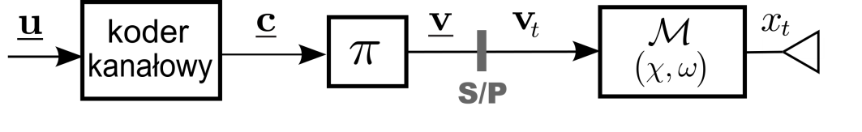
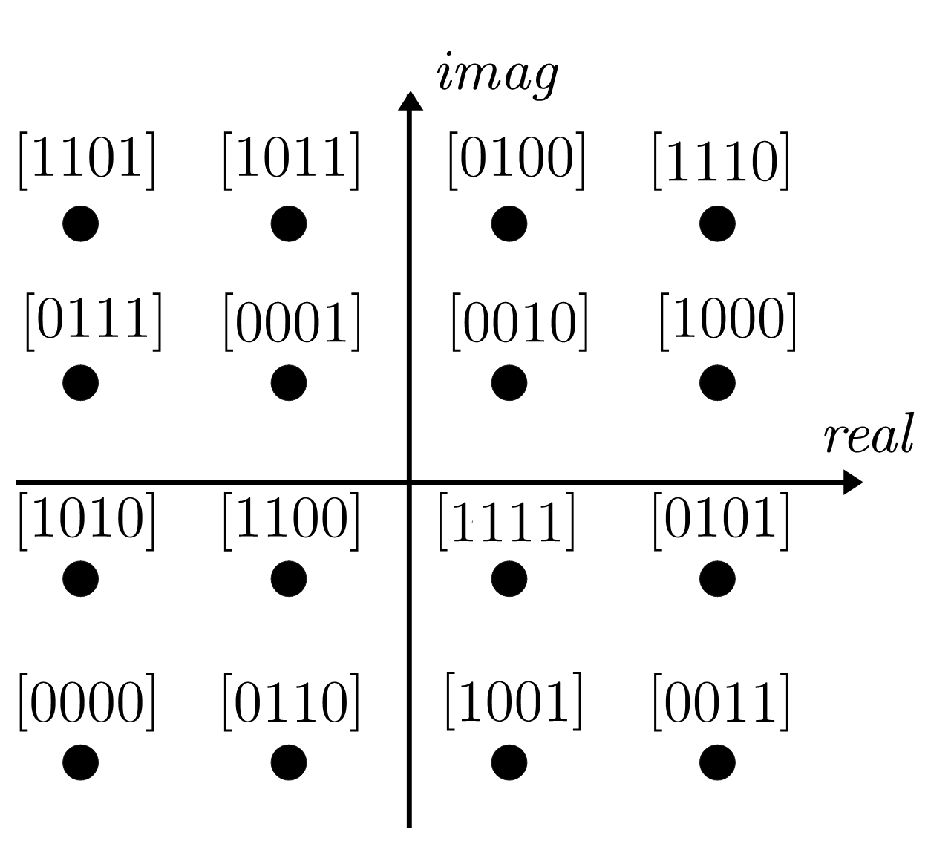
BICM transmitter model
Complex signals represent amplitude
and phase of real passband signals.
channel
encoder
BICM is a promising technique
for systems transmitting over fading channel.

Slide 4
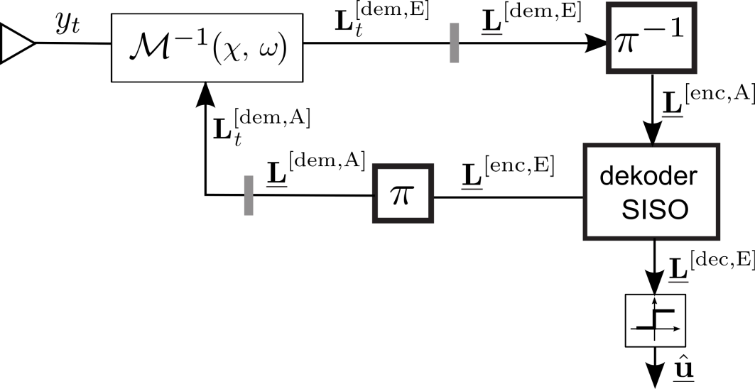
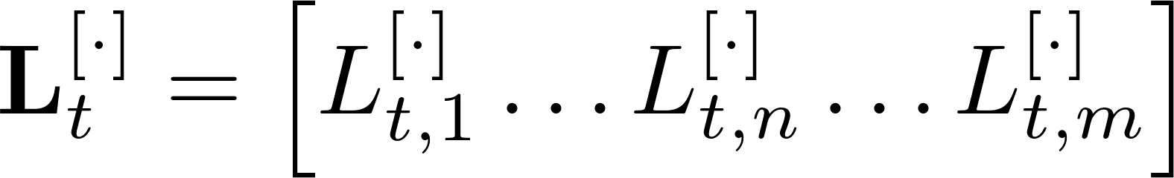
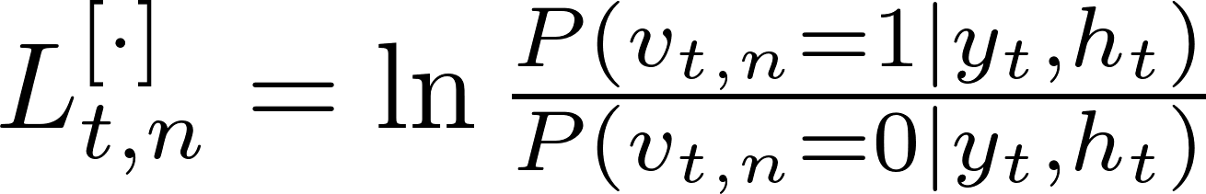
Transmitter
channel
encoder
Receiver
SISO
decoder

Slide 5
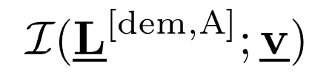
BICM-ID (BICM With Iterative Decoding)
channel
encoder
SISO
decoder
1
BICM-ID
iteration

Slide 6

Error-Free Feedback (EF) State
SISO
decoder
1
BICM-ID
iteration

Slide 7
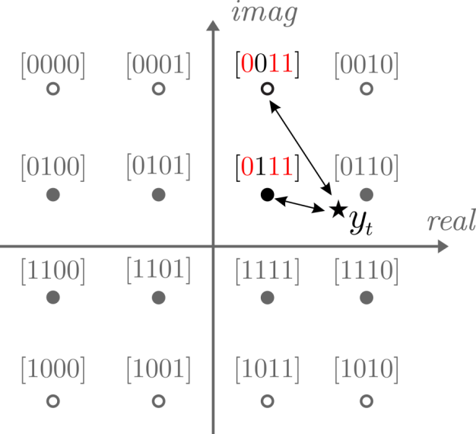
Ideal feedback case
need for a labeling map that assigns bit labels
differing in one position from each other
to possibly far constellation points

Slide 8
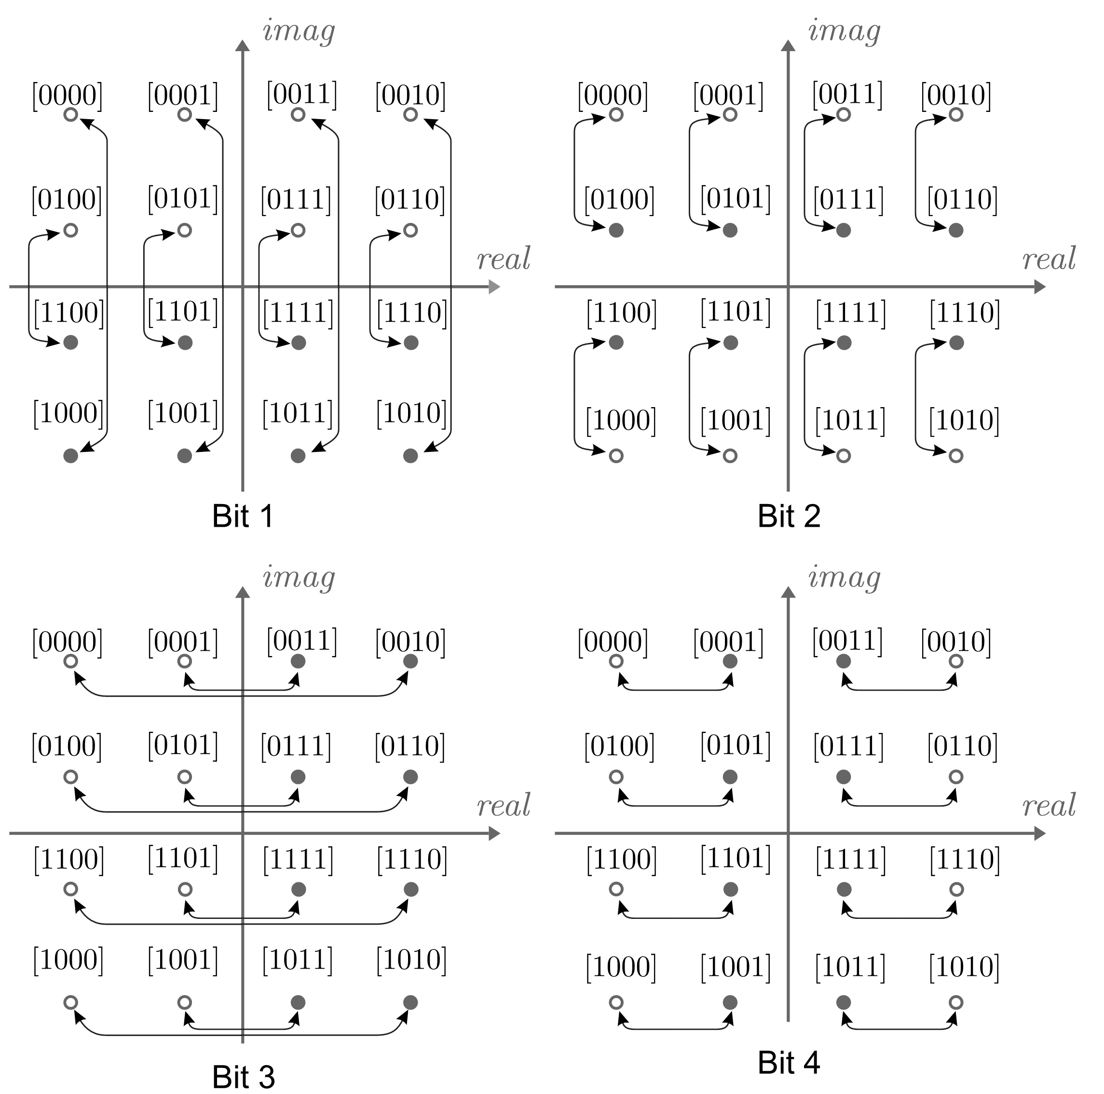
Gray labeling
– the worst choice

Slide 9
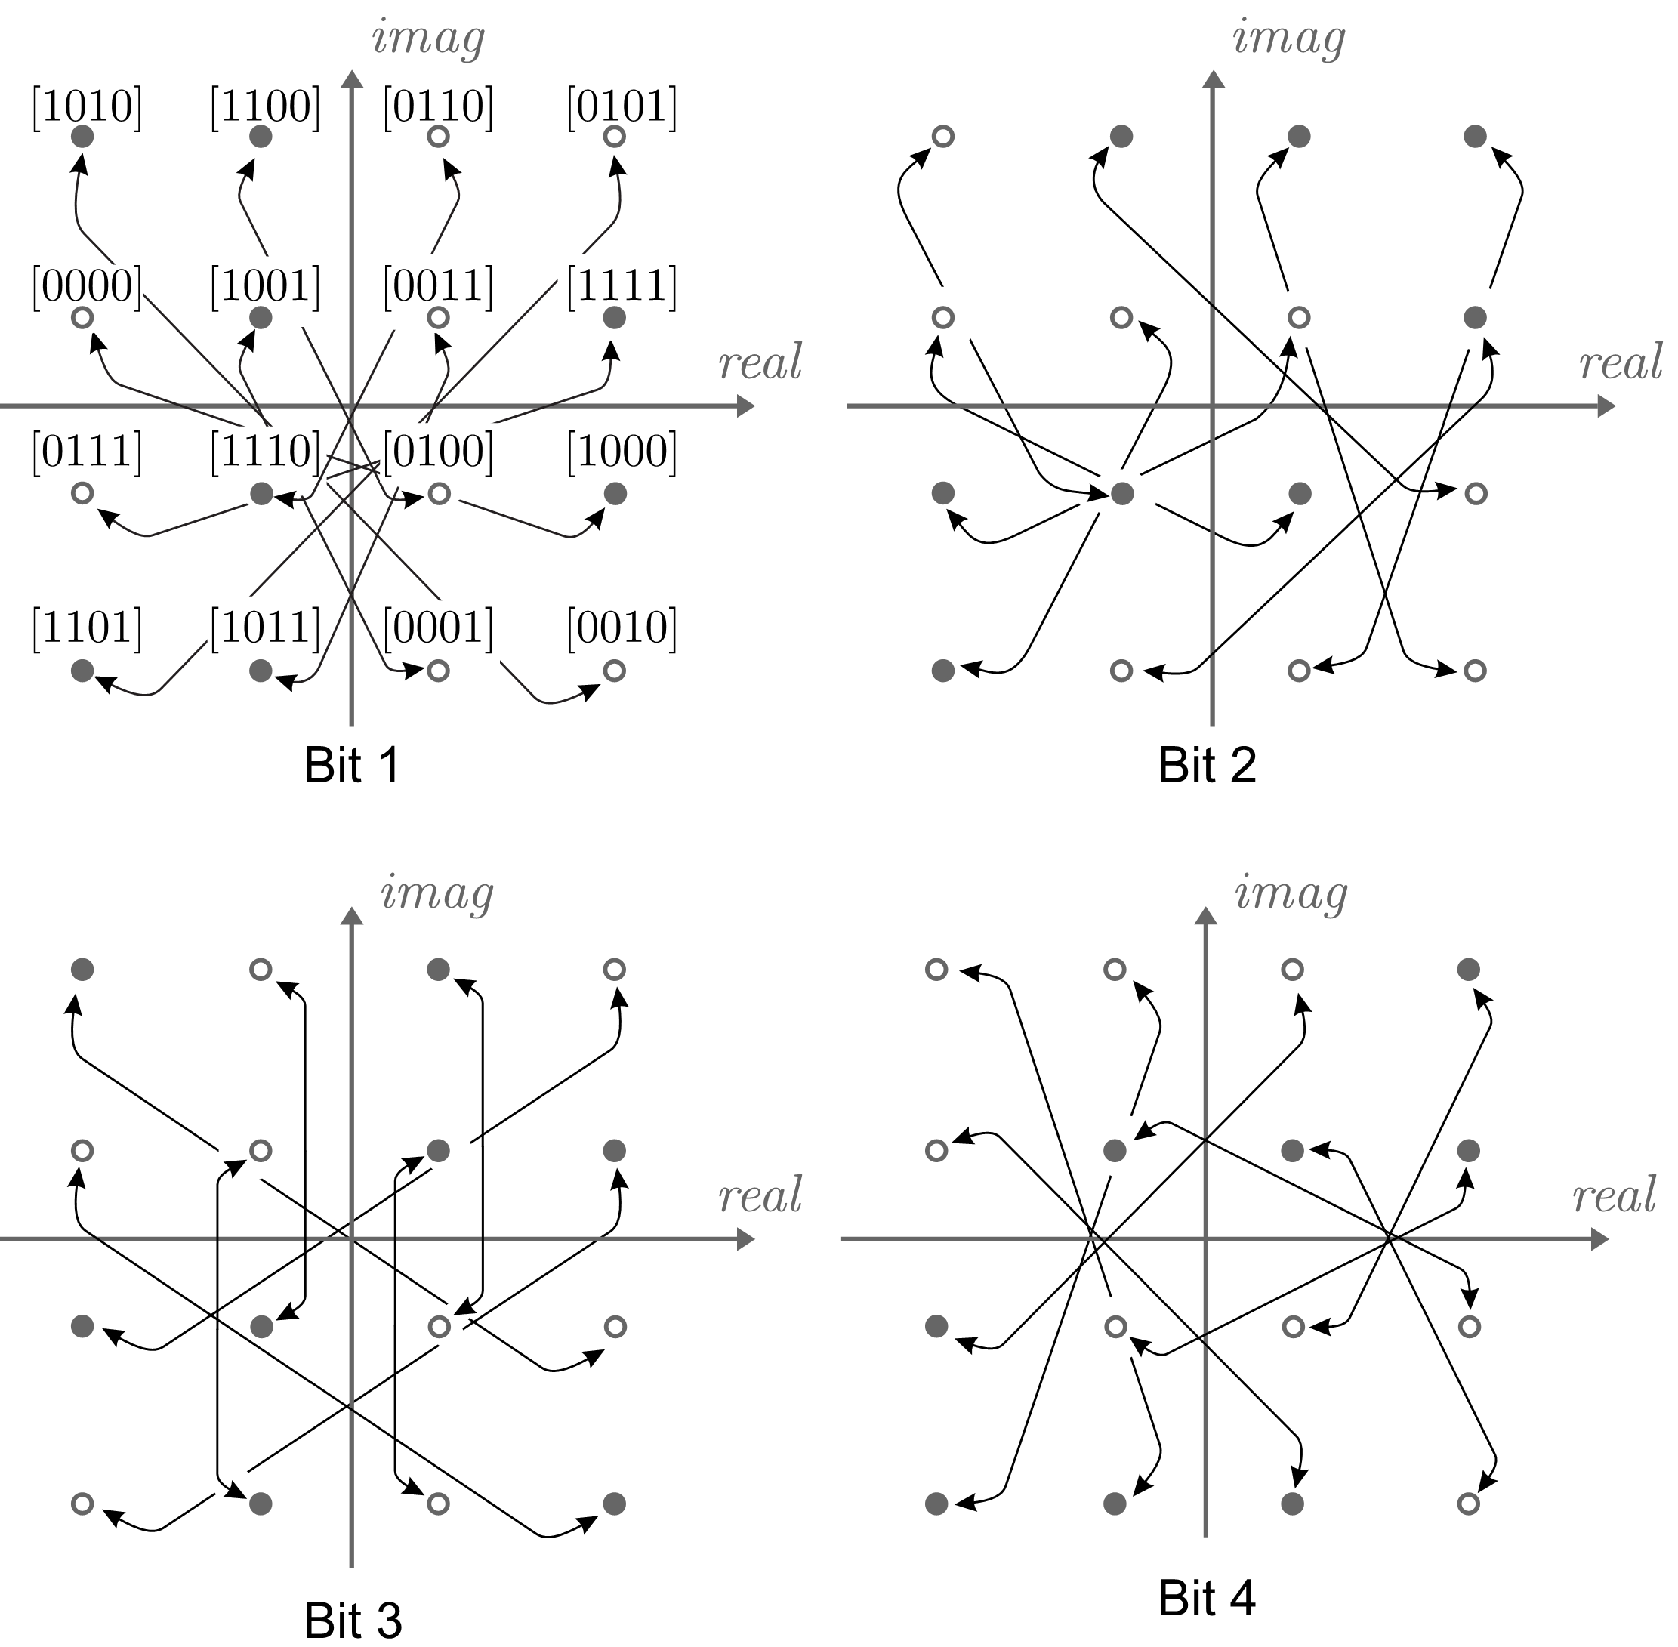
M16ª
– the optimal one
(avg. pairwise distance maximized)

Slide 10
Packet Appending for BICM-ID – assumptions
Append regular packet of Gray-labeled signals
by some additional signals mapped according to
a labeling map suitable for iterative decoding purposes
Adjust the number of additional signals w.r.t.
the current channel state
Legacy receiver should be able to understand the regular packet
Use high constrained-length code
Use higher order modulation to avoid higher time consumption

Slide 11
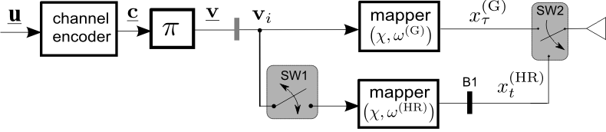


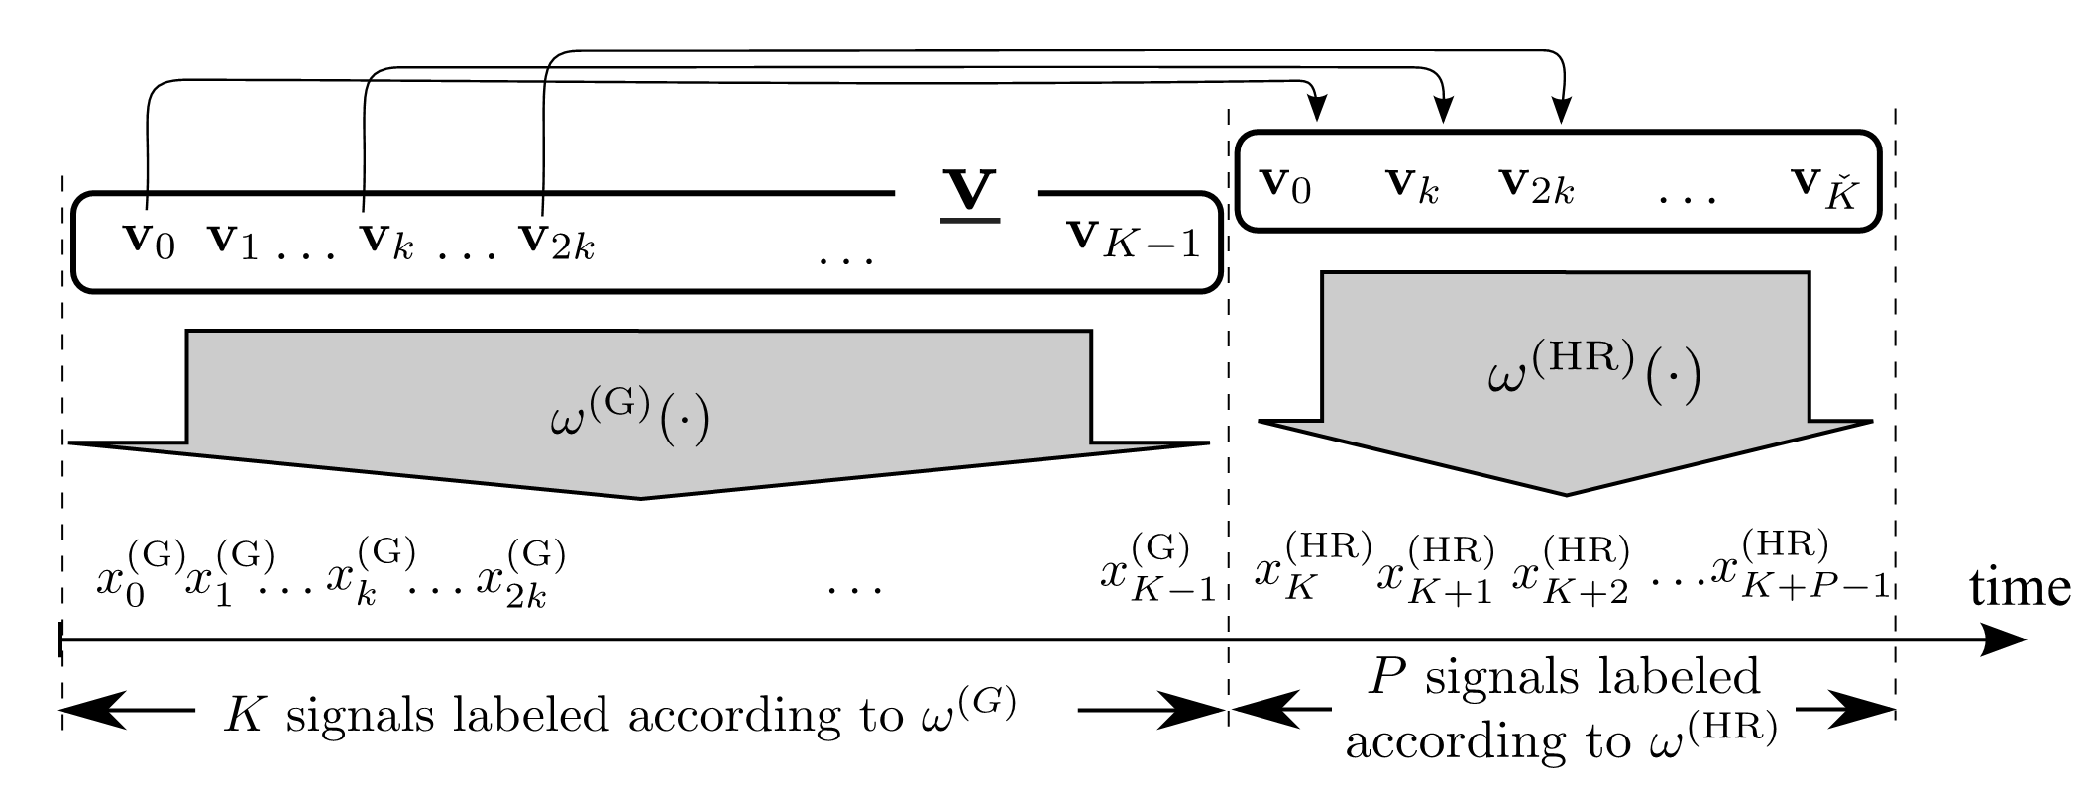
PA-BICM-ID transmitter
labeling map good for iterative decoding purposes by Huang & Ritcey

Slide 12
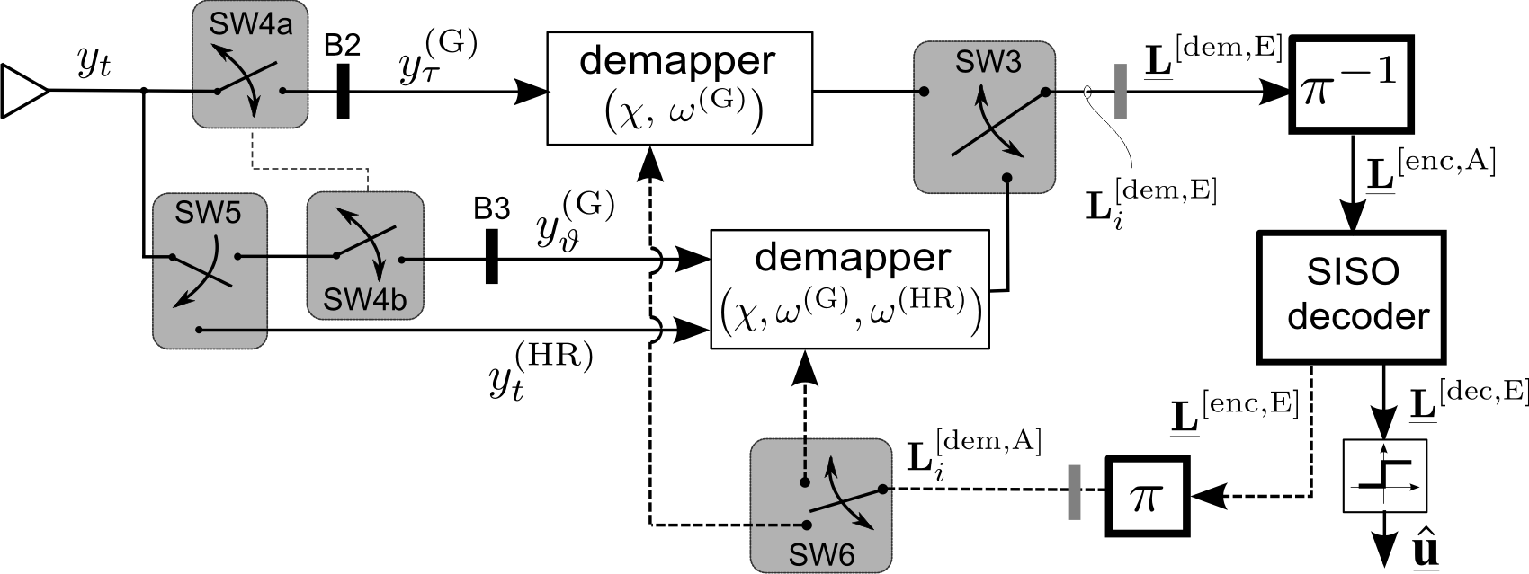

PA-BICM-ID receiver

Slide 13



Modulation doping reference
. . .
. . .
(Gray labeling)
(non-Gray labeling)
Some symbols transmitted only according to a non-Gray labeling map
Flexibility, but only moderate performance gain over reference

Slide 14
Simulation setup
Each data frame consists of 10 000 data bytes
Pseudo-random interleaver
64-QAM PA-BICM-ID compared with 16-QAM BICM
Two retransmission ratio values:
For statistical accuracy, simulation runs until 100 erroneous frames have been encountered
Retransmission ratio ( ξ = K/P ) | Max. spectral efficiency (bpcu)
2/3 | 2
1/2 | 2.25

Slide 15
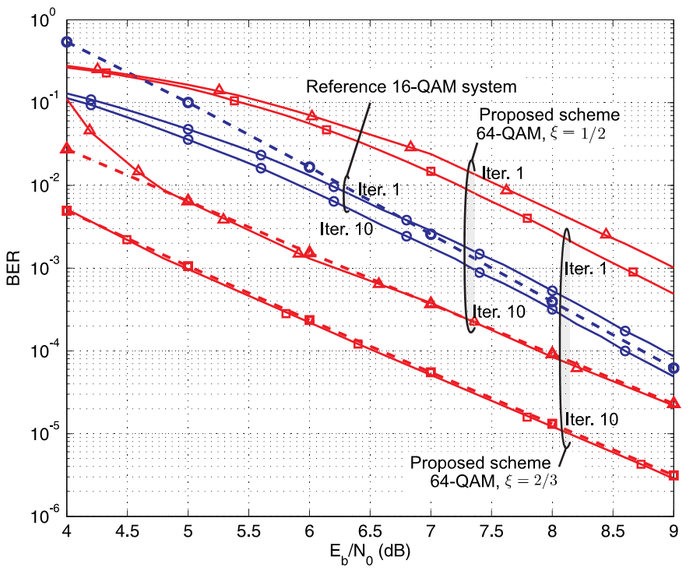
Simulation results (1)

Slide 16
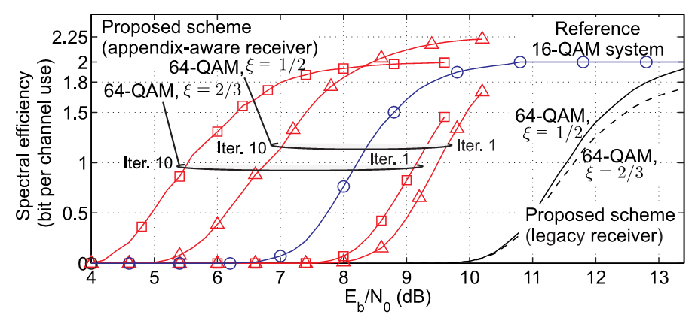
Simulation results (2)

Slide 17
Summary
PA-BICM-ID introduces the benefits of iterative decoding to systems not originally intended for this purpose
Fine ‟tuning” to the current propagation conditions
No multidimensional constellation = no exponential growth in the demapper routine
The whole legacy packet transmitted explicitly
– the old devices can still hear and decode it
Suitable for future multi-casting scenarios

Slide 18
Straw poll
Do you find PA-BICM-ID a promising technique for future WLAN applications?

