Slide 1
802.11 Working Group Opening Report November 2015
Date: 2015-11-07
Authors:

Slide 2
Introduction
This presentation, together with the reports cited on the next slide, forms the opening report of the IEEE 802.11 Working Group for Nov 2015.
Subgroup status is reported in the “Snapshots” submission (see next slide for link). This is incorporated by reference into this opening report.
“Mx.y.z” terminology indicates that the item was on the tentative agenda for the Monday 802.11 plenary, and was agenda item x.y.z.

Slide 3
M2.3.1 Summary of new Liaisons
802.19 is responsible for responding to liaisons to/from 3GPP on LTE-LAA.
IEEE 802.11 has received two related liaison documents from 3GPP RAN4 on radio measurement and RSSI measurement.
Please see: https://mentor.ieee.org/802.11/dcn/15/11-15-1263-00-0000-liaison-from-3gpp-ran4-on-measurement-and-rssi.doc

Slide 4
M2.3.1 Summary of ongoing Liaisons
NGMN Liaison and Whitepaper - Owned by REG SC
The outgoing liaison approved in May invited NGMN to provide a speaker for today’s Tutorial panel session.
NGMN were not able to identify a speaker.
Jeorge Hurtarte will be attending NGMN, and has been invited to address them in December on the topic of what 802.11 is doing in 5G
I will appoint him as an 802.11 “Liaison Official” to NGMN, subject to confirmation by the WG.
The Liaison Official is “a person designated to advance communications among organizations.”
The Liaison Official must attending meetings of both groups.

Slide 5
M2.3.2 – incoming 3GPP liaison on measurement and RSSI
I sent an email to the 802.11 reflector soliciting involvement and a leader.
The following responded (as of the time of writing): Laurent Cariou, Stephen McCann, James Wang, Richard Roy, Andrew Miles, Allert van Zelst, Vinko Erceg, Fillip Mestanov, Yakun Sun, Lisa Ward
Laurent Cariou has volunteered to organize an ad-hoc to consider a response.
An initial report is expected for the Wed plenary, with any approval of outgoing liaisons on Friday.

Slide 6
M3.1 802.11 Working Group Session Documents
WG Session Reports
WG Agenda | https://mentor.ieee.org/802.11/dcn/11-15-1217
Opening report | https://mentor.ieee.org/802.11/dcn/11-15-1218
Snapshots | https://mentor.ieee.org/802.11/dcn/11-15-1224
Supplementary Material | https://mentor.ieee.org/802.11/dcn/11-15-1219
Motions | https://mentor.ieee.org/802.11/dcn/11-15-1226
Closing report | https://mentor.ieee.org/802.11/dcn/11-15-1227
1st vice chair | https://mentor.ieee.org/802.11/dcn/11-15-1214
Treasurer | https://mentor.ieee.org/802.11/dcn/11-15-1215
2nd vice chair | https://mentor.ieee.org/802.11/dcn/11-15-1225

Slide 7
M3.2 Joint meetings and Reciprocal Credit
Joint Meetings
Thu am1: TGak, ARC, 802.1
Reciprocal credit is provided to 802.11 voters for attendance at: 802.18, 802.19, 802.24, 802.1 and Privacy ECSG
Reciprocal credit for 802.19 is for Coexistence in Unlicensed Bands Study Group
Reciprocal credit for 802.1 is for 801.1Qbz, 802.1CF

Slide 8
M3.10 Topics for Wednesday plenary
Report on the Attendance Reporting Survey
Briefing on the ETSI BRAN meeting (Myles)
“802.11 as part of IMT-2020” (Myles)
Report on 3GPP/5G workshop (Levy)
Still plenty of agenda time available

Slide 9
M3.11 802 EC and IEEE-SA Standards Board decisions
PARS
None
Approval of draft standards
The IEEE 802 executive committee (EC) conditionally approved sending P802.11ah to Sponsor Ballot.

Slide 10
M4.1.1 Type of Groups
Type of Group | Description
WG | Working Group
SC | Standing Committee
TG | Task Group
SG | Study Group

Slide 11
M4.1.1 Groups
Type | Group | Description
WG | WG11 | The IEEE 802.11 Working Group
SC | ARC | Architecture
SC | PAR | PAR review
SC | REG | Regulatory
SC | WNG | Wireless Next Generation
802 SC | JTC1 | ISO/IEC JTC1/SC6
TG | MC | Revision mc (REVmc)
TG | AH | Operation in 900 MHz bands (S1G)
TG | AI | Fast Initial Link Setup (FILS)
TG | AJ | China Milli-Meter Wave (CMMW)
TG | AQ | Pre-association Discovery (PAD)
TG | AK | General Link (GLK)
TG | AX | High Efficiency Wireless LAN (HEW)
TG | AY | Next Generation 60 GHz (NG60)
TG | AZ | Next Generation Positioning (NGP)

Slide 12
M4.1.2 PAR Expiration/Renewal Schedule
Project | PAR Expiration Date
AH | 31-DEC-2016
AI | 31-DEC-2016
MC | 31-DEC-2016
AJ | 31-DEC-2016
AK | 31-DEC-2016
AQ | 31-DEC-2016
AX | 31-DEC-2018
AY | 31-DEC-2019
AZ | 31-DEC-2019
http://www.ieee802.org/11/PARs/index.html

Slide 13
M4.1.3 802.11 WG Appointed positions
WG Secretary – Stephen McCann
Treasurer – Jon Rosdahl
ANA Authority – Adrian Stephens
WG Technical Editors – Adrian Stephens, Peter Ecclesine

Slide 14
M4.1.3 Officers
Cat | Group | Chair | Vice Chair | Technical Editor | Secretary
WG |  | Adrian STEPHENS | Jon ROSDAHL Dorothy STANLEY | Adrian STEPHENS Peter ECCLESINE | Stephen MCCANN
SC | ARC | Mark HAMILTON | Joseph LEVY
SC | REG | Richard KENNEDY
SC | PAR | Jon ROSDAHL
SC | PUB | Open
SC | WNG | Jim LANSFORD | Open
TG | MC | Dorothy STANLEY | Mark HAMILTON Jon ROSDAHL | Adrian STEPHENS, Sub-editors Emily QI and Edward AU | Jon ROSDAHL
TG | AH | Yongho SEOK | Alfred ASTERJADHI Zander LEI | Yongho SEOK Alfred ASTERJADHI | Zander LEI
TG | AI | Hiroshi MANO | Marc EMMELMANN | Lee ARMSTRONG Ping FANG | Hitoshi MORIOKA
TG | AJ | Xiaoming PENG | Haiming WANG Jiamin CHEN | Jiamin CHEN | HAO Peng
TG | AK | Donald EASTLAKE | Mark HAMILTON | Donald EASTLAKE Norm FINN | Open
TG | AQ | Stephen MCCANN | Yunsong YANG | Lee Armstrong | Open
TG | AX | Osama ABOUL-MAGD | Simone MERLIN Ron PORAT | Robert STACEY | Yasuhiko INOUE
TG | AY | Edward AU | SangHyun CHANG, Yan XIN | Carlos CORDEIRO | Jeorge HURTARTE
TG | AZ | Jonathan SEGEV |  |  | Zhou Lan
Updated at last session

Slide 15
IEEE 802.11 Revisions
802.11
-2003
802.11
-2007
802.11
-2012
802.11
-2016 (TBC)
MAC
11k
RRM
11s
Mesh
11aa
Video Transport
11e
QoS
IEEE
Std
802.11
-1997
11h
DFS & TPC
11u
WIEN
11v
Network
Management
11ae
QoS Mgt Frames
11d
Intl roaming
11i
Security
11z
TDLS
11w
Management
Frame
Security
11f
Inter AP
11r
Fast Roam
11n
High
Throughput
(>100 Mbps)
11af
TV Whitespace
11a
54 Mbps
5GHz
11j
JP bands
11ac -VHT
>1 Gbps @ 5GHz
11b
11 Mbps
2.4GHz
11g
54 Mbps
2.4GHz
11p
WAVE
11y
Contention
Based
Protocol
11ad - VHT
>1 Gbps @ 60GHz
MAC
&
PHY
Notes:
doc.: IEEE 802.11-11/0483r0
May 2011
Bruce Kraemer (Marvell)
Page 15

Slide 16
IEEE 802.11 Standards Pipeline
MAC
TBD
802.11
-2016
802.11
-2012
802.11aq
PAD
802.11aa
Video Transport
802.11ak
GLK
802.11ae
QoS Mgt Frames
802.11ai
FILS
LRLP TIG
Long Range
Low Power
802.11az
NGP
WNG
802.11ax
HEW
802.11ah
< 1Ghz
802.11af
TVWS
802.11ac
VHT 5GHz
802.11ay
NG60
802.11ad
VHT 60 GHz
802.11aj
CMMW
MAC & PHY
Discussion Topics
TIG/Study
groups
TG without
Approved draft
WG
Letter Ballot
Sponsor
Ballot
Published
Amendment
Published
Standard
16
Notes:
doc.: IEEE 802.11-11/0483r0
May 2011
Bruce Kraemer (Marvell)
Page 16

Slide 17
M4.1.5 Summary of ballots and comment collections
Type | Label | Group | Opened (mm-dd) | Dur (d) | # Comments | Pool | Approve | Disapprove + invalid | Abstain | Return % | Approve % | Result
LB | 215 | TGah | 09-18 | 15 | 1 | 330 | 262 | 6+2 | 15 | 86 | 98 | P
LB | 216 | TGaq | 10-07 | 30
SB | Initial | TGah | 10-06 | 30 | 552 | 176 | 115 | 12 | 11 | 78 | 91 | P
TBD
216

Slide 18
M4.1.5.1 – TGah CRC formation
In sponsor ballot, resolution of comments is delegated to a comment resolution committee (CRC). These operate under slightly looser rules than an 802.11 WG.
TGah will act as the CRC for P802.11ah – existing officers remain
The CRC a “committee of the whole of 802.11” – i.e., all voting members of WG
The CRC can meet in person and/or telecon to 802.11 reflector using 10 day notification for telecons and 30 notification rules for F2F
The CRC can make motions to resolve comments and recirculate at any of its meetings, except as noted below
Resolutions of any comments related to IP or patents, or communications to PatCom or the IEEE-SA standards board must be approved only during a WG session.

Slide 19
M4.1.6 Current Membership Status
Status | Number
Aspirant | 142
Potential Voter | 97
Voter | 347
Ex Officio Voter | 11
Definitions:
Aspirant: a member who has attended 1 qualifying meeting
Potential Voter: a member who has attended 2 qualifying meetings and will become a voter at the start of the next plenary they attend
Ex Officio Voter: a voter who has voting rights by virtue of their membership of the 802 EC and has requested to be recorded as an ex officio voter in 802.11
Data as of 2015-05-10

Slide 20
M4.1.6 Recent voting member history

Slide 21
M4.1.7 ANA Status
The latest database is 11-11/0270r33 (Nov 2015)
Changes since last meeting:
r33: TGmc allocations based on approved comment resolutions

Slide 22
background data

Slide 23
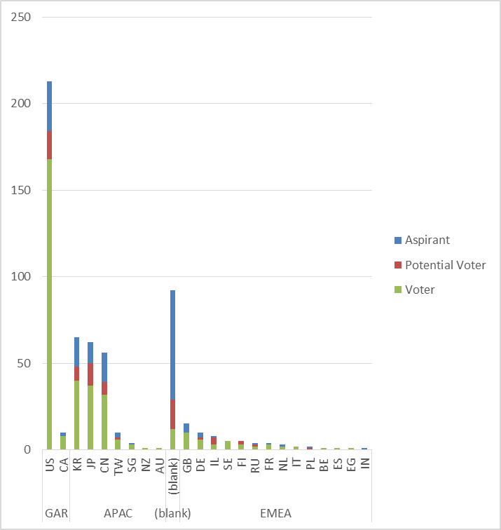
Membership by Country and Region

Slide 24
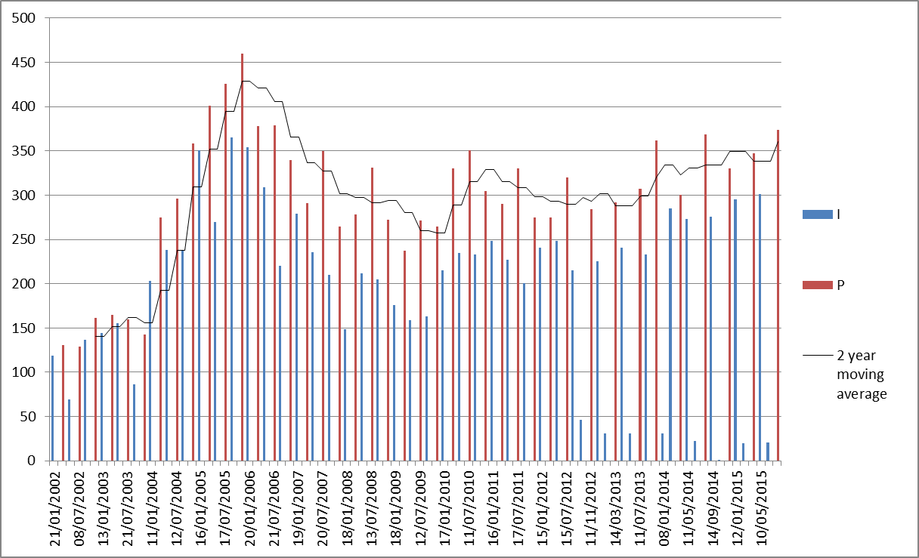
Meeting Attendance – Historic Data

Slide 25
Membership – Historic Data

