Slide 1
1st Vice Chair Report November 2015 - Dallas
Date: 2015-11-13
Authors:

Slide 2
Abstract
This slide contains requested reports and status from the 802.11 1st Vice-Chair:
Monday:
Other WG meeting plans
Meeting room locations
Next meeting reminder
Meeting registration
Recording attendance
File server
Breakfast, breaks, social
Friday:
Straw Poll of membership regarding this meeting location
Future venues status and discussion

Slide 3
Monday– 802.11 Opening Plenary
802.11 First Vice Chair Report

Slide 4
M3.3 II Other WG meeting plans
802.1 802.3 802.11 802.15 802.16 802.18 802.19 802.21 802.22 802.24
Treasurer Report: 11-15/1215r0
Patent policy (in IEEE-SA bylaws), patent policy (slide set), and antitrust guidelines

Slide 5
Online Calendar
This session’s meetings are also shown on the 802.11 calendar on the 802.11 home page (http://www.ieee802.org/11).
This is a Google calendar “802_11_calendar@ieee.org”
There are multiple ways of accessing this information, for example from a cell-phone, or as a remote calendar.
Note: the schedule on this calendar is automatically updated shortly after the updates to the Online Meeting Schedule. Online Meeting Schedule is most accurate. Room changes will be posted on rooms.

Slide 6
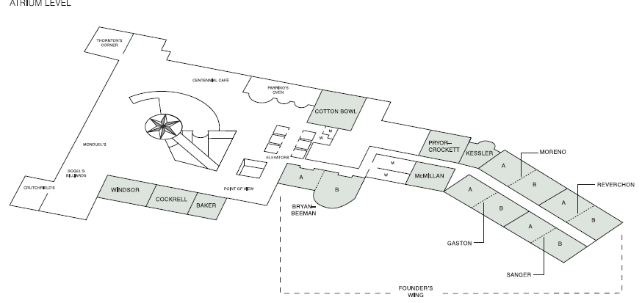
Meeting Areas
Monday Agenda Item 3.4

Slide 7
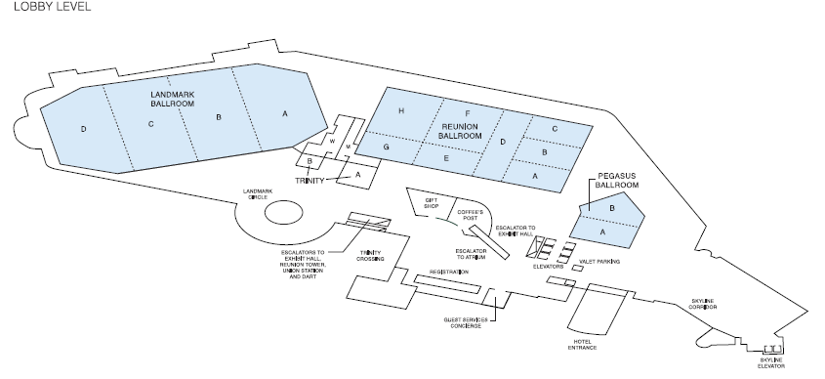
Meeting Areas
Monday Agenda Item 3.4

Slide 8
M3.5 Next WG Meetings
Next 802 Interim Meeting –
IEEE 802 Interim session – 17-22 January 2016
Hyatt Regency Atlanta, Atlanta, GA, USA
For information and registration links, see
Registration and Hotel Reservations https://802world.org/apps/session/94/register2

Slide 9
M3.6 Meeting Registration
Working Group | Number
802.11 | 344
802.3 | 283
802.15 | 82
802.1 | 56
none | 15
802.xx | 12
802.21 | 9
802.19 | 8
802.22 | 4
802.18 | 3
802.16 | 2
802.24 | 2
As of 08 November 2015

Slide 10
2016 STANDARDS DVD
2016 Standards DVD will be available to all Registered Attendees.
DVDs will be distributed at the Registration Desk.
A signature log will be maintained for all distributed DVD’s.

Slide 11
M3.7 Recording Attendance
It is a requirement that attendees record their participation at an 802.11 session and declare their affiliation. This record is usually made using the IMAT attendance system.
If you wish to participate without recording attendance, send an email per session to the WG 1st vice chair declaring your participation and affiliation.
However, You cannot gain or maintain 802.11 voting membership using this method.
You must record 75% attendance of eligible 802.11 slots in a session for that session to count towards gaining or maintaining 802.11 voting membership
You need a single IEEE-SA web account
The IEEE SA web account requires a working email address
do not remove your email address from the account
Use the email address associated with that web account when registering attendance
If you change email addresses, update the web account, don’t create a new web account, or your membership status may not be calculated properly.
Record attendance using this URL: https://imat.ieee.org/attendance

Slide 12
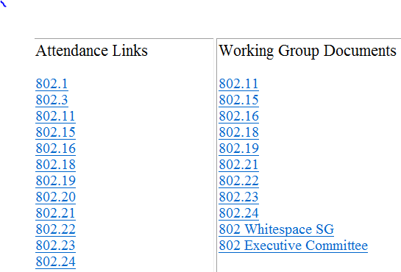
M3.8 Local File Document Server information
Local FTP server: ftp://griffin.events.ieee.org (anonymous)
External Document Server https://mentor.ieee.org/802.11/documents

Slide 13
Synchronizing while at the meeting
While Particularly important when external bandwidth is limited and unreliable
Please Use anonymous ftp
Host: ftp://griffin.events.ieee.org
User: anonymous
Password: <your-email-address-here>
Destination directory: /802.11/15
Freeware tools are available, for example search for “syncback free” **
** Other tools are available. The IEEE does not endorse the use of any particular tool.

Slide 14
M3.9 FOOD & BEVERAGE
Reunion Foyer
Continental Breakfast 7:30 AM to 9:00 AM
Morning Coffee/Tea 10:00 AM to 11:00 AM
Afternoon Coffee/Tea/Snacks 3:00 PM to 4:00 PM

Slide 15
SOCIAL EVENT
Registered attendees and their guests (1 per attendee) are invited to attend a casual reception at the Hyatt Regency.
Tickets are not required. – Please wear your Mtg Badge
Date: Wednesday November 11th
Time: 6:30 PM – 9:30 PM
Place: Marsalis Hall
SOCIAL EVENT DRINK TICKET
Attached to Name Badge Handout

Slide 17
Welcome to Dallas
Social Attached is the social flyer with all the details.
Guest badges are available from Donna at Meeting Concierge after 11:30 on Tuesday.
2. DVD’s distributed at registration
3. Receipts for registrations available from Donna at Meeting Conceirge starting Wednesday morning. If they require something unique please have them email Lisa Ronmark.
4. See website and bulletin board for lunch and dinner specials offered by hotel. Additional items also available from the coffee shop.
5. Information on Maucau (Maucao) available near registration.
6. Registration and hotel reservations are available for January interim in Atlanta.

Slide 18
Wednesday – 802.11 Mid-Week Plenary
802.11 First Vice Chair Report

Slide 20
Friday – 802.11 Closing Plenary
802.11 First Vice Chair Report

Slide 21
F3.1.2: 802.11 Venue Straw polls
Return to Dallas?: Y:37 N: 28

Slide 22
F3.1.3: Future Venue Insight
Future 802 Wireless Interims:
May 2016 Hilton Waikoloa Sept 2016: Finalists –
Warsaw Doubletree,
Warsaw Marriott,
Budapest Marriott
Nov 30 Wireless Chairs SC Telecon to determine location.
Jan 2017 Hyatt Regency Atlanta May 2017 Daejeon Convention Center Sept 2017 Hilton Waikoloa January 2018 Hotel Irvine (TBC – contract pending) May 2018 TBD Sept 2018 Hilton Waikoloa

Slide 23
F3.1.3: Future Venue Insight
Future 802 Plenary Sessions:
January 2016 – 802 Interim - Hyatt Regency Atlanta
March 2016 Venetian Macao - Macao
July 2016 Manchester Grand Hyatt – San Diego
Nov 2016 Grand Hyatt San Antonio
March 2017 Hyatt Regency/Fairmont – Vancouver
July 2017 Estrel Hotel – Berlin
Nov 2017 Caribe Hotel and Convention Center - Orlando
March 2018 Hyat Regency O’Hare – Rosemont, IL
July 2018 Manchester Grand Hyatt – San Diego
Nov 2018 Potential Targets:
KL - Ritz and Marriott
(2015-11-12 - Floor space Price update)
SuZhou, China -
(New facility, pricing model being negotiated, Sponsor capability investigation)

Slide 24
802 Plenary March 2016
Save the Date: 13-18 March 2016
Registration target to open Dec 1, 2015
Meeting Space – Covered by Room Block
Hotel Information: (Block Reservation open Dec 1 – Feb 16)
charges are a bit higher on weekends:
Friday: 1,700 MOP (~USD$213)
Saturday: 2,300 MOP (~USD$288)
Sunday-Thursday : 1,550 MOP (~USD$194)
Required 802 Block = 3255 total nights at a cost of about $650,338
Make Reservations Early to be in the block
Required Nights: 2 or 3 (TBD during EC closing plenary)
Cancellation Policy:
Cancel prior to Feb 16, 2016

Slide 25
802 Plenary March 2016
Getting to Macao:
FYI: http://www.macau-airport.com/en/flight-information/flight-time-table/arrival You can click "Flight Timetable" and review the flight destinations for the Macao airport.
Ferry from Hong Kong is most common method.
about 30 Min Ferry from Hong Kong to Macao
More Details will be included in Meeting Announcement.

Slide 26
Local Venue Information AdHoc
Next Plenary:
13-18 March 2016, the Venetian Macao, China
The Venetian Macao~Resort~Hotel
Estrada da Baia de N. Senhora da Esperanca,
Cotai, Macau (SAR), P.R. China
Please suggest
Restaurants,
methods of getting from Airport to Hotel,
local attractions
Etc.
Send suggestions to Jon Rosdahl who will forward to the appropriate PCO for posting.
-------Deadline Jan 5th ---

Slide 27
Local Venue Information AdHoc
802 Interim:
January 17-22, 2016 at the Hyatt Regency in Atlanta, Georgia USA
Hyatt Regency Atlanta
265 Peachtree Street NE
Atlanta, GA 30303
USA
Tel: +1 (404) 577-1234
Hotel Information: http://www.atlantaregency.hyatt.com
Please suggest
Restaurants,
methods of getting from Airport to Hotel,
local attractions
Etc.
Send suggestions to Jon Rosdahl who will forward to the appropriate PCO for posting.
-------Deadline Jan 5th ---

