Slide 1
Follow-up on IEEE 802.11 as a “component”
Authors:

Slide 2
Motivation and purpose
At the July meeting a tutorial titled “IEEE 802.11 as a ‘component’” was presented. A lot of feedback was received during the presentation and in offline conversations following the presentation. Straw polls at the end of the tutorial indicated interest and support. There were also requests for more details.
This contribution
  Provides the first steps in our work to better define the need and scope for this activity,
  attempts to answer some questions,
  Highlights how this activity could benefit vendors of 802.11 implementations, end-users and service providers, in the incoming years (2020 and beyond)

Slide 3
802.11 as a ‘component’
General objective
So far, 802.11 has done a great job in offering the right service to the right customers, hence becoming ubiquitous
Thanks to this, in times where densification is an important driver of network deployments, 802.11 is more than ever the solid incumbent:
  Home, enterprise and most venues already provide access to the inter/intranet over 802.11 from any device and satisfy the end-user needs
In that sense, 802.11 is definitely an integral part of current wireless networks.
The objective of this activity is to ensure that 802.11 technology will remain and continue to grow as the wireless technology of choice in the incoming years.

Slide 4
“5G” terminology to describe the evolution of wireless networks in the incoming years
5G carries different meanings in different context
  It is linked to cellular/mobile networks evolution (follow-up of 4G), and cellular operators are the most vocal in trying to define its requirements (NGMN, …)
  But it can be perceived to refer to a wider concept, a general evolution of wireless networks, inclusive of all actors
Even if 5G documentations are still evolving, it is a good source of information for evolution of wireless networks, services, and requirements for 2020 and beyond.
In this presentation, we focus more on cellular operator perspective, having in mind that similar analysis should be initiated for all other actors, especially the ones relying strongly on 802.11 technology

Slide 5
“Cellular” 5G Objectives
High-level objectives compared to 4G:
Higher throughput (10X), lower latency, support higher user density (100X), available everywhere…
Lower cost, better energy efficiency…
Able to support a wider range of services…

Slide 6
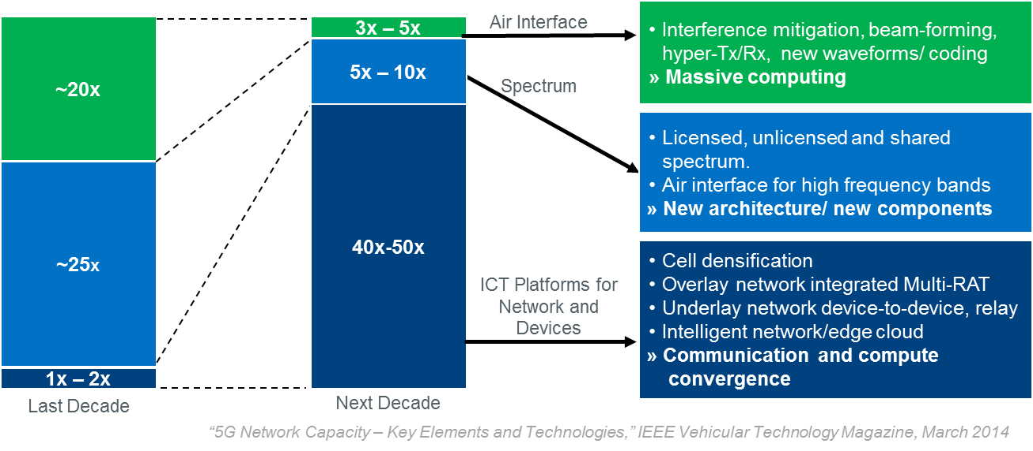
A big part of “Cellular” 5G objectives will be met with densification
Illustration of the different categories of improvements that will help reach the objectives

Slide 7
Wi-Fi would easily achieve “cellular” 5G densification target…
Wi-Fi AP to Macro cell ratios is already roughly 50:1, approaching 5G required ratio
ABI: Installed macrocells and small cells
ABI: WiFi APs deployed worldwide

Slide 8
Wi-Fi would easily achieve “cellular” 5G densification target…
Reaching this level of densification is challenging for operators:
  cost, installation (especially indoors - negotiation with venue owners), management, …
Some key facilitators:
  Use of unlicensed spectrum facilitates this at the cost of spectrum control
  Use of neutral-host small cells deployed locally (Small cell as a service (SCaaS)) facilitates this at the cost of network ownership for operators
WLAN as a service (WaaS) combines these facilitators and is therefore a very competitive solution to help operators reach this level of densification
  It consists of a venue-driven deployment, managed by a neutral host, which supports multiple operators, each using this WiFi network as a BlackBox
  Benefits:
    Fast deployment of services, low cost for all actors,
    beneficial for venue-owner, and for any types of operators, …

Slide 9
… assuming it can easily be accessed and reaches the level of flexibility needed for future services
WaaS solutions exist today
  As a blackBox without much interface
Do we need to make modifications to 802.11 to consolidate this model for 2020 and beyond?
  What will be the right balance between what stays in the BlackBox and what is exposed/open?
  What is needed to enable added-value for operators?
In order to meet the requirements:
  Simple, seamless, secure access
  With features and flexibility to support new services
  With the right level of integration with each operator’s network

Slide 10
  2020 WaaS: evolution of 802.11 technology?
  Simple, Seamless, Secure access
802.11u/WFA’s Passpoint facilitates simple, seamless and secure access
  802.11ai further improves some aspects of it
  Can/should we do better?
    Suppress redundancy for authentication, security between different radio access technologies
    Faster/simpler
Should we further improve 802.11 network selection
  Clearer metrics, interface to access them

Slide 11
2020 WaaS: evolution of 802.11 technology?
Support new services and new network functionalities
  WaaS should be flexible to enable fast deployment of new and diverse services
  5G has the ambition to enable services that would require an adaptation or an interface with lower layers
    Tactile internet (better QoS mapping), Massive IoT, location-based services (need for context information)…
  If we want WaaS to be the neutral-host home of 5G networks in venues, we need to evaluate the implications on how it should interface with other networks and with service platforms.
    What level of adaptation is needed in lower layers to flexibly enable important services in the future?

Slide 12
2020 WaaS: evolution of 802.11 technology?
Integration with cellular networks (1/2)
  Non-integrated neutral-host 802.11 networks seem sufficient as of today for most services
    Currently, all main traffic/services can go through 802.11 network, even voice
    The added value of a deeper integration is limited for the operators
  In the future?
    Better interfaces of WaaS with operator networks can provide added value to operators and users, for example:
        User experience: Enable multiple operators to manage and negotiate QoS prioritization on these neutral WaaS networks,
        Aggregated throughput: Enable multiple operators to deploy LWA (LTE-Wi-Fi Aggregation) on neutral WaaS networks,
        Management/control: provide some level of control to multiple operators

Slide 13
2020 WaaS: evolution of 802.11 technology?
Integration with cellular networks (2/2)
An example: Throughput aggregation
LWA (LTE-Wi-Fi aggregation) is under definition in 3GPP (RP-151114)
  For WiFi APs collocated or non-collocated with LTE small cells
  In the latter case, it defines a control plane interface Xw between eNB and WLAN Termination (WT) integrated into AP, AC
By defining the 802.11 side of this interface, we could enable operators to quickly deploy such aggregation solution, even on neutral-host Wi-Fi networks (WaaS)
  This would improve the services provided by WaaS
What would be needed:
  Monitoring for flow control (load balancing between LTE and WiFi)
  Tools for discovery and metrics for WiFi network selection
  Non-duplicated association/security (security bootstrapping mechanism: PSK-like key is generated by the eNB and configured to UE and WT)

Slide 14
Conclusion
This presentation has the objective to initiate the work to better define the need and scope for this activity: 802.11 as a component of 5G
  Starting from a very high-level analysis targeting mobile operator
Studies are needed to:
  better understand 5G evolution and requirements, including the vision from other actors (OTT players, device vendors, cable operators…)
  Clarify the use cases and needs
  … to see if changes are needed in 802.11, and what changes

