Slide 1
Long range low power Use Cases for Indoor
Date: 2015-09-14
Authors:

Slide 2
Abstract
IoT is expected to be one of the most significant drivers of growth in technology markets
802.11 community has not seriously considered supporting IoT applications so far
In this presentation, we list various IoT use cases for indoor and requirements for them

Slide 3
Various IoT Applications for Indoor
 | Has data input and output? | Radio Trans. Tech. (WLAN/WPAN) | Data Speed | Power Limited
Central Controller | I, O | L, P | Control
Set-top Box | I, O | L, P | W-UHD
Home Theater | I, O | L, P | W-UHD, W-Audio
Display, TV | I | L, P | W-UHD
Speaker | I | P | W-Audio
Door, Window Sensor | O | P | Control | Y
Gas Sensor | O | P | Control | Y
Smoke Sensor | O | P | Control | Y
Gas Valve Sensor/Controller | I, O | P | Control | Y
Heater/Air conditioner | I, O | L, P | Control
Appliances | I, O | L, P | W-Data
Surveillance Camera | I, O | L, P | W-Video, Control
Printer/Scanner | I, O | L, P | W-Data, Control
Wireless UHD: 10’s Gbps, Low latency
Wireless Video: 10-100Mbps, Low latency
Wireless Audio: Below 1Mbps, Low latency
Wireless Data: Below 10Mbps
Wireless Control: Below 1Mbps

Slide 4

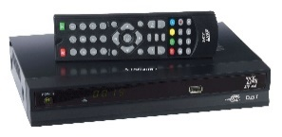
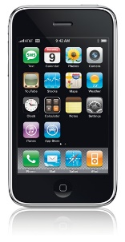
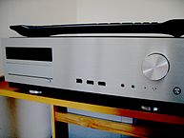
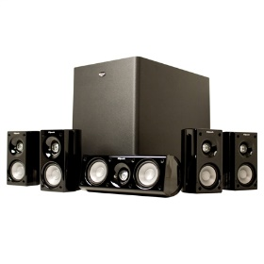
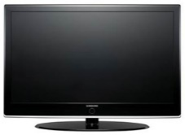
Use case for home theater (1)
non-AP STAs are associated with the LRLP AP
LRLP AP
Controller (indoor mobile device)
Set top box
Home theater
Speakers
TV
control
data

Slide 5
Use case for home theater (2)
The central controller may be a mobile device
Pairing is performed through an LRLP AP by the central controller (mobile device)
After connection setup, either Wi-Fi Direct or Bluetooth may be used for user data transfer between non-AP STAs

Slide 6
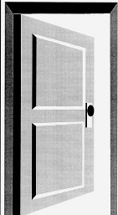
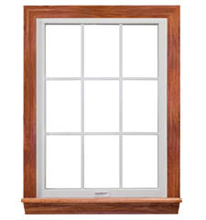
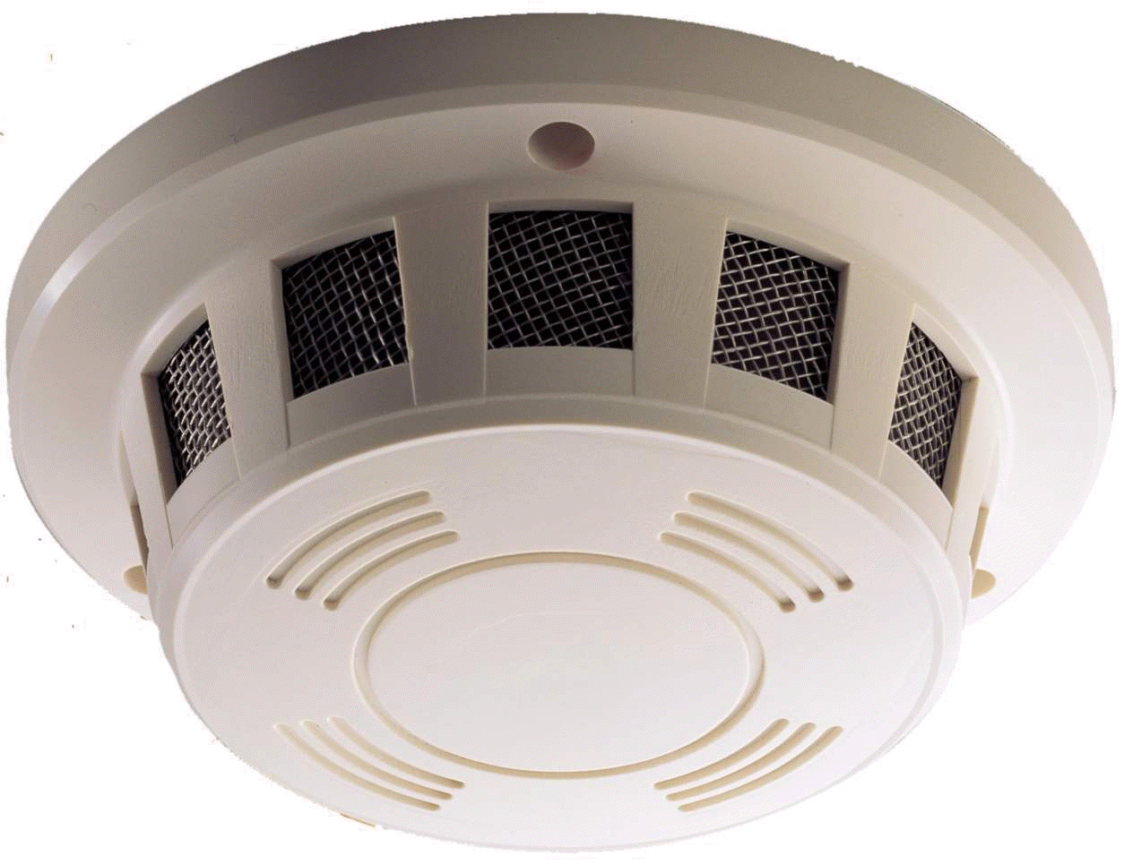
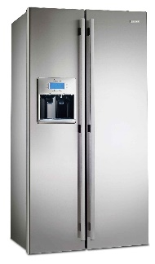
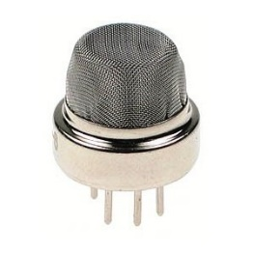
Use case for home security (1)
Door/window sensor, Gas sensor, Smoke detector, home appliances
Door
LRLP AP
Outdoor
mobile device
Window
Smoke detector
Home appliances
Gas sensor
control

Slide 7
Use case for home security (2)
Any abnormal state sends an alarm to the mobile device
Fast wakeup
  From a dormant state, the communication must be reestablished quickly
  Bypass login procedure, pairing, DHCP, etc.
Reconnection procedure must be secure as well

Slide 8
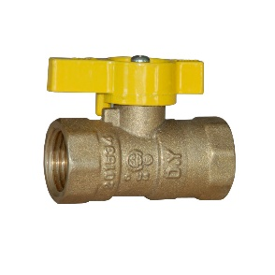
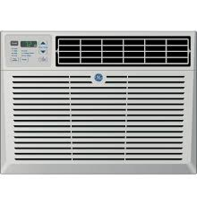
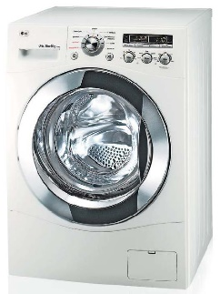
Use case for indoor device control
Gas value controller, Heater/AC, Home appliances, Surveillance cameras
Gas valve
controller
LRLP AP
Controller (outdoor
mobile device)
Heater
A/C
Washing machine
control

Slide 9
Summary
The mobile device controls the indoor devices
For home theater use case, pairing is performed through LRLP AP by a mobile device for direct connection between A/V devices
For home security use case, fast wakeup and secure reconnection are required
For indoor device control use case, a mobile device can control the indoor devices

