Slide 1
11ax Support for IoT
Date: 2015-09-09
Authors:
Name | Affiliation | Address | Phone | Email
Shimi Shilo | Huawei Technologies. Co., Ltd. |  |  | shimi.shilo@huawei.com
Doron Ezri |  |  |  | doron.ezri@huawei.com
Oded Redlich |  |  |  | oded.redlich@huawei.com
Genadiy Tsodik |  |  |  | genadiy.tsodik@huawei.com
Le Liu |  |  |  | liule@huawei.com
Sheng Liu |  |  |  | martin.liu@huawei.com
Yi Luo |  |  |  | roy.luoyi@huawei.com
Peter Loc |  |  |  | peterloc@iwirelesstech.com
Jiayin Zhang |  |  |  | zhangjiayin@huawei.com
Junghoon Suh |  |  |  | Junghoon.Suh@huawei.com

Slide 2
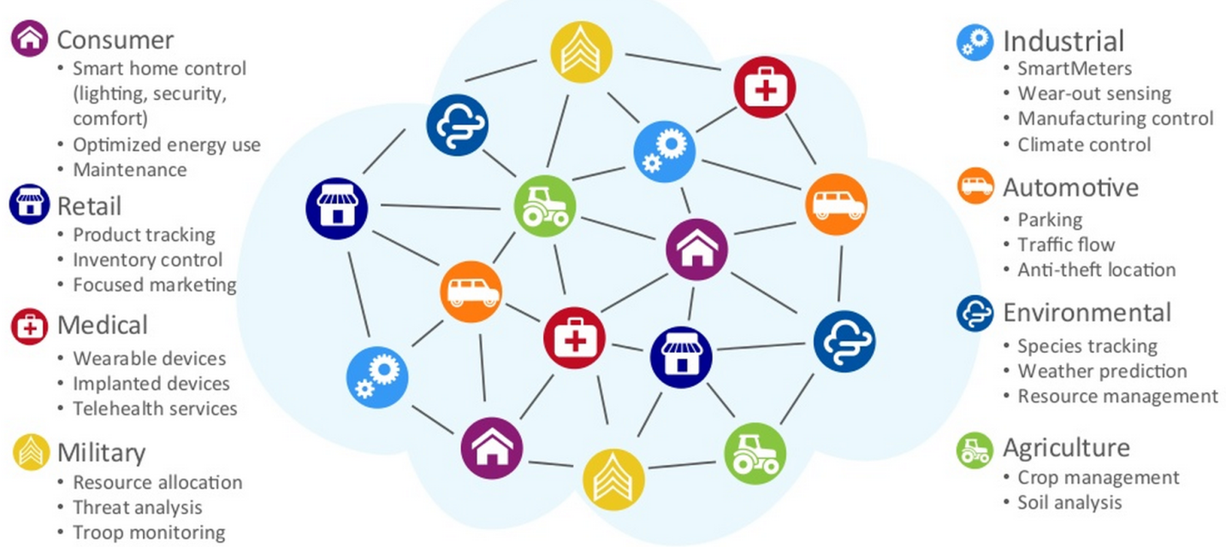
Introduction
  The Internet of Things (IoT) is a scenario where a large number of objects or ‘things’ is connected to the network
  There are many use cases for IoT as shown in the figure below

Slide 3
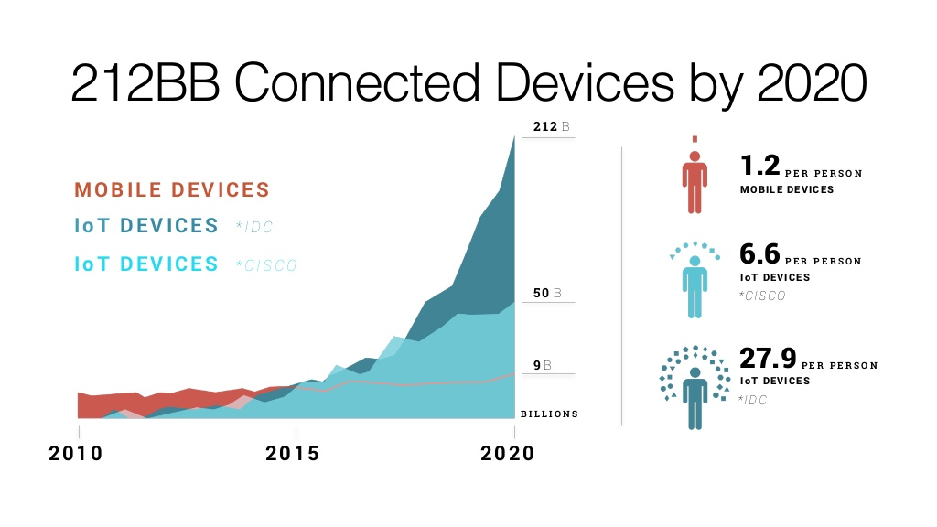
Introduction
  Current estimates for IoT devices range from several billion to 200 billion IoT devices connected to the internet by 2020
  Though many of these devices will use other technologies (ZigBee, Bluetooth, etc.), we want as many of these IoT devices to use 11ax

Slide 4
Impact of IoT Devices on the Network
  Adding IoT devices to the network has several impacts:
    Number of Devices: The number of IoT devices is expected to be very large (and much larger than non-IoT devices); the network therefore has to support a much larger number of devices
    Energy Consumption: Many IoT devices will be battery operated, so in order to support these devices energy consumption becomes a very important consideration
    Range Extension: Many of these IoT devices will be located far from the AP, so range extension becomes very important (similar to the 11ah use case, only operating at 2.4GHz and 5GHz bands)
  In order for 11ax to effectively support IoT devices, the above 3 pillars need to be considered

Slide 5
IoT Initiative in 802.11
  It was recently proposed in the WNG SC to start a study group focusing on Long Range Lower Power (LRLP) operation for IoT [1]
  This proposal suggests, among other objectives:
    10dB link margin improvement
    Range functionality at least comparable with 11ah (and operating at higher frequency bands)
    Significantly lower energy consumption
    Coexistence and limited impact on primary BSS
  We believe that new designs within 11ax can incorporate these ideas so that 11ax can become the IoT leader within 802.11
  The link margin value is TBD

Slide 6
Supporting IoT in 11ax
New low PAPR transmission scheme co-existing with OFDMA
  Low PAPR Training (HE-STF, HE-LTF)
  Some features are common for more than one foundation; in the next slides we will discuss some of them
Narrow Bandwidth
Transmission co-existing with OFDMA
Smart link adaptation, including band selection
Relay (D2D)
Range Extension
New, efficient Random Access scheme
Energy optimized resource allocations
MAC header compression
Advanced power save mechanisms
Minimizing Energy Consumption
Supporting many STAs
Time re-use (Time
Segments)
Limiting number of clients (sectorization, etc.)

Slide 7
Narrow Bandwidth Transmission Co-Existing with OFDMA
  Transmissions using narrow bandwidth can benefit both range extension and reducing energy consumption
  In addition, this enables STAs to re-use the RF of conventional long range low power devices
  In order to efficiently support IoT STAs, a new frame structure combining low bandwidth IoT STAs with 11ax STAs should be defined
  Combining 11ax into the OFDMA frame yields several spectrum utilization benefits:
    Narrowband IoT devices fit easily into small RUs in 11ax OFDMA
    Simultaneous transmission to/from IoT and 11ax devices
    Reusing/enhancing power saving in 11ax to reduce energy consumption

Slide 8
Narrow Bandwidth Transmission Co-Existing with OFDMA
  In addition, re-using OFDMA increases access connections via
    UL MU-MIMO (x8)
    DL/UL OFDMA small RUs (x9 within 20MHz)
    Time segments for small packets (x4)
  The IoT STAs’ transmission may be based on OFDM or alternative schemes such as, for example, single-carrier
  Using OFDM for IoT has minimal impact on 11ax, however PAPR may be too high
  Using single-carrier may yield lower PAPR (especially in the uplink) which is important for both range extension and reducing energy consumption

Slide 9
Low PAPR Transmission Scheme Co-Existing with OFDMA
  Far users are (also) limited by the PAPR of their transmitted signal; when the maximum PAPR is e.g. 10dB, the PA backs-off ~10dB, so the average transmitted power is ~10dB lower than the max power
  Clearly, reducing the maximum PAPR (while maintaining detection quality) directly translates into range extension
  We would like to use a transmission scheme which
    Allows a simple, concurrent transmission with OFDMA
    Allows detection with a single FFT at the receiver, concurrently with other OFDMA signals
    Has significantly lower PAPR than OFDMA, and hopefully also lower than SC-FDMA

Slide 10
Low PAPR Transmission Scheme Co-Existing with OFDMA
  We may consider a single-carrier transmission technique that co-exists together with OFDMA
  Here co-existence means that although the modulation schemes are different, the waveforms remain orthogonal at the receiver’s FFT output
SC Part
SC Tx
FFT
OFDMA Tx
OFDMA Part

Slide 11
Low PAPR Transmission Scheme Co-Existing with OFDMA
  Our initial investigations show that special attention to the PAPR issue can result in significantly lower PAPR over OFDMA and even LTE’s SC-FDMA
  The significant gap compared with OFDMA may be translated into significant range extension, for example for remote IoT devices

Slide 12
Low PAPR Training Signals
  Reducing the PAPR of the data part is not satisfactory by itself, since it is always preceded by other fields (e.g. training fields)
  The field with the highest PAPR is the bottleneck in terms of limiting the transmitted power
  We therefore need to make sure the PAPR of the training fields is not higher than the new, lower PAPR of the data part

Slide 13
Energy Optimized Resource Allocation
  Optimizing the transmission for minimal energy consumption leads to surprising results (this is not the common optimality criterion in wireless communications)
  In contrast to the “natural” approach of allocating narrow Tx bandwidth, fundamental information theoretic results show that the consumed energy decreases strongly as the allocated bandwidth increases
  Moreover, results remain consistent with this rule when considering the consumed power of practical PAs
  On the other hand, the required resources increase with the bandwidth, so there is a trade-off between minimal energy and minimal resources

Slide 14
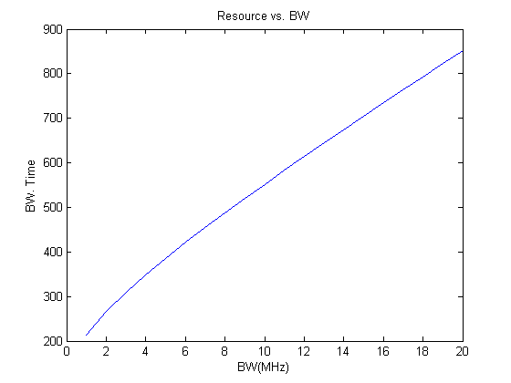
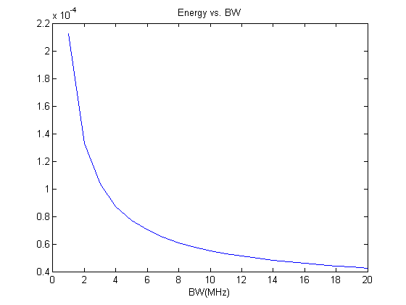
Energy Optimized Resource Allocation
  The figure on the right shows how the energy decreases with the bandwidth
  The figure on the left shows how the resources (bandwidth X time) increase with the bandwidth

Slide 15
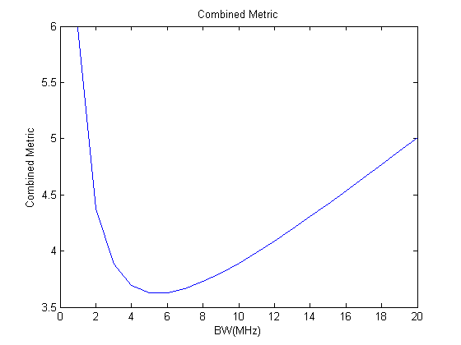
Energy Optimized Resource Allocation
  Considering the consumed energy (mostly for off-grid devices), may
  lead to a very significant increase in battery-life
  We can consider, as an example, a new
  metric which combines the bandwidth
  and resources to yield the optimal
  operating point
  The figure on the right shows an
  example of such a combined metric,
  where it is shown that the optimal
  bandwidth is ~6MHz where the
  energy is 1/3
  Such energy efficiency considerations may be applicable in specific IoT scenarios

Slide 16
Efficient Random Access Scheme
  Adding support for IoT STAs means the random access mechanism needs to accommodate:
    Range extension – at least as much as the HE-Data field
    Large number of STAs – ensuring low collision rate probability
    Short duty-cycle - transmitting and receiving within a very short pre-defined time frame
  Such a design can of course be used for IoT & Non-IoT STAs so that the overall system performance is improved
  We believe a new narrow bandwidth, extremely low PAPR design which supports detection of a very large number of simultaneous STAs can meet the requirements of IoT and significantly improve system efficiency

Slide 17
MAC Header Compression
  IoT STAs are expected to transmit a very short packet, up to ~32B [1]
  When considering the 11ac 34B MAC header, the latter becomes very significant compared with data payload
  The figure on the right compares the
  total transmission time assuming a
  60usec preamble, and two MAC
  header sizes – 11ac and reduced (~50%)
  As shown, the total transmission time
  can be significantly reduced, especially
  for low payload sizes
  In terms of energy, this reduced duration
  can significantly reduce the consumption

Slide 18
Summary
  There is an initiative within 802.11 WNG SC to begin working on supporting long range low power IoT devices
  We believe that new designs within 11ax can help 11ax become the IoT leader within 802.11
  Specifically the low PAPR single-carrier approach may provide the 10dB link margin improvement defined by the LRLP initiative, as well as a better alternative than 11b (range extension, multiplexing, UL MU-MIMO)
  We presented the main pillars required for 11ax to support IoT, and which important features should be included in order for the standard to effectively include IoT STAs

Slide 19
References
[1] IEEE 802.11-15/0775r1 WNG Integrated Long Range Low Power Operation for IoT

