Slide 1
“802.11 as a component”
Available OAM interface specifications
Date: 2015-09-14
Authors:

Slide 2
Abstract
The presentation provides an overview about available specifications of open OAM interfaces for implementations of IEEE 802.11.
In a particular sense all the specifications describe ‘802.11 as a kind of component’.
The material may provide insights into today’s requirements and capabilities, as the presented specifications are all widely deployed.

Slide 3




IEEE 802.11 Standards Environment
IEEE 802.11 defines a radio interface
Wi-Fi Alliance ensures compliance of the radio interface by certification
OAM of the 802.11 radio interface is described by a comprehensive MIB
A couple of organizations developed special variants of OAM interfaces for 802.11
However there is a single solution for AAA: RADIUS
AAA
Server
802.11
OAM
AAA
?
IEEE 802.11
Network
RADIUS

Slide 4
‘OAM’ Interface Specifications for 802.11
BroadBandForum
  Wi-Fi model and attributes of Device Data Model 2 (TR-181) for
  CPE WAN Management Protocol (TR-069)
CableLabs
  Wi-Fi Provisioning Framework Specification (WR-SP-WiFi-MGMT)
IETF CAPWAP
  Control And Provisioning of Wireless Access Points (CAPWAP) Protocol Specification (RFC5415) and Binding for IEEE 802.11 (RFC5416)
LINUX Wireless
  mac80211 Wi-Fi driver architecture with cfg80211 kernel configuration module and nl80211 netlink user space interface
IETF RADIUS
  IEEE 802.1X Remote Authentication Dial In User Service (RADIUS)Usage Guidelines (RFC3580), RADIUS Attributes for IEEE 802 Networks (RFC7268) and Carrying Location Objects in RADIUS and Diameter (RFC5580)

Slide 5
BroadBand Forum CWMP
CWMP: CPE WAN Management Protocol aka TR-069
  https://www.broadband-forum.org/cwmp.php
        Broadband Forum, MR230, TR-069 deployment scenarios
  TR-069 is an soap/HTTP based protocol for transmission of XMLbased descriptions of management models between CPE and ACS
  TR-069 Data Models are xml documents that are “schema-like”, that describe the management objects and parameters used for particular use cases.
The CWMP Data Model Schema is specified in TR-106.
TR-181 defines version 2 of the TR-069 Device data model (Device:2) and is applicable to all types of TR-069-enabled devices. It obsoletes both Device:1 and InternetGatewayDevice:1 specifications

Slide 6
TR-181 Wi-Fi Model
Device.WiFi
Device.WiFi.Radio.{i}
Device.WiFi.Radio.{i}.Stats
Device.WiFi.NeighboringWiFiDiagnostic
Device.WiFi.NeighboringWiFiDiagnostic.Results.{i}
WiFi.SSID.{i}
WiFi.SSID.{i}.Stats
WiFi.EndPoint.{i}.
WiFi.EndPoint.{i}.Stats
WiFi.EndPoint.{i}.Securtiy
WiFi.EndPoint.{i}.Profile.{i}
WiFi.EndPoint.{i}.Profile.{i}.Security
WiFi.EndPoint.{i}.WPS
WiFi.EndPoint.{i}.AC.{i}
WiFi.EndPoint.{i}.AC.{i}.Stats
WiFi.AccessPoint.{i}
WiFi.AccessPoint.{i}. Security
WiFi.AccessPoint.{i}. Accounting
WiFi.AccessPoint.{i}.WPS
WiFi.AccessPoint.{i}. AssociatedDevises.{i}
WiFi.AccessPoint.{i}. AssociatedDevises.{i}.Stats
WiFi.AccessPoint.{i}.AC.{i}
WiFi.AccessPoint.{i}.AC.{i}.Stats

Slide 7
TR-181 Wi-Fi model summary
TR-181 supports two kinds of devices: APs and (nonAP) STAs (Endpoints)
A Wi-Fi device consists out of 1..n radio interfaces, 1..n SSIDs and 1..n AccessPoints or EndPoints
A compact set of IEEE 802.11 specific attributes are provided for configuration
Each of the elements of the Wi-Fi model has a rich set of attributes for monitoring/accounting/statistics.

Slide 8
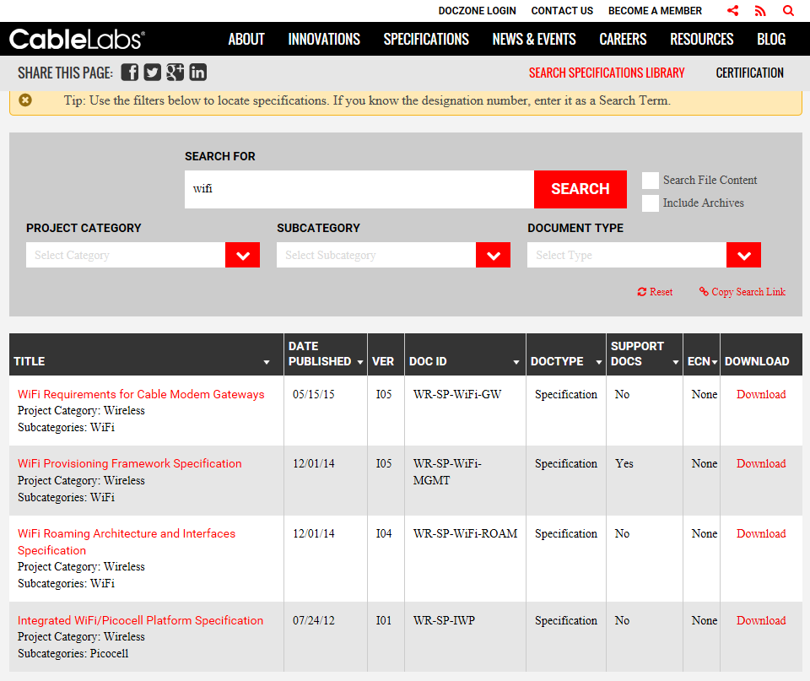
CableLabs

Slide 9
CableLabs Wi-Fi MGMT overview
WR-SP-WiFi-MGMT-I05-141201.pdf is CableLabs’ most relevant specification for OAM of Wi-Fi interfaces.
CableLabs builds management of Wi-Fi on top of TR-069 approaches by
  adopting the TR-181 device model for Wi-Fi
  amending the device model by vendor specific extensions for missing functions
  defining a compatible SNMP MIB to enable backward-compatibility to the legacy provisioning and management systems in the cable environment
CableLabs has currently the most far-reaching Wi-Fi management model for ‘residential’ deployments
  Covering Passpoint™ and reaching out into SON for Wi-Fi

Slide 10
CableLab specific extensions:
RadiusClient
Interworking
Service
Passpoint
ClientSessions
ClientState
ApNeighborStats
AccessControlFilter
WR-SP-WiFi-MGMT-I05: Access Point Object Model Class Diagram

Slide 11
IETF CAPWAP
Control And Provisioning of Wireless Access Points
CAPWAP adresses the communication between a wireless termination point (WTP) and an access controller (AC)
Supports different architectural models with various possibilities to locate functions either in WTB or AC
RFC 5415 defines Control And Provisioning of Wireless Access Points (CAPWAP) Protocol
RFC 5416 provides Binding of CAPWAP for IEEE 802.11
+-+ wireless frames +-+
| |--------------------------------| |
| | +-+ | |
| |--------------| |---------------| |
| |wireless PHY/ | | CAPWAP | |
| | MAC sublayer | | | |
+-+ +-+ +-+
STA WTP AC
Representative CAPWAP Architecture for Split MAC
+-+wireless frames +-+ 802.3 frames +-+
| |----------------| |--------------| |
| | | | | |
| |----------------| |--------------| |
| |wireless PHY/ | | CAPWAP | |
| | MAC sublayer | | | |
+-+ +-+ +-+
STA WTP AC
Representative CAPWAP Architecture for Local MAC

Slide 12
Applicability
Market momentum of CAPWAP was never reached to diminishing benefits of split-MAC implementations
  High throughput is easier handled by local MAC solutions
Local MAC solutions not really require a complex protocol like CAPWAP
  Other protocols like TR-069 (or even ssh) are sufficient
802.11 binding in RFC5416 is too hard-coded.
  Even tiny extensions have to go through a complete IETF standardization cycle
  Recent activities in IETF opsawg to amend RFC5416 for more recent 802.11 standards and deployment scenarios
    RFC7494: IEEE 802.11 Medium Access Control (MAC) Profile for Control and Provisioning of Wireless Access Points (CAPWAP)

Slide 13
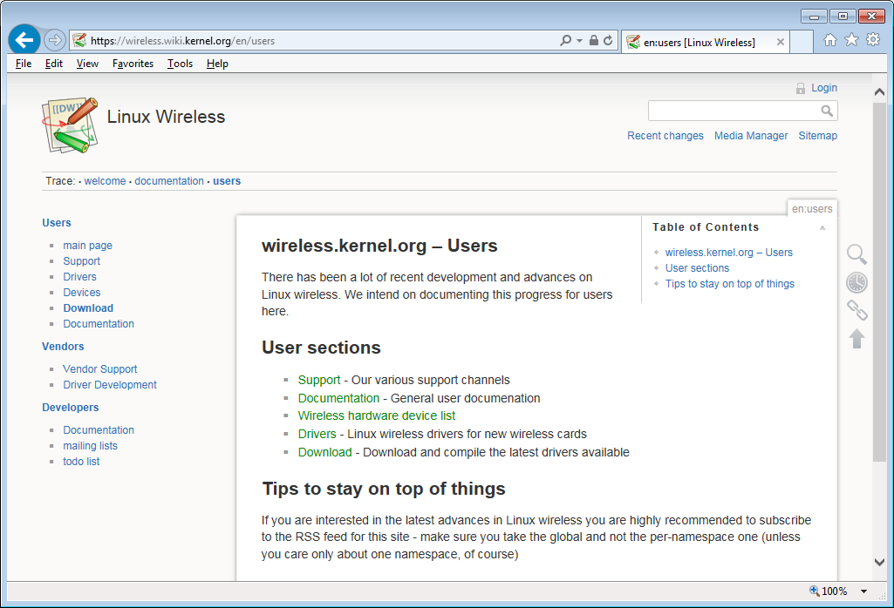
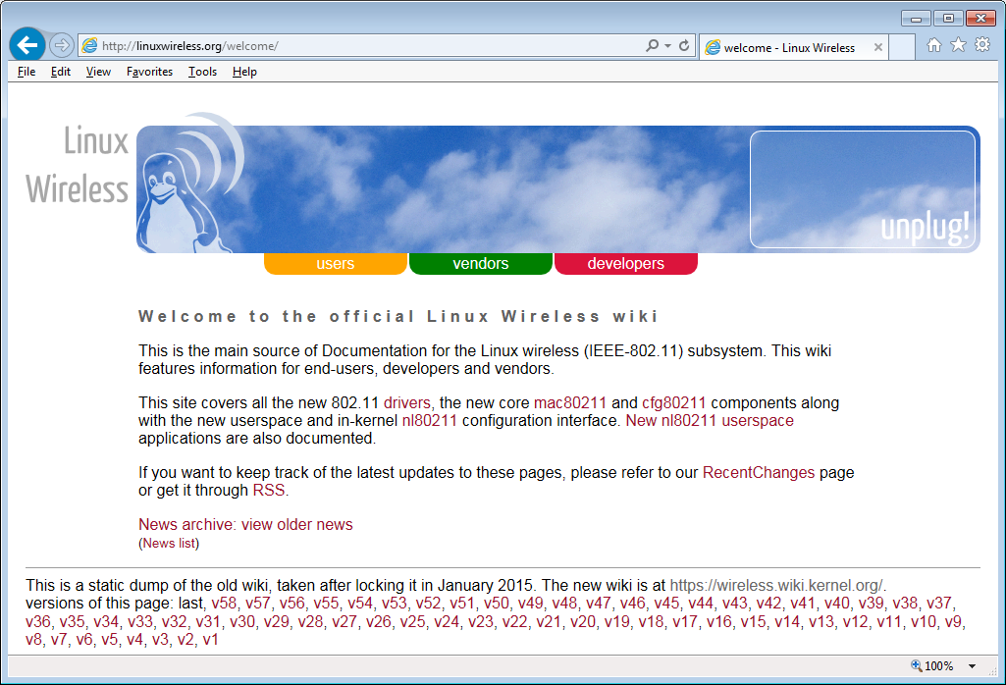
LINUX Wireless

Slide 14
LINUX Wi-Fi driver architecture
iw
hostapd
wpa_suplicant
nl80211 has become defacto standard for Wi-Fi configuration in LINUX
  Defines a comprehensive list of controls, commands and attributes for Wi-Fi
  Communicates by netlink (RFC3549) with kernel
cfg80211 provides unified interface into kernel drivers
…
userspace
nl80211
cfg80211
kernel
mac80211 and future fullmac drivers
Wi-Fi ‘hardware’

Slide 15
Wi-Fi OAM specification ‘nl80211.h’ http://git.kernel.org/cgit/linux/kernel/git/linville/wireless.git/tree/include/uapi/linux/nl80211.h?id=HEAD
#ifndef __LINUX_NL80211_H
#define __LINUX_NL80211_H
/*
* 802.11 netlink interface public header
*
* Copyright 2006-2010 Johannes Berg <johannes@sipsolutions.net>
* Copyright 2008 Michael Wu <flamingice@sourmilk.net>
* Copyright 2008 Luis Carlos Cobo <luisca@cozybit.com>
* Copyright 2008 Michael Buesch <m@bues.ch>
* Copyright 2008, 2009 Luis R. Rodriguez <lrodriguez@atheros.com>
* Copyright 2008 Jouni Malinen <jouni.malinen@atheros.com>
* Copyright 2008 Colin McCabe <colin@cozybit.com>
*
* Permission to use, copy, modify, and/or distribute this software for any
* purpose with or without fee is hereby granted, provided that the above
* copyright notice and this permission notice appear in all copies.
*
* THE SOFTWARE IS PROVIDED "AS IS" AND THE AUTHOR DISCLAIMS ALL WARRANTIES
* WITH REGARD TO THIS SOFTWARE INCLUDING ALL IMPLIED WARRANTIES OF
* MERCHANTABILITY AND FITNESS. IN NO EVENT SHALL THE AUTHOR BE LIABLE FOR
* ANY SPECIAL, DIRECT, INDIRECT, OR CONSEQUENTIAL DAMAGES OR ANY DAMAGES
* WHATSOEVER RESULTING FROM LOSS OF USE, DATA OR PROFITS, WHETHER IN AN
* ACTION OF CONTRACT, NEGLIGENCE OR OTHER TORTIOUS ACTION, ARISING OUT OF
* OR IN CONNECTION WITH THE USE OR PERFORMANCE OF THIS SOFTWARE.
*
*/
#include <linux/types.h>
#define NL80211_GENL_NAME "nl80211"
/**
* DOC: Station handling
*
* Stations are added per interface, but a special case exists with VLAN
* interfaces. When a station is bound to an AP interface, it may be moved
* into a VLAN identified by a VLAN interface index (%NL80211_ATTR_STA_VLAN).
* The station is still assumed to belong to the AP interface it was added
* to.
*
* Station handling varies per interface type and depending on the driver's
* capabilities.
*
nl80211.h defines…
120 commands
about 600 attributes and controls
Potentially nl80211.h is the most comprehensive open OAM interface for 802.11
next to the 802.11 MIB

Slide 16
IETF RADIUS
Remote Authentication Dial-In User Service
RADIUS is commonly used for the communication between Access Point and AAA server for user authentication, user authorization and user accounting.
Support of EAPoLAN (IEEE 802.1X), which was introduced to 802.11 by 802.11i, is specified in RFC3580 (IEEE 802.1X Remote Authentication Dial In User Service (RADIUS) Usage Guidelines).
Further IEEE802 specific attributes are specified by RFC7268 (RADIUS Attributes for IEEE 802 Networks) to support interworking with external networks and enhanced security modes.
RFC5580 (Carrying Location Objects in RADIUS and Diameter) allows also 802.11 to convey location information over the AAA infrastructure.

Slide 17
Conclusion
There are severaly specifications for open OAM interfaces into an IEEE802.11 radio interface.
  Created in various places in the communication industry according to deployment needs
None of them seems to be sufficient to cover all current and future deployment cases.
  Ease of amending the OAM interface specification seems to be highly important to allow for timely deployment of new 802.11 features and functions.
    Apparently some of the current specifications do better than others
Is there really need to start something new from scratch?

Slide 18
Steps forward
Further work on the assessment of existing OAM specification for 802.11 would benefit from input from experts:
Are there other specifications?
Guidance for comparison of specifications?
Is there a recommended structure for listing/grouping capabilities?
  e.g. CableLabs Access Point Management Object Model
Is there any prior art on comparative assessment of 802.11 management models?

