Slide 1
Feedback overhead in DL-MU-MIMO
Date: 2015-09-14
Authors:

Slide 2
Abstract
In this presentation we discuss the need to improve the efficiency of the MIMO compressed feedback mechanism in 11ax, when reporting more than 1 spatial vectors. This can be achieved based on the 11ac feedback format by reducing the number of quantised coefficients

Slide 3
Points of this presentation
In 11ax the amount of CSI feedback needed for DL-MU-MIMO is likely to be larger than for 11ac
Due to sensitivity to channel aging the recurrence in time of feedback reports in MU-MIMO is likely to be larger than for SU-MIMO
Efficiency and performance can be improved by reducing the feedback overhead per CSI report and increase the occurrence of the reports

Slide 4
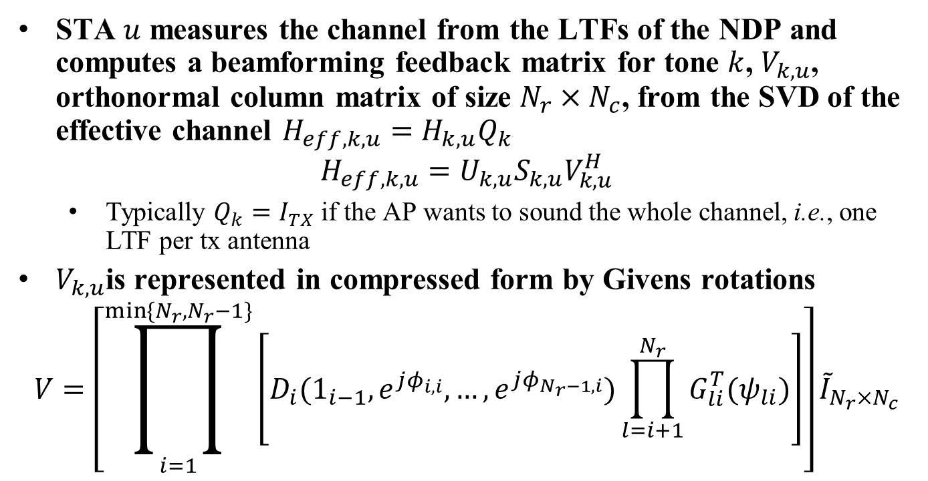
MIMO compressed feedback in 11ac
STA $u$ measures the channel from the LTFs of the NDP and computes a beamforming feedback matrix for tone $k$, $V_{k,u}$, orthonormal column matrix of size $N_{r}×N_{c}$, from the SVD of the effective channel $H_{eff,k,u}=H_{k,u}Q_{k}$
$$H_{eff,k,u}=U_{k,u}S_{k,u}V_{k,u}^{H}$$
  Typically $Q_{k}=I_{TX}$ if the AP wants to sound the whole channel, i.e., one LTF per tx antenna
$V_{k,u}$is represented in compressed form by Givens rotations
$$V=\left[\prod_{i=1}^{\min{\{N_{r},N_{r}−1\}}}{\left[D_{i}(1_{i−1},e^{jφ_{i,i}},…,e^{jφ_{N_{r}−1,i}})\prod_{l=i+1}^{N_{r}}{G_{li}^{T}(ψ_{li})}\right]}\right]{\tilde{I}}_{N_{r}×N_{c}}$$

Slide 5
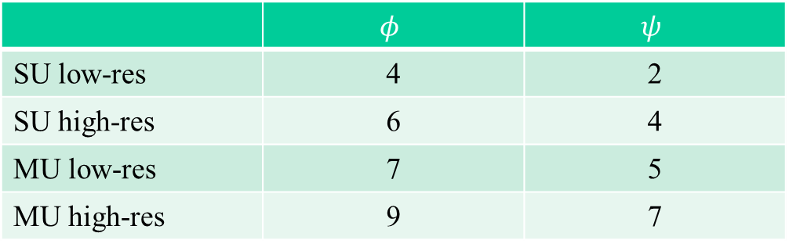
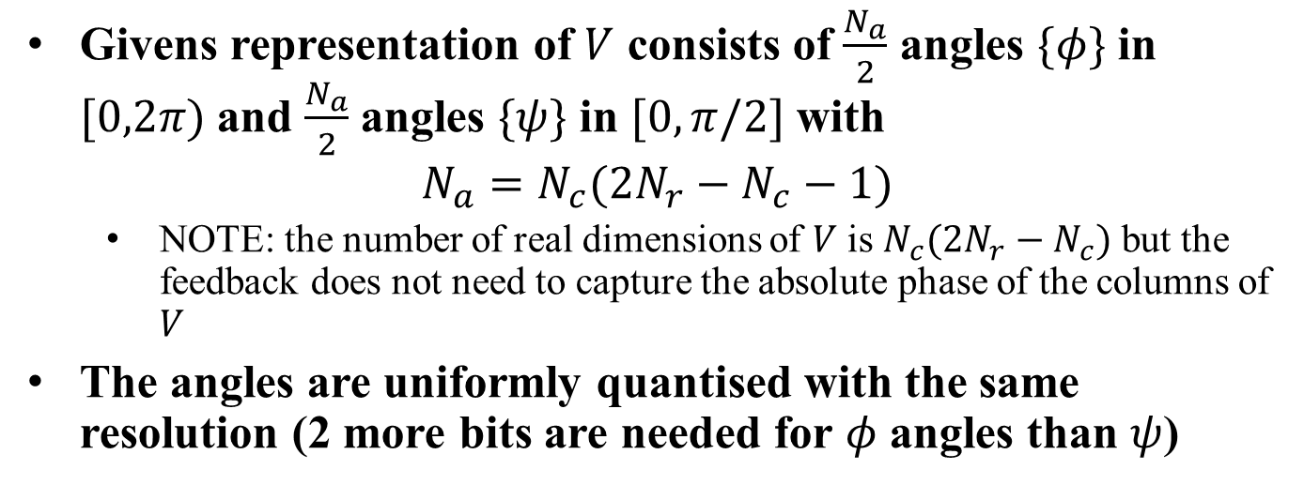
MIMO compressed feedback in 11ac
Givens representation of $V$ consists of $\frac{N_{a}}{2}$ angles $\{φ\}$ in $[0,2π)$ and $\frac{N_{a}}{2}$ angles $\{ψ\}$ in $[0,π/2]$ with
$$N_{a}=N_{c}(2N_{r}−N_{c}−1)$$
  NOTE: the number of real dimensions of $V$ is $N_{c}(2N_{r}−N_{c})$ but the feedback does not need to capture the absolute phase of the columns of $V$
The angles are uniformly quantised with the same resolution (2 more bits are needed for $φ$ angles than $ψ$)
 | $$φ$$ | $$ψ$$
SU low-res | 4 | 2
SU high-res | 6 | 4
MU low-res | 7 | 5
MU high-res | 9 | 7

Slide 6
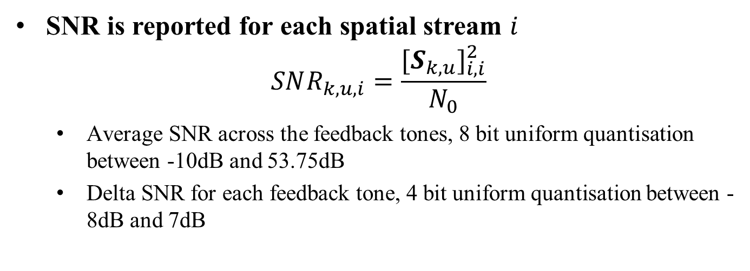
SNR reporting in 11ac
SNR is reported for each spatial stream $i$
$$SNR_{k,u,i}=\frac{{[S_{k,u}]}_{i,i}^{2}}{N_{0}}$$
  Average SNR across the feedback tones, 8 bit uniform quantisation between -10dB and 53.75dB
  Delta SNR for each feedback tone, 4 bit uniform quantisation between -8dB and 7dB

Slide 7
Feedback overhead in 11ax
The amount of feedback in 11ax is likely to increase because
  11ax may be used outdoors with higher channel frequency selectivity and Doppler spread, hence more reports are needed in frequency and time
  Multiple antenna terminals may become more widespread and reporting multiple spatial vectors more common
DL-MU-MIMO is more sensitive to channel aging than SU-MIMO because of the residual interference across users and more frequent reports are needed.
Efficiency and performance can be improved by
  reducing the amount of feedback in each report
  trading off part of this overhead reduction for more frequent reports, to lessen the effect of channel aging

Slide 8
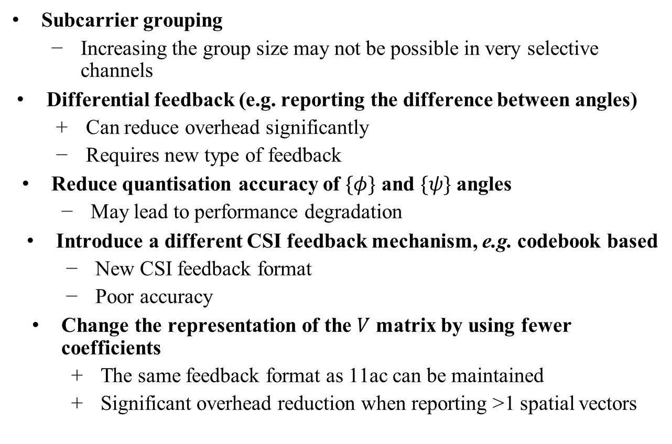
Strategies to reduce feedback overhead
Subcarrier grouping
  Increasing the group size may not be possible in very selective channels
Differential feedback (e.g. reporting the difference between angles)
  Can reduce overhead significantly
  Requires new type of feedback
Reduce quantisation accuracy of $\{φ\}$ and $\{ψ\}$ angles
  May lead to performance degradation
Introduce a different CSI feedback mechanism, e.g. codebook based
  New CSI feedback format
  Poor accuracy
Change the representation of the $V$ matrix by using fewer coefficients
  The same feedback format as 11ac can be maintained
  Significant overhead reduction when reporting >1 spatial vectors

Slide 9


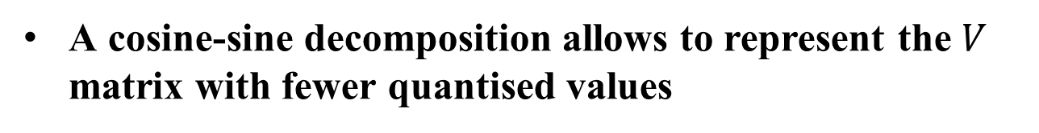
Modified representation of $V$
A cosine-sine decomposition allows to represent the $V$ matrix with fewer quantised values
The feedback signals a linear combination of the 11ac spatial vectors $V$

Slide 10
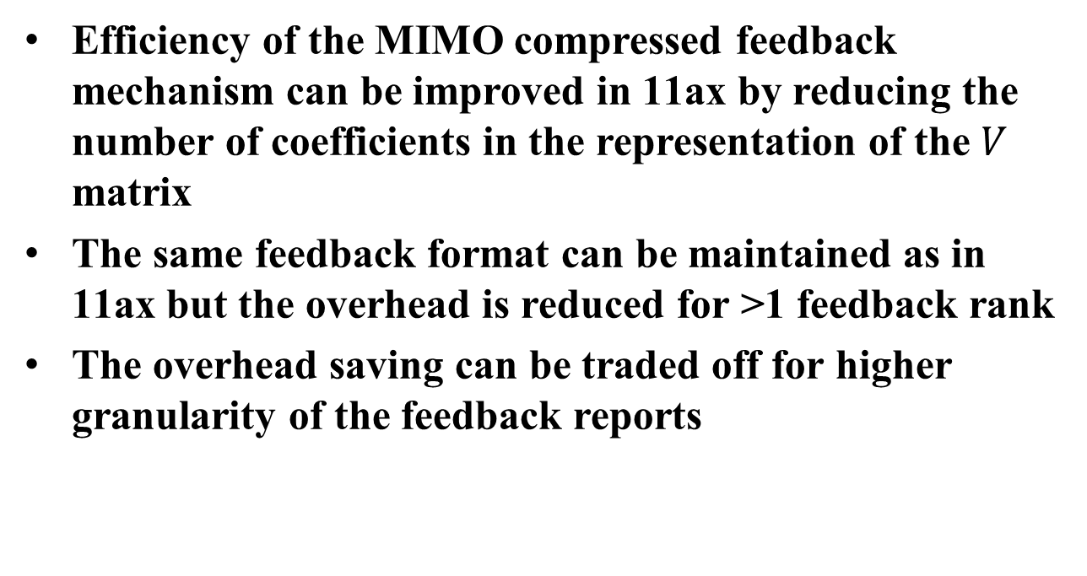
Summary
Efficiency of the MIMO compressed feedback mechanism can be improved in 11ax by reducing the number of coefficients in the representation of the $V$ matrix
The same feedback format can be maintained as in 11ax but the overhead is reduced for >1 feedback rank
The overhead saving can be traded off for higher granularity of the feedback reports

Slide 11
Straw Poll
Do you think there is a need in 11ax to allow for more frequent feedback reports to support MU-MIMO by reducing the overhead of each report
  Y:N:A =

