Slide 1
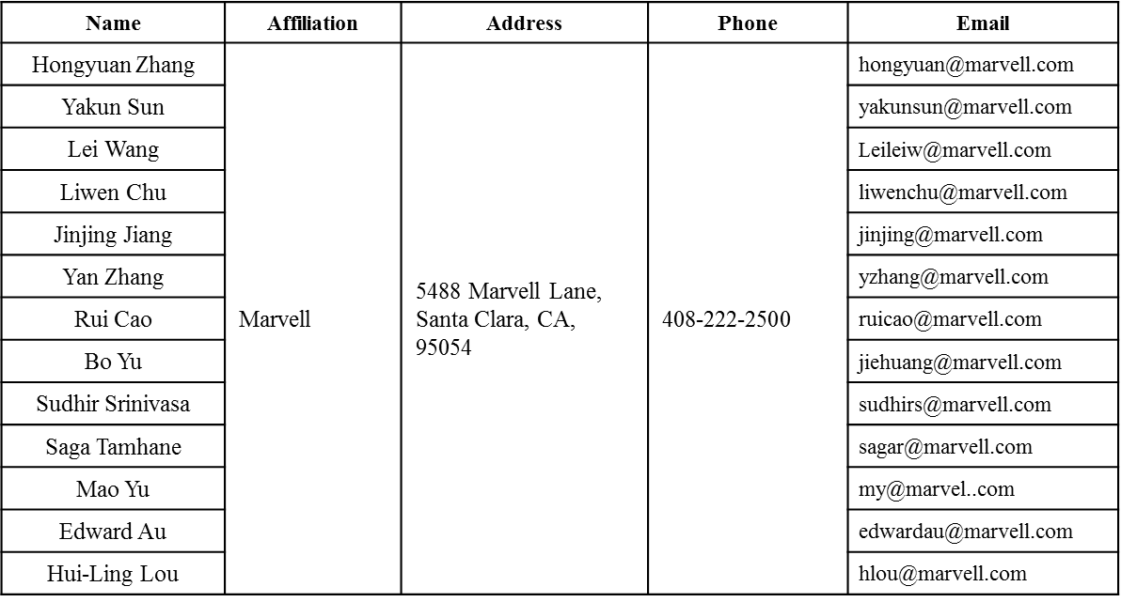
Acknowledgement to DL MU
Date: 2015-09-14

Slide 2
Authors (continued)
Name | Affiliation | Address | Phone | Email
Albert Van Zelst | Qualcomm | Straatweg 66-S Breukelen, 3621 BR Netherlands |  | allert@qti.qualcomm.com
Alfred Asterjadhi |  | 5775 Morehouse Dr. San Diego, CA, USA |  | aasterja@qti.qualcomm.com
Arjun Bharadwaj |  | 5775 Morehouse Dr. San Diego, CA, USA |  | arjunb@qti.qualcomm.com
Bin Tian |  | 5775 Morehouse Dr. San Diego, CA, USA |  | btian@qti.qualcomm.com
Carlos Aldana |  | 1700 Technology Drive San Jose, CA 95110, USA |  | caldana@qca.qualcomm.com
George Cherian |  | 5775 Morehouse Dr. San Diego, CA, USA |  | gcherian@qti.qualcomm.com
Gwendolyn Barriac |  | 5775 Morehouse Dr. San Diego, CA, USA |  | gbarriac@qti.qualcomm.com
Hemanth Sampath |  | 5775 Morehouse Dr. San Diego, CA, USA |  | hsampath@qti.qualcomm.com
Menzo Wentink |  | Straatweg 66-S Breukelen, 3621 BR Netherlands |  | mwentink@qti.qualcomm.com
Richard Van Nee |  | Straatweg 66-S Breukelen, 3621 BR Netherlands |  | rvannee@qti.qualcomm.com
Rolf De Vegt |  | 1700 Technology Drive San Jose, CA 95110, USA |  | rolfv@qca.qualcomm.com
Sameer Vermani |  | 5775 Morehouse Dr. San Diego, CA, USA |  | svverman@qti.qualcomm.com
Simone Merlin |  | 5775 Morehouse Dr. San Diego, CA, USA |  | smerlin@qti.qualcomm.com
Tevfik Yucek |  | 1700 Technology Drive San Jose, CA 95110, USA |  | tyucek@qca.qualcomm.com
VK Jones |  | 1700 Technology Drive San Jose, CA 95110, USA |  | vkjones@qca.qualcomm.com
Youhan Kim |  | 1700 Technology Drive San Jose, CA 95110, USA |  | youhank@qca.qualcomm.com

Slide 3
Authors (continued)
Name | Affiliation | Address | Phone | Email
Robert Stacey | Intel | 2111 NE 25th Ave, Hillsboro OR 97124, USA | +1-503-724-893 | robert.stacey@intel.com
Eldad Perahia |  |  |  | eldad.perahia@intel.com
Shahrnaz Azizi |  |  |  | shahrnaz.azizi@intel.com
Po-Kai Huang |  |  |  | po-kai.huang@intel.com
Qinghua Li |  |  |  | quinghua.li@intel.com
Xiaogang Chen |  |  |  | xiaogang.c.chen@intel.com
Chitto Ghosh |  |  |  | chittabrata.ghosh@intel.com
Laurent cariou |  |  |  | laurent.cariou@intel.com
Rongzhen Yang |  |  |  | rongzhen.yang@intel.com
Ron Porat | Broadcom |  |  | rporat@broadcom.com
Matthew Fischer |  |  |  | mfischer@broadcom.com
Sriram Venkateswaran
Andrew Blanksby
Matthias Korb
Tu Nguyen
Vinko Erceg

Slide 4
Authors (continued)
Name | Affiliation | Address | Phone | Email
James Yee | Mediatek | No. 1 Dusing 1st Road, Hsinchu, Taiwan | +886-3-567-0766 | james.yee@mediatek.com
Alan Jauh |  |  |  | alan.jauh@mediatek.com
Chingwa Hu |  |  |  | chinghwa.yu@mediatek.com
Frank Hsu |  |  |  | frank.hsu@mediatek.com
Thomas Pare | Mediatek USA | 2860 Junction Ave, San Jose, CA 95134, USA | +1-408-526-1899 | thomas.pare@mediatek.com
ChaoChun Wang |  |  |  | chaochun.wang@mediatek.com
James Wang |  |  |  | james.wang@mediatek.com
Jianhan Liu |  |  |  | Jianhan.Liu@mediatek.com
Tianyu Wu |  |  |  | tianyu.wu@mediatek.com
Russell Huang |  |  |  | russell.huang@mediatek.com
Joonsuk Kim | Apple |  |  | joonsuk@apple.com
Aon Mujtaba |  |  |  | mujtaba@apple.com
Guoqing Li |  |  |  | guoqing_li@apple.com
Eric Wong |  |  |  | ericwong@apple.com
Chris Hartman |  |  |  | chartman@apple.com

Slide 5
Authors (continued)
Name | Affiliation | Address | Phone | Email
Phillip Barber | Huawei | The Lone Star State, TX |  | pbarber@broadbandmobiletech.com
Peter Loc |  |  |  | peterloc@iwirelesstech.com
Le Liu |  | F1-17, Huawei Base, Bantian, Shenzhen | +86-18601656691 | liule@huawei.com
Jun Luo |  | 5B-N8, No.2222 Xinjinqiao Road, Pudong, Shanghai |  | jun.l@huawei.com
Yi Luo |  | F1-17, Huawei Base, Bantian, Shenzhen | +86-18665891036 | Roy.luoyi@huawei.com
Yingpei Lin |  | 5B-N8, No.2222 Xinjinqiao Road, Pudong, Shanghai |  | linyingpei@huawei.com
Jiyong Pang |  | 5B-N8, No.2222 Xinjinqiao Road, Pudong, Shanghai |  | pangjiyong@huawei.com
Zhigang Rong |  | 10180 Telesis Court, Suite 365, San Diego, CA 92121 NA |  | zhigang.rong@huawei.com
Rob Sun |  | 303 Terry Fox, Suite 400 Kanata, Ottawa, Canada |  | Rob.Sun@huawei.com
David X. Yang |  | F1-17, Huawei Base, Bantian, Shenzhen |  | david.yangxun@huawei.com
Yunsong Yang |  | 10180 Telesis Court, Suite 365, San Diego, CA 92121 NA |  | yangyunsong@huawei.com
Zhou Lan |  | F1-17, Huawei Base, Bantian, SHenzhen | +86-18565826350 | Lanzhou1@huawei.com
Junghoon Suh |  | 303 Terry Fox, Suite 400 Kanata, Ottawa, Canada |  | Junghoon.Suh@huawei.com
Jiayin Zhang |  | 5B-N8, No.2222 Xinjinqiao Road, Pudong, Shanghai | +86-18601656691 | zhangjiayin@huawei.com

Slide 6
Authors (continued)
Name | Affiliation | Address | Phone | Email
Hyeyoung Choi | LG Electronics | 19, Yangjae-daero 11gil, Seocho-gu, Seoul 137-130, Korea |  | hy0117.choi@lge.com
Kiseon Ryu |  |  |  | kiseon.ryu@lge.com
Jinyoung Chun |  |  |  | jiny.chun@lge.com
Jinsoo Choi |  |  |  | js.choi@lge.com
Jeongki Kim |  |  |  | jeongki.kim@lge.com
Giwon Park |  |  |  | giwon.park@lge.com
Dongguk Lim |  |  |  | dongguk.lim@lge.com
Suhwook Kim |  |  |  | suhwook.kim@lge.com
Eunsung Park |  |  |  | esung.park@lge.com
HanGyu Cho |  |  |  | hg.cho@lge.com
Thomas Derham | Orange |  |  | thomas.derham@orange.com
Bo Sun | ZTE | #9 Wuxingduan, Xifeng Rd., Xi'an, China |  | sun.bo1@zte.com.cn
Kaiying Lv |  |  |  | lv.kaiying@zte.com.cn
Yonggang Fang |  |  |  | yfang@ztetx.com
Ke Yao |  |  |  | yao.ke5@zte.com.cn
Weimin Xing |  |  |  | xing.weimin@zte.com.cn
Brian Hart | Cisco Systems | 170 W Tasman Dr, San Jose, CA 95134 |  | brianh@cisco.com
Pooya Monajemi |  |  |  | pmonajem@cisco.com

Slide 7
Authors (continued)
Name | Affiliation | Address | Phone | Email
Fei Tong | Samsung | Innovation Park, Cambridge CB4 0DS (U.K.) | +44 1223 434633 | f.tong@samsung.com
Hyunjeong Kang |  | Maetan 3-dong; Yongtong-Gu Suwon; South Korea | +82-31-279-9028 | hyunjeong.kang@samsung.com
Kaushik Josiam |  | 1301, E. Lookout Dr, Richardson TX 75070 | (972) 761 7437 | k.josiam@samsung.com
Mark Rison |  | Innovation Park, Cambridge CB4 0DS (U.K.) | +44 1223 434600 | m.rison@samsung.com
Rakesh Taori |  | 1301, E. Lookout Dr, Richardson TX 75070 | (972) 761 7470 | rakesh.taori@samsung.com
Sanghyun Chang |  | Maetan 3-dong; Yongtong-Gu Suwon; South Korea | +82-10-8864-1751 | s29.chang@samsung.com
Yasushi Takatori | NTT | 1-1 Hikari-no-oka, Yokosuka, Kanagawa 239-0847 Japan |  | takatori.yasushi@lab.ntt.co.jp
Yasuhiko Inoue |  |  |  | inoue.yasuhiko@lab.ntt.co.jp
Yusuke Asai |  |  |  | asai.yusuke@lab.ntt.co.jp
Koichi Ishihara |  |  |  | ishihara.koichi@lab.ntt.co.jp
Akira Kishida |  |  |  | kishida.akira@lab.ntt.co.jp
Akira Yamada | NTT DOCOMO | 3-6, Hikarinooka, Yokosuka-shi, Kanagawa, 239-8536, Japan |  | yamadaakira@nttdocomo.com
Fujio Watanabe |  | 3240 Hillview Ave, Palo Alto, CA 94304 |  | watanabe@docomoinnovations.com
Haralabos Papadopoulos |  |  |  | hpapadopoulos@docomoinnovations.com

Slide 8
Overview of Trigger Frame Format
Unicast Trigger and broadcast Trigger frame are MAC control frames.
Unicast Trigger and broadcast Trigger can be transmitted in DL OFDMA PPDU. ^{[2]}
MPDU Delimiter is attached to the Trigger frame in such case.
Common Info and Per STA Info are included in frame body of Trigger frame.
4
Common Info
Per STA/Group Info
Pad
STA0’s Info or
Group 0 Info
……
STAn’s Info or
Group m Info

Slide 9
DL OFDMA Frame Exchange Sequence
11ax allows DL OFDMA
DL MU MIMO may be combined with DL OFDMA.
STAs which are DL OFDMA receivers need to acknowledge the received frames if the AP ask for immediate Ack or BA.
OFDMA acknowledge can decrease the acknowledge overhead
Trigger frame or its simplification should be used for scheduling UL OFDMA acknowledgement.
OFDMA BA
AP’s (MU MIMO) A-MPDU with unicast Trigger to STA0, STA4, STA5
BA
BA
BA
BA
AP’s A-MPDU with unicast Trigger to STA3
Backoff or
PIFS
BA
AP’s A-MPDU with unicast Trigger to STA2
BA
AP’s A-MPDU with unicast Trigger to STA1
BA
Primary 20MHz channel.
DL
UL
TXOP

Slide 10
Simplified Trigger for UL OFDMA Acknowledgement
Unicast trigger frame can transmit schedule info for UL OFDMA data and acknowledgement from STAs.
In DL OFDMA with short data frame, e.g. ~ 80-byte data PPDU in narrow resource unit (RU = subchannel), unicast trigger frame has bigger overhead.
The simplified Trigger for OFDMA acknowledgement can decrease the overhead and should include the following scheduling information in the frame payload:
RU Allocation includes Resource Unit information allocated to the STA.
UL PPDU Length.
MCS can be omitted since the AP and STA can figure out the same MCS by UL PPDU Length and RU Allocation
The most robust MCS whose transmission time is shorter than UL PPDU Length can be selected.
Other fields in Unicast trigger frame can also be saved when triggering UL OFDMA acknowledgement, e.g.
AID, TC, Nsts are not needed for control frame.
GI Mode, LTF Type/Num can be same as DL OFDMA.
Bits:
9
TBD
UL PPDU Length
RU Allocation

Slide 11
Simplified Trigger in MAC Header
Putting the schedule information (frame body) of the simplified Trigger in MAC header
uses less medium time than that used by separate Trigger.
guarantee that a STA correctly receives schedule information when the STA needs to acknowledge the received frames.
 | OFDMA ACK Trigger in MAC header | OFDMA ACK Trigger in MAC Frame
12bits/symbol/26tones | 27.2us | 190.4us
24bits/symbol/26tones | 13.6us | 95.2us
48bits/symbol/26tones | 6.8us | 47.6us
4
2 | 2 | 6 or 0 | 6 | ~3 | 4
Frame Control | Duration | A2 | A1 | Simplified Sched Info | FCS
OFDMA ACK Trigger
~3
Simplified Sched Info
OFDMA ACK Trigger in MAC Header

Slide 12
References
[1] 802.11-15/0132-04-00ax-spec-framework
[2] 11-15-0831-00-00ax- broadcast and unicast in DL MU

Slide 13
Straw Poll 1
Do you agree to add the following to the SFD?
The spec shall allow that the schedule information for OFDMA acknowledgement from STAs is contained in the MAC header of DL MPDU.

Slide 14
Straw Poll 2
Do you agree to add the following to the SFD?
The scheduling information content of OFDMA acknowledgement from STAs with the other scheduling information TBD:
UL PPDU Length (9 bits) + RU Allocation (TBD).

