Slide 1
Discussions on Spatial Reuse Enhancement
Date: 2015-09-14
Authors:

Slide 2
Introduction
According to 11ax Functional Requirements[1],
The 802.11ax amendment shall provide a mechanism to facilitate efficient use of spectrum resources and to manage interference between neighboring overlapping BSS (OBSS) in a dense deployment scenario.
Legacy performance shall not be significantly degraded by operation in or in proximity of 11ax network.
Until recently, there have been many contributions that show the improvement of spatial reuse[2-4].
In this contribution, we consider the usage of BSS color and legacy protection scheme when increasing CCA threshold.

Slide 3
BSS Color for 11ax
In the previous contribution [2], spatial reuse gain by changing CCA threshold using the same simulation scenario has been addressed.
For example, 26-112% gain in BSSs total throughput
Transmitting a packet from STA in the same BSS is definitely harmful.
If HE STAs use increased CCA threshold, the interference from HE STA at the same BSS would be increased.
BSS color [5] would be helpful for 11ax to protect transmitted packets in the same BSS.

Slide 4
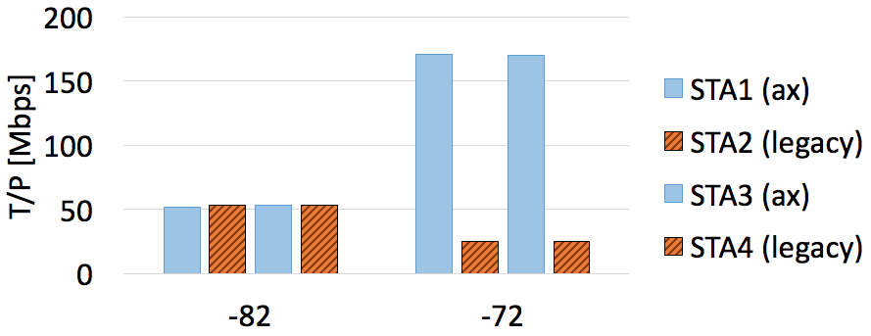
Issue on Legacy STA Fairness
Without any legacy protection scheme, the performance degradation of legacy STA may be serious in a specific environment.
Based on the scenario in [2], replacing two STAs to legacy devices,
Legacy
Legacy
* Simulation results, T/P [Mbps]
← Significant degradation
of legacy STA at -72 dBm
: HE STAs occupy most of airtime continuously.
CCA threshold of ax [dBm]

Slide 5
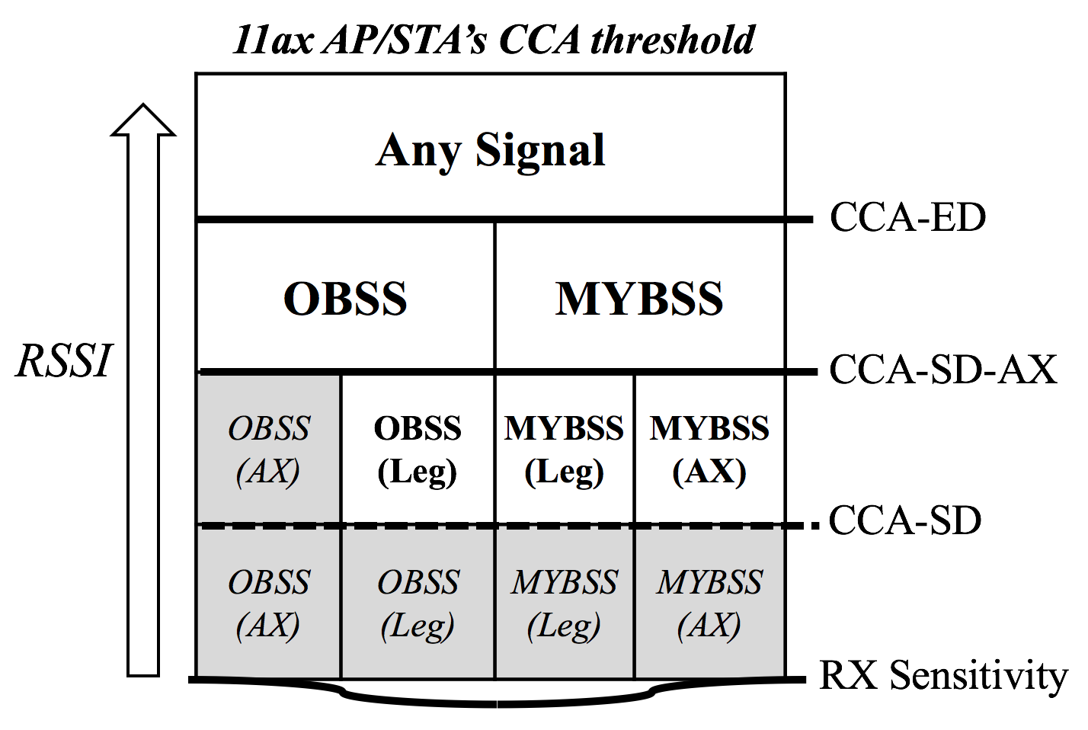
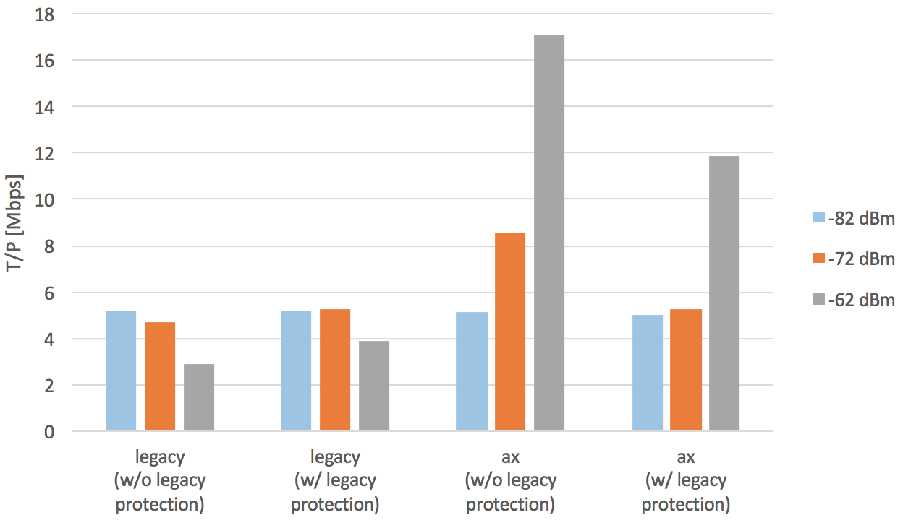
Legacy Fairness Using BSS Color
HE STA applies increased CCA threshold when OBSS HE frame is observed.
HE STA applies the legacy CCA threshold when non-HE frame is observed.
* Simulation results [6], T/P [Mbps]
CCA threshold of ax
Legacy protection scheme mitigates the degradation of legacy STA.

Slide 6
Summary
BSS color in 11ax can be helpful to protect a packet in the same BSS.
In order to provide the fairness to legacy STA, HE STA should apply increased CCA threshold when HE frame from OBSS is observed.

Slide 7
References
[1] 11-14/1009r2 Proposed 802.11ax Functional Requirements
[2] 11-15/0801r0 DCCA/DSC Reference Simulation Results
[3] 11-15/0807r0 DSC Summary
[4] 11-15/0883r2 Follow up Discussion on The Receiver Behavior
[5] IEEE P802.11ah/D5.0
[6] 11-15/0374r1 Further Considerations on Legacy Fairness with Enhanced CCA

Slide 8
Straw poll
Do you agree to add the following text into 11ax SFD ?
5.y.z HE STA shall apply increased CCA threshold for spatial reuse only when HE PPDU from OBSS is observed.
Y
N
A

