Slide 1
Trigger Frame Channel Access
Date: 2015-09-15
Authors:

Slide 2
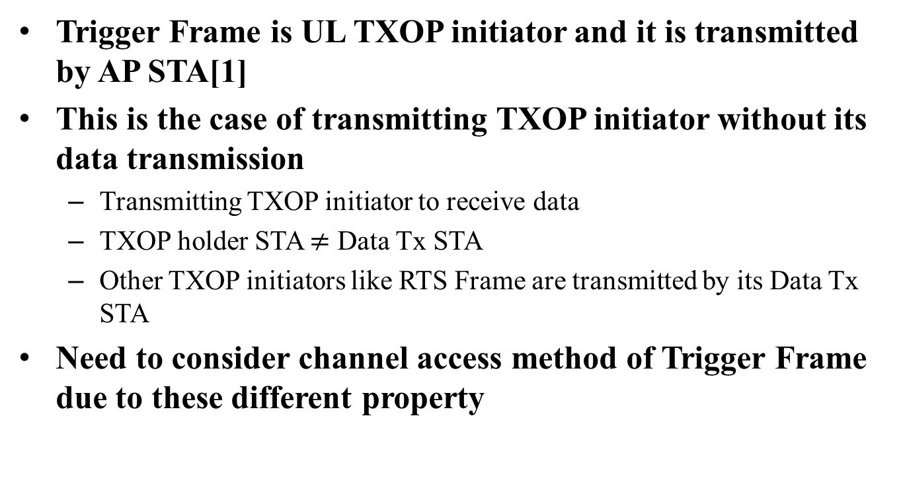
Introduction
Trigger Frame is UL TXOP initiator and it is transmitted by AP STA[1]
This is the case of transmitting TXOP initiator without its data transmission
  Transmitting TXOP initiator to receive data
  TXOP holder STA $≠$ Data Tx STA
  Other TXOP initiators like RTS Frame are transmitted by its Data Tx STA
Need to consider channel access method of Trigger Frame due to these different property

Slide 3
Review – SU simple transmission
Channel Access with EDCA Parameters for data transmission
In this case, TXOP Initiator is Tx Data
EDCA parameters of Data frame follows Access Category of Data frame

Slide 4
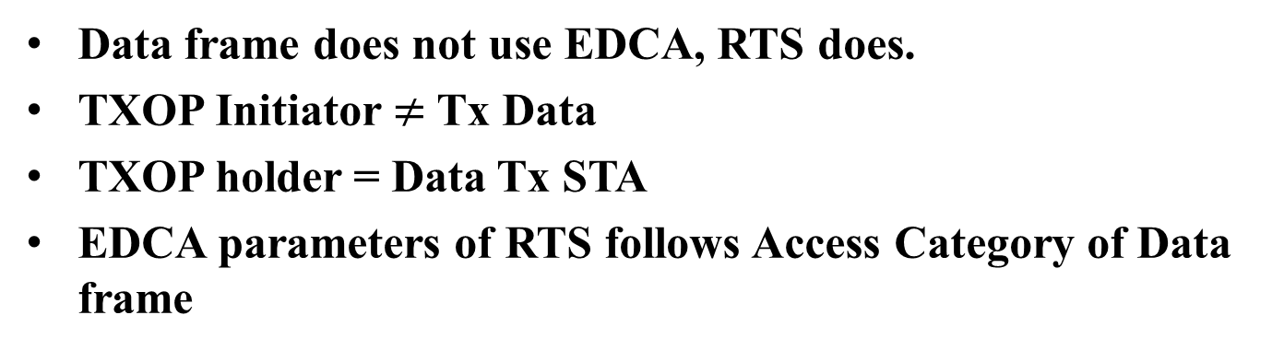
Review – SU RTS/CTS transmission
Data frame does not use EDCA, RTS does.
TXOP Initiator $≠$ Tx Data
TXOP holder = Data Tx STA
EDCA parameters of RTS follows Access Category of Data frame

Slide 5
Review – DL MU-MIMO transmission[2]
TXOP Initiator = Tx Data
Multiple AC could exist on DL Data
Choose Primary AC by virtual contention
DL OFDMA could reuse this scheme

Slide 6
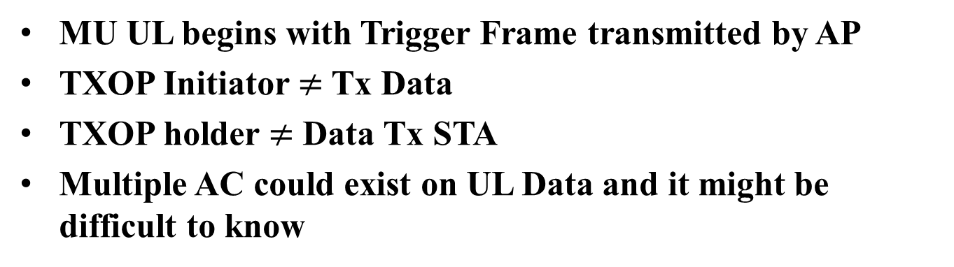
Trigger Frame Based Channel Access
AP
AIFS
Trigger
M
-
Frame
BA
STA
1
UL PPDU
STA
2
UL PPDU
STA
3
UL PPDU
STAs
Which EDCA parameters trigger Frame need to follow
?
MU UL begins with Trigger Frame transmitted by AP
TXOP Initiator $≠$ Tx Data
TXOP holder $≠$ Data Tx STA
Multiple AC could exist on UL Data and it might be difficult to know

Slide 7
Trigger Frame Based Channel Access
Sol 1 – AC feedback before Trigger Frame Transmission
  Access Category of UL Data need to be reported perfectly
  Using virtual contention method like MU DL case
  Pros
    EDCA Parameters of UL Data could be applied for Trigger Frame Channel Access
  Cons
    Perfect feedback need to be preceded
    1-bit UL Data presence feedback is not sufficient
    Random Access Trigger Frame(TF-R) cannot justify its EDCA parameter

Slide 8
Trigger Frame Based Channel Access
Sol 2 – New Access Category for Trigger Frame
  Setting New EDCA parameters for Trigger Frame of MU-UL
  Regardless of UL Data contents, Trigger Frame Access Category would be applied for Trigger Frame Channel Access
  Not only constant EDCA parameters, but also variable EDCA parameters could be considered
    Related to channel bandwidth, number of users, etc.
  Pros
    Simply implemented, AC feedback procedure is not needed
  Cons
    Cannot reflect access category of UL Data

Slide 9
Further Discussion on Trigger Frame
Channel Access
Trigger Frame Failure
  Trigger Frame failure could be justified by following UL PPDU(s)
    An UL OFDMA MPDU/A-MPDU is the acknowledgement of the trigger frame. When the AP receives MPDU correctly from at least one STA indicated by trigger frame, the frame exchange initiated by the trigger frame is successful.[1]
  If Trigger Frame failed to access channel, its exponential back-off procedure need to be considered again
  If trigger frame need to be retransmitted, exponential back-off would be adopted until maximum retransmission count in conventional 802.11
  There are no need to retransmit Trigger Frame due to its validity of scheduling
    Making new Trigger Frame is more effective

Slide 10
Further Discussion on Trigger Frame
Channel Access
Trigger Frame Failure
  If trigger frame is not retransmission frame or its retransmission count is fixed to 0, every trigger Frame might access channel with initial size of contention window[3]

Slide 11
Further Discussion on Trigger Frame
Channel Access
Trigger Frame Failure
  No CW doubling may cause congestion and fairness problem
  To solve these problems, doubled CW could be applied after trigger frame failure

Slide 12
Conclusion
DL-OFDMA could reuse virtual contention channel access
AC Feedback is not easy way to using Trigger Frame Channel Access
  Need feedback overhead and it limits use of MU UL transmission
  Justifying Access Category for Trigger Frame is more simple and effective way
Trigger Frame does not need to be retransmitted
  Scheduling validity may not be guaranteed due to large delay
  Instead of retransmission, trigger frame with same scheduling information could be transmitted after failure of trigger Frame
  Congestion and Fairness Problems could be solved by doubling CW after trigger frame failure

Slide 13
StrawPoll 1
Do you agree to add to the TG Specification Frame work document?
  4.1. DL-OFDMA shall reuse sharing an EDCA TXOP mechanism of DL MU-MIMO.
    Y
    N
    A

Slide 14
StrawPoll 2
Do you agree to add to the TG Specification Frame work document?
  4.1. Spec shall define new EDCA parameter values(TBD) of trigger frame.
    Y
    N
    A

Slide 15
StrawPoll 3
Do you agree to add to the TG Specification Frame work document?
  4.1. Spec shall define a trigger frame as a control frame without retransmission.
    Y
    N
    A

Slide 16
StrawPoll 4
Do you agree with that in case of trigger frame failure, next frame transmission shall use doubled CW?
    Y
    N
    A

Slide 17
References
[1] 15/0132r7 “Spec Framework”
[2] 10/1123r0 “TXOP Sharing for DL MU-MIMO Support”
[3] 15/0878r0 “Issues on Trigger Frame Retransmission”

