Slide 1
Airtime Analysis of EDCA
Date: 2015-09-14

Slide 2
Abstract
This presentation examines (some aspects of) EDCA medium access overhead, including the contributions of the different components of overhead and the relationships between them.
The analysis is motivated by a separate proposal [6] of an enhanced EDCA-based mode that greatly reduces medium access overhead.

Slide 3
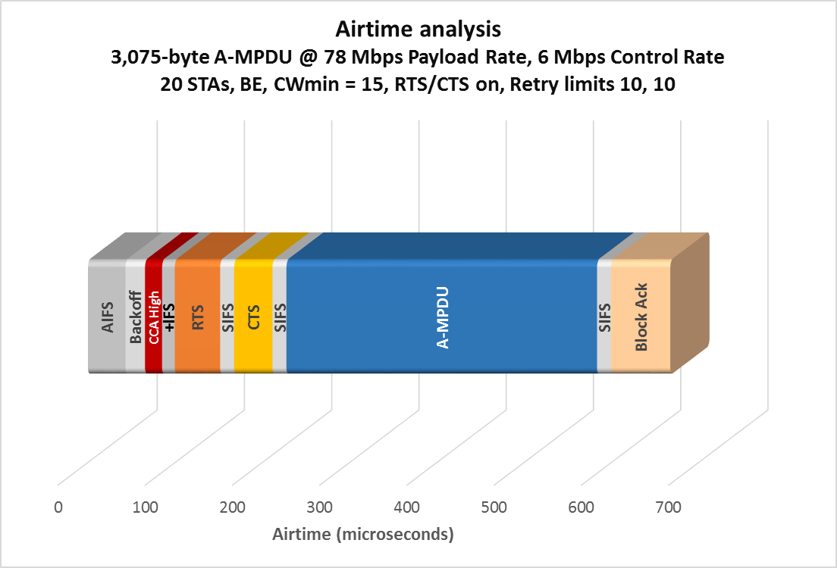
Cf. Box 3 calibration; all uplink
AIFS
Backoff
CCA High
+IFS
RTS
SIFS
CTS
SIFS
A-MPDU
SIFS
BA
43
22
20
15
52
16
44
16
356
16
68
668
STAs (here and throughout) include all those competing for the medium; not simply one BSS

Slide 4
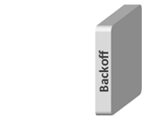
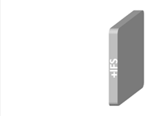
Key—I
Backoff (backoff counter decrements) averaged per STA and per any successful transmission
CCA High (busy medium due to collision) averaged per any successful transmission
+IFS (medium idle time in which the STA’s backoff counter does not decrement, and is not in the first AIFS) averaged per STA and per any successful transmission

Slide 5
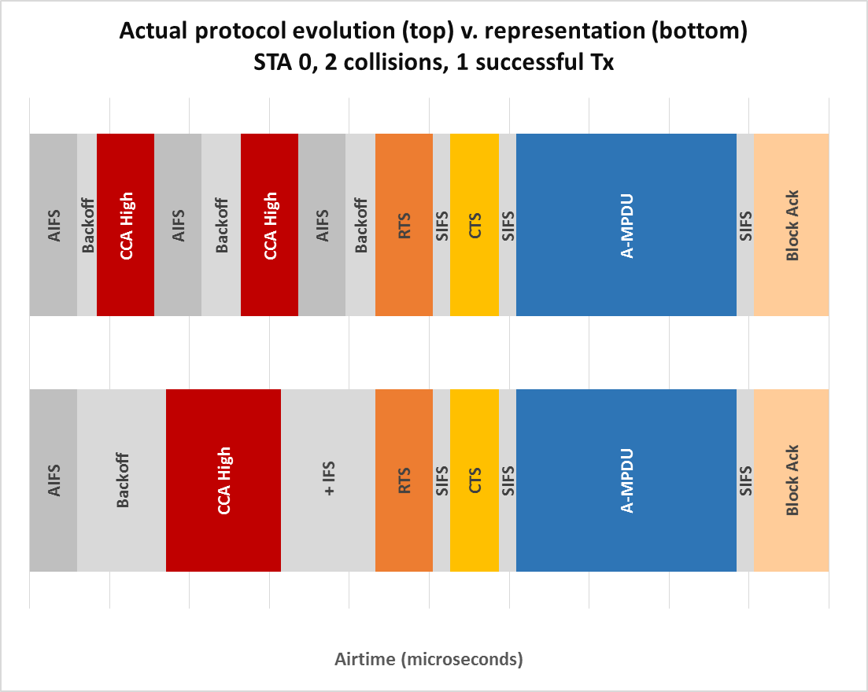
Key—II
Successful Tx by any STA; collisions of other STAs
0
726

Slide 6
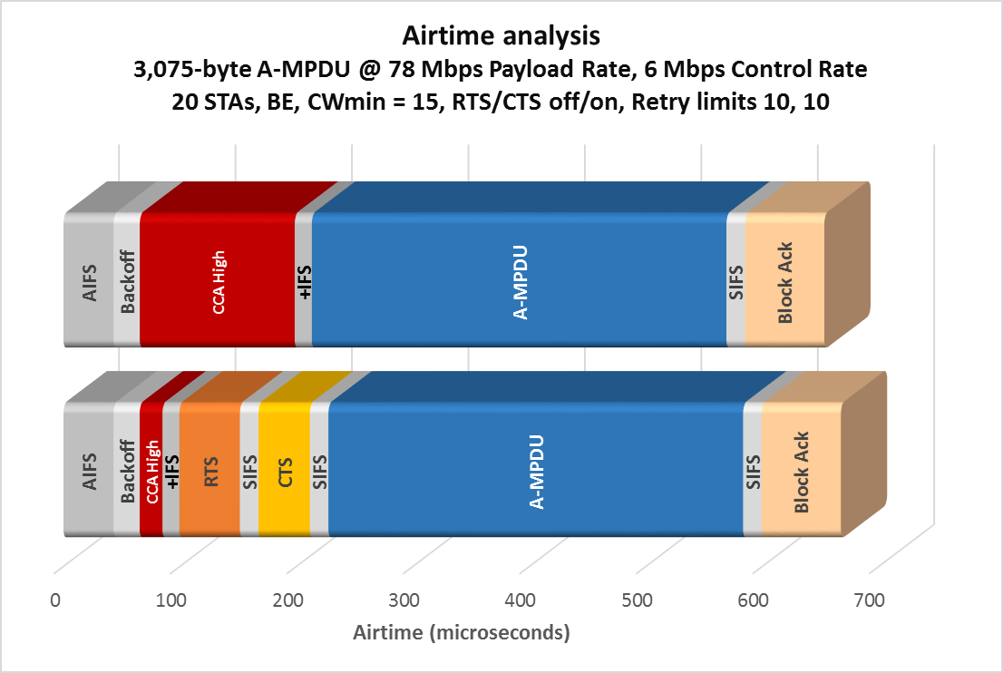
. . .
Backoff
CCA High
+IFS
. . .
22
133
15
AIFS
Backoff
CCA High
+IFS
RTS
SIFS
CTS
SIFS
A-MPDU
SIFS
BA
43
23
20
15
52
16
44
16
356
16
68
No hidden nodes; measurements taken over interval [5s, 10s]

Slide 7
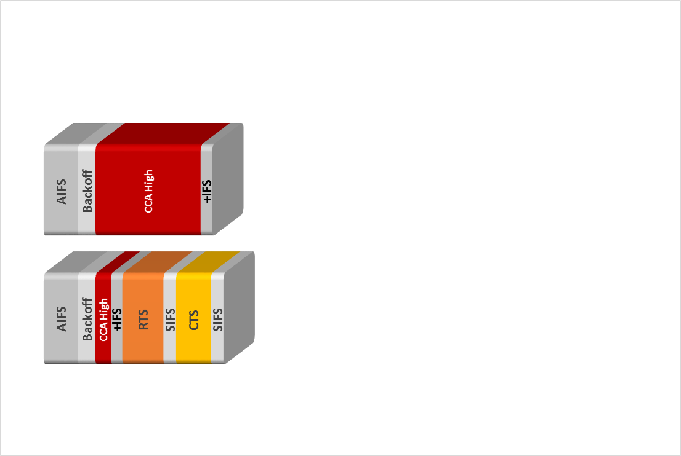
Motivation
Baseline EDCA medium access overhead = the lower of the two quantities shown
The main goal of this presentation is to show that both quantities are usually significant
It is possible to achieve much lower medium access overhead than either of these, by re-using well-proven components that are already part of the protocol [6]

Slide 8
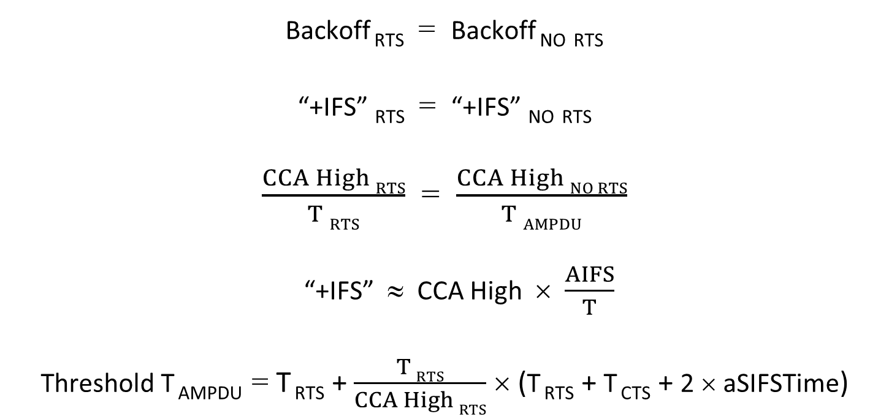
Relationships between components
Backoff _{RTS} = Backoff _{NO} _{RTS}
“+IFS” _{RTS} = “+IFS” _{NO} _{RTS}
$\frac{CCA High RTS}{T RTS}$ = $\frac{CCA High NO RTS}{T AMPDU}$
“+IFS” ≈ CCA High × $\frac{AIFS}{T}$
Threshold T _{AMPDU} = T _{RTS} + $\frac{T RTS}{CCA High RTS}$ × (T _{RTS} + T _{CTS} + 2 × aSIFSTime)
(1)
(2)
(3)
(4)
(5)

Slide 9
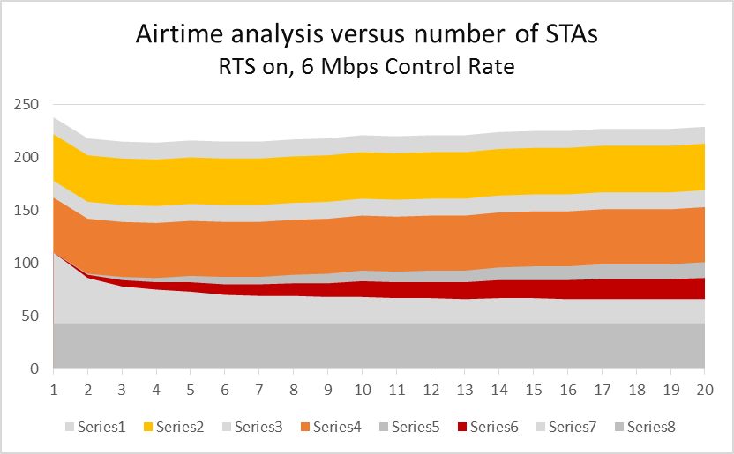
Microseconds
Subtract 40 μs for 24 Mbps Control Rate (RTS 28 μs vs. 52; CTS 28 μs v. 44)

Slide 10
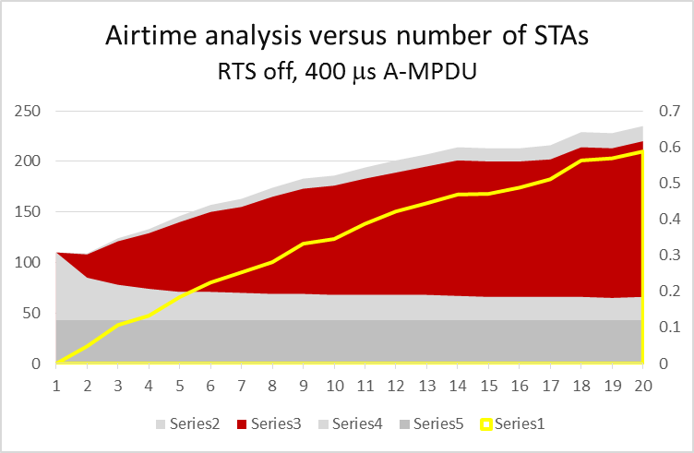
Ratio
= ratio to optimum RTS threshold

Slide 11
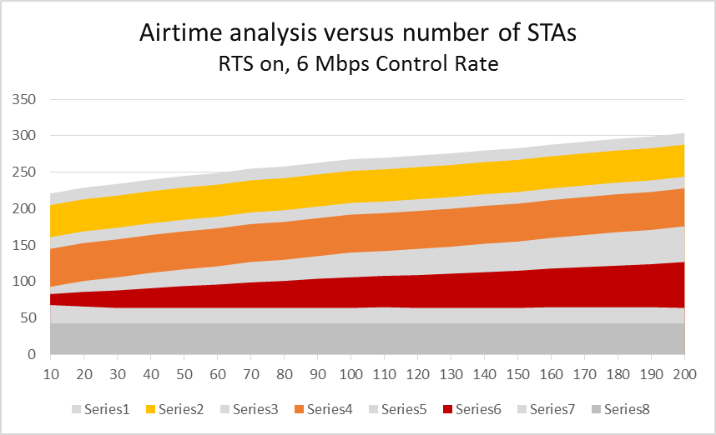
Subtract 40 μs for 24 Mbps Control Rate (RTS 28 μs vs. 52; CTS 28 μs v. 44)

Slide 12
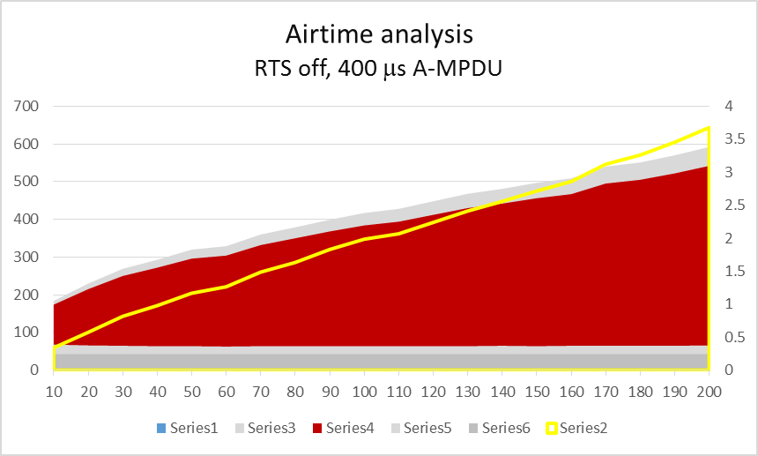
Ratio
= ratio to optimum RTS threshold

Slide 13
Conclusions
There is appreciable medium access overhead even at low numbers of contending STAs, with and without RTS
≈ 225 μs for low contending numbers in BE traffic with RTS, extending to beyond 300 μs for high numbers of contending STAs
Baseline of ≈ 200 μs: 43 μs AIFS + ≥ 22 μs Backoff + 128 μs RTS-CTS = 193 μs, even before considering CCA High and extra IFS
≈ 200 μs for 12 competing STAs in BE traffic without RTS (for 400 μs A-MPDU—roughly proportional to A-MPDU size)
Significant fraction of A-MPDU airtime when that is below optimum RTS threshold duration
Though not simulated here, overhead not much less for VO or VI traffic
9 μs lower AIFS; backoff and +IFS slightly lower but low for BE anyway

Slide 14
References
[1] IEEE doc. 11/15-0341r2, “Empirical Measurements of Channel Degradation Under Load”, C. Lukaszewski, L. Li (Aruba Networks), March 2015
[2] “Designing Very High Density Best Practices and Test Results”, C. Lukaszewski (Aruba Networks), Wireless LAN Professionals Conference (WLPC) Dallas 2015
[3] G. Bianchi, “Performance analysis of the IEEE 802.11 distributed coordination function”, IEEE Journal on Selected Areas in Communications, vol. 18 no. 3, March 2000, pp. 535-547
[4] M.X. Gong, E. Perahia, R. Stacey, R. Want, S. Mao, “A CSMA/CA MAC Protocol for Multi-User MIMO Wireless LANs”, Proc. IEEE GLOBECOM, Dec. 2010, pp. 1-6
[5] IEEE doc. 11/15-0059r1, “Uplink RTS/CTS Control”, S. Schelstraete (Quantenna), et al., January 2015
[6] IEEE doc. 11/15-1115r1, “High Efficiency in Accessing the Medium”, S. Coffey, D.Z. Liu (Realtek), September 2015

Slide 15
APPENDIX

Slide 16
(I) RTS on, 1-20 STAs
STAs | AIFS | BO | CCA H | +IFS | RTS | SIFS | CTS | SIFS | Thr.
 | μs | μs | μs | μs | μs | μs | μs | μs | μs
1 | 43 | 67 | 0 | 0 | 52 | 16 | 44 | 16
2 | 43 | 43 | 3 | 1 | 52 | 16 | 44 | 16 | 2271
3 | 43 | 35 | 6 | 3 | 52 | 16 | 44 | 16 | 1161
4 | 43 | 32 | 7 | 4 | 52 | 16 | 44 | 16 | 1003
5 | 43 | 30 | 9 | 6 | 52 | 16 | 44 | 16 | 792
6 | 43 | 27 | 10 | 7 | 52 | 16 | 44 | 16 | 699
7 | 43 | 26 | 11 | 7 | 52 | 16 | 44 | 16 | 645
8 | 43 | 26 | 12 | 8 | 52 | 16 | 44 | 16 | 619
9 | 43 | 25 | 13 | 9 | 52 | 16 | 44 | 16 | 551
10 | 43 | 25 | 15 | 10 | 52 | 16 | 44 | 16 | 539
11 | 43 | 24 | 15 | 10 | 52 | 16 | 44 | 16 | 501
12 | 43 | 24 | 15 | 11 | 52 | 16 | 44 | 16 | 477
13 | 43 | 23 | 16 | 11 | 52 | 16 | 44 | 16 | 466
14 | 43 | 24 | 17 | 12 | 52 | 16 | 44 | 16 | 457
15 | 43 | 24 | 17 | 13 | 52 | 16 | 44 | 16 | 453
16 | 43 | 23 | 18 | 13 | 52 | 16 | 44 | 16 | 437
17 | 43 | 23 | 19 | 14 | 52 | 16 | 44 | 16 | 423
18 | 43 | 23 | 19 | 14 | 52 | 16 | 44 | 16 | 407
19 | 43 | 23 | 19 | 14 | 52 | 16 | 44 | 16 | 401
20 | 43 | 23 | 20 | 15 | 52 | 16 | 44 | 16 | 400

Slide 17
(II) RTS off, 1-20 STAs
STAs | AIFS | BO | CCA H | +IFS | Thr.
 | μs | μs | μs | μs | μs
1 | 43 | 67 | 0 | 1
2 | 43 | 42 | 23 | 2 | 2271
3 | 43 | 35 | 43 | 3 | 1161
4 | 43 | 31 | 55 | 4 | 1003
5 | 43 | 28 | 69 | 5 | 792
6 | 43 | 28 | 79 | 6 | 699
7 | 43 | 27 | 85 | 7 | 645
8 | 43 | 26 | 96 | 8 | 619
9 | 43 | 26 | 104 | 9 | 551
10 | 43 | 25 | 108 | 10 | 539
11 | 43 | 25 | 115 | 11 | 501
12 | 43 | 25 | 121 | 12 | 477
13 | 43 | 25 | 127 | 13 | 466
14 | 43 | 24 | 134 | 14 | 457
15 | 43 | 23 | 134 | 15 | 453
16 | 43 | 23 | 134 | 16 | 437
17 | 43 | 23 | 136 | 17 | 423
18 | 43 | 23 | 148 | 18 | 407
19 | 43 | 22 | 148 | 19 | 401
20 | 43 | 23 | 154 | 20 | 400

Slide 18
(III) RTS on, 10-200 STAs
STAs | AIFS | BO | CCA H | +IFS | RTS | SIFS | CTS | SIFS | Thr.
 | μs | μs | μs | μs | μs | μs | μs | μs | μs
1 | 43 | 25 | 15 | 10 | 52 | 16 | 44 | 16
2 | 43 | 23 | 20 | 15 | 52 | 16 | 44 | 16 | 2271
3 | 43 | 21 | 24 | 18 | 52 | 16 | 44 | 16 | 1161
4 | 43 | 21 | 27 | 21 | 52 | 16 | 44 | 16 | 1003
5 | 43 | 21 | 30 | 23 | 52 | 16 | 44 | 16 | 792
6 | 43 | 21 | 32 | 25 | 52 | 16 | 44 | 16 | 699
7 | 43 | 21 | 35 | 28 | 52 | 16 | 44 | 16 | 645
8 | 43 | 21 | 37 | 29 | 52 | 16 | 44 | 16 | 619
9 | 43 | 21 | 40 | 31 | 52 | 16 | 44 | 16 | 551
10 | 43 | 21 | 42 | 34 | 52 | 16 | 44 | 16 | 539
11 | 43 | 22 | 43 | 34 | 52 | 16 | 44 | 16 | 501
12 | 43 | 21 | 45 | 36 | 52 | 16 | 44 | 16 | 477
13 | 43 | 21 | 47 | 37 | 52 | 16 | 44 | 16 | 466
14 | 43 | 21 | 49 | 39 | 52 | 16 | 44 | 16 | 457
15 | 43 | 21 | 51 | 40 | 52 | 16 | 44 | 16 | 453
16 | 43 | 22 | 53 | 42 | 52 | 16 | 44 | 16 | 437
17 | 43 | 22 | 55 | 44 | 52 | 16 | 44 | 16 | 423
18 | 43 | 22 | 57 | 46 | 52 | 16 | 44 | 16 | 407
19 | 43 | 22 | 59 | 47 | 52 | 16 | 44 | 16 | 401
20 | 43 | 21 | 63 | 49 | 52 | 16 | 44 | 16 | 400

Slide 19
(IV) RTS off, 10-200 STAs
STAs | AIFS | BO | CCA H | +IFS | Thr.
 | μs | μs | μs | μs | μs
10 | 43 | 25 | 106 | 10 | 539
20 | 43 | 23 | 149 | 15 | 400
30 | 43 | 22 | 185 | 19 | 329
40 | 43 | 21 | 208 | 21 | 299
50 | 43 | 21 | 232 | 24 | 274
60 | 43 | 20 | 241 | 25 | 260
70 | 43 | 21 | 268 | 28 | 242
80 | 43 | 21 | 286 | 29 | 232
90 | 43 | 21 | 304 | 31 | 218
100 | 43 | 21 | 320 | 33 | 210
110 | 43 | 21 | 330 | 34 | 207
120 | 43 | 21 | 348 | 36 | 200
130 | 43 | 21 | 366 | 38 | 194
140 | 43 | 22 | 377 | 39 | 188
150 | 43 | 21 | 392 | 41 | 183
160 | 43 | 22 | 402 | 42 | 178
170 | 43 | 22 | 430 | 45 | 173
180 | 43 | 22 | 440 | 46 | 169
190 | 43 | 22 | 457 | 48 | 165
200 | 43 | 23 | 476 | 50 | 161

Slide 20
(V) Comments on RTS on v. RTS off
For fixed number of competing devices, there is an optimum threshold duration for use of RTS/CTS that maximizes throughput
Base standard permits defining an RTS Threshold length in bytes
Adding threshold duration was considered in 2007 (LB 97) but rejected
RTS Threshold length is dynamically settable per STA so capability is equivalent (even if more clumsy than it needs to be)
Cf. 11ax SFD item enabling AP to distribute threshold length / duration [5]
Optimum threshold duration decreases with increasing contention and with increasing control rates
Optimum threshold duration – T _{RTS} ∝ 1 / CCA High _{RTS}

