Slide 1
BSS-TXOP
Name | Affiliations | Address | Phone | email
Amin Jafarian | Newracom |  |  | amin.jafarian@newracom.com
Reza Hedayat
Minho Cheong
Young Hoon Kwon
Daewon Lee
Vida Ferdowsi
Yongho Seok

Slide 2
CCA performance analysis summary
Summary of the last couple of meetings:
  We showed that
    Reducing the CCA threshold does not really solve the medium reuse issue when the network is crowded
    There is a lot of medium reuse opportunity for other neighbor STAs even without effecting primary MCS
    The medium reuse opportunity increases even more if the network gets more crowded

Slide 3
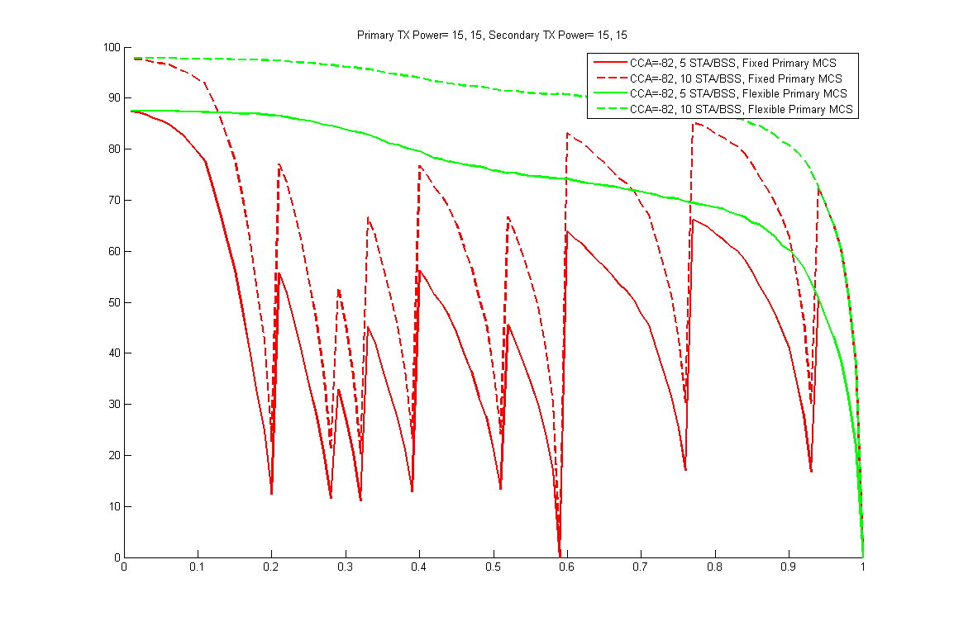
An Example of how dramatic can the medium reuse be for CCA=-82dBm
Percentage of spatial reuse that CCA prevented
Normalized distance between primary nodes

Slide 4
The group agreed on
We agreed on the following two straw polls:
A STA is allowed to transmit even if the channel is busy according to Clause 22 if some specific condition is met. One instant of the above condition is limiting the maximum amount of interference caused by the secondary pair transmission on the primary pair receivers.
Y/N/A:17/1/23
Here we address a framework to facilitate this idea

Slide 5
General Concept
We showed that it is possible to increase the spatial reuse by letting other (OBSS) STAs to transmit simultaneously ignoring the NAV as long as they don’t introduce a lot of interference at the “primary” STAs
“How much interference is allowed” is a question to be answered next.
  One way is to find conditions under which the interference caused by the secondary pair is in the noise level at the primary pair
  A better way is to let the primary STAs chose how much interference they can handle
    We introduce BSS TXOP to address this

Slide 6
BSS TXOP
Conventionally we have only one type of TXOP, an STA initializing the TXOP will set the NAV for all the other STAs within or outside the BSS
We suggest to add a new TXOP type “BSS TXOP” that with initiating it, the STA will set the NAV only for the STAs within the BSS.
  The main benefit of this is that we can increase the medium reuse
  To motivate use of BSS TXOP, we propose to decrease the TXOP limit of the conventional TXOP and set the TXOP limit of the BSS TXOP equal to the current TXOP limit of the conventional TXOP.

Slide 7
BSS TXOP used case
Conventional TXOP
BSS TXOP
STA A1 (BSS1)
Set the NAV for Everybody within Range
Set the NAV within BSS only
Set the NAV within BSS only
BSS TXOP
STA A2 (BSS1)
BSS TXOP
STA B1 (BSS2)
Set the NAV within BSS only
Set the NAV within BSS only
BSS TXOP
STA B2 (BSS2)

Slide 8
How helpful
BSS TXOP can significantly improve the spatial reuse if the primary pairs are located very close to each other and the secondaries are located further
  Apartment/ hotel scenario
In this case, the primary don’t really need to set the NAV for OBSS STAs and it can use the BSS-TXOP
Secondaries are also in the same situation and can switch to the BSS-TXOP
If one of the STAs observed a lot of collision, it can switch back to the Conventional TXOP

Slide 9
Summary
In a network of 40 STAs, there is a chance of >50% that some other pair of STAs could share the medium with the CCA holder but the CCA prevents that (this is the case when CCA threshold is -72dbm).
  For CCA threshold of -82db, it is more than 95% chance
We propose a new TXOP that motivates not setting the NAV for OBSS and promotes spatial reuse

Slide 10
Straw Poll
Do you agree with the definition of BSS-TXOP that can be used to set the NAV for the BSS STAs only.
  Y/N/A:

Slide 11
Back Up slides
From 318r1 and 588r0

Slide 12
CCA Performance analysis
In the last meeting, we showed a new performance analysis for CCA:
  Measures the probability that a new pair of STA could communicate while the CCA did not allow it
  Note: The lower the number, the better the performance of the CCA is
We also showed two different type of curves:
  Secondary pair is allowed to exist even if it perturbs the primary transmission (as long as the MCS0 is attainable at the primary pair)
  Secondary pair is not allowed to has any effect on the primary transmission
We concluded that this probability is low enough if we increase the CCA threshold to -72dbm
Percentage of spatial reuse that CCA prevented
1
2
Percentage of spatial reuse that CCA prevented
Normalized distance between primary nodes

Slide 13
What if there are multiple Secondary STAs?
In a crowded network it is very likely that there are multiple BSS around the BSS that sets the CCA
In each BSS, there are multiple STAs that the BSS AP could potentially communicate with during the CCA
What is the probability that at least one AP among all the neighbor BSS could communicates with at least one of its STAs, but the CCA did not permit?
  We will simulate this for two CCA levels as before

Slide 14
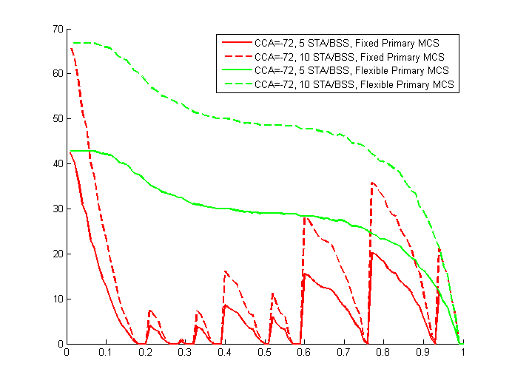
4 BSS each with 5 or 10 STAs
Green curve: x% of the time, there could be another secondary pair among OBSS that might have perturbed the primary transmission, (given that both could coexist together with at least MCS0), but the CCA did not allow
Red Curve: x% of the time, there could be another secondary pair among OBSS without effecting the primary transmission at all, but the CCA did not allow
Percentage of spatial reuse that CCA prevented
Normalized distance between primary nodes

Slide 15
Evaluate CCA protocol
Conventional way to evaluate CCA protocols
  Consider a few specific scenarios
    Fix location of STAs/APs in each scenario
  Compute the average medium efficiency gain/loss due to the proposed CCA per scenario and compare it with the baseline CCA.
Potential Issues:
    In each Scenario, the evaluation results can be extremely STA locations dependent
      There might be many more locations that the proposed CCA does not provide any gain
      There might be many locations that the gain is higher
    What is a good definition for gain can be debatable and the result can totally change depends on definition of the gain
      Weighted sum-rate (not fair to the CCA originator)
      Maximum achievable rate (not fair to the CCA originator)

Slide 16
Proposed Evaluation Criteria
To address the previous issues, we propose the following way to evaluate CCA:
For an specific scenario, and the proposed CCA, consider many joint locations for all the STAs in the network
For each of the locations, compute the event if a simultaneous transmission was possible but the proposed CCA did not allow
Compute the percentage number of joint locations (average cases) that #2 was satisfied
  The lower the number is, the better the proposed CCA performed
  The same thing can be done for the current CCA regime and we can compare the result to see how much gain the proposal provided
The simultaneous transmission could have no additional conditions:
  Gain definition 1: both transmissions were possible by at least the lowest MCS
  Note that this provides an upper bound on the performance of the CCA. But it is not fair for the CCA originator
Or under the condition that the secondary transmission does not hurt the CCA originator’s transmissions
  Gain definition 2: the secondary transmission was possible with at least the lowest MCS while the original transmission does not change its MCS level
  Note 1: that this is the best performance that one can expect from a CCA regime and what we believe is the correct definition of medium efficiency and fairness in this scenario.
  Note 2: while we believe it is very difficult to propose a CCA regime to accomplish this, in our examples, by providing some side information to the transmitters, we will put a figure on this gain.

Slide 17
Comparing two approaches
While conventional approach can provide us with the maximum and minimum gain in an specific CCA regime, the new approach will provide a figure of how the CCA regime works in an average deployment. Note that most of the users will not “optimize” the location of their APs and most of the STAs are moving around, so and average gain (average over the joint possible locations of all the STAs) should be a better metric to measure proposed CCA performance.
We propose to Compute the percentage number of joint locations that two simultaneous transmission (by either allowing hurting or not allowing hurting the original transmitter) was possible but not allowed under the proposed CCA.
  This allows us to find a lower and upper bound on the performance of CCA regime instead of focusing on an specific efficiency metric.

Slide 18
Simple Scenario
We will show a few example of two different CCA regimes under a very simple scenario and assumptions:
  We consider a very simple outdoor scenario, no shadowing, no multipath
  Two BSS:
    Primary: This is the CCA originator, we assume the STA started the NAV is the AP in the primary BSS but the same idea goes through if it is a non-AP STA
    Secondary: This is the BSS close to the primary CCA
      The transmitter of the secondary BSS is located in the area that is blocked by the existing CCA rules (received power at the transmitter of secondary is greater than the proposed CCA threshold)
      We will calculate the percentage of scenarios (locations) under which there could be a secondary transmission
  Because of symmetry we will fix the location of primary pair and change the secondary pair locations
    We find the percentage of locations that the secondary transmission could exist but it is not allowed as a function of normalized distance of Primary TX and RX (normalized such that the maximum distance for MCS0 being 1).
  We modify the TX powers at each STA and plot the result for each set of TX power.
  For MCS calculations, we used a simple mapping of received SINR to MCS at each receiver. We considered RX sensitivity =-88dbm, and the minimum SINR=4db that maps to MCS0.
  Data Packet Assumptions: Primary Transmitter has a very long packet in the air (more than the duration needed for the secondary packet to be transmitted)

Slide 19
Step1: Fixed the Location of Primary Pairs at distance r (start with very small r)
Primary Receiver RX sensitivity Range
Location of Primary Receiver
Location of Primary Transmitter
Primary Transmitter Range for
TX power=15dbm
RX sensitivity=-88 dbm

Slide 20
CCA Coverage
CCA coverage of the ongoing transmission

Slide 21
Step 2: Through Secondary TX and RX
Secondary Transmitter Range for
TX power=15dbm
RX sensitivity=-85 dbm
Location of secondary Transmitter
NOTE: it is within CCA threshold of ongoing tranmission

Slide 22
Step 3: Compute if two simultaneous transmission is possible
Secondary Receiver Range for
TX power=15dbm
RX sensitivity=-85 dbm
Location of secondary receiver
NOTE: it is within the RX range of secondary transmitter

Slide 23
Final Steps
Step 4: Repeat step 2 and 3 many times
  At the end find the percentage of cases that two simultaneous transmission was possible
Step 5: Change the normalized distance of primary pair to r+delta
  Redo the computations
Step 6: Plot the percentage of cases with respect to distance r

Slide 24
CCA Regimes
Four CCA regimes are considered:
CCA threshold -72dbm
  Fixed power: Secondary STAs are not allowed to change their TX power
  Dynamic Power: Secondary STAs are provided with the channel knowledge so that they can compute the optimal transmit power that enables them to communicate without causing much interference to the primary pair if possible at all
    Note that this provides the best possible performance one can expect from dynamic CCA. The goal of this presentation is no to address how this information is provided. It is more along the direction of how much this best information can improve CCA regime
CCA threshold -82dbm
  Fixed Power
  Dynamic Power

Slide 25
Results I (MAX TX powers= 15, 15, 15, 15)
Under Gain definition 2
Under Gain definition 1
Percentage of spatial reuse that CCA prevented
Percentage of spatial reuse that CCA prevented
Normalized distance between primary nodes
Normalized distance between primary nodes

Slide 26
Results I (TX powers= 15, 15, 5, 5)
Under Gain definition 2
Under Gain definition 1
Percentage of spatial reuse that CCA prevented
Percentage of spatial reuse that CCA prevented
Normalized distance between primary nodes
Normalized distance between primary nodes

Slide 27
Interpretation
In these scenarios dynamic CCA is not needed:
  CCA threshold of -72dbm provides very good result, in fact it is less than 5% of locations that the secondary pair could utilize the medium and CCA prevents that so is there any motivation to propose a more complicated CCA regime for all the STA just to achieve that 5% of locations?
  This is specially the case where the secondary Transmitter is a non-AP STA.

