Slide 1
TXOP Considerations for Spatial Reuse
Date: 2015-09-12
Authors:
Name | Affiliations | Address | Phone | email
Reza Hedayat Amin Jafarian Young Hoon Kwon Yongho Seok Vida Ferdowsi | Newracom | 9008 Research Drive, Irvine, CA 92618 |  | reza.hedayat at newracom.com amin.jafarian at newracom.com younghoon.kwon at newracom.com yongho.seok at newracom.com vida.ferdowsi at newracom.com
Reza Hedayat, Newracom

Slide 2
Outline
The spatial reuse debate has focused mostly on (a) altering the CCA threshold, (b) special treatment of frames from own BSS vs OBSS, (c) …
This contribution instead focuses on over-protection that current CCA rule has and considers how to minimize it
Reza Hedayat, Newracom

Slide 3
What is optimum CCA level; -82dBm, -72dBm, etc?
One dominating perspective in majority of spatial reuse contributions is the topic of optimum CCA level
As it’s been identified by some contributions, optimum CCA depends on multiple factors: frequency reuse, topology of BSS/OBSSs deployment, TX power, etc
While there have been so many contributions dedicated on this question, there has not been a unique answer, mostly due to differences in deployment setup and system modeling
In this contribution, we do not focus on the optimum CCA level. However the method provided here works with any CCA threshold
Reza Hedayat, Newracom

Slide 4
CCA Threshold based in Presence of OBSS
11ah has adopted Color field in PHY header, and its application implies:
frames from own BSS is treated with legacy CCA threshold
frames from OBSS is treated with a larger CCA threshold
Applying new CCA thresholds based on Color field is most effective when CCA coverage of two OBSS overlap minimally (such as apartment complex, simulation scenario 1), where in such cases boundary STAs back off often unnecessarily
AP
AP
CCA=-82dBm
L-SIG coverage
Reza Hedayat, Newracom

Slide 5
CCA Threshold based in Presence of OBSS
However, if overlap of the two OBSS is significant, applying new CCA thresholds based on Color field causes:
STAs from one OBSS to ignore frames from other OBSS
Adding interference to other BSS and receiving more interference from them
This happens in dense unmanaged WLANs, such as outdoor hot-spots, airports, …
So when is effective to loosen CCA and when it should be left as in legacy?
AP
AP
CCA=-82dBm
L-SIG coverage
Reza Hedayat, Newracom

Slide 6
Current CCA Rule
Current CCA rule requires any STA that receives a frame higher than -82dBm to back off regardless of the destination of the frame
For instance, if STA A sends a frame to STA B (BSS1), then STA C (BSS2) has to consider the medium is busy (and set the NAV according the to the MAC header content of the frame) even though the recipient of the frame, STA B, received negligible interference from STA C
A’s coverage
B
BSS1
A
BSS2
C
D
C’s coverage
Reza Hedayat, Newracom

Slide 7
Current CCA Rule
Considering relative location of the pair of the STAs shown in this figure, we realize that the current CCA rule offers:
Right protection for the cases where OBSS STAs are within vicinity of each other, e.g. the cross-coverage areas
Overprotection for the cases where an OBSS receiver is far from the transmitter of the other STAs
A’s coverage
B
BSS1
A
BSS2
C
D
C’s coverage
Reza Hedayat, Newracom

Slide 8
Current CCA Rule
Considering STAs A could be anywhere within STA’s C coverage, STA C in fact backs off for recipients that happen to be in an area much larger than its own coverage area
And this overprotection is a byproduct of the CCA rule that:
Considers the level of potential interference that a STA makes on the transmitter of a frame
But does not consider the level of potential interference that a STA makes on the recipient of a frame
A’s coverage
B
BSS1
A
BSS2
C
D
A
B
C’s coverage
Reza Hedayat, Newracom

Slide 9
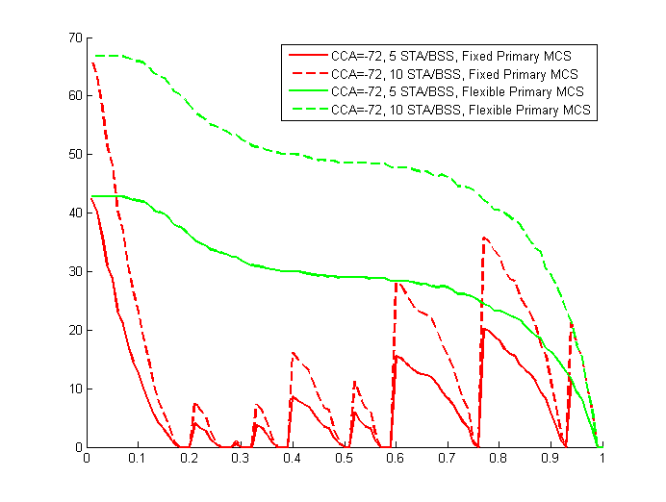
Current CCA Rule
Our previous contribution, 15/588r0, shows that there is a large percentage of reuse that current CCA rule prevents
Even with CCA=-72dBm, there is significant spatial reuse that due to current CCA rule (being based on the received RSSI from the transmitter) is left unachieved
Percentage of spatial reuse that CCA prevents
Normalized distance between primary STAs
Reza Hedayat, Newracom

Slide 10
How to consider potential interference to frames’ recipients?
Currently the measured RSSI of a frame offers an approximate level of interference that a STA would make to the transmitter of the frame if the STA were to send a frame
With a single frame exchange, it is only possible to measure the RSSI of the transmitter of a frame and there is no way to obtain any info about the recipient of the frame
However, considering a frame and the response frame that usually follows it is possible to measure the RSSI of the pair. Given the RSSI of the two STAs, a third STA can actually evaluate the level of interference that it’d cause to the recipient of the frame
Reza Hedayat, Newracom

Slide 11
Revising NAV During TXOP
Therefore, considering that it’d take two frames to determine potential interference level that a STA makes on the recipient of a frame, we can enhance spatial reuse by revising medium status or revising NAV during a period of frames exchanges between two STAs such as a TXOP
Most of the frame exchanges are multiple exchanges, for instance:
(RTS) + [CTS] + (Data) + [ACK] + (Data) + [ACK] + …
(Short frame) + [ACK] + (Data) + [ACK] + (Data) + [ACK] + …
(Short frame) + [ACK] + (Data) + (Data) + (Data) + [BA] + …
So adapting CCA can be based on RSSI information that is obtained from an immediately prior frame exchange and applied to the subsequent frame exchanges
Reza Hedayat, Newracom

Slide 12
Revising NAV During TXOP
STA A and STA B exchange a frame and a response frame, e.g. RTS and CTS. Meanwhile STA C receives the frames and record the RSSI and TA/RA from the exchange
During the short frame exchange, e.g. RTS/CTS, STA C observes the legacy CCA threshold and sets the NAV accordingly
B
BSS1
A
RSSI AC
TXOP
RSSI BC
RTS
Data
…
STA A
C
STA B
CTS
ACK/BA
RSSI AC
BSS2
D
RSSI BC
STA C
Legacy CCA rules applies
Revise NAV based on RSSI AC and RSSI BC?
Reza Hedayat, Newracom

Slide 13
Revising NAV During TXOP
The condition that allows for enhances spatial reuse is when
RSSI_AC is larger than RSSI_BC plus a TBD delta
i.e. STA B is farther from STA C compared to STA A to STA C
RSSI _AC and RSSI_BC are lower than a threshold
i.e. STAs A and B are far enough from STA C
If RSSI_BC is lower than sensitivity then it might be set to a TBD sensitivity level
If above condition is met STA C may:
Reevaluate the medium status, and/or
Revise the NAV status
Therefore one condition for relaxing enhanced spatial reuse is:
RSSI BC + delta < RSSI AC
RSSI AC and RSSI BC < TBD Threshold
Reza Hedayat, Newracom

Slide 14
Revising NAV During TXOP
Revising the medium status or NAV duration could happen in the middle of a TXOP, when a STA observes the RSSI of a frame and its response frame and checks for the right condition
TXOP
Data
…
Data
STA A
STA B
ACK/BA
ACK/BA
RSSI AC
RSSI BC
STA C
STA C starts sensing the medium
Legacy CCA rules applies
Revise NAV based on RSSI AC and RSSI BC?
Reza Hedayat, Newracom

Slide 15
Protection of Response Frames
Spatial reuse topics always brings up the issue of issue protecting the response frames at the transmitter side
For instance, referring to the previous example, a fair and robust spatial reuse need to make sure that the response frames (such as ACK, BA) at STA A side is affected minimally
One solution to use transmit power control (TPC) to reduce the amount of interference to STA A (and to STA B)
Another solution is to use robust MCS for response frames (e.g. CTS, ACK, BA etc) which is a common practice
E.g. MCS 0-2 offer larger than 10dB interference tolerance compared to MCS 6-9
B
Frame
Response
Frame
A
C
D
Reza Hedayat, Newracom

Slide 16
Considerations for Multiuser Frames
The previous discussion mostly focuses on SU frame exchanges
Regarding multiuser frames, it is possible to extend the RSSI rules
However in MU case, the spatial reuse depends on the relative locations of MU frame transmitter and the several STAs that are recipients of the MU frame, and that would make the situation more difficult
A safe alternative is to refrain from spatial reuse in case of MU frame exchange
Reza Hedayat, Newracom

Slide 17
Conclusion
The optimum CCA level has been debated within TGax extensively and it seems it’d depend on the topology of the BSS and presence of OBSS
A different treatment of OBSS frames vs BSS frames, e.g. based on Color field, might be a good solution but it’d also depend on topology and over of BSS and OBSS
Current CCA rule offers needed protection when a set of STAs are within reach of each of each other. But it offers overprotection when some of the recipient STAs are farther from the rest
This contribution proposes to evaluate the status of the medium based on RSSI from a frame and its response frame and revise the status of the medium or NAV
Reza Hedayat, Newracom

Slide 18
Straw Poll
Do you agree the following to be added to 11ax SFD:
The specification to consider a procedure that may revise the NAV depending on TBD conditions on the RSSI levels that a STA has measured from an immediately preceding pair of frame and its response frame, such as an RTS and CTS frames exchanged by OBSS STAs.
Reza Hedayat, Newracom

