Slide 1
ACK/BA frame for UL MU under cascading structure
Date: 2015-09-14
Authors:

Slide 2
Abstract
This presentation breaks down the issues in sending ACK/BA frame for UL MU under cascading structure.

Slide 3
Points of this presentation
Cascading structure [1] being approved now, multiplexing control frame such as ACK and data frames will be possible.
Length of control frame is generally much shorter than that of data frame.
OFDMA or broadcast based acknowledge is considered in cascading [2], but a following question will arise.
Is it also possible to multiplex unicast BA frames and broadcast BA frame for multiple STAs?

Slide 4
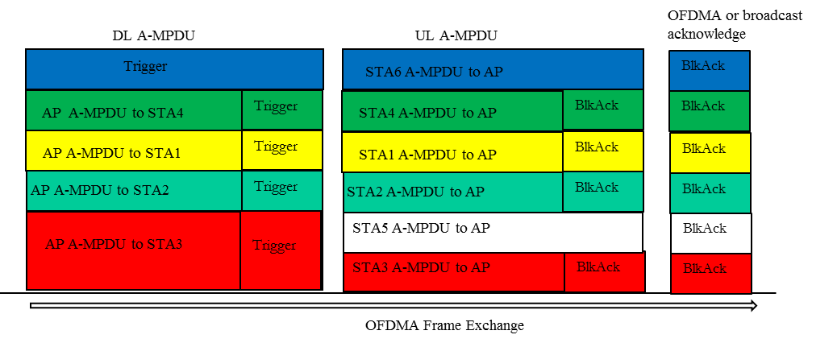
Acknowledge frame for UL MU in cascading
Combined multicast and unicast transmissions is shown in [2].
As for the acknowledgement frame, unicast BlockAck sent in OFDMA or broadcast acknowledge is considered in [2].
[2] 802.11-15/0831r2

Slide 5
Example of Acknowledge frame for UL MU
In the following cases, when BA frames and aggregated data and BA frames are multiplexed together, it can reduce the efficiency of multiple transmission.
BA undergoes packet error check at the AP and if it fails, AP will have to resend the data
AP may not have DL data for all the stations that sent UL data but only for a few stations
DL data sta1
T
UL data sta1
BA
BA
Padding
UL data sta1
DL data sta1
BA
DL data sta2
T
UL data sta2
BA
DL data sta2
BA
UL data sta2
DL data sta2
BA
DL data sta3
T
UL data sta3
BA
BA
Padding
Trigger
UL data sta3
BA
Padding
DL data sta4
T
UL data sta4
BA
BA
Padding
UL data sta4
BA
Padding
DL data sta5
T
UL data sta5
BA
BA
Padding
UL data sta5
BA
Padding
T:Trigger

Slide 6
Unicast and Broadcast BA case
July 2015
If unicast BA frames and broadcast frame for multiple STAs (multi-STA BA) can be multiplexed, higher efficiency of multiple transmission is expected.
DL data sta1
T
UL data sta1
BA
BA
Padding
DL data sta6
DL data sta2
T
UL data sta2
BA
DL data sta2
BA
DL data sta7
DL data sta3
T
UL data sta3
BA
BA
Padding
B
A
DL data sta8
DL data sta4
T
UL data sta4
BA
BA
Padding
DL data sta9
DL data sta5
T
UL data sta5
BA
BA
Padding
DL data sta10
DL data sta1
T
UL data sta1
BA
DL data sta6
DL data sta9
DL data sta2
T
UL data sta2
BA
DL data sta2
BA
DL data sta10
BA
DL multi-STA BA
multi-STA BA
DL data sta3
T
UL data sta3
(for sta 1,3-5)
DL data sta11
DL data sta4
T
UL data sta4
BA
DL data sta7
DL data sta12
DL data sta5
T
UL data sta5
BA
DL data sta8
DL data sta13

Slide 7
Multiplex unicast and broadcast BA
AP sends new DL data for new station using free subchannels.
Aggregated frame of BA and DL data is sent as a unicast frame.
BA only frames are sent as Multi-STA BA.
Multi-STA BA uses broadcast address
The stations which sent UL data use the subchannel for broadcast address to check for the acknowledgement.
DL data sta1
T
UL data sta1
BA
DL data sta6
(UC)
DL data sta2
T
UL data sta2
BA
DL data sta2
BA
(UC)
DL data sta3
T
UL data sta3
BA
DL multi-STA BA
DL multi-STA BA
(BC)
(for sta 1,3-5)
DL data sta4
T
UL data sta4
BA
DL data sta7
(UC)
DL data sta5
T
UL data sta5
BA
DL data sta8
(UC)
UC: unicast
BC: broadcast

Slide 8
Other discussion points on UC&BC BA
The trigger frame aggregated with DL multi-STA BA can include the same broadcast address as the multi-STA BA thereby triggering multiple STAs for UL MU transmission
DL data sta1
T
UL data sta1
BA
DL data sta6
T
(UC)
DL data sta2
T
UL data sta2
BA
DL data sta2
BA
T
(UC)
DL data sta3
T
UL data sta3
BA
DL multi-STA BA
(BC)
T
DL data sta4
T
UL data sta4
BA
DL data sta7
T
(UC)
DL data sta5
T
UL data sta5
BA
DL data sta8
T
(UC)

Slide 9
Summary
ACK/BA frames for UL MU under cascading structure was considered.
Further work on how to
multiplex unicast BA and multi-STA BA
Send trigger frame in the multi-STA BA case.

Slide 10
References
[1] 802.11-15/ 841r1 “Cascading Structure”
[2] 802.11-15/0831r2 “Broadcast and Unicast (Trigger) in DL MU”

Slide 11
Straw Poll 1
Do you think we should be able to multiplex unicast BA and multi-STA BA?
Y:N:A =

