Slide 1
ACK/BA frame for UL MU under cascading structure
Date: 2015-09-13
Authors:

Slide 2
Abstract
This presentation breaks down the issues of how to send ACK/BA frame for UL MU under cascading structure.

Slide 3
Points of this presentation
As cascading structure [1] now being approved, multiplexing control frame such as acknowledge and data frame will be possible.
  Length of control frame is generally much shorter than that of data frame.
OFDMA or broadcast based acknowledge is considered in cascading [2], but a following question will arise.
  Is it also possible to multiplex both unicast BA frames and broadcast frame for multiple STAs?
Notes:
Cascading structure [1] has approved and multiplexing control frame such as acknowledge and data frame will be possible. However, length of control frame is generally much shorter than that of data frame.

Slide 4
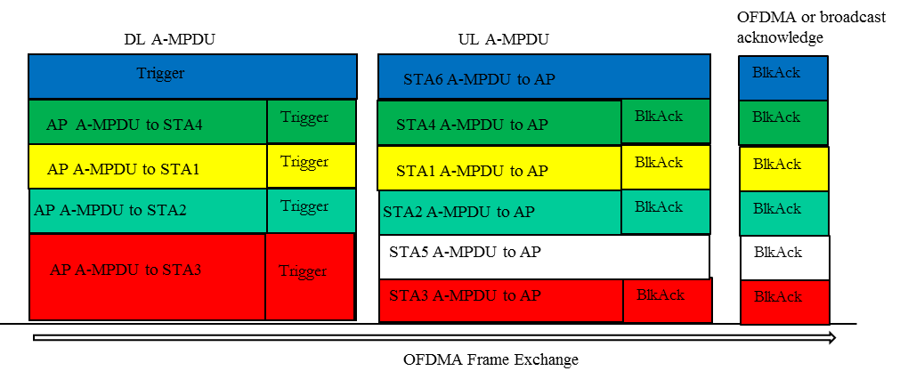
Acknowledge frame for UL MU in cascading
Combined multicast and unicast transmissions is shown in [2].
As for acknowledgement frame, unicast BlockAck sent in OFDMA or broadcast acknowledge is considered in [2].
[2] 802.11-15/0831r2

Slide 5
Example of Acknowledge frame for UL MU
In the following cases, BA only frames and data and BA aggregated frames are multiplexed and it reduces the efficiency of multiple transmission.
  BA undergoes packet error check at the AP and if it fails, AP will resend the data
  AP has DL data not for all UL data sending stations but for several stations.
DL data sta1
T
UL data sta1
BA
BA
Padding
UL data sta1
DL data sta1
BA
DL data sta2
T
UL data sta2
BA
DL data sta2
BA
UL data sta2
DL data sta2
BA
DL data sta3
T
UL data sta3
BA
BA
Padding
Trigger
UL data sta3
BA
Padding
DL data sta4
T
UL data sta4
BA
BA
Padding
UL data sta4
BA
Padding
DL data sta5
T
UL data sta5
BA
BA
Padding
UL data sta5
BA
Padding
T:Trigger

Slide 6
Unicast and Broadcast BA case
July 2015
If unicast BA frames and broadcast frame for multiple STAs (multi-STA BA) can be multiplexed, higher efficiency of multiple transmission is expected.
DL data sta1
T
UL data sta1
BA
BA
Padding
DL data sta6
DL data sta2
T
UL data sta2
BA
DL data sta2
BA
DL data sta7
DL data sta3
T
UL data sta3
BA
BA
Padding
B
A
DL data sta8
DL data sta4
T
UL data sta4
BA
BA
Padding
DL data sta9
DL data sta5
T
UL data sta5
BA
BA
Padding
DL data sta10
DL data sta1
T
UL data sta1
BA
DL data sta6
DL data sta9
DL data sta2
T
UL data sta2
BA
DL data sta2
BA
DL data sta10
BA
DL multi-STA BA
multi-STA BA
DL data sta3
T
UL data sta3
(for sta 1,3-5)
DL data sta11
DL data sta4
T
UL data sta4
BA
DL data sta7
DL data sta12
DL data sta5
T
UL data sta5
BA
DL data sta8
DL data sta13

Slide 7
Multiplex unicast and broadcast BA
AP sends new DL data for new station using free subchannels.
Aggregating frame of BA and DL data is sent using unicast. BA only frames are sent as Multi-STA BA.
Multi-STA BA uses broadcast address, so that stations which sent UL data use subchannel with broadcast address if they know there is no their own address.
DL data sta1
T
UL data sta1
BA
DL data sta6
(UC)
DL data sta2
T
UL data sta2
BA
DL data sta2
BA
(UC)
DL data sta3
T
UL data sta3
BA
DL multi-STA BA
DL multi-STA BA
(BC)
(for sta 1,3-5)
DL data sta4
T
UL data sta4
BA
DL data sta7
(UC)
DL data sta5
T
UL data sta5
BA
DL data sta8
(UC)
UC: unicast
BC: broadcast

Slide 8
Other discussion points on UC&BC BA
The trigger frame aggregated with DL multi-STA BA can include the same broadcast(or multicast) address as the multi-STA BA thereby triggering multiple STAs for UL transmission
DL data sta1
T
UL data sta1
BA
DL data sta6
T
(UC)
DL data sta2
T
UL data sta2
BA
DL data sta2
BA
T
(UC)
DL data sta3
T
UL data sta3
BA
DL multi-STA BA
(BC)
T
DL data sta4
T
UL data sta4
BA
DL data sta7
T
(UC)
DL data sta5
T
UL data sta5
BA
DL data sta8
T
(UC)

Slide 9
Summary
The way to send ACK/BA frame for UL MU under cascading structure was considered.
The authors want to confirm group’s intention toward some of the points, such as
  possibility of multiplexing unicast and broadcast BA
  how to send trigger frame in the multi-STA BA case.

Slide 10
References
[1] 802.11-15/ 841r1 “Cascading Structure”
[2] 802.11-15/0831r2 “Broadcast and Unicast (Trigger) in DL MU”

Slide 11
Straw Poll 1
Do you think we should be able to multiplex unicast BA and multi-STA BA?
  Y:N:A =

