Slide 1
Considerations on Range Extension with SIG-A Repetition
Date: 2015-09-14
Authors:

Slide 2
Abstract
Time repetition features [1][2] are proposed in the preamble structure for 11ax.
In this submission, range extension mode with repeated SIG-A is evaluated in outdoor circumstances.
150/300 bytes data packet as beacon frame simulated with repeated SIG-A to measure coverage change.
Effects from gain of range extension mode is minimal when it comes to increase the coverage of BSS.

Slide 3
Range Extension Mode
…
Repeated HE-SIG-A
…
Legacy preamble
HE-SIG-A
HE-SIG-B
…
…
Interleaver
…
Repeated HE-SIG-A is supposed to bypass BCC interleaver in case of outdoor or large coverage scenarios.
MRC and additional frequency diversity gain can be achieved.
AP decides the suitable mode depending on channel conditions.
There would be Normal mode and Range extension mode.
Range extension mode shall be indicated before HE-SIG-A.

Slide 4
Coverage of 802.11 Systems
Probe Request
Beacon/Probe Response
AP
STA
Reception of Beacon frame (or probe request/response frame) is necessary for AP-STA communication.
Beacon frames is sent using Non-HT PPDU.
Transmission of beacon frame in HE PPDU is an unattractive solution as the AP will need to transmit Non-HT PPDU beacons for legacy STA support anyway. However, this is a possibility.
Use of beamforming to gain additional coverage is not possible for beacon frames (regardless when it is transmitted in Non-HT or HE PPDU format).
Beamforming in the probe response is impractical since this would be performed pre-association and no CSI feedback has been made.
Therefore, 802.11 system will be limited by the non-beamformed (i.e. omni-directional) beacon frame coverage.

Slide 5
Simulation Environments
150 and 300 bytes/packet for 242-tone
Practical size of Beacon frame is assumed
Details in Appendix
Bandwidth : 20MHz
Multi-antenna transmission : 1x1, 2x1, and 4x1
Wireless channel: ITU NLOS UMi
CP length: 3.2 us
Carrier frequency offset (CFO): fixed at 40 ppm (@ 5GHz)
Phase noise (both at Tx/Rx): -41dBc
Real timing estimation & synchronization
Additional frequency/phase tracking gain from additional SIG-A symbols captured in simulation.
CDD as a precoding type
Delay value optimized in accordance with the number of transmit antenna
Normal & Range Extension mode with Repeated L-SIG

Slide 6
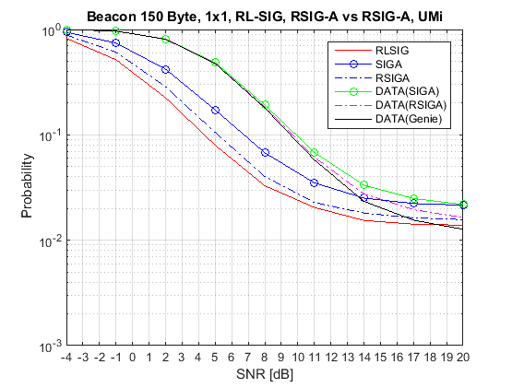
Simulation (Beacon 150 bytes, 1x1)
Data (SIGA) and Data (RSIGA) was assumed to have error if
- L-SIG validity check fails or - SIG-A 8 bit CRC fails or - actual data FCS fails
Data(Genie) was assumed to have error if
- actual data FCS fails
Less than 2% PER floor gain (at high SNR) is observed even with Genie mode that assumed not to have L-SIG and SIG-A error.
No practical difference in interested SNR regime.
Range extension mode in [1] does not provide beacon frame coverage enhancement.

Slide 7
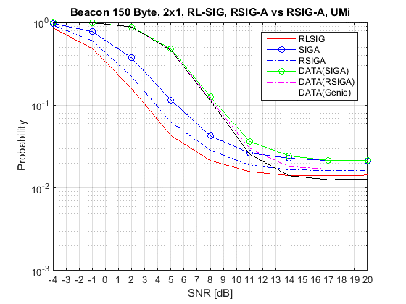
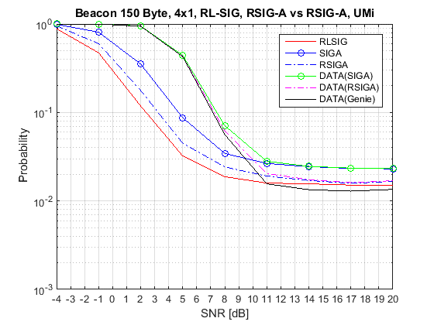
Simulation (cont’d) (Beacon 150 bytes, 2x1 and 4x1)
- Similar trend. No meaningful improvement in beacon frame coverage.

Slide 8
Summary
Repeated HE-SIG-A provides some gain for correct reception of HE-SIG-A.
Unfortunately improving HE-SIG-A performance does not help improve data reception for 150 bytes or larger.
802.11 system coverage is defined by accurate reception of Beacon frames which is approximately 150 bytes ~ 300 bytes.
No meaningful coverage enhancement from HE-SIG-A repetition was observed.

Slide 9
References
[1] 11-15-0579r3, 802.11ax Preamble Design and Auto-detection
[2] 11-15-0826r0, HE-SIGA transmission for range extension

Slide 10
Appendix Size of Beacon Frame
Mandatory fields in Beacon frame
Header: 24 bytes
Non-HT Mandatory: 17~56 bytes
Timestamp 8 bytes
Beacon interval 2 bytes
Capability information 2 bytes
Service Set Identifier 2 + (0~32) bytes
Supported Rates and BSS Membership Selectors 2+(1~8) bytes
HT Mandatory: 52 bytes
HT Capabilities element 28 bytes
HT Operation element 24 bytes
VHT Mandatory: 21 bytes
VHT Capabilities element 14 bytes
VHT Operation element 7 bytes
FCS: 4 byte
Optional and Vendor dependent
118 ~ 157
bytes
*
303
bytes
* Each 1 byte of Element ID & Length

Slide 11
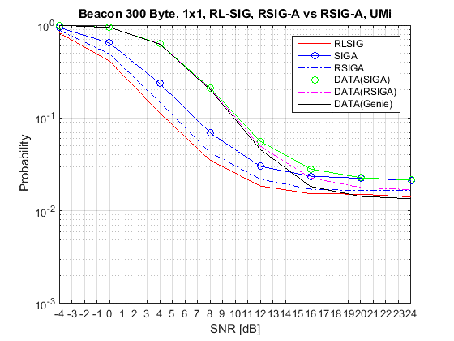
Simulation (cont’d) (Beacon 300 bytes, 1x1)
- Similar trend. No meaningful improvement in beacon frame coverage.

Slide 12
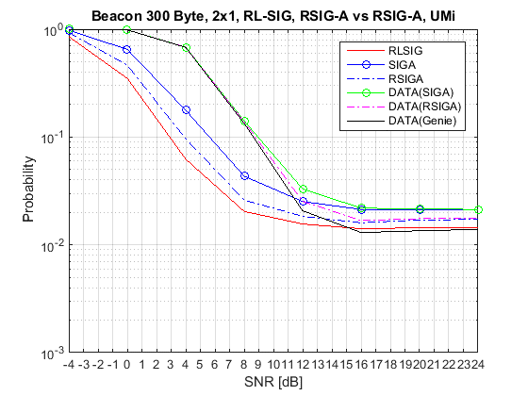
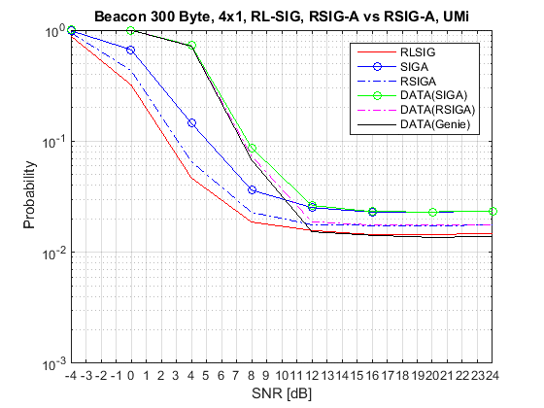
Simulation (cont’d) (Beacon 300 bytes, 2x1 and 4x1)
- Similar trend. No meaningful improvement in beacon frame coverage.

