Slide 1
Consideration on multi-STA BA frame indication
Date: 2015-09-16
Authors:

Slide 2
Introduction
The SFD defined a multi-STA BA frame by using the Multi-TID BA frame format with the following changes,
Add an indication that the frame is a multi-STA BA (TBD)
Each BA Information field can be addressed to different STAs
B0-B10 of the Per TID Info field carry a (Partial) AID identifying the intended receiver of the BA Information field
In this contribution, we discuss consideration in using a reserved bit in BA control field to indicate that the frame is multi-STA BA frame.

Slide 3
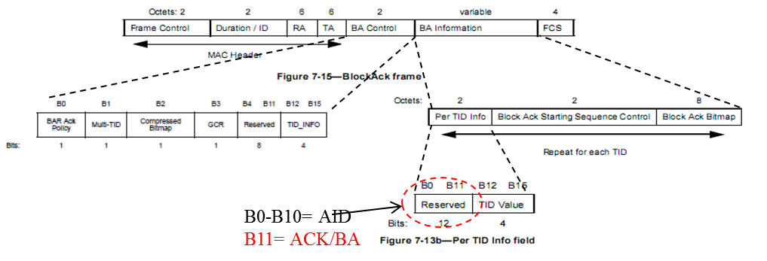
Background
The SFD defined a multi-STA BA frame by using the Multi-TID BA frame format
However, how to indicate that the frame is a multi-STA BA frame is still TBD

Slide 4
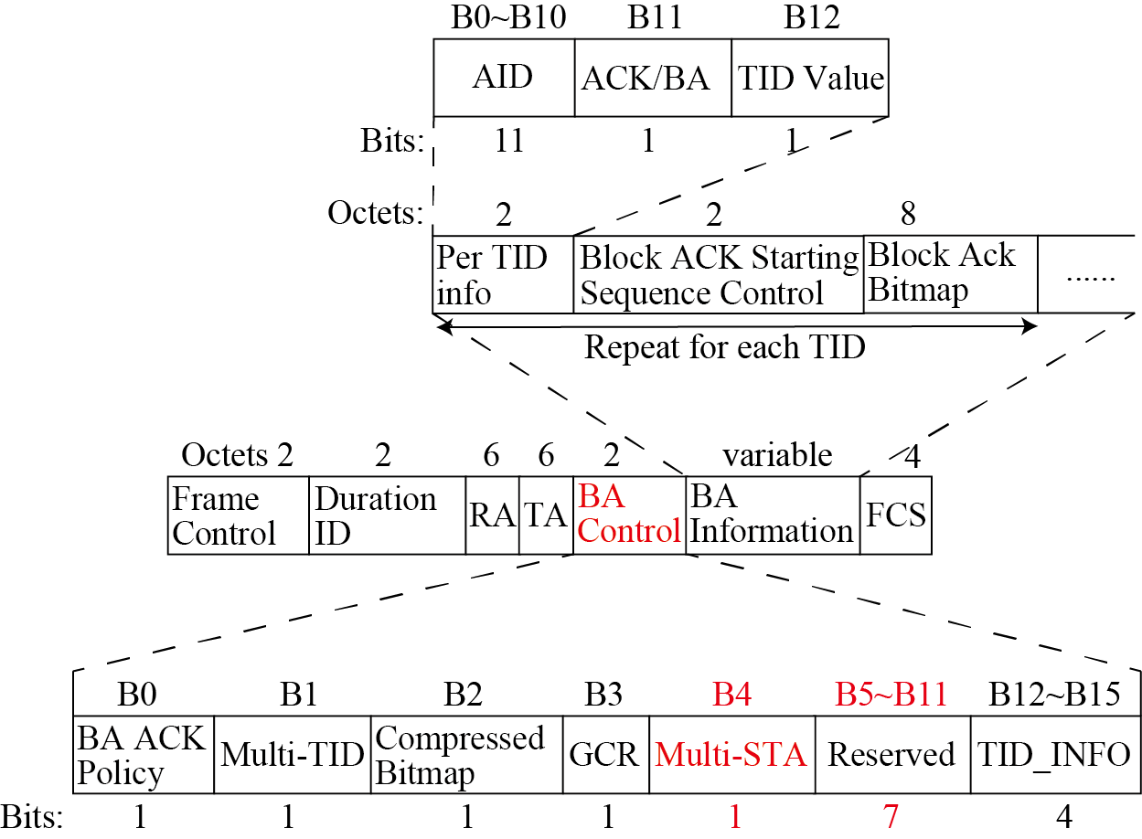
Consideration on multi-STA BA frame indication
We suggest using a reserved bit in BA control field to indicate that the frame is multi-STA BA frame.
Example:

Slide 5
Consideration on multi-STA BA frame indication
We suggest using a reserved bit in BA control field to indicate that the frame is BlockAck frame.
Example: BA frame variant encoding
Multi-TID Subfield value | Compressed Bitmap Subfield value | GCR Subfield value | Multi-STA subfield value | BlockACK frame variant
0 | 0 | 0 | 0 | Basic BlockAck
0 | 1 | 0 | 0 | Compressed BlockAck
1 | 0 | 0 | 0 | Reserved
1 | 1 | 0 | 0 | Multi-TID BlockAck
0 | 0 | 1 | 0 | Reserved
0 | 1 | 1 | 0 | GCR BlockAck
1 | 0 | 1 | 0 | Reserved
1 | 1 | 1 | 0 | Reserved
0 | 0 | 0 | 1 | Reserved
0 | 1 | 0 | 1 | Reserved
1 | 0 | 0 | 1 | Reserved
1 | 1 | 0 | 1 | Multi-STA BlockAck
0 | 0 | 1 | 1 | Reserved
0 | 1 | 1 | 1 | Reserved
1 | 0 | 1 | 1 | Reserved
1 | 1 | 1 | 1 | Reserved

Slide 6
Conclusions
In this contribution, we discussed consideration in using a reserved bit in BA control field to indicate that the frame is multi-STA BA frame.

Slide 7
Straw poll
Do you agree to add to the TG Specification Frame work document?
Do you agree to use a reserved bit in BA control field to indicate that the frame is multi-STA BA frame.
Y
N
A

Slide 8
References
[1] 802.11-15/0132r7 “spec-framework”
[2] IEEE standard part 11n: Wireless LAN MAC and PHY specifications. Amendment 5: enhancements for higher throughput
[3] IEEE standard part 11aa: Wireless LAN MAC and PHY specifications. Amendment 5: MAC Enhancements for robust audio video streaming

