Slide 1
Consideration on multi-STA BA frame indication
Date: 2015-09-
Authors:

Slide 2
Introduction
TGax approved to add the following to SFD[1]
  The SFD should define a multi-STA BA frame by using the Multi-TID BlockAck frame format with the following changes:
  • Add an indication that the frame is a multi-STA BA (TBD)
In this contribution, we discuss consideration on adding a bit in BA control field for indicating that the frame is multi-STA BA frame

Slide 3
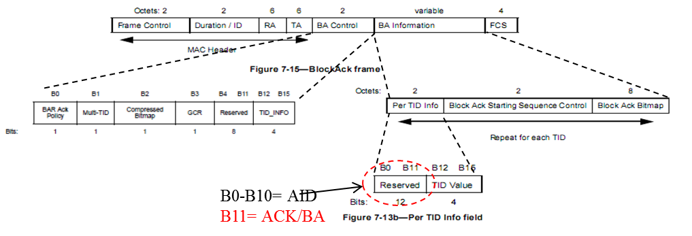
Background
Multi-STA BA frame design in 11ax [1]
However, how to add an indication that the frame is a multi-STA BA is still TBD

Slide 4
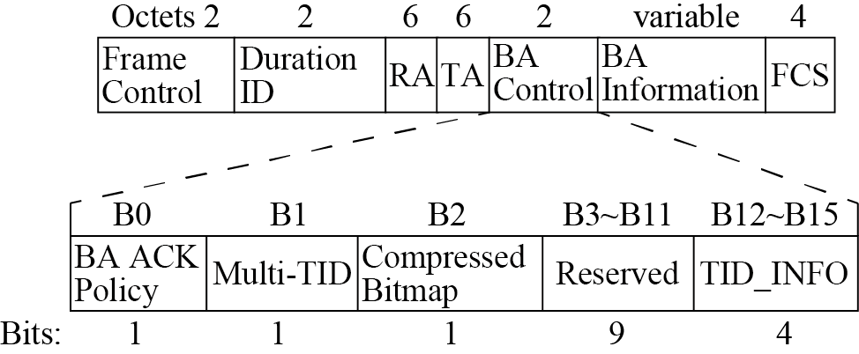
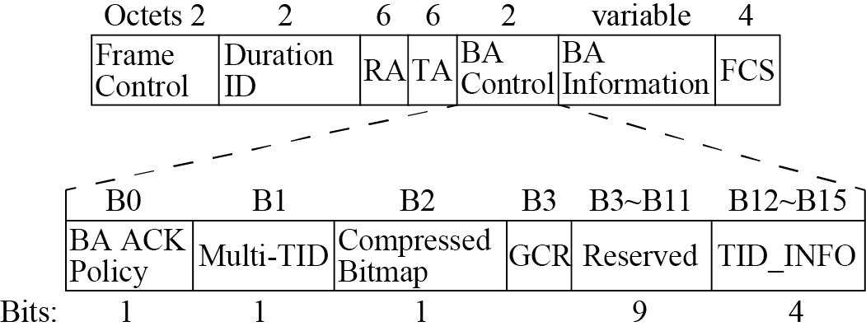
Legacy BA frame design
BlockAck frame structure in 11n [2]
BlockAck frame structure in 11aa [3]
  BA frame variant encoding
  BA frame variant encoding
Multi-TID Subfield value | Compressed Bitmap Subfield value | BlockACK frame variant
0 | 0 | Basic BlockAck
0 | 1 | Compressed BlockAck
1 | 0 | Reserved
1 | 1 | Multi-TID BlockAck
Multi-TID Subfield value | Compressed Bitmap Subfield value | GCR Subfield value | BlockACK frame variant
0 | 0 | 0 | Basic BlockAck
0 | 1 | 0 | Compressed BlockAck
1 | 0 | 0 | Reserved
1 | 1 | 0 | Multi-TID BlockAck
0 | 0 | 1 | Reserved
0 | 1 | 1 | GCR BlockAck
1 | 0 | 1 | Reserved

Slide 5
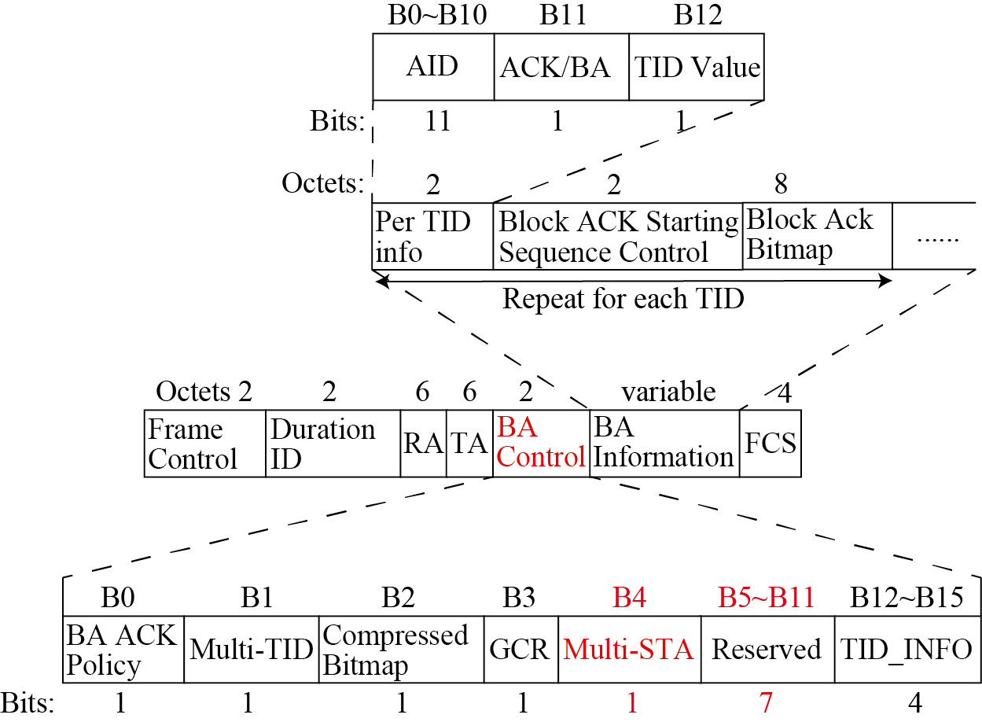
Consideration on adding a bit for indicating Multi-STA BA frame in 11ax
Following the legacy BlockAck frame structure design concept, we suggest using a reserved bit in BA control field for indicating that the frame is BlockAck frame structure in 11ax

Slide 6
Consideration on adding a bit for indicating Multi-STA BA frame in 11ax
  BA frame variant encoding
Multi-TID Subfield value | Compressed Bitmap Subfield value | GCR Subfield value | Multi-STA subfield value | BlockACK frame variant
0 | 0 | 0 | 0 | Basic BlockAck
0 | 1 | 0 | 0 | Compressed BlockAck
1 | 0 | 0 | 0 | Reserved
1 | 1 | 0 | 0 | Multi-TID BlockAck
0 | 0 | 1 | 0 | Reserved
0 | 1 | 1 | 0 | GCR BlockAck
1 | 0 | 1 | 0 | Reserved
1 | 1 | 1 | 0 | Reserved
0 | 0 | 0 | 1 | Reserved
0 | 1 | 0 | 1 | Reserved
1 | 0 | 0 | 1 | Reserved
1 | 1 | 0 | 1 | Multi-STA BlockAck
0 | 0 | 1 | 1 | Reserved
0 | 1 | 1 | 1 | Reserved
1 | 0 | 1 | 1 | Reserved
1 | 1 | 1 | 1 | Reserved

Slide 7
References
[1] 802.11-15/0132r5 “spec-framework”
[2] IEEE standard part 11n: Wireless LAN MAC and PHY specifications. Amendment 5: enhancements for higher throughput
[3] IEEE standard part 11aa: Wireless LAN MAC and PHY specifications. Amendment 5: MAC Enhancements for robust audio video streaming

