Slide 1
6LoWPAN over 802.11
Date: 2015-09-13
Authors:

Slide 2
Outline
Outlook
Background
Motivation
What is 6LoWPAN?
LLC SNAP and EPD Compatibility
Compatibility with Protocol Versions
Compression Principles
6LOWPAN (RFC 6282)
6LoWPAN Dispatch Field
6LoWPAN Header
6Lo for 802.11
Evaluations
Discussion

Slide 3
Outlook
WLAN is a widespread and popular wireless technology, thus it makes sense to improve 802.11 for IoT use cases
WLAN + higher layer protocols will be enablers of IoT
  Higher layer protocols are designed for IoT at IETF
  IEEE defines PHY & MAC layers
We invite the IEEE community to comment to the author on the feasibility to apply:
  IPv6 header compression in for 802.11 systems
  6LoWPAN Protocol as a header compression protocol to be used with 802.11

Slide 4
Background
IoT is a current topic in IEEE and IETF discussions
IEEE 802.11ah is one WLAN solution for IoT
  Channel bandwidth is reduced to 2 MHz and OFDM symbol duration is 40 µs (longer transmission durations)
6LoWPAN (IPv6 over Low-Power Wireless Personal Area Networks) was developed for 802.15.4 and currently is being adapted at IETF for different radio technologies
  E.g. BLUETOOTH(R) Low Energy , MS/TP Networks , DECT Ultra Low Energy, Near Field Communication, ITU-T G.9959 Networks

Slide 5
Motivation
IoT devices are expected to transmit short packets, thus reduction of overhead in all layers is welcomed
  802.11ah has worked in reducing L2 overhead
  Payload size affects the transmission duration
What about reduction of L3 (IPv6) overhead optimized for 802.11?
  Adaptation of 6LoWPAN compression for 802.11ah was proposed at IETF to improve performance of 802.11ah
  Reducing air-time of transmission is good for 802.11
The needed elements are present in 802.11, thus no modification in L1/L2 are required

Slide 6
What is 6LoWPAN?
6LoWPAN is an IETF Protocol designed for “Transmission of IPv6 Packets over IEEE 802.15.4 Networks” (rfc4944 , rfc6282)
6LoWPAN allows compression of IPv6 header and other headers such as UDP
  IPv6 overhead reduction from 40bytes to e.g. 2/3 bytes
The 6Lo Working Group in IETF (https://tools.ietf.org/wg/6lo/) adapts 6LoWPAN protocol to other link layers technologies
  E.g. 6LoWPAN for Bluetooth Low Energy is being finalized (https://tools.ietf.org/wg/6lo/draft-ietf-6lo-btle/)

Slide 7
6LoWPAN allows IPv6
6LoWPAN is just an adaptation layer between 802.11 LLC and IPv6.
Sensor STA
Higher layers
AP
IPv6
IPv6
6LoWPAN
6LoWPAN
Ethernet
internet
802.11 LLC
802.11 LLC
MAC 802.11
MAC 802.11
PHY 802.11
PHY 802.11
PHY
MAC
header
LLC
6LoWPAN
higher layers
PHY
MAC
header
LLC
IPv6
header
higher layers
Fig 1. Example of a stack including 6LoWPAN

Slide 8
LLC SNAP and EPD Compatibility
All MSDU is a LLC PDU (Section 5.1.4 802.11)
New Ethertype can be used to indicate 6LoWPAN compression protocol being fully backwards compatible
If the 6LoWPAN is discrimated by Ethertype, then it will be compatible with EPD as well.
Bytes: 1 2 3 3 2 variable
DSAP
0xAA
SSAP
0xAA
CTL
0x03 =UI
OUI:
00-00-00
Ethertype
e.g. 6LoWPAN
MSDU
Fig 2. Format of LPD compatible with current 802.11 recommendations

Slide 9
Compatibility with Protocol Versions (PV)
6LoWPAN can be used with both PV0 and PV1
PV0 is the current format for data frames for 802.11
PV1 is defined by the 802.11ah amendment as a format with less optional fields
It is expected that PV0 will be used in early 802.11ah STAs and PV1 will be deployed particularly in sensor type STAs, therefore compatibility with both Protocol Versions is desired for 6LoWPAN

Slide 10
Compression Principles 1/2
6LoWPAN compresses the header reducing redundancy
  Some information is deducted from underlying link layer
This achieves an efficient transport of IPv6 headers and next headers
  In some cases, IPv6 addresses can be deduced from MAC addresses
  IP payload length can be deduced from L2/L1 length information
  Traffic Class and Flow Label values are set to zero
  Version field value is IPv6
  Hop limit can be set to predefined values

Slide 11
Compression Principles 2/2
Example of header compression
IPv6 base header fields
Potential IPv6 base header fields to be carried inline
Version
Elided; v6 only
Version
Traffic Class
Set to 0
Traffic class
Flow Label
Set to 0
Flow Label
6LoWPAN
Payload length
Deduced from link info
Payload length
Next header
Maybe compressed
Next header
Hop limit
Set to a known value
Hop limit
Source address
Deduced from MAC
address or compressed or
uncompressed carried inline
Source address
Dest. address
Dest. address
Fig 3. 6LoWPAN compression

Slide 12
6LOWPAN (RFC 6282)
Comprises a Dispatch
  Identifies the type of header immediately following the Dispatch Header.
  Similar to a Frame Control field.
It follows a LOWPAN IP Header Compression (LOWPAN_IPHC) field

Slide 13
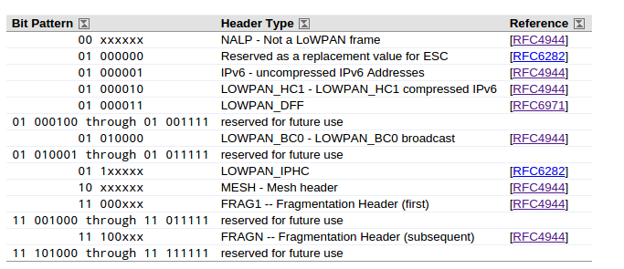
6LoWPAN Dispatch Field
Dispatch values assigned by IANA
Bytes: 1 2 or 3
Dispatch
LOWPAN_IPHC
Fig 4. 6LoWPAN dispatch values

Slide 14
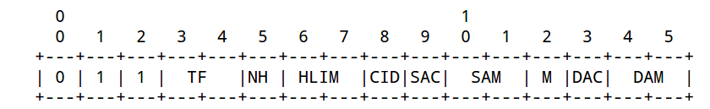
6LoWPAN Header
TF : Traffic Class, Flow Label
NH : Next Header
HLIM: Hop Limit
CID : Context Identifier Extension
SAC : Source Address Compression
M : Multicast Compression
DAC: Destination Address
Compression
DAM: Destination Address Mode
SAM: Source Address Mode
Bytes: 1 2 or 3
Dispatch
LOWPAN_IPHC
Fig 5. 6LoWPAN header format

Slide 15
6Lo for 802.11
Initial ideas has been shared in IETF (https://tools.ietf.org/html/draft-delcarpio-6lo-wlanah-00)
where 6LoWPAN has been proposed to be
adapted to 802.11ah
Technical comments has been received from TGah and IETF members, the document is being updated based on them.

Slide 16
Evaluation of 6LoWPAN
The evaluation of 6LoWPAN from the point-of-view of reduction of air-time of transmission has been studied
802.11ah PHY/MAC are taken as a example of a WLAN system using 6LoWPAN Protocol

Slide 17
Evaluation Assumptions
Reduction on the size of the body frame are reflected in air-time reduction
802.11ah D5.0 assumptions are used (Table 24-38/42 ):
  650 kbps for 2 MHz MCS-0
  2.6 Mbps for 2 MHz MCS-3
  150 kbps for 1 MHz MCS-10
Preamble (symbol length)
  Short 2MHz (6 ∙ 40µs)
  Short 1MHz (14 ∙ 40µs)
MPDU bits to symbols
Short MAC header: 14 bytes
Total air-time of a packet:
  preamble + MPDU air-time
Data transmission air-time
  DATA + SIFS + ACK
Stack : IPv6/UDP
  Uncompressed size
  (40 + 8) bytes = 48 bytes
  Compressed size 3 bytes
The gain (%) is the reduction of air-time of a transmission in the WM

Slide 18
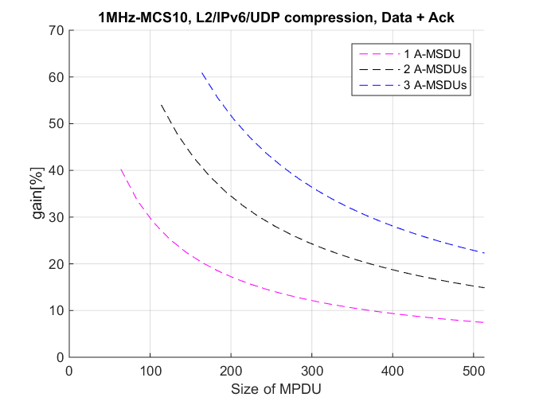
Evaluations BW 1MHz MCS10
Mode for extended range operation
  air-time of packets is longer
  in this mode
Combination of A-MSDU
and 6LoWPAN header compression provides good gains (reduction of air-time)
If IPv6/UDP payload is larger, then compression benefits are least noticeable

Slide 19
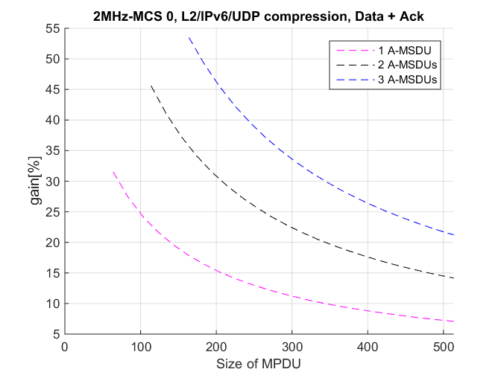
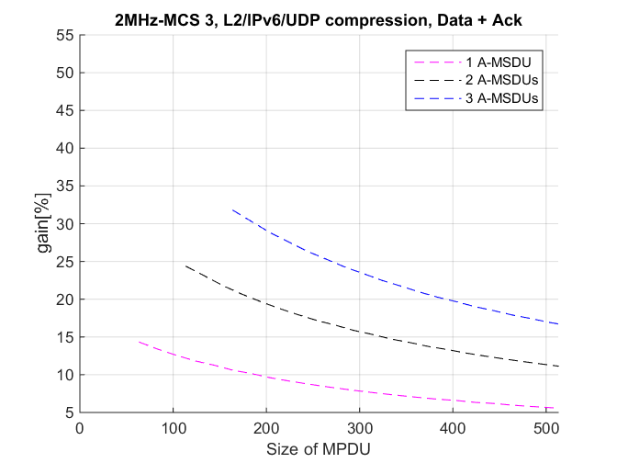
Evaluations BW 2Mhz MCS0/MCS3
Larger reductions are observed at lower MCS classes
Good for poor SNR scenarios

Slide 20
Discussion
Benefits are larger for lower MCS classes which yield longer air-time for transmissions
  Largest gains are observed when MCS-10 is used
6LoWPAN brings benefits such as
  Allowing less use of air-time by device
  Shorter packets have reduced collision probability and probability of error
  Reduced number of retransmission in the BSS
  Improved system capacity
  Reduction in air-time can be translated into reduction of energy consumption

Slide 21
Questions?
Thank you very much

