Slide 1
Analysis of BSS and ESS Structure
During Concurrent SR Transmissions
Date: 2015-09-13
Authors:

Slide 2
Abstract
The many SR contributions to date have dealt with “point” scenarios where a few APs & STAs are dropped in specific locations. [1 – 10]
“SINR compression” causes fundamental changes in the structure of a BSS when 2 or more SR-enabled cells are TXing at the same time.
This contribution models the structure and potential achievable data rates in an SR-ESS, in particular how many channels are needed to achieve overlapping MCS7 or MCS4 coverage during SR events.
For >=40m SR-ICD, during concurrent TX, the coverage radius for each MCS rate has nearly constant proportion to the SR-ICD distance
A minimum of 2 and as many as 5 “guard cells” are required between same-channel SR-BSS to enforce the minimum rate goal in the SR-ESS.
This contribution also finds that SR may be incompatible with 80-MHz channelizations worldwide, and with 40-MHz in some countries.

Slide 3
Assumptions
Focus on managed deployments with multiple BSS in ESS
  Use of “engineered” cells with configuration values selected by a knowledgeable operator.
  ESS has an “outer perimeter.” Inside this edge, overlapping BSS provide continuous coverage. (e.g. SS#2, SS#3, SS#4)
Typical AP-AP distance in managed deployments = ~20m
  Lots of CCI in current environments.
  Wi-Fi works primarily because duty cycles are low
  Inside managed perimeters, operators generally target minimum MCS7 performance (-65 dBm cell edge) and trim out low 11a / MCS rates
  Multi-operator indoor overlays will each have ~20m spacing
20-MHz channels with static power on all subcarriers
  No compensation for NF increase in wider bandwidths

Slide 4
Proposed Spatial Reuse Terminology
Term | Definition
Interference-Limited WLAN | An ESS that uses increased RXS level, CCAT and/or BSS coloring such that multiple BSS can TX concurrently when 802.11 CCA would otherwise prevent it.
SR-ESS
Term | Definition
Interference-Limited WLAN | An ESS that uses increased RXS level, CCAT and/or BSS coloring such that multiple BSS can TX concurrently when 802.11 CCA would otherwise prevent it.
SR-ESS
SR-BSS | A specific BSS within an SR-ESS.
Term | Definition
Interference-Limited WLAN | An ESS that uses increased RXS level, CCAT and/or BSS coloring such that multiple BSS can TX concurrently when 802.11 CCA would otherwise prevent it.
SR-ESS
SR-BSS | A specific BSS within an SR-ESS.
SR-ICD | Distance between same channel SR-BSS in an SR-ESS.
Term | Definition
Interference-Limited WLAN | An ESS that uses increased RXS level, CCAT and/or BSS coloring such that multiple BSS can TX concurrently when 802.11 CCA would otherwise prevent it.
SR-ESS
SR-BSS | A specific BSS within an SR-ESS.
SR-ICD | Distance between same channel SR-BSS in an SR-ESS.
SR-CCI | I/N increase measured in an SR-BSS due to one or more same-channel SR-BSS TXing concurrently. (May block higher MCS as opposed to normal CCI which blocks TX entirely.)
Term | Definition
Interference-Limited WLAN | An ESS that uses increased RXS level, CCAT and/or BSS coloring such that multiple BSS can TX concurrently when 802.11 CCA would otherwise prevent it.
SR-ESS
SR-BSS | A specific BSS within an SR-ESS.
SR-ICD | Distance between same channel SR-BSS in an SR-ESS.
SR-CCI | I/N increase measured in an SR-BSS due to one or more same-channel SR-BSS TXing concurrently. (May block higher MCS as opposed to normal CCI which blocks TX entirely.)
CCA-PD | CCA preamble detect level. (a.k.a. CCA-CS or CCA-SD)
Term | Definition
Interference-Limited WLAN | An ESS that uses increased RXS level, CCAT and/or BSS coloring such that multiple BSS can TX concurrently when 802.11 CCA would otherwise prevent it.
SR-ESS
SR-BSS | A specific BSS within an SR-ESS.
SR-ICD | Distance between same channel SR-BSS in an SR-ESS.
SR-CCI | I/N increase measured in an SR-BSS due to one or more same-channel SR-BSS TXing concurrently. (May block higher MCS as opposed to normal CCI which blocks TX entirely.)
CCA-PD | CCA preamble detect level. (a.k.a. CCA-CS or CCA-SD)
SR Duty Cycle | For each usable channel, the number of same-channel SR-BSS in SR-ESS that are TXing concurrently.

Slide 5
PART 1:
SR-BSS STRUCTURE
IN FREE SPACE

Slide 6
Understanding BSS Structure with SR
Most DSC contributions have emphasized RSSI and only 2 or 3 cells.
However, SINR and ESS scale expose critical properties of BSS structure.
Consider 3 adjacent same-channel SR-BSSes on the edge from SS#3.
  We ignore the other 16 SR-BSS in the cluster and any wraparound
  This is same ICD as the SR calibration scenario (15/0652r1)
Each SR-BSS affects the structure of the others. Later, we will look at ESS.
Aggressor
Victim
Aggressor
BSS1
BSS2
BSS3
30m
TGax SS #3
R=3, SR-ICD = 30m

Slide 7
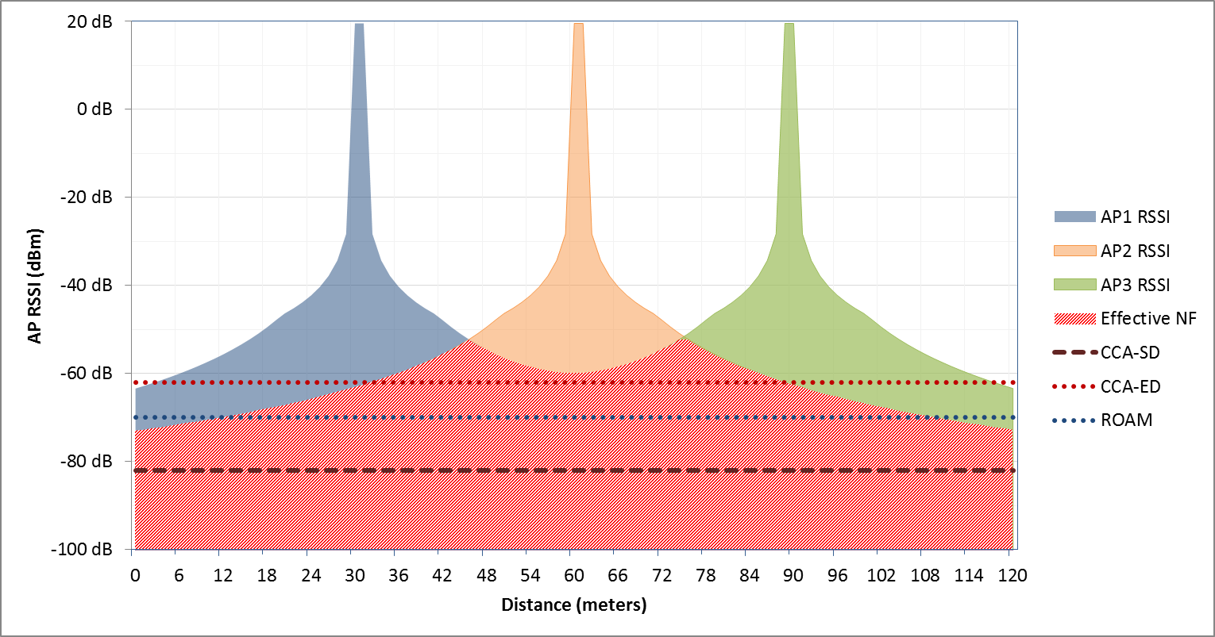
BSS Structure with SR – 3 BSS Case (RSSI)
Aggressor
Victim
Aggressor
The colored area above the NF is the SINR in each BSS if all are TXing.
Cumulative NF exceeds ED for 60m from AP1 to AP3!
Any STA using a -70 dBm RSSI threshold will not roam gracefully.
BSS1
BSS2
BSS3
AP EIRP = 20dBm; SS#3 fading model with 10m breakpoint used

Slide 8
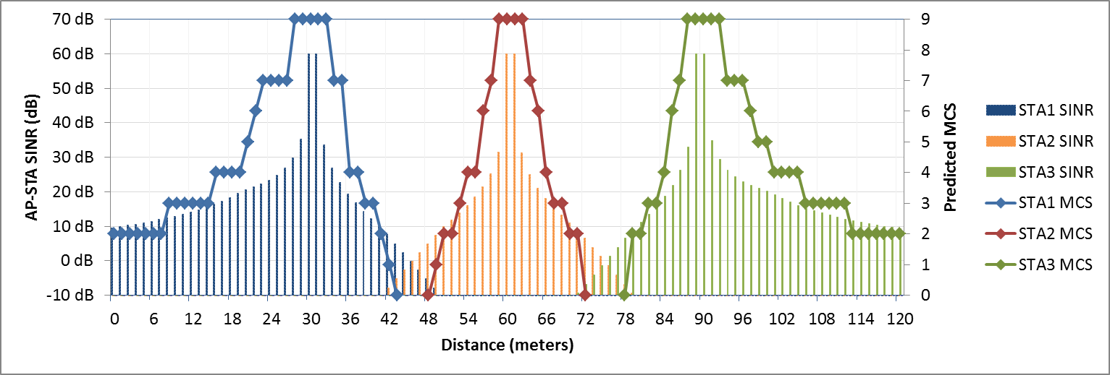
BSS Structure with SR – 3 BSS Case (SINR)
Aggressor
Victim
Aggressor
SINR drops to <= 0dB at inter-BSS midpoint.
It is impossible to roam directly between same channel SR-BSS.
  Reuse=1 deployments cannot work
Rapid SINR drop causes rapid data rate rolloff.
BSS1
BSS2
BSS3

Slide 9
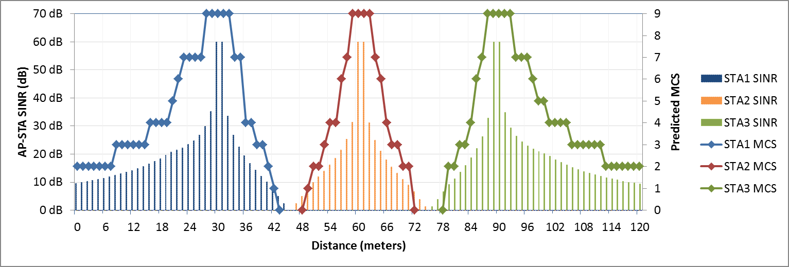
BSS Structure with SR – 3 BSS Case (SINR)
30m
30m
BSS1
BSS2
BSS3
7.2m
12m
Same as SS#3 with 30m ICD distance (reuse = 3)
Focus on victim BSS2 in center. Ignore aggressor BSS1 & BSS3.
For BSS2, the intra-BSS radius of MCS7 coverage is just 3.6 meters
Each STA will rate adapt approximately 1 rate every 1.3 meters
How does STA roaming algorithm adapt to rapid, PER-driven rate rolloff?

Slide 10
BSS Structure with SR – 3 BSS Case (SINR)
30m
30m
BSS1
BSS2
BSS3
22.8m
22.8m
18m
18m
If MCS4 is minimum allowable rate, the inter-BSS gap is 18 meters.
With reuse=3, there are not enough channels to fill the gap.
What is the minimum reuse number to achieve overlapping MCS4 or MCS7 coverage with SR?

Slide 11
Proposed SR-BSS Structure Terminology
Within SR-ESS, each channel is reuse = 1
MCS4
Radius
Limit
MCS0
Radius
Limit
MCS7
Limit
SR-ICD
20m
20m
20m
Ch X
Ch Y
Ch Z
Ch X
SR-BSS Midpoint
(SR-ICD / 2)

Slide 12
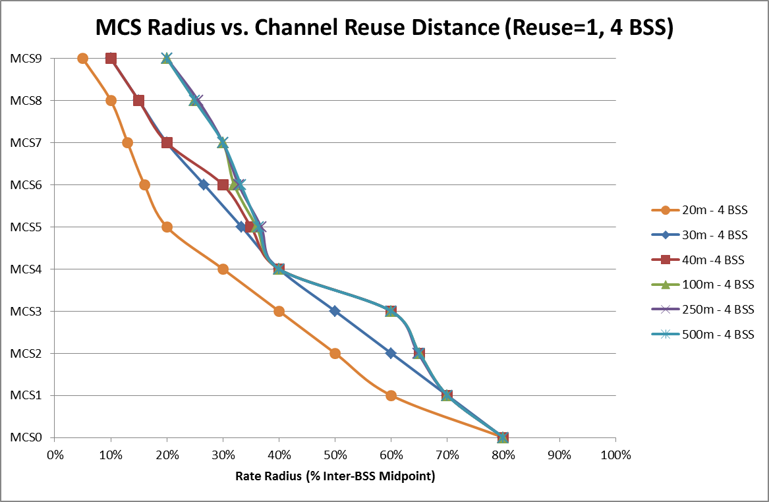
Modeling Rate Radius Limits for Victim SR-BSS
Smaller SR-ICD = reduce cell size
70% of cell is not covered
MCS7 limit is 30% of midpoint for 100m channel repeat distance
60% of cell is not covered
MCS0 Limit is 80% of midpoint for all repeat distances
MCS4 Limit is 40% of midpoint for 30m spacing
Same channel SR-BSS have narrowly defined rate edges regardless SR-ICD.
More aggressor SR-BSSes or smaller SR-ICD reduces radius of every rate
For MCS7 minimum SR-ESS rate with 0% overlap, 5 additional channels are required in between every same-channel SR-BSS (e.g. “guard cells”)
For MCS4 minimum SR-ESS rate and 0% overlap, 3 additional channels are required in between

Slide 13
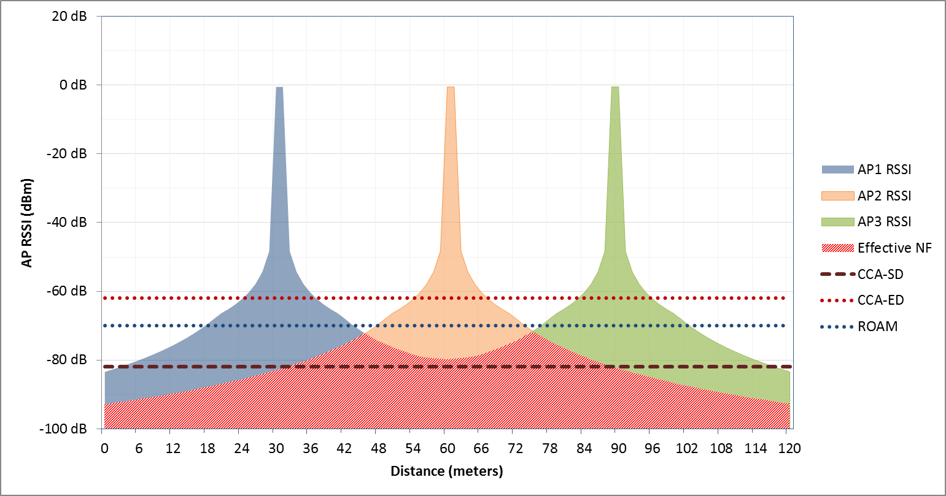
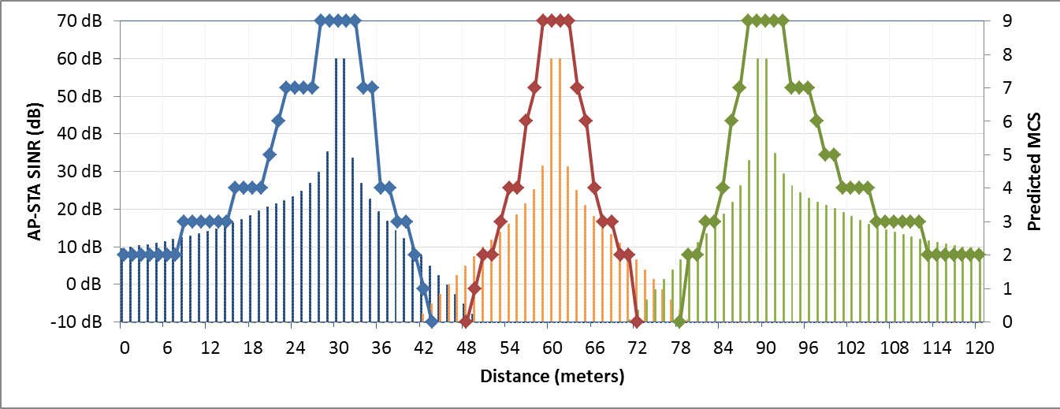
SR-BSS Rate Structure is EIRP Invariant
20 dBm EIRP
Aggressor
Victim
Aggressor
Identical SINR & MCS
0 dBm EIRP

Slide 14
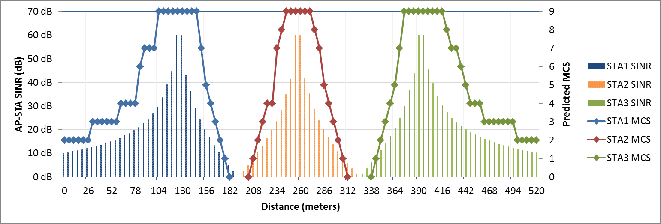

SR-BSS Rate Structure is Distance Invariant
Aggressor
Victim
Aggressor
Consider SR-ICD of 130m and 500m
  SS#4 = 130m ICD
Increasing SR-ICD increases absolute distance covered by each rate (meters)
However, relative SR-BSS structure does not change (% radius)
No MCS will ever overlap
30m inter-BSS distance
130m inter-BSS distance
500m inter-BSS distance

Slide 15
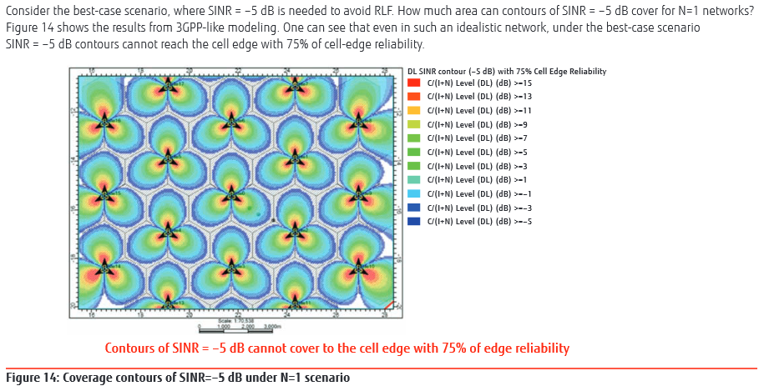
LTE Reuse=1 Networks Have Same Challenge [11]
802.11 does not support negative SINR demod
Green areas in this model approximate SR-ESS shown on previous slides

Slide 16
TGax Needs LTE-Like Interference
Management Techniques to Maximize SR
OFDMA subchannel resource units should be allocated to minimize SR-CCI (avoiding east/west conflicts between adjacent SR-BSS). Similar to LTE ICIC.
OFDMA RUs could be allocated to enable fractional frequency reuse (FFR) coupled with TPC
MU spatial streams should be allocated to minimize SR-CCI, not just intra-BSS CCI.

Slide 17
PART 2:
SR-BSS STRUCTURE
IN SIMPLE NLOS CONDITIONS

Slide 18
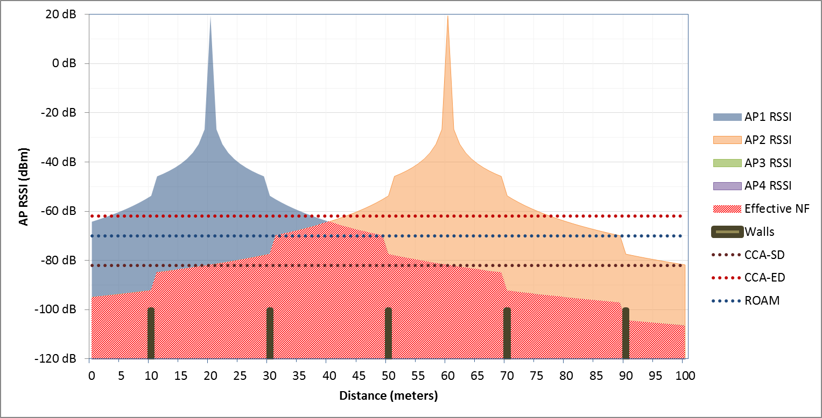
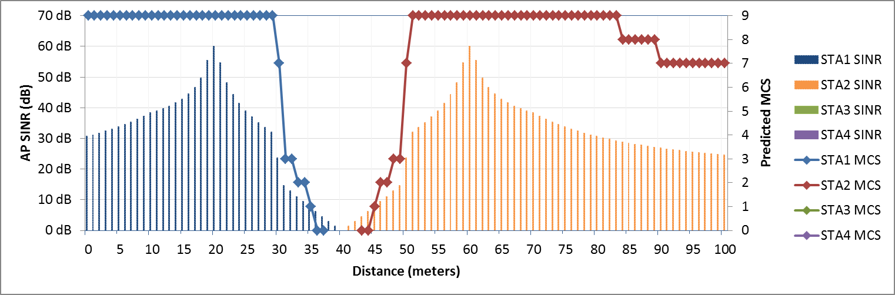
Walls Change BSS Structure
Channels 1-16
Channels 1-16
Walls and floors cause discrete discontinuities in path loss curves.
Consider SS#2 with a 16 channel plan.
  Walls permit higher edge MCS inside the SR-BSS
This increases SINR in any NLOS SR-BSS.
Non-discrete absorbers have less favorable effects (furniture, people)
SS#2 pathloss model (7dB wall, 10m breakpoint), no fading/shadowing

Slide 19
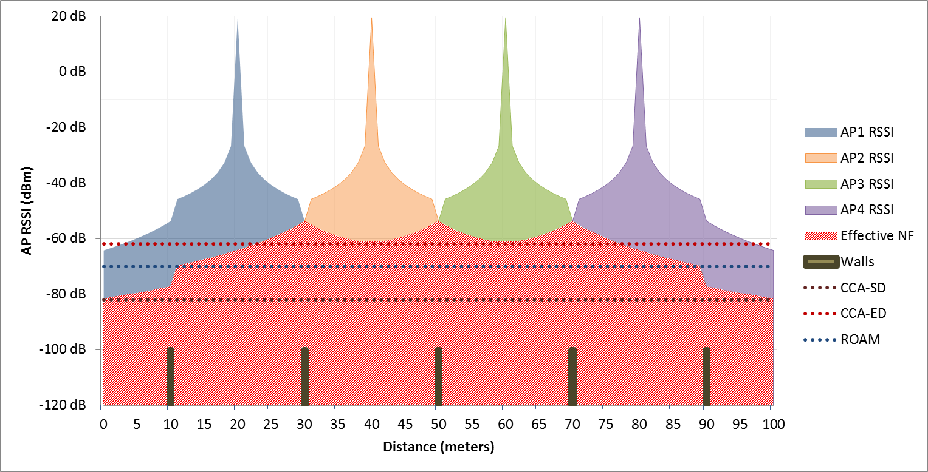
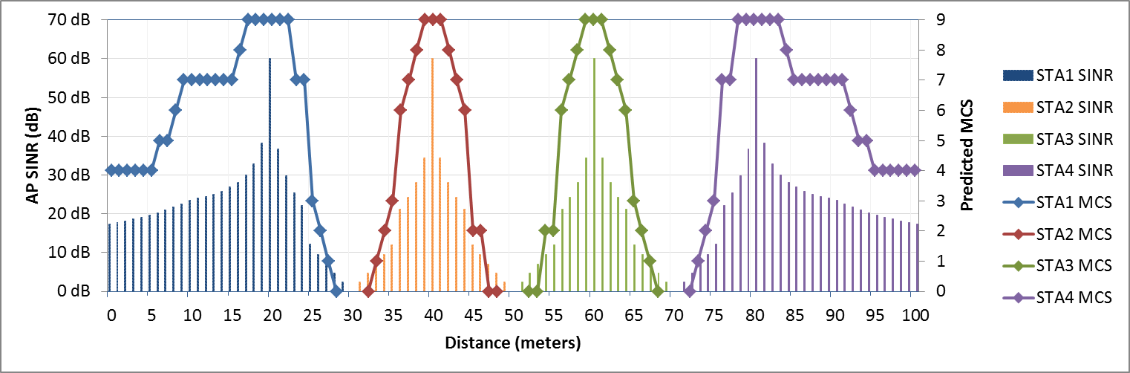
Channel Count Still Matters
Channels 1-8
Channels 1-8
Channels 1-8
Channels 1-8
Channels 1-8
Now consider SS#2 with an 8-channel or even a 4-channel plan.
80-MHz is unusable worldwide (6 channels max)
40-MHz is the largest usable SR bandwidth in many countries
In some countries only VHT20 is usable (e.g. Russia, China, Israel)
SS#2 pathloss model (7dB wall, 10m breakpoint), no fading/shadowing

Slide 20
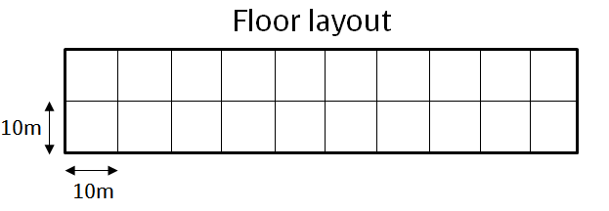
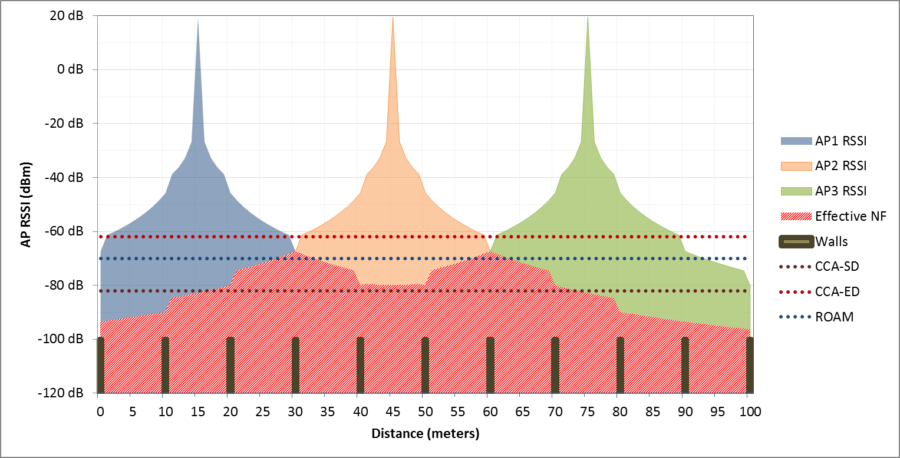
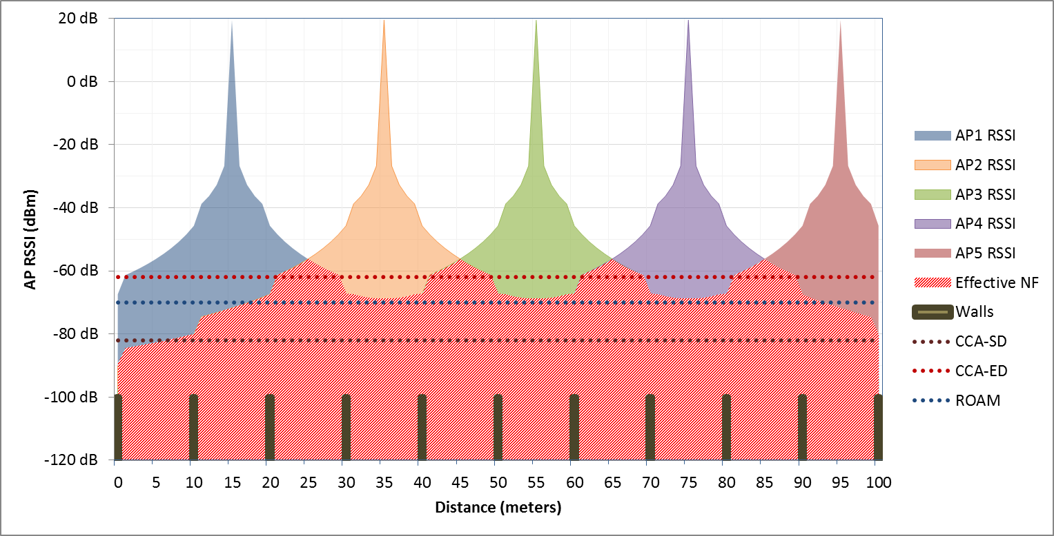
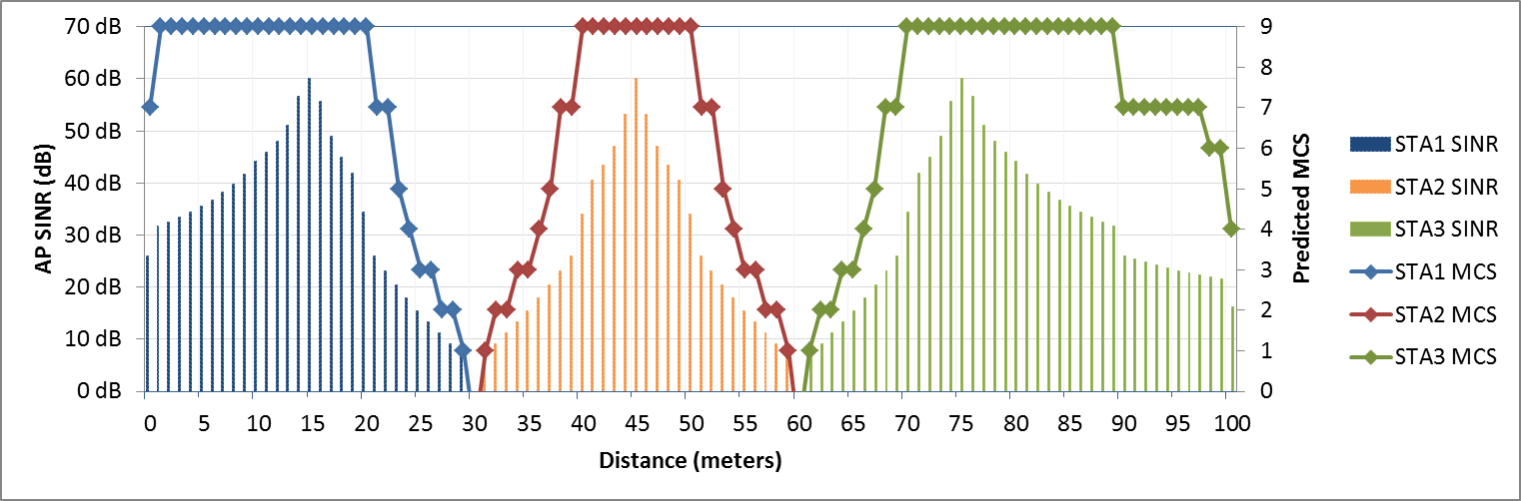
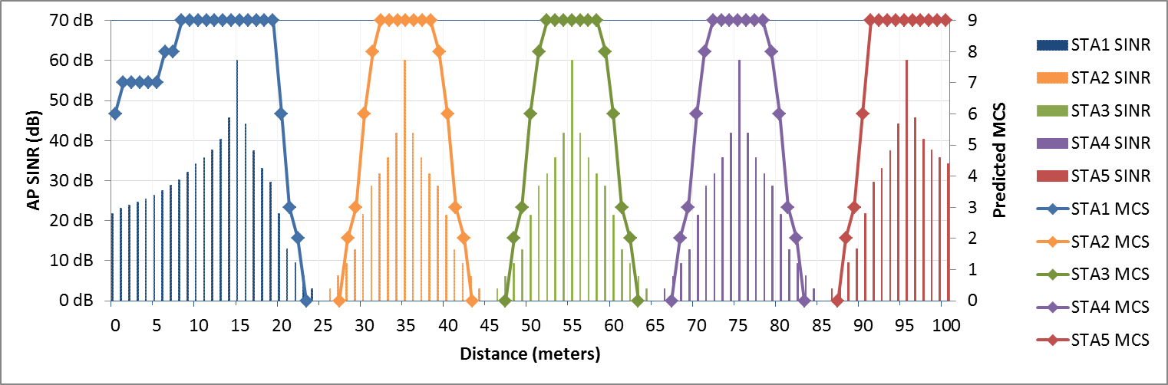
Walls Matter - Residential Scenario
Reuse=7
Reuse=4
SS#1 pathloss model (5dB wall, 5m breakpoint), no fading/shadowing

Slide 21
Reconciling My Simple Model With Real World
Factors that are understating SR performance
  No intelligent RU scheduling, MU, TxBF, or other
  Constant power on all subcarriers
  No PAR backoff for higher MCS
  Wall loss in TGax simulation scenarios is much too conservative [12]
Factors that are overstating SR performance
  Small number of BSS in a linear, 1D configuration
    Actual I/N increase would be higher by 10*log(n) where n = number of SR-BSS at equal range. Similar to SS#3 19 cell with wraparound.
  One floor only, no I/N increase from other floors
  NF rise for 40- and 80-MHz bandwidths not considered
  No MRC, multiple-chain, STBC, TxBF or other processing gains

Slide 22
PART 3:
SR-eSS STRUCTURE
IN FREE SPACE

Slide 23
Choosing an ESS Minimum Rate
802.11 ESS design has always been based on a minimum achievable data rate target
MCS7 is the preferred minimum rate:
  256-QAM is only achievable at very short range
  MCS7 is a good balance of robustness and performance
MCS4 is the lowest acceptable rate in a SR-BSS:
  For any MCS8-limited channelization, it is 50% of MCS8
  For all MCS9 channelizations, it is only 45% of MCS9
    This is slightly below breakeven.
    Below MCS4, it is always better to defer than attempt SR.
  Therefore, SR should only be attempted for MCS4 and up.

Slide 24
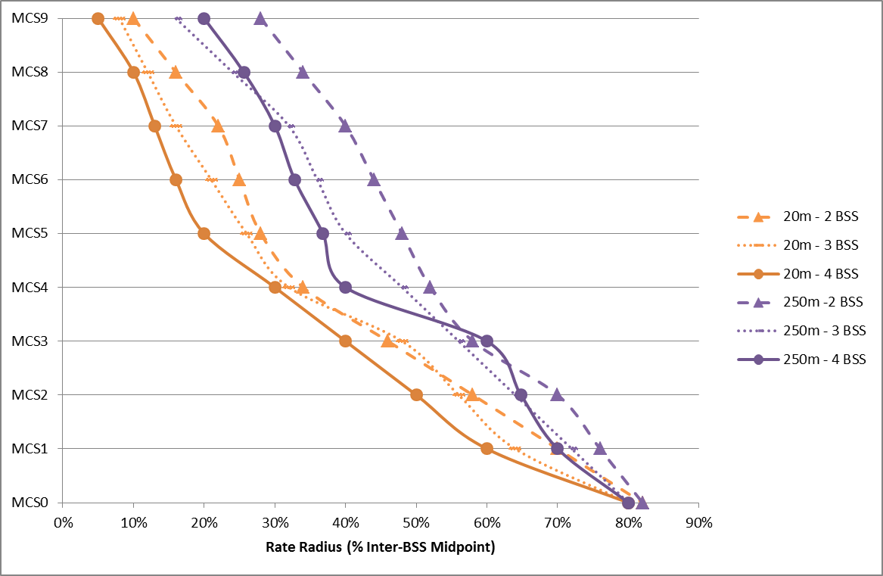
Effect of Increasing SR-BSS Duty Cycle
Rate radius drops up to 10% with 4 BSS versus 2
Rate radius drops over 15% with closer BSS spacing
Every SR-BSS is both a victim and an aggressor
Each additional SR-BSS transmitting simultaneously further compresses available SINR, making cells smaller.

Slide 25
SR Duty Cycle and Cumulative NF
Assume SR-BSS in center has A-MPDU to send and needs to make pre-TX SR payoff decision
  1 hop SR duty cycle – 3 BSS
  2 hop SR duty cycle – 3 BSS
Aggregate I/N @ BSS1 is RX power from all active SR-BSS.
  Ring 1 I/N = -63.4 dBm + 4.8dB = -58.6 dBm
  Ring 2 I/N = -73.9 dBm + 4.8dB = -69.1 dBm
  Combined I/N = -58.2 dBm
Aggregate I/N also varies with RX bandwidth.
BSS1
TGax SS #3, R=3

Slide 26
Minimum Reuse Number by Target MCS
3
2
3
2
7
1
5
2
2
7
1
6
12
1
6
12
5
11
4
1
5
5
11
4
10
16
3
7
4
4
10
16
9
15
9
15
8
14
19
6
3
7
8
14
19
13
18
Reuse=19
Reuse=7
2
6
13
18
3
17
1
5
17
2
7
1
6
12
4
5
11
3
7
4
10
16
6
9
15
8
14
19
13
18
17
Reuse = 7 required for MCS4 with 2 cell guard zone
Reuse = 19 required for MCS7 with 4 cell guard zone
Buildings with rectangular or other linear geometry could have lower minimums

Slide 27
Minimum Channel Count
The number of “guard cells” required to enforce the minimum ESS rate target varies with SR duty cycle.
In free space with conventional hex layout, the following minimum channel counts are required:

Slide 28
SR May Require Small Channelizations
If at least 19 channels are required to achieve MCS7 minimum ESS rate with SR in LOS or NLOS, then this is incompatible with both 80-MHz and 40-MHz channelizations in all worldwide regulatory domains.
For MCS4, both 40-MHz and 20-MHz channelizations are possible, but 40-MHz may not be feasible in some countries.
Higher wall/floor path loss values will improve SR for wider bandwidths. How should AP/STA learn?
Alternatively, cellular-style RB scheduling (ICIC), FFR or other techniques may be required to reduce guard zone requirement between SR-BSS.

Slide 29
Summary of Key Findings
For >=40m SR-ICD, during concurrent TX, the coverage radius for each MCS rate has nearly constant proportion to the SR-ICD distance
A minimum of 2 and as many as 5 guard cells are required between same-channel SR-BSS to enforce the minimum rate goal in the SR-ESS.
SR-ESS will need new design techniques to ensure desired minimum rates (e.g. no more “-65dBm cell edge”) during SR operation. Building geometry and OFDMA MU/RU modeling are important.
Roaming needs to be carefully re-evaluated for SR

Slide 30
References
14/0082r0 - Improved Spatial Reuse Feasibility – Part I, R. Porat & N. Jindal (Broadcom), Jan 2014
14/0523r4 – “MAC Simulation Results for DSC & TPC”, I Jamil, L Cariou et al (Orange), Apr 2014
15/0045r0 – “Performance Analysis of BSS Color and DSC”, Itagaki et all (Sony + NTT), Jan 2015
15/0595r2 – “Discussion on The Receiver Behavior for DSC/CCAC with BSS Color”, Inoue et. al (Sony, NTT, DII) – May 2015
14/0889r3 – “Performance Gains from CCA Optimization”, Jindal & Porat (Broadcom), Jun 2014
14/1199r1 – “Effect of CCA in Residential Scenario Part 2”, Barriac, Merlin et al. (Qualcomm), Sep 2014
v14/0372r2 – “System Level Simulations on Increased Spatial Reuse”, Jiang et al (Marvell), Mar 2014
14/0779r2 - “Dynamic Sensitivity Control - Practical Usage” , Graham Smith, July 2014
14/0328r2 - “Dense Apartment Complex Throughput Calculations,” Graham Smith, Mar 2014
13/1487r2 – “Apartment Capacity – DSC and Channel Selection,” Graham Smith, Nov 2013
“Enhancing LTE Cell-Edge Performance via PDCCH ICIC”, Fujitsu Network Communications, 2011
15/0179r0 – “Indoor Wall Propagation Loss Measurements”, C. Lukaszewski (Aruba), Jan 2015

Slide 31
Backup material

Slide 32
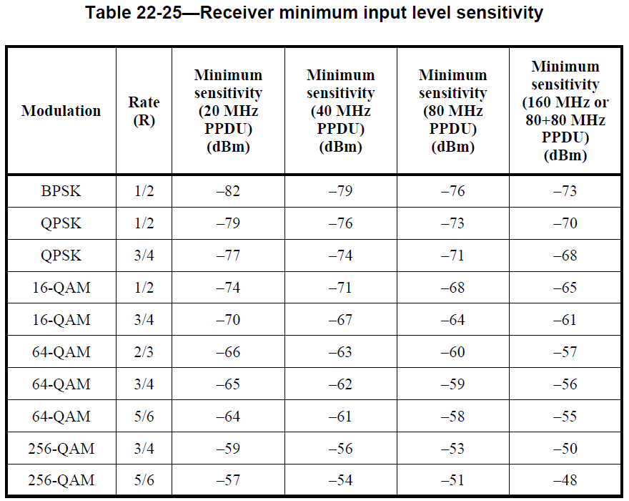
Creating SINR → MCS Mapping Table
Take minimum VHT20 RX sensitivity values from 802.11ac-2013, Table 22-25 in Clause 22.3.19.1
Anchor BPSK at SINR = 4 dB to determine NF = -86 dBm
For each rate, subtract NF from RXS level*
* Similar to genie MCS values from 14/0889r3
-86 dBm NF

Slide 33
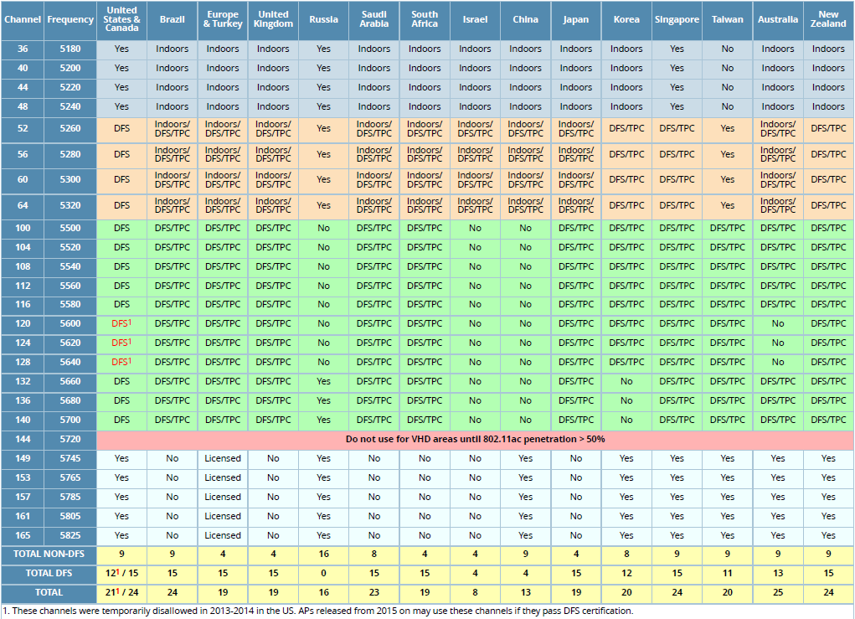
Worldwide Channel Availability at 3/1/2015

