Slide 1
HE-SIGA content
Date: 2015-07-12
Authors:
Name | Affiliation | Address | Phone | Email
Jiayin Zhang | Huawei | 5B-N8, No.2222 Xinjinqiao Road, Pudong, Shanghai | +86-18601656691 | zhangjiayin@huawei.com
Jun Zhu |  |  |  | zhujun75@huawei.com
Le Liu |  | F1-17, Huawei Base, Bantian, Shenzhen | +86-18601656691 | liule@huawei.com
Jun Luo |  | 5B-N8, No.2222 Xinjinqiao Road, Pudong, Shanghai |  | jun.l@huawei.com
Yi Luo |  | F1-17, Huawei Base, Bantian, Shenzhen | +86-18665891036 | Roy.luoyi@huawei.com
Yingpei Lin |  | 5B-N8, No.2222 Xinjinqiao Road, Pudong, Shanghai |  | linyingpei@huawei.com
Jiyong Pang |  | 5B-N8, No.2222 Xinjinqiao Road, Pudong, Shanghai |  | pangjiyong@huawei.com
Zhigang Rong |  | 10180 Telesis Court, Suite 365, San Diego, CA 92121 NA |  | zhigang.rong@huawei.com
Rob Sun |  | 303 Terry Fox, Suite 400 Kanata, Ottawa, Canada |  | Rob.Sun@huawei.com
David X. Yang |  | F1-17, Huawei Base, Bantian, Shenzhen |  | david.yangxun@huawei.com

Slide 2
Authors (continued)
Name | Affiliation | Address | Phone | Email
Kiseon Ryu | LG Electronics | 19, Yangjae-daero 11gil, Seocho-gu, Seoul 137-130, Korea |  | kiseon.ryu@lge.com
Jinyoung Chun |  |  |  | jiny.chun@lge.com
Jinsoo Choi |  |  |  | js.choi@lge.com
Jeongki Kim |  |  |  | jeongki.kim@lge.com
Giwon Park |  |  |  | giwon.park@lge.com
Dongguk Lim |  |  |  | dongguk.lim@lge.com
Suhwook Kim |  |  |  | suhwook.kim@lge.com
Eunsung Park |  |  |  | esung.park@lge.com
HanGyu Cho |  |  |  | hg.cho@lge.com
Thomas Derham | Orange |  |  | thomas.derham@orange.com
Bo Sun | ZTE | #9 Wuxingduan, Xifeng Rd., Xi'an, China |  | sun.bo1@zte.com.cn
Kaiying Lv |  |  |  | lv.kaiying@zte.com.cn
Yonggang Fang |  |  |  | yfang@ztetx.com
Ke Yao |  |  |  | yao.ke5@zte.com.cn
Weimin Xing |  |  |  | xing.weimin@zte.com.cn
Brian Hart | Cisco Systems | 170 W Tasman Dr, San Jose, CA 95134 |  | brianh@cisco.com
Pooya Monajemi |  |  |  | pmonajem@cisco.com

Slide 3
Authors (continued)
Name | Affiliation | Address | Phone | Email
Yunsong Yang | Huawei | 10180 Telesis Court, Suite 365, San Diego, CA 92121 NA |  | yangyunsong@huawei.com
Junghoon Suh |  | 303 Terry Fox, Suite 400 Kanata, Ottawa, Canada |  | Junghoon.Suh@huawei.com
Peter Loc |  |  |  | peterloc@iwirelesstech.com
Name | Affiliation | Address | Phone | Email
Hongyuan Zhang | Marvell | 5488 Marvell Lane, Santa Clara, CA, 95054 | 408-222-2500 | hongyuan@marvell.com
Yakun Sun |  |  |  | yakunsun@marvell.com
Lei Wang |  |  |  | Leileiw@marvell.com
Liwen Chu |  |  |  | liwenchu@marvell.com
Jinjing Jiang |  |  |  | jinjing@marvell.com
Yan Zhang |  |  |  | yzhang@marvell.com
Rui Cao |  |  |  | ruicao@marvell.com
Jie Huang |  |  |  | jiehuang@marvell.com
Sudhir Srinivasa |  |  |  | sudhirs@marvell.com
Saga Tamhane |  |  |  | sagar@marvell.com
Mao Yu |  |  |  | my@marvel..com
Edward Au |  |  |  | edwardau@marvell.com
Hui-Ling Lou |  |  |  | hlou@marvell.com

Slide 4
Authors (continued)
Name | Affiliation | Address | Phone | Email
Albert Van Zelst | Qualcomm | Straatweg 66-S Breukelen, 3621 BR Netherlands |  | allert@qti.qualcomm.com
Alfred Asterjadhi |  | 5775 Morehouse Dr. San Diego, CA, USA |  | aasterja@qti.qualcomm.com
Bin Tian |  | 5775 Morehouse Dr. San Diego, CA, USA |  | btian@qti.qualcomm.com
Carlos Aldana |  | 1700 Technology Drive San Jose, CA 95110, USA |  | caldana@qca.qualcomm.com
George Cherian |  | 5775 Morehouse Dr. San Diego, CA, USA |  | gcherian@qti.qualcomm.com
Gwendolyn Barriac |  | 5775 Morehouse Dr. San Diego, CA, USA |  | gbarriac@qti.qualcomm.com
Hemanth Sampath |  | 5775 Morehouse Dr. San Diego, CA, USA |  | hsampath@qti.qualcomm.com
Menzo Wentink |  | Straatweg 66-S Breukelen, 3621 BR Netherlands |  | mwentink@qti.qualcomm.com
Richard Van Nee |  | Straatweg 66-S Breukelen, 3621 BR Netherlands |  | rvannee@qti.qualcomm.com
Rolf De Vegt |  | 1700 Technology Drive San Jose, CA 95110, USA |  | rolfv@qca.qualcomm.com
Sameer Vermani |  | 5775 Morehouse Dr. San Diego, CA, USA |  | svverman@qti.qualcomm.com
Simone Merlin |  | 5775 Morehouse Dr. San Diego, CA, USA |  | smerlin@qti.qualcomm.com
Tevfik Yucek |  | 1700 Technology Drive San Jose, CA 95110, USA |  | tyucek@qca.qualcomm.com
VK Jones |  | 1700 Technology Drive San Jose, CA 95110, USA |  | vkjones@qca.qualcomm.com
Youhan Kim |  | 1700 Technology Drive San Jose, CA 95110, USA |  | youhank@qca.qualcomm.com

Slide 5
Authors (continued)
Name | Affiliation | Address | Phone | Email
James Yee | Mediatek | No. 1 Dusing 1st Road, Hsinchu, Taiwan | +886-3-567-0766 | james.yee@mediatek.com
Alan Jauh |  |  |  | alan.jauh@mediatek.com
Chingwa Hu |  |  |  | chinghwa.yu@mediatek.com
Frank Hsu |  |  |  | frank.hsu@mediatek.com
Thomas Pare | Mediatek USA | 2860 Junction Ave, San Jose, CA 95134, USA | +1-408-526-1899 | thomas.pare@mediatek.com
ChaoChun Wang |  |  |  | chaochun.wang@mediatek.com
James Wang |  |  |  | james.wang@mediatek.com
Jianhan Liu |  |  |  | Jianhan.Liu@mediatek.com
Tianyu Wu |  |  |  | tianyu.wu@mediatek.com
Russell Huang |  |  |  | russell.huang@mediatek.com
Joonsuk Kim | Apple |  |  | joonsuk@apple.com
Aon Mujtaba |  |  |  | mujtaba@apple.com
Guoqing Li |  |  |  | guoqing_li@apple.com
Eric Wong |  |  |  | ericwong@apple.com
Chris Hartman |  |  |  | chartman@apple.com

Slide 6
Authors (continued)
Name | Affiliation | Address | Phone | Email
Ron Porat | Broadcom |  |  | rporat@broadcom.com
Sriram Venkateswaran |  |  |  | mfischer@broadcom.com
Matthew Fischer
Leo Montreuil
Andrew Blanksby
Vinko Erceg
Robert Stacey | Intel | 2111 NE 25th Ave, Hillsboro OR 97124, USA | +1-503-724-893 | robert.stacey@intel.com
Eldad Perahia |  |  |  | eldad.perahia@intel.com
Shahrnaz Azizi |  |  |  | shahrnaz.azizi@intel.com
Po-Kai Huang |  |  |  | po-kai.huang@intel.com
Qinghua Li |  |  |  | quinghua.li@intel.com
Xiaogang Chen |  |  |  | xiaogang.c.chen@intel.com
Chitto Ghosh |  |  |  | chittabrata.ghosh@intel.com
Laurent cariou |  |  |  | laurent.cariou@intel.com
Rongzhen Yang |  |  |  | rongzhen.yang@intel.com

Slide 7
Authors (continued)
Name | Affiliation | Address | Phone | Email
Fei Tong | Samsung | Innovation Park, Cambridge CB4 0DS (U.K.) | +44 1223 434633 | f.tong@samsung.com
Hyunjeong Kang |  | Maetan 3-dong; Yongtong-Gu Suwon; South Korea | +82-31-279-9028 | hyunjeong.kang@samsung.com
Kaushik Josiam |  | 1301, E. Lookout Dr, Richardson TX 75070 | (972) 761 7437 | k.josiam@samsung.com
Mark Rison |  | Innovation Park, Cambridge CB4 0DS (U.K.) | +44 1223 434600 | m.rison@samsung.com
Rakesh Taori |  | 1301, E. Lookout Dr, Richardson TX 75070 | (972) 761 7470 | rakesh.taori@samsung.com
Sanghyun Chang |  | Maetan 3-dong; Yongtong-Gu Suwon; South Korea | +82-10-8864-1751 | s29.chang@samsung.com
Yasushi Takatori | NTT | 1-1 Hikari-no-oka, Yokosuka, Kanagawa 239-0847 Japan |  | takatori.yasushi@lab.ntt.co.jp
Yasuhiko Inoue |  |  |  | inoue.yasuhiko@lab.ntt.co.jp
Yusuke Asai |  |  |  | asai.yusuke@lab.ntt.co.jp
Koichi Ishihara |  |  |  | ishihara.koichi@lab.ntt.co.jp
Akira Kishida |  |  |  | kishida.akira@lab.ntt.co.jp
Akira Yamada | NTT DOCOMO | 3-6, Hikarinooka, Yokosuka-shi, Kanagawa, 239-8536, Japan |  | yamadaakira@nttdocomo.com
Fujio Watanabe |  | 3240 Hillview Ave, Palo Alto, CA 94304 |  | watanabe@docomoinnovations.com
Haralabos Papadopoulos |  |  |  | hpapadopoulos@docomoinnovations.com

Slide 8
Abstract
In [1], the following motion passed.
HE-SIG-A (using a DFT period of 3.2 µs and subcarrier spacing of 312.5 kHz) is duplicated on each 20 MHz after the legacy preamble to indicate common control information. [Motion #4, January 2015,]
HE-SIG-A is present in all 11ax packets and is two OFDM symbols long when it uses MCS0
Information bits in HE-SIG-A are jointly encoded as in VHT-SIG-A (using 48 tones or 52 tones is TBD).
SU packets and UL Trigger based packets do not contain HE-SIG-B symbols. [PHY Motion 16, July 16, 2015]
In this slide, we discuss the potential fields in HE-SIG-A.

Slide 9
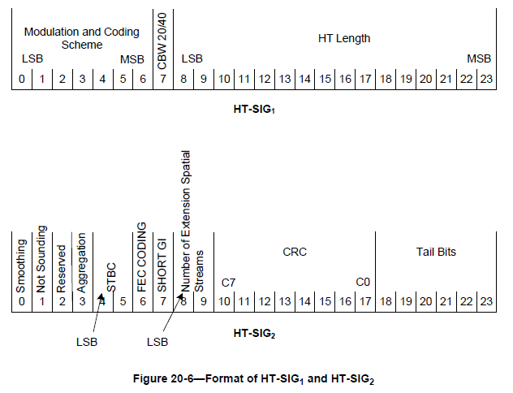
HT-SIG fields in 11n

Slide 10
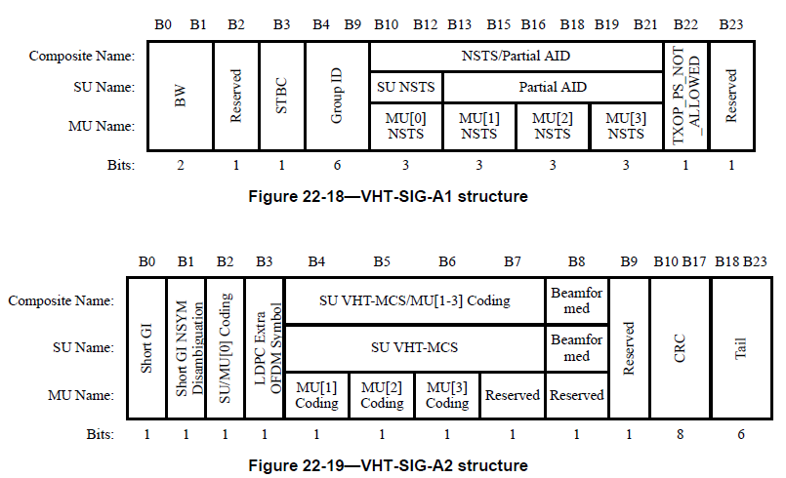
VHT-SIGA in 11ac

Slide 11
Configuration for SU PPDU decoding
Considering there is no SIGB for SU PPDU, we need to transmit all configurations for data payload in HE-SIG-A.
Similar as previous standard, the following fields is still necessary for the receiver to decode SU PPDU.
BW
Payload GI | 0.8/1.6/3.2us
Packet extension | [2]
Payload MCS
coding | LDPC/BCC
LTF compression | 2x/4x LTF symbol
Nsts | 1~8 spatial streams
STBC
BF
CRC
tail

Slide 12
Configuration for decoding HE-SIG-B in DL MU PPDU
Number of symbols in HE-SIG-B
In [1],
Downlink HE MU PPDU shall include HE-SIG-B field, and the number of OFDM symbols of HE-SIG-B field is variable. [PHY Motion #8, March 2015]
HE-SIG-B shall use a DFT period of 3.2 µs and subcarrier spacing of 312.5 kHz. [Motion #14, May 2015]
MCS of HE-SIG-B
HE-SIG-B can also modulate with higher MCS in order to reduce the overhead because it is only required by the intended STA.
The MCS level is TBD.

Slide 13
Format indication
In [3], the group agreed that there is no SIGB for UL MU PPDU and SU PPDU in 11ax.
Receiver still need one bit in HE-SIG-A to differentiate whether the current PPDU is SU PPDU or UL MU PPDU, considering SU and MU PPDU had different interpretation on SIGA content.

Slide 14
TXOP duration
In 11ac, Duration field is in MAC header for NAV setting for unintended STA.
In 11ax, we still need such field for
Hidden node protection
Power saving
Spatial reuse: OBSS AP/STA can adjust its transmission according to the rest of TXOP
We proposed to carry TXOP duration in HE-SIG-A field due to
Higher Reliability
Overhead reduction
Feasibility for MU PPDU
Independence of RTS/CTS

Slide 15
TXOP duration
Necessity of TXOP duration field in HE-SIGA
Other STAs can’t set the NAV (i.e., not decode MAC duration) after receiving UL MU PPDU because of no SIGB in UL MU PPDU
DL/UL OFDMA/MU-MIMO Ack/BA frame may be longer than legacy EIFS.
Risk to use L-SIG length to indicate TXOP duration
Legacy STAs become suspicious if energy disappears during the reception and discard the remainder – e.g. in the gap between the reception of a Trigger frame and the UL MU PPDU, some legacy STA will drop the BUSY indication.
Legacy device can’t truncate the TXOP while HE STAs reset NAV when CF-End is received before the end of TXOP indicated by L-SIG. Because legacy devices interpret L-SIG length as PPDU length, and they can’t decode CF-end frame sent in the middle of TXOP duration.
So, L-SIG length shall indicate the PPDU length not TXOP duration
Therefore, we suggest including TXOP duration field in SIG-A.
The length is TBD.

Slide 16
HE-SIG-A for SU PPDU
CAT | SU | bit | note
SIGA format | Format Indication | 1 | SU PPDU or UL MU PPDU
 | DL/UL flag | 1 | Differentiate DL/UL SU PPDU for power saving[4]
Spatial Reuse fields | BSS Color | 6 | [4][5]
 | TXOP duration | TBD
PPDU format | BW | 2 | 20/40/80/160/80+80
 | Payload GI | 2 | 0.8/1.6/3.2 us
 | PE | 3 | Packet extension [2]
MCS related | MCS | 4 | MCS levels TBD
 | coding | 2 | BCC/LDPC
MIMO related | LTF compression | 1 | 2X/4X
 | Nsts | 3 | 1~8
 | STBC | 1
 | BF | 1
ending bits | CRC | 4
 | tail | 6

Slide 17
HE-SIG-A for DL MU PPDU
CAT | DL/UL MU PPDU | bit | note
SIGA format | Format indication | 1 | SU PPDU or UL MU PPDU
Spatial Reuse fields | BSS Color | 6
 | TXOP duration | TBD
PPDU format | BW | TBD
SIGB related | Number of HE-SIG-B symbols | TBD
 | MCS of HE-SIG-B | TBD | MCS levels TBD
ending bits | CRC | 4
 | tail | 6
Note: SIGB related fields are not used in UL MU PPDU
Note: SIGB related fields are not used in UL MU PPDU

Slide 18
reference
[1] 11-15-0132-07-00ax-spec-framework
[2] 11-15-0810-01-00ax HE PHY Padding and Packet Extension
[3] 11-15-0822-02-00ax-sig-a-structure-in-11ax-preamble
[4] 11-15-xxxx-00-00ax-Identifiers in HE PPDUs for power saving
[5] 11-15-xxxx-00-00ax-Number-of-BSS-Color-bits

Slide 19
Straw poll 1
Do you agree to add to SFD
HE-SIG-A shall include the following fields in SU PPDU.
The size of each field is TBD
The other fields are TBD
Format indication
TXOP duration
BW
Payload GI
PE
MCS
coding
LTF compression
Nsts
STBC
BF
CRC
tail

Slide 20
Straw poll 2
Do you agree to add to SFD
HE-SIG-A shall include the following fields in MU DL PPDU.
The size of each field is TBD
The other fields are TBD
Format indication
TXOP duration
Number of HE-SIG-B symbols
MCS of SIGB
CRC
tail

Slide 21
Straw Poll 3
Do you agree to add to SFD
HE-SIG-A shall include the following fields in MU UL PPDU.
The size of each field is TBD
The other fields are TBD
Format indication
TXOP duration
CRC
tail

