Slide 1
Adaptive CCA and TPC
Date: 2015-09-12
Authors:
Name | Affiliation | Address | Phone | Email
James Wang | Mediatek USA | 2860 Junction Ave, San Jose, CA 95134, USA | +1-408-526-1899 | james.wang@mediatek.com
Thomas Pare |  |  |  | thomas.pare@mediatek.com
ChaoChun Wang |  |  |  | chaochun.wang@mediatek.com
Jianhan Liu |  |  |  | Jianhan.Liu@mediatek.com
Tianyu Wu |  |  |  | tianyu.wu@mediatek.com
Russell Huang |  |  |  | russell.huang@mediatek.com
James Yee | Mediatek | No. 1 Dusing 1st Road, Hsinchu, Taiwan | +886-3-567-0766 | james.yee@mediatek.com
Alan Jauh |  |  |  | alan.jauh@mediatek.com
Chingwa Hu |  |  |  | chinghwa.yu@mediatek.com
Frank Hsu |  |  |  | frank.hsu@mediatek.com

Slide 2
Authors (continued)
Name | Affiliation | Address | Phone | Email
Albert Van Zelst | Qualcomm | Straatweg 66-S Breukelen, 3621 BR Netherlands |  | allert@qti.qualcomm.com
Alfred Asterjadhi |  | 5775 Morehouse Dr. San Diego, CA, USA |  | aasterja@qti.qualcomm.com
Arjun Bharadwaj |  | 5775 Morehouse Dr. San Diego, CA, USA |  | arjunb@qti.qualcomm.com
Bin Tian |  | 5775 Morehouse Dr. San Diego, CA, USA |  | btian@qti.qualcomm.com
Carlos Aldana |  | 1700 Technology Drive San Jose, CA 95110, USA |  | caldana@qca.qualcomm.com
George Cherian |  | 5775 Morehouse Dr. San Diego, CA, USA |  | gcherian@qti.qualcomm.com
Gwendolyn Barriac |  | 5775 Morehouse Dr. San Diego, CA, USA |  | gbarriac@qti.qualcomm.com
Hemanth Sampath |  | 5775 Morehouse Dr. San Diego, CA, USA |  | hsampath@qti.qualcomm.com
Menzo Wentink |  | Straatweg 66-S Breukelen, 3621 BR Netherlands |  | mwentink@qti.qualcomm.com
Richard Van Nee |  | Straatweg 66-S Breukelen, 3621 BR Netherlands |  | rvannee@qti.qualcomm.com
Rolf De Vegt |  | 1700 Technology Drive San Jose, CA 95110, USA |  | rolfv@qca.qualcomm.com
Sameer Vermani |  | 5775 Morehouse Dr. San Diego, CA, USA |  | svverman@qti.qualcomm.com
Simone Merlin |  | 5775 Morehouse Dr. San Diego, CA, USA |  | smerlin@qti.qualcomm.com
Tevfik Yucek |  | 1700 Technology Drive San Jose, CA 95110, USA |  | tyucek@qca.qualcomm.com
VK Jones |  | 1700 Technology Drive San Jose, CA 95110, USA |  | vkjones@qca.qualcomm.com
Youhan Kim |  | 1700 Technology Drive San Jose, CA 95110, USA |  | youhank@qca.qualcomm.com

Slide 3
Authors (continued)
Name | Affiliation | Address | Phone | Email
Robert Stacey | Intel | 2111 NE 25th Ave, Hillsboro OR 97124, USA | +1-503-724-893 | robert.stacey@intel.com
Eldad Perahia |  |  |  | eldad.perahia@intel.com
Shahrnaz Azizi |  |  |  | shahrnaz.azizi@intel.com
Po-Kai Huang |  |  |  | po-kai.huang@intel.com
Qinghua Li |  |  |  | quinghua.li@intel.com
Xiaogang Chen |  |  |  | xiaogang.c.chen@intel.com
Chitto Ghosh |  |  |  | chittabrata.ghosh@intel.com
Laurent cariou |  |  |  | laurent.cariou@intel.com
Rongzhen Yang |  |  |  | rongzhen.yang@intel.com
Ron Porat | Broadcom |  |  | rporat@broadcom.com
Matthew Fischer |  |  |  | mfischer@broadcom.com
Sriram Venkateswaran
Andrew Blanksby
Matthias Korb
Tu Nguyen
Vinko Erceg

Slide 4
Authors (continued)
Name | Affiliation | Address | Phone | Email
Phillip Barber | Huawei | The Lone Star State, TX |  | pbarber@broadbandmobiletech.com
Peter Loc |  |  |  | peterloc@iwirelesstech.com
Le Liu |  | F1-17, Huawei Base, Bantian, Shenzhen | +86-18601656691 | liule@huawei.com
Jun (Rossi) Luo |  | 5B-N8, No.2222 Xinjinqiao Road, Pudong, Shanghai |  | jun.l@huawei.com
Yi Luo |  | F1-17, Huawei Base, Bantian, Shenzhen | +86-18665891036 | Roy.luoyi@huawei.com
Yingpei Lin |  | 5B-N8, No.2222 Xinjinqiao Road, Pudong, Shanghai |  | linyingpei@huawei.com
Jiyong Pang |  | 5B-N8, No.2222 Xinjinqiao Road, Pudong, Shanghai |  | pangjiyong@huawei.com
Zhigang Rong |  | 10180 Telesis Court, Suite 365, San Diego, CA 92121 NA |  | zhigang.rong@huawei.com
Rob Sun |  | 303 Terry Fox, Suite 400 Kanata, Ottawa, Canada |  | Rob.Sun@huawei.com
David X. Yang |  | F1-17, Huawei Base, Bantian, Shenzhen |  | david.yangxun@huawei.com
Yunsong Yang |  | 10180 Telesis Court, Suite 365, San Diego, CA 92121 NA |  | yangyunsong@huawei.com
Zhou Lan |  | F1-17, Huawei Base, Bantian, SHenzhen | +86-18565826350 | Lanzhou1@huawei.com
Junghoon Suh |  | 303 Terry Fox, Suite 400 Kanata, Ottawa, Canada |  | Junghoon.Suh@huawei.com
Jiayin Zhang |  | 5B-N8, No.2222 Xinjinqiao Road, Pudong, Shanghai | +86-18601656691 | zhangjiayin@huawei.com

Slide 5
Authors (continued):
Name | Affiliation | Address | Phone | Email
Hongyuan Zhang | Marvell | 5488 Marvell Lane, Santa Clara, CA, 95054 | 408-222-2500 | hongyuan@marvell.com
Yakun Sun |  |  |  | yakunsun@marvell.com
Lei Wang |  |  |  | Leileiw@marvell.com
Liwen Chu |  |  |  | liwenchu@marvell.com
Jinjing Jiang |  |  |  | jinjing@marvell.com
Yan Zhang |  |  |  | yzhang@marvell.com
Rui Cao |  |  |  | ruicao@marvell.com
Bo Yu |  |  |  | jiehuang@marvell.com
Sudhir Srinivasa |  |  |  | sudhirs@marvell.com
Saga Tamhane |  |  |  | sagar@marvell.com
Mao Yu |  |  |  | my@marvel..com
Edward Au |  |  |  | edwardau@marvell.com
Hui-Ling Lou |  |  |  | hlou@marvell.com
Joonsuk Kim | Apple |  |  | joonsuk@apple.com
Aon Mujtaba |  |  |  | mujtaba@apple.com
Guoqing Li |  |  |  | guoqing_li@apple.com
Eric Wong |  |  |  | ericwong@apple.com
Chris Hartman |  |  |  | chartman@apple.com

Slide 6
Authors (continued)
Name | Affiliation | Address | Phone | Email
Hyeyoung Choi | LG Electronics | 19, Yangjae-daero 11gil, Seocho-gu, Seoul 137-130, Korea |  | hy0117.choi@lge.com
Kiseon Ryu |  |  |  | kiseon.ryu@lge.com
Jinyoung Chun |  |  |  | jiny.chun@lge.com
Jinsoo Choi |  |  |  | js.choi@lge.com
Jeongki Kim |  |  |  | jeongki.kim@lge.com
Giwon Park |  |  |  | giwon.park@lge.com
Dongguk Lim |  |  |  | dongguk.lim@lge.com
Suhwook Kim |  |  |  | suhwook.kim@lge.com
Eunsung Park |  |  |  | esung.park@lge.com
HanGyu Cho |  |  |  | hg.cho@lge.com
Thomas Derham | Orange |  |  | thomas.derham@orange.com
Bo Sun | ZTE | #9 Wuxingduan, Xifeng Rd., Xi'an, China |  | sun.bo1@zte.com.cn
Kaiying Lv |  |  |  | lv.kaiying@zte.com.cn
Yonggang Fang |  |  |  | yfang@ztetx.com
Ke Yao |  |  |  | yao.ke5@zte.com.cn
Weimin Xing |  |  |  | xing.weimin@zte.com.cn
Brian Hart | Cisco Systems | 170 W Tasman Dr, San Jose, CA 95134 |  | brianh@cisco.com
Pooya Monajemi |  |  |  | pmonajem@cisco.com

Slide 7
Authors (continued)
Name | Affiliation | Address | Phone | Email
Fei Tong | Samsung | Innovation Park, Cambridge CB4 0DS (U.K.) | +44 1223 434633 | f.tong@samsung.com
Hyunjeong Kang |  | Maetan 3-dong; Yongtong-Gu Suwon; South Korea | +82-31-279-9028 | hyunjeong.kang@samsung.com
Kaushik Josiam |  | 1301, E. Lookout Dr, Richardson TX 75070 | (972) 761 7437 | k.josiam@samsung.com
Mark Rison |  | Innovation Park, Cambridge CB4 0DS (U.K.) | +44 1223 434600 | m.rison@samsung.com
Rakesh Taori |  | 1301, E. Lookout Dr, Richardson TX 75070 | (972) 761 7470 | rakesh.taori@samsung.com
Sanghyun Chang |  | Maetan 3-dong; Yongtong-Gu Suwon; South Korea | +82-10-8864-1751 | s29.chang@samsung.com
Yasushi Takatori | NTT | 1-1 Hikari-no-oka, Yokosuka, Kanagawa 239-0847 Japan |  | takatori.yasushi@lab.ntt.co.jp
Yasuhiko Inoue |  |  |  | inoue.yasuhiko@lab.ntt.co.jp
Yusuke Asai |  |  |  | asai.yusuke@lab.ntt.co.jp
Koichi Ishihara |  |  |  | ishihara.koichi@lab.ntt.co.jp
Akira Kishida |  |  |  | kishida.akira@lab.ntt.co.jp
Akira Yamada | NTT DOCOMO | 3-6, Hikarinooka, Yokosuka-shi, Kanagawa, 239-8536, Japan |  | yamadaakira@nttdocomo.com
Fujio Watanabe |  | 3240 Hillview Ave, Palo Alto, CA 94304 |  | watanabe@docomoinnovations.com
Haralabos Papadopoulos |  |  |  | hpapadopoulos@docomoinnovations.com

Slide 8
Authors (continued)
Name | Affiliation | Address | Phone | Email
Masahito Mori | Sony Corporation | 1-7-1 Konan Minato-ku, Tokyo 108-0075, Japan |  | Masahito.Mori@jp.sony.com
Takeshi Itagaki |  |  |  | Takeshi.Itagaki@jp.sony.com

Slide 9
Outline
Interference problems for spatial reuse transmission
Adaptive CCA and TPC schemes
Conclusions

Slide 10
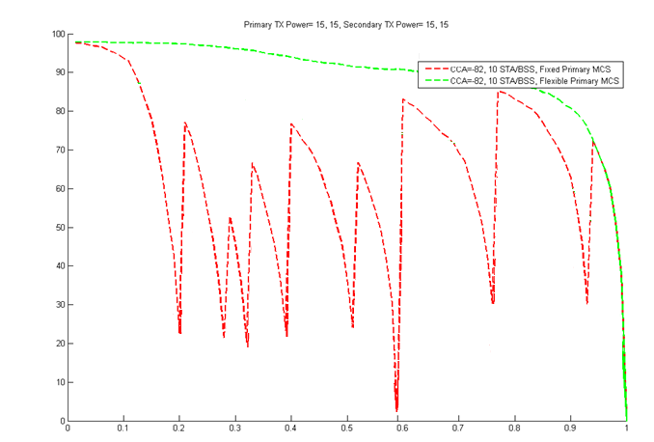
Interference Problem for Spatial Re-use
In Ref[11], a 4 BSSs/40STAs scenario is presented
  CCA prevents high percentage of spatial re-use transmission (>90% for CCA=-82dBm)
  Significant percentage of spatial re-use transmission (shaded area: >30%) will affect the MCSs of the on-going frame exchange
4BSSs/40STAs, all TX Power = 15 dBm
TPC needed to avoid collisions
Spatial Re-use Possible
Spatial re-use induced collision causes loss in throughput before link can adapt to lower MCSs.
Interference mitigation (such as
Higher MCS
Normalized distance (by that of MCS0) between primary nodes
transmit power control) should be employed during SR transmission to avoid collision with on-going frame exchange in a dense environment
James Wang, Mediatek, et al

Slide 11
Adaptive CCA/TPC Schemes
To achieve higher spatial re-use in a dense environment, the following step are needed.
  Detect and identify whether a received PPDU is from inter-BSS or intra-BSS (e.g., via BSS Color)
  for OBSS PPDUs, employ an OBSS specific channel access procedure for spatial re-use (such as employing a OBSS_PD CCA threshold)
  initiate a spatial re-use transmission under specific conditions (such as employs transmit power adjustment)
Higher OBSS CCA threshold increases spatial re-use. However, to
  avoid interference to OBSS transmission
  maintain fairness to legacy STAs
the OBSS CCA threshold should be accompanied by a TXPWR value and a reduction in the TXPWR should be allowed to be accompanied by an increase in the OBSS CCA threshold value.
There are many contributions (e.g, Ref 1~12) on this subject. Specific methods (Ref 1~12) of adaptive CCA and TPC implementations are still subject to further investigation and comparison.
James Wang, Mediatek, et al

Slide 12
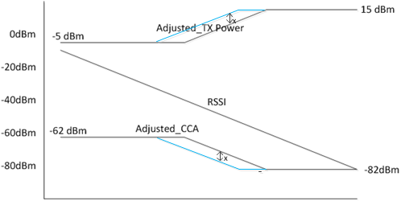
An Example of Adaptive CCA/PC Scheme
STA’s OBSS_PD threshold and transmit power are based on received RSSI (e.g, received RCPI of the beacon or path loss) and constants determined by AP
  Adjusted_TX_Pwr = TX_Pwr_{nominal} –RSSI_{AP} +constant 1
  Adjusted_OBSS_PD = OBSS_PD_{nominal} + RSSI_{AP} + constant 2
Limits the OBSS_PD threshold to be
  -82dBm<Adj_CCA<-62 dBm
(Note: OBSS_PD for AP can be set to the value based on the farthest STA.)
Less adjustment
More adjustment
Higher SR,
Lower TX PWR
Lower SR,
Higher TX PWR
James Wang, Mediatek, et al

Slide 13
Simulation Results for the Example Adaptive CCA/TPC Scheme
Simulation Scenario 6, 11ax BSS
BSS B (middle) achieves the highest throughput improvement.
BSS A and BSS C (edge) also achieve significant throughput improvement.
BSS C
BSS B
BSS A
BSS | Adaptive CCA TPC Gput (Mbps) | Baseline Gput (Mbps) | Gput Improvement (%)
A | 175.168 | 132.377 | 32
B | 160.268 | 102.156 | 57
C | 174.616 | 134.330 | 30
Total | 510.052 | 368.863 | 38
James Wang, Mediatek, et al

Slide 14
Simulation Results for the Example Adaptive CCA/TPC Scheme
Simulation results of a mixed 11ax BSS and legacy BSS (BSS B is legacy BSS)
Note that legacy BSS performance is not degraded
BSS | Adaptive CCA TPC Gput (Mbps) | Baseline Gput (Mbps) | Gput Improvement (%)
A | 171.128 | 132.377 | 29
B | 112.639 | 102.156 | 10
C | 172.721 | 134.330 | 28
Total | 456.488 | 368.863 | 23
James Wang, Mediatek, et al

Slide 15
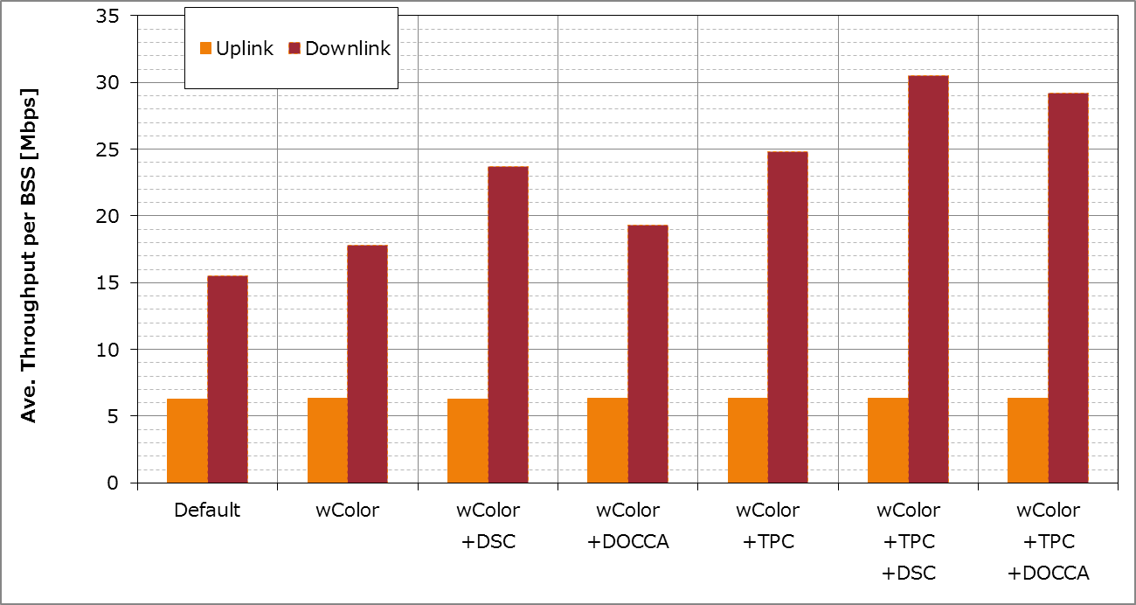
Sony’s Simulation Results – SS1
(All of STAs are Ax-STA)
(Offered DL load=60Mbps)
From Ref 12
Offered
UL load
When TPC and DCCA(DSC/DOCCA) are used together, larger gain can be obtained than when TPC/DCCA is used alone.

Slide 16
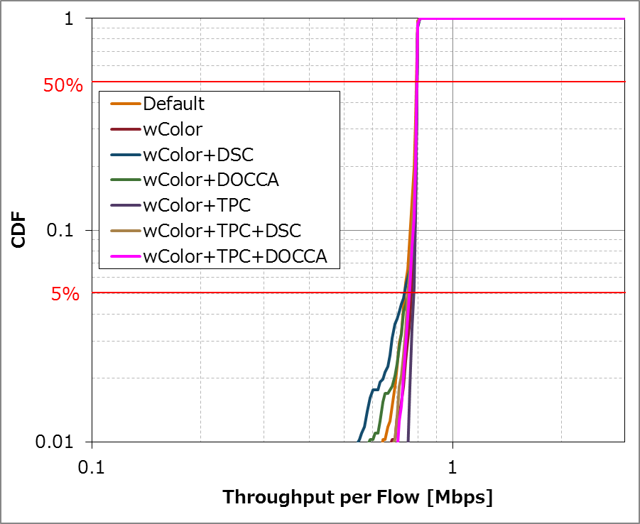
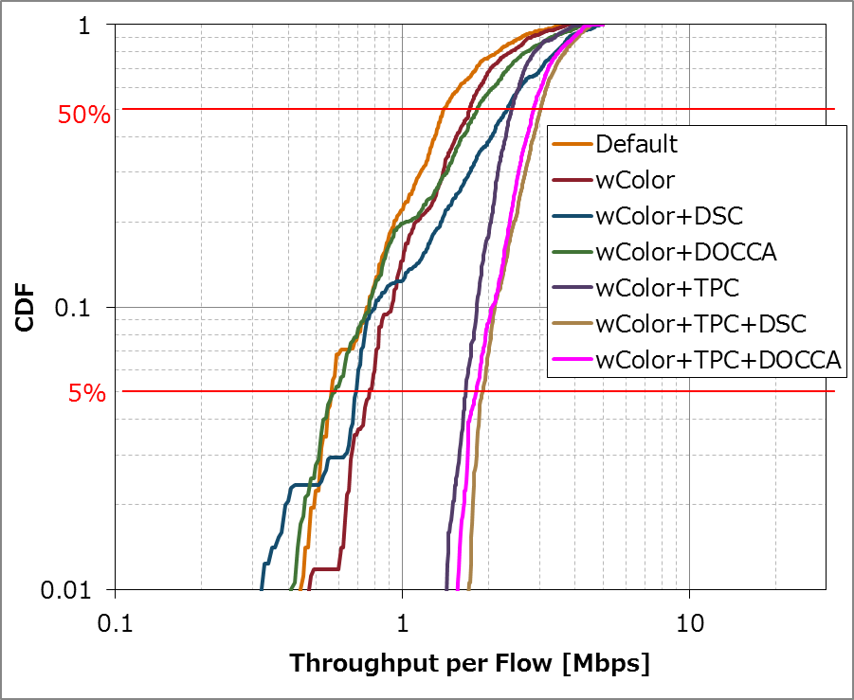
Sony’s Simulation Results for SS1
(All of STAs are Ax-STA)
From Ref 12
Uplink
Downlink
DCCA(DSC/DOCCA) can deteriorate the 5%tile throughput when used alone.
On the other hand, when TPC is used with DCCA, 5%tile throughput can be improved.

Slide 17
Conclusions
In this contribution, simulation results for adaptive CCA/TPC show that higher network throughput can be achieved while maintaining fairness to legacy STA and 5 percentile performance.
Propose that for adaptive CCA/TPC scheme, the OBSS CCA threshold in the adaptive CCA/TPC scheme should be accompanied by a TXPWR value and a reduction in the TXPWR should be accompanied by an increase in the OBSS CCA threshold value
James Wang, Mediatek, et al

Slide 18
Straw Poll
When an 11ax STA regards a valid OBSS PPDU as not having been received at all (e.g., should not update its NAV), except that the medium condition shall indicate BUSY during the period of time that is taken by the receiving STA to validate that the PPDU is from an Inter-BSS, but not longer than the time indicated as the length of the PPDU payload if the RXPWR of the received PPDU is below the OBSS_PD threshold and TBD conditions are met, noting that the OBSS_PD threshold is accompanied by a TXPWR value and a reduction in the TXPWR may be accompanied by an TBD increase in the OBSS_PD threshold value.
  Yes:
  No:
  Abstain:
  (Note: “discard PPDU is changed to “PPDU as not having been received at all (e.g., should not update its NAV), except that the medium condition shall indicate BUSY during the period of time that is taken by the receiving STA to validate that the PPDU is from an Inter-BSS, but not longer than the time indicated as the length of the PPDU payload,”)
James Wang, Mediatek, et al

Slide 19
Backup Charts

Slide 20
Scenario Description (slides 12 and 13)
802.11ac Enterprise Network with OBSS, Scenario 6.
DCN: 11-09-0451-16-00ac-tgac-functional-requirements-and-evaluation-methodology
Parameters:
  3 802.11ac 20MHz overlapped BSS
    BSS A: 5 STAs
    BSS B: 20 STAs
    BSS C: 5 STAs
  AP Tx power: 20 dBm
  STA Tx power: 15 dBm
  ED CCA threshold: -62 dBm
  Fixed Rate: MCS5
  EDCA, AC_BE, [CWmin = 15, CWmax = 1023], AIFSn = 3
  MSDU Packet size: 1500 bytes
  full buffer
 | BSS A
Station | UL
STA3 | Y
STA9 | Y
STA15 | Y
STA21 | Y
STA27 | Y
 | BSS B
Station | UL
STA1 | Y
STA2 | Y
STA4 | Y
STA5 | Y
STA7 | Y
STA8 | Y
STA10 | N
STA11 | N
STA13 | N
STA14 | N
STA16 | N
STA17 | N
STA19 | N
STA20 | N
STA22 | Y
STA23 | Y
STA25 | Y
STA26 | Y
STA28 | Y
STA29 | Y
 | BSS C
Station | UL
STA6 | Y
STA12 | Y
STA18 | Y
STA24 | Y
STA30 | Y
James Wang,Mediate,k et al

Slide 21
Reference
[1] DCN 14-1187r1 “The Effect of Preamble Error Model on MAC Simulator”, Po-Kai Huang, Intel
[2] DCN 15-367r0 “OBSS preamble detection”, Gwen Barriac , Qualcomm
[3] DCN 14-637 “Spatial Reuse and Coexistence with Legacy Devices” James Wang, Mediatek
[4] DCN 14-0082r1 “Improved Spatial Reuse Feasibility – Part I” Ron Porat, Broadcom
[5] DCN 14-1224 “Link Aware CCA” Brian Hart, Cisco
[6]DCN 14-637 “Spatial Reuse and Coexistence with Legacy Devices” James Wang, Mediatek
[7] DCN 14-1207r1 “OBSS reuse mechanism which preserves fairness” Imad Jamil, Orange
[8] DCN 14-1199r1 “CCA Study in Residential Scenario - Part 2” Gwen Barriac, Qualcomm
[9] DCN 14-846r0 “CCA Study in Residential Scenario”, Gwen Barriac, Qualcomm
[10] DCN 14-1448r2 “Considerations for Adaptive CCA” Reza Hedayat, Newracom
[11] DCN 15-588r0 “CCA Revisited” Amin Jafarian, Newracom
[12[ DCN 15-1045r0 Sony Dynamic CCA control and TPC Simulation Results

