Slide 1
HE-SIG-B Contents
Date: 2015-09-13
Authors:
Name | Affiliation | Address | Phone | Email
Kaushik Josiam | Samsung | 1301, E. Lookout Dr, Richardson TX 75082 | (972) 761 7437 | k.josiam@samsung.com
Rakesh Taori |  | 1301, E. Lookout Dr, Richardson TX 75082 | (972) 761 7470 | rakesh.taorig@samsung.com
Sanghyun Chang |  | Maetan 3-dong; Yongtong-Gu Suwon; South Korea | +82-10-8864-1751 | s29.chang@samsung.com
Hyunjeong Kang |  | Maetan 3-dong; Yongtong-Gu Suwon; South Korea | +82-31-279-9028 | hyunjeong.kang@samsung.com
Mark Rison |  | Innovation Park, Cambridge CB4 0DS (U.K.) | +44 1223 434633 | m.rison@samsung.com
Fei Tong |  | Innovation Park, Cambridge CB4 0DS (U.K.) | +44 1223 434600 | f.tong@samsung.com
Ron Porat | Broadcom |  |  | rporat@broadcom.com
Matthew Fischer |  |  |  | mfischer@broadcom.com
Sriram Venkateswaran
Leo Montreuil
Andrew Blanksby
Vinko Erceg

Slide 2
Authors (continued)
Name | Affiliation | Address | Phone | Email
Kazuyuki Sakoda | Sony Electronics |  |  | Kazuyuki.Sakoda@am.sony.com
Yusuke Tanaka |  |  |  | YusukeC.Tanaka@jp.sony.com
Eisuke Sakai |  |  |  | Eisuke.Sakai@jp.sony.com
Yuichi Morioka |  |  |  | Yuichi.Morioka@jp.sony.com
Masahito Mori |  |  |  | Masahito.Mori@jp.sony.com
Robert Stacey | Intel | 2111 NE 25th Ave, Hillsboro OR 97124, USA | +1-503-724-893 | robert.stacey@intel.com
Po-Kai Huang |  |  |  | po-kai.huang@intel.com
Qinghua Li |  |  |  | quinghua.li@intel.com
Xiaogang Chen |  |  |  | xiaogang.c.chen@intel.com
Chitto Ghosh |  |  |  | chittabrata.ghosh@intel.com
Rongzhen Yang |  |  |  | rongzhen.yang@intel.com
Laurent cariou |  |  |  | laurent.cariou@intel.com

Slide 3
Authors (continued)
Name | Affiliation | Address | Phone | Email
Yakun Sun | Marvell | 5488 Marvell Lane, Santa Clara, CA, 95054 | 408-222-2500 | yakunsun@marvell.com
Hongyuan Zhang |  |  |  | hongyuan@marvell.com
Lei Wang |  |  |  | Leileiw@marvell.com
Liwen Chu |  |  |  | liwenchu@marvell.com
Jinjing Jiang |  |  |  | jinjing@marvell.com
Yan Zhang |  |  |  | yzhang@marvell.com
Rui Cao |  |  |  | ruicao@marvell.com
Sudhir Srinivasa |  |  |  | sudhirs@marvell.com
Saga Tamhane |  |  |  | sagar@marvell.com
Mao Yu |  |  |  | my@marvell..com
Edward Au |  |  |  | edwardau@marvell.com
Hui-Ling Lou |  |  |  | hlou@marvell.com

Slide 4
Authors (continued)
Name | Affiliation | Address | Phone | Email
Peter Loc | Huawei |  |  | peterloc@iwirelesstech.com
Le Liu |  | F1-17, Huawei Base, Bantian, Shenzhen | +86-18601656691 | liule@huawei.com
Jun Luo |  | 5B-N8, No.2222 Xinjinqiao Road, Pudong, Shanghai |  | jun.l@huawei.com
Yi Luo |  | F1-17, Huawei Base, Bantian, Shenzhen | +86-18665891036 | Roy.luoyi@huawei.com
Yingpei Lin |  | 5B-N8, No.2222 Xinjinqiao Road, Pudong, Shanghai |  | linyingpei@huawei.com
Jiyong Pang |  | 5B-N8, No.2222 Xinjinqiao Road, Pudong, Shanghai |  | pangjiyong@huawei.com
Zhigang Rong |  | 10180 Telesis Court, Suite 365, San Diego, CA 92121 NA |  | zhigang.rong@huawei.com
Rob Sun |  | 303 Terry Fox, Suite 400 Kanata, Ottawa, Canada |  | Rob.Sun@huawei.com
David X. Yang |  | F1-17, Huawei Base, Bantian, Shenzhen |  | david.yangxun@huawei.com
Yunsong Yang |  | 10180 Telesis Court, Suite 365, San Diego, CA 92121 NA |  | yangyunsong@huawei.com
Zhou Lan |  | F1-17, Huawei Base, Bantian, SHenzhen | +86-18565826350 | Lanzhou1@huawei.com
Junghoon Suh |  | 303 Terry Fox, Suite 400 Kanata, Ottawa, Canada |  | Junghoon.Suh@huawei.com
Jiayin Zhang |  | 5B-N8, No.2222 Xinjinqiao Road, Pudong, Shanghai | +86-18601656691 | zhangjiayin@huawei.com

Slide 5
Authors (continued)
Name | Affiliation | Address | Phone | Email
Albert Van Zelst | Qualcomm | Straatweg 66-S Breukelen, 3621 BR Netherlands |  | allert@qti.qualcomm.com
Alfred Asterjadhi |  | 5775 Morehouse Dr. San Diego, CA, USA |  | aasterja@qti.qualcomm.com
Bin Tian |  | 5775 Morehouse Dr. San Diego, CA, USA |  | btian@qti.qualcomm.com
Carlos Aldana |  | 1700 Technology Drive San Jose, CA 95110, USA |  | caldana@qca.qualcomm.com
George Cherian |  | 5775 Morehouse Dr. San Diego, CA, USA |  | gcherian@qti.qualcomm.com
Gwendolyn Barriac |  | 5775 Morehouse Dr. San Diego, CA, USA |  | gbarriac@qti.qualcomm.com
Hemanth Sampath |  | 5775 Morehouse Dr. San Diego, CA, USA |  | hsampath@qti.qualcomm.com
Menzo Wentink |  | Straatweg 66-S Breukelen, 3621 BR Netherlands |  | mwentink@qti.qualcomm.com
Richard Van Nee |  | Straatweg 66-S Breukelen, 3621 BR Netherlands |  | rvannee@qti.qualcomm.com
Rolf De Vegt |  | 1700 Technology Drive San Jose, CA 95110, USA |  | rolfv@qca.qualcomm.com
Sameer Vermani |  | 5775 Morehouse Dr. San Diego, CA, USA |  | svverman@qti.qualcomm.com
Simone Merlin |  | 5775 Morehouse Dr. San Diego, CA, USA |  | smerlin@qti.qualcomm.com
Tevfik Yucek |  | 1700 Technology Drive San Jose, CA 95110, USA |  | tyucek@qca.qualcomm.com
VK Jones |  | 1700 Technology Drive San Jose, CA 95110, USA |  | vkjones@qca.qualcomm.com
Youhan Kim |  | 1700 Technology Drive San Jose, CA 95110, USA |  | youhank@qca.qualcomm.com

Slide 6
Authors (continued)
Name | Affiliation | Address | Phone | Email
Kiseon Ryu | LG Electronics | 19, Yangjae-daero 11gil, Seocho-gu, Seoul 137-130, Korea |  | kiseon.ryu@lge.com
Jinyoung Chun |  |  |  | jiny.chun@lge.com
Jinsoo Choi |  |  |  | js.choi@lge.com
Jeongki Kim |  |  |  | jeongki.kim@lge.com
Giwon Park |  |  |  | giwon.park@lge.com
Dongguk Lim |  |  |  | dongguk.lim@lge.com
Suhwook Kim |  |  |  | suhwook.kim@lge.com
Eunsung Park |  |  |  | esung.park@lge.com
HanGyu Cho |  |  |  | hg.cho@lge.com
Bo Sun | ZTE | #9 Wuxing duan, Xifeng Rd, Xi’an, China |  | Sub.bo1@zte.com.cn
Kaiying Lv |  |  |  | lv.kaiying@zte.com.cn
Yonggang Fang |  |  |  | yfang@ztetx.com
Ke Yao |  |  |  | Yao.ke5@zte.com.cn
Weimin Xing |  |  |  | Xing.weimin@zte.com.cn
Thomas Derham | Orange |  |  | thomas.derham@orange.com
Brian Hart | Cisco Systems | 170 W Tasman Dr, San Jose, CA 95134 |  | brianh@cisco.com
Pooya Monajemi |  |  |  | pmonajem@cisco.com

Slide 7
Authors (continued)
Name | Affiliation | Address | Phone | Email
Russell Huang | Mediatek USA | 2860 Junction Ave, San Jose, CA 95134, USA | +1-408-526-1899 | thomas.pare@mediatek.com
ChaoChun Wang |  |  |  | chaochun.wang@mediatek.com
Tianyu Wu |  |  |  | james.wang@mediatek.com
Jianhan Liu |  |  |  | Jianhan.Liu@mediatek.com
James Wang |  |  |  | tianyu.wu@mediatek.com
Thomas Pare |  |  |  | russell.huang@mediatek.com
James Yee | Mediatek | No. 1 Dusing 1st Road, Hsinchu, Taiwan | +886-3-567-0766 | james.yee@mediatek.com
Alan Jauh |  |  |  | alan.jauh@mediatek.com
Chingwa Hu |  |  |  | chinghwa.yu@mediatek.com
Frank Hsu |  |  |  | frank.hsu@mediatek.com
Guoqing LI | Apple | 1 Infinite Loop Cupertino, CA 95014 USA | +1-408-862-3055 | guoqing_Li@apple.com
Joonsuk Kim |  |  |  | Joonsuk.kim@apple.com
Eric Wong |  |  |  | ericwong@apple.com
Chris Hartman |  |  |  | chartman@apple.com

Slide 8
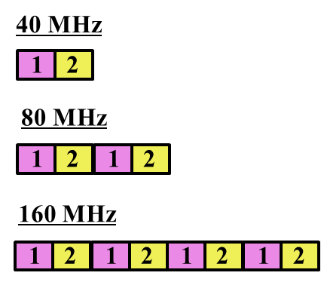
HE-SIG-B Structure
The group agreed the following about HE-SIG-B structure [1]
  HE-SIG-B is encoded on a per 20 MHz basis using BCC with common and user blocks separated in the bit domain.
  For bandwidths ≥ 40 MHz, the number of 20 MHz subbands carrying different content is two and with structure as shown in Figure 1. Each square in the figure represents 20 MHz subband and 1/2 represents different signalling information.
  HE-SIG-B has a common field followed by a user specific field, where
    The common field includes the information for all of designated STAs to receive the PPDU in corresponding bandwidth
    The user specific field consists of multiple sub-fields that do not belong to the common field, where one or multiple of those sub-fields are for each designated receiving STA
    The boundary between the common and the user specific field is at the bit level and not the OFDM symbol level
  The common field in HE-SIG-B contains Resource Unit (RU) allocation
Figure 1 - 20 MHz subchannel content for HE-SIG-B for bandwidths ≥ 40 MHz

Slide 9
In this presentation
We build on the progress from the last meeting by adding details on
  The resource allocation information in the common part of HE-SIG-B
    The size of the resource allocation information
  Signaling information for each user in the sub-fields of the user –specific part
  Improving HE-SIG-B efficiency by load balancing for MU-MIMO allocations
    Arrangement of the common and the user-specific portions for MU-MIMO RUs > 20MHz.

Slide 10
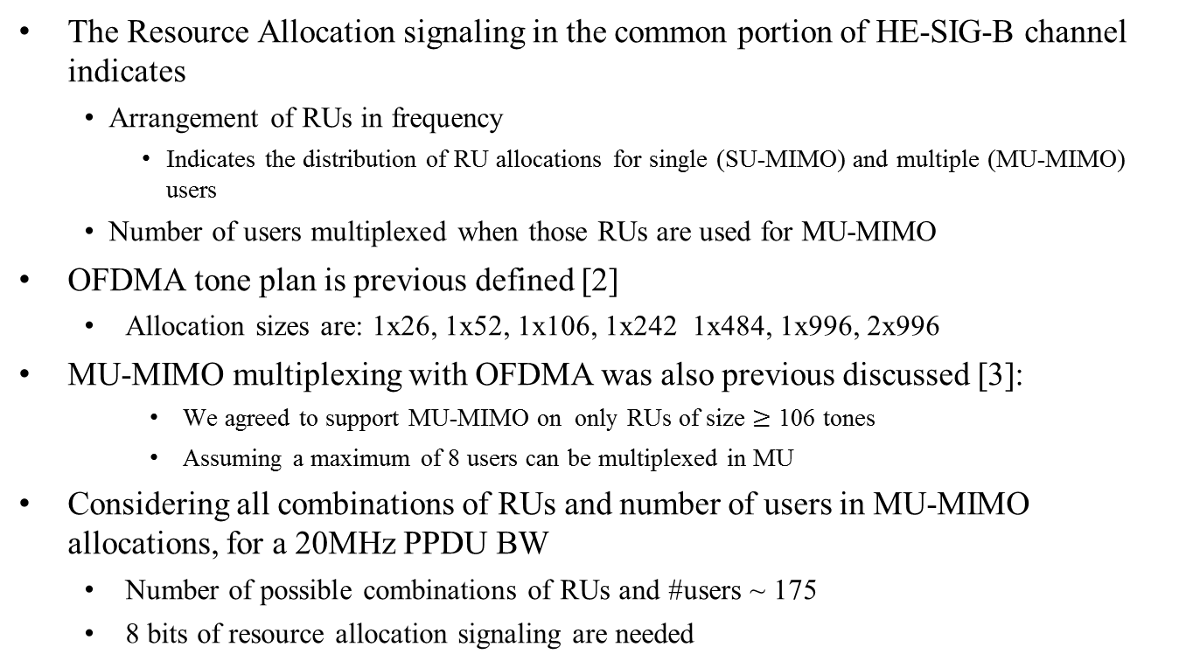
Resource Allocation Signaling
The Resource Allocation signaling in the common portion of HE-SIG-B channel indicates
  Arrangement of RUs in frequency
    Indicates the distribution of RU allocations for single (SU-MIMO) and multiple (MU-MIMO) users
  Number of users multiplexed when those RUs are used for MU-MIMO
OFDMA tone plan is previous defined [2]
  Allocation sizes are: 1x26, 1x52, 1x106, 1x242 1x484, 1x996, 2x996
MU-MIMO multiplexing with OFDMA was also previous discussed [3]:
    We agreed to support MU-MIMO on only RUs of size $≥$ 106 tones
    Assuming a maximum of 8 users can be multiplexed in MU
Considering all combinations of RUs and number of users in MU-MIMO allocations, for a 20MHz PPDU BW
  Number of possible combinations of RUs and #users ~ 175
  8 bits of resource allocation signaling are needed

Slide 11
User Specific Fields in HE-SIG-B
User-specific field
Tells how many user specific fields follow
Common information communicates RU arrangement and the number of users for MU-MIMO allocations
Each user specific field contains information for STA scheduled in the MU- PPDU
  User specific sub-fields should contain
    STA-ID for addressing
    the information necessary to decode the PPDU
      For single-user allocations in a RU: NSTS (Number of Spatial Streams), TxBF (transmit beamforming ), MCS (Modulation and Coding Scheme) and Coding (Use of LDPC)
      For each user in a multi-user allocation in a RU: Spatial Configuration Fields, MCS and Coding.
    Other fields are TBD

Slide 12
User Specific Fields in HE-SIG-B
In an accompanying contribution [5], we propose encoding groups of user specific information field together with one BCC.
Each user specific sub-field can carry information for either MU or SU.
  Each user in a MU–MIMO allocation is separately addressed.
    Data parsing of the content of user specific sub-fields differs based on SU or MU.
To enable efficient grouping for joint encoding of user specific sub-fields
  We prefer that the size of the user specific sub-fields be the same for both SU and MU allocations
Encoded together

Slide 13

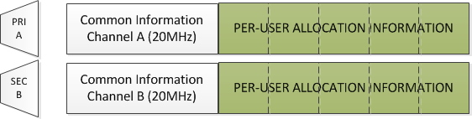
HE-SIG-B Multiplexing
For 20MHz, the HE-SIG-B construction is straight forward
  Signal the RU Arrangement + MU information using 8 bits in the common information followed by per-user allocation information
    STA uses the common information and the position of its allocation to unambiguously identify the RU containing its data
For 40MHz, the HE-SIG-B has two channels each with different information
  Each channel carries RU allocation information for users scheduled in the 20MHz segment
    May require padding in either of channels for last symbol alignment
HE-SIG-B Channel 1
8 bits
8 bits
HE-SIG-B Channel 1
HE-SIG-B Channel 2
8 bits

Slide 14
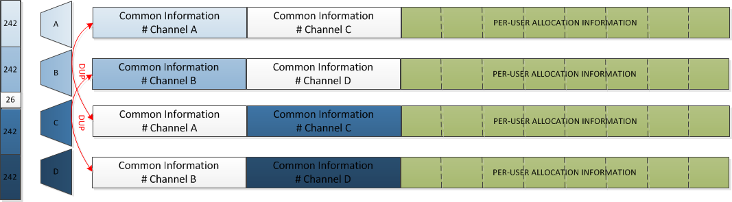
HE-SIG-B Multiplexing (80MHz)
Four 20MHz segments have to be mapped to 2 HE-SIG-B channels duplicated per 40MHz [3]
  80MHz tone plan not aligned with 20MHz segments.
    Channel A, B, C, D below refer to 242 tones RUs – and can signal RU arrangements for smaller RUs with-in the 242 tone RUs
      8 bits per 242 tone RU – 16 bits total per HE-SIG-B Channel
    Central 26 tone RU may be signaled separately
  An example of the multiplexing arrangement is shown below.
  Duplication of HE-SIG-B channels keeps control information in the 20MHz sub-carriers closest to the data sub-carriers.
HE-SIG-B Channel 1
Encoded Together
HE-SIG-B Channel 1
16 bits
HE-SIG-B Channel 2
HE-SIG-B Channel 2
16 bits
16 bits
16 bits

Slide 15
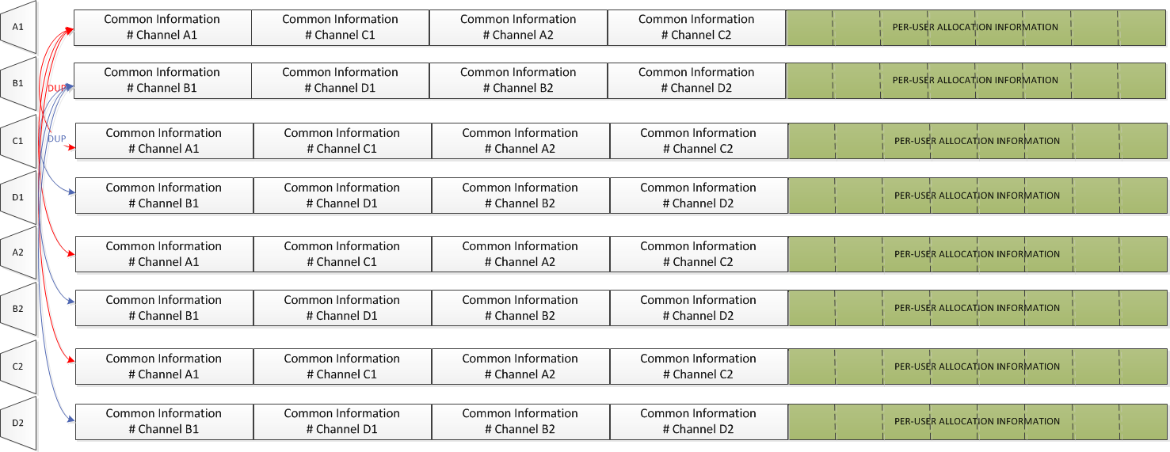
Extending Multiplexing Support to 160MHz
Eight 20MHz segments have to be mapped to 2 HE-SIG-B channels duplicated per 40MHz
  160MHz tone plan built as two concatenated 80MHz tone plans
    Channel A, B, C, D below refer to 242 tones RUs – and can signal RU arrangements for smaller RUs with-in the 242 tone RUs
      32 bits totally for the four channels
    Two central 26 tone RUs in each 80MHz may be signaled separately.
Example Arrangement:
HE-SIG-B Channel 1
32 bits
32 bits
HE-SIG-B Channel 2

Slide 16
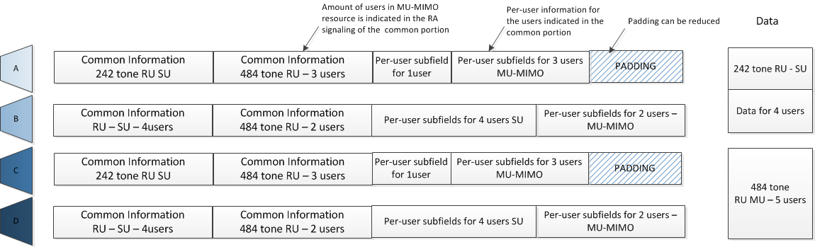
Load Balancing for large MU-MIMO allocations
  When RU sizes > 20MHz are used, AP divides the per-user content blocks between allocated channels dynamically based on load in each allocated channel
    Since information spans 2 channels, control is carried over a 20MHz segment of the data - reliability in HE-SIG-B is ensured.
  Common Control Portion:
    Repeat MU-MIMO allocation size in each allocated channel
    Indicate number of per-user content blocks carried in the corresponding channel
  User specific fields:
    Transmit per-user content blocks for the subset of users indicated in the common portion

Slide 17
Summary
Resource Allocation Signaling in the common portion of HE-SIG-B needs 8 bits per 20MHz PPDU and indicates
  RU Arrangement in the frequency domain
  If MU-MIMO Capable RUs carry MU-MIMO
    Number of users multiplexed when those RUs are used for MU-MIMO
Resource Allocation Signaling indicates the number of user allocation sub-fields that follow the common portion of HE-SIG-B
  Each user allocation sub-field addresses and STA and gives necessary information to decode data in the PPDU
  Data parsing of the content of user allocation sub-fields differs based on SU or MU. The size of the sub-field should be the same for both SU and MU.

Slide 18
Summary
For BW > 20MHz, the mapping of control information to two HE-SIG-B channels is done such that
  the control information is carried in the same 20MHz segment as the data – ensures reliability.
  For 80MHz, duplication of HE-SIG-B requires that
    Control information for 2 segments be carried in each HE-SIG-B channel.
      8 bits per 20MHz segment – 16 bits of common control
  For 160 MHz, control information for 4 segments be carried in each HE-SIG-B channel
    32 bits of common control information.
For MU-MIMO allocations spanning larger than 20MHz BW, the AP can dynamically allocate users to each HE-SIG-B channel to improve load balancing among the two 2 HE-SIG-B channels.

Slide 19
References
[1] 11-15-0132-07-00ax-spec-framework
[2] 11-15-0330-04-00ax-OFDMA-numerology-and-structure
[3]11-15-0832-00-00ax-performance-evaluation-of-su-mu-mimo-in-ofdma
[4] 11-15-0873-00-00ax-HE-SIG-B-encoding-structure
[5] 11-15-0821-02-00ax-HE-SIG-B-structure
[6] 11-15-1059-00-00ax-sig-b-encoding-structure-part-II

Slide 20
Straw Poll #1
Do you agree to add the following text to the 11ax SFD:
The RU allocation signaling in the common field of HE-SIG-B signals an 8 bit per 20MHz PPDU BW for signaling
  The RU arrangement in frequency domain
  Number of MU-MIMO allocations: The RUs allocated for MU-MIMO and the number of users in the MU-MIMO allocations.
  The exact mapping of the 8 bit to the RU arrangement and the number of MU-MIMO allocations is TBD.
  Signaling for the center 26 unit in 80MHz is TBD

Slide 21
Straw Poll #2
Do you agree to add the following text to the 11ax SFD:
  The user specific subfields of HE-SIG-B containing the per user dedicated information include the following fields
  STA-ID
  For single-user allocations in a RU: NSTS (Number of Spatial Streams), TxBF (transmit beamforming ), MCS (Modulation and Coding Scheme) and Coding (Use of LDPC)
  For each user in a multi-user allocation in a RU: Spatial Configuraiton Fields, MCS and Coding.
  Other fields are TBD.

Slide 22
Straw Poll #3
Do you agree to add the following text to the 11ax SFD:
  The length of the user specific subfield in HE-SIG-B for a single-user allocation is equal to the length of the user specific subfield of each user in a multi-user allocation.

Slide 23
Straw Poll #4
Do you agree to add the following text to the 11ax SFD:
  For MU-MIMO allocation of RU size > 20MHz, the user-specific subfields is dynamically split between two HE-SIG-B content channels(1/2) and the split is decided by the AP (on a per case basis)

Slide 24
APPENDIX

Slide 25
Number of bits for RA signaling
#1 | #2 | #3 | #4 | #5 | #6 | #7 | #8 | #9
26 | 26 | 26 | 26 | 26 | 26 | 26 | 26 | 26
52 |  | 52 |  | 26 | 52 |  | 52
52 |  | 26 | 26 | 26 | 26 | 26 | 26 | 26
26 | 26 | 52 |  | 26 | 26 | 26 | 26 | 26
26 | 26 | 26 | 26 | 26 | 52 |  | 26 | 26
26 | 26 | 26 | 26 | 26 | 26 | 26 | 52
52 |  | 52 |  | 26 | 26 | 26 | 26 | 26
52 |  | 26 | 26 | 26 | 52 |  | 26 | 26
52 |  | 26 | 26 | 26 | 26 | 26 | 52
26 | 26 | 52 |  | 26 | 52 |  | 26 | 26
26 | 26 | 52 |  | 26 | 26 | 26 | 52
26 | 26 | 26 | 26 | 26 | 52 |  | 52
52 |  | 52 |  | 26 | 52 |  | 26 | 26
52 |  | 52 |  | 26 | 26 | 26 | 52
52 |  | 26 | 26 | 26 | 52 |  | 52
26 | 26 | 52 |  | 26 | 52 |  | 52
106 |  |  |  | 26 | 106
106 |  |  |  | 26 | 26 | 26 | 26 | 26
106 |  |  |  | 26 | 26 | 26 | 52
106 |  |  |  | 26 | 52 |  | 26 | 26
106 |  |  |  | 26 | 52 |  | 52
26 | 26 | 26 | 26 | 26 | 106
26 | 26 | 52 |  | 26 | 106
52 |  | 26 | 26 | 26 | 106
52 |  | 52 |  | 26 | 106
242
8 bits are sufficient for resource allocation signaling in 20MHz PPDU BW
484
996
2*996

