Slide 1
Multiple Resource Unit Allocation for TGax OFDMA
Date: 2015-09-12
Authors:

Slide 2
Outline
Motivation
Existing design and open questions
System Level Simulation assumptions and results
Link Level Simulation assumptions and results
Conclusion

Slide 3
Motivation
Show potential benefits of multiple RU allocation over single user allocation via system simulations.
  Identify need for updated interleaver design to enable multiple RU allocation
Show potential benefits of non-contiguous multiple RU allocation over contiguous multiple RU allocations via system and link level simulations

Slide 4
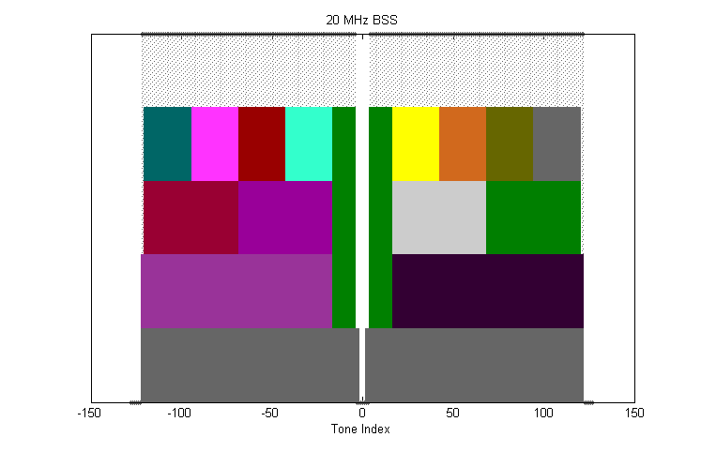
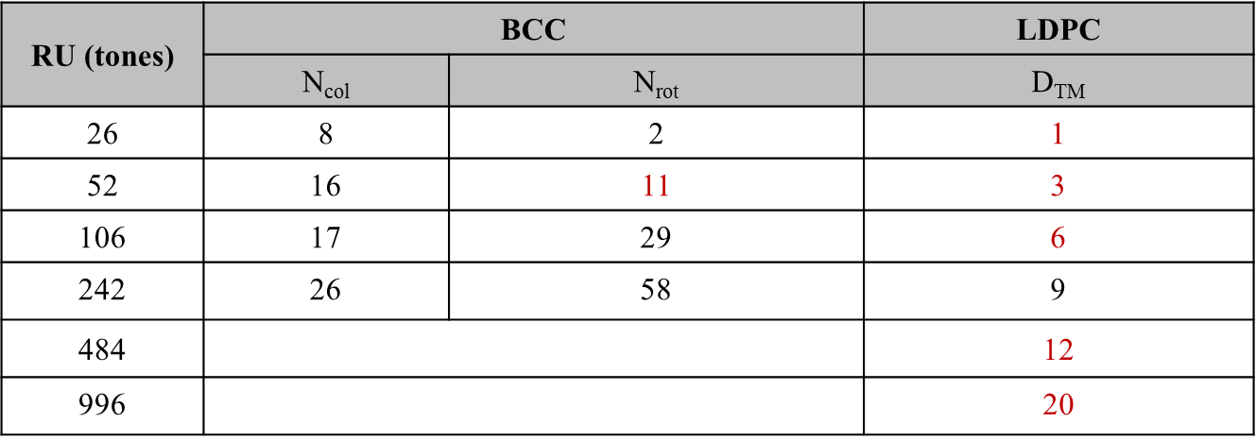
Existing Design
OFDMA Numerology and Structure [1]
  PHY #10: Define 20MHz, 40 MHz, 80MHz, 160MHz / 80MHz + 80MHz OFDMA building blocks
Interleaver and Tone Mapper for OFDMA [2]
  PHY #33: The BCC interleaver and LDPC tone mapper parameters to be defined in the table below
Numerology for 20MHz
BCC Interleaver and LDPC Tone Mapper

Slide 5
Open Questions
Q: Should we allocate more than one RU per user ?
Q: If multiple RUs can be allocated per user, how does this affect the interleaver design?
  Observation: current design does not take all multiple RU allocation scenarios into consideration e.g. 3 x 26-tone RU allocation
Q: If multiple RUs per user are allocated, should those RUs be contiguous or non-contiguous ?
  DL OFDMA Signalling [3]
    SP1: Do you think we should be able to express non-contiguous RU allocation? Y:N:A = 46:22:54

Slide 6
Study Outline
Study system throughput performance in SS1 and SS3 for
  Single RU allocation
  Multiple RU allocation : contiguous
  Multiple RU allocation : non-contiguous
Study link level performance for MCS 7 in Channel D
  Multiple RU allocation : contiguous
  Multiple RU allocation : non-contiguous

Slide 7
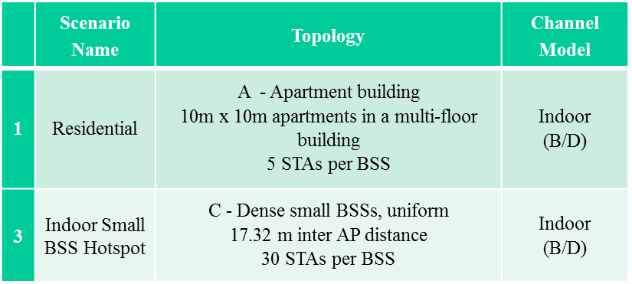
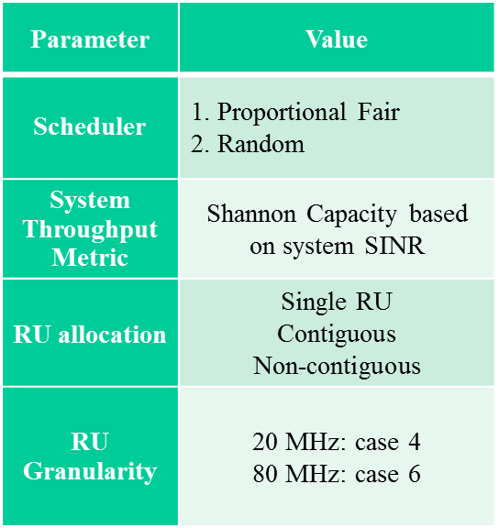

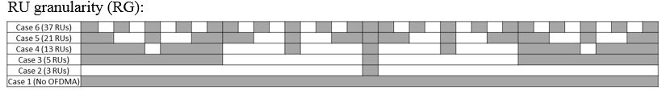
System Throughput Simulation Assumptions
No MAC protocol overhead assumed
STAs are located based on specific TGax simulation scenarios [4]
20 MHz
80 MHz
Table derived from [8]

Slide 8
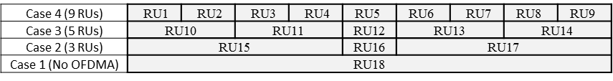
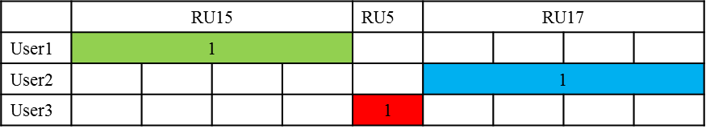
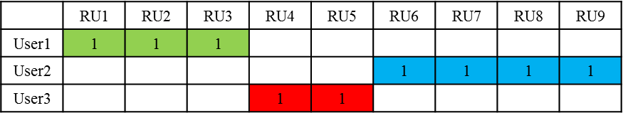
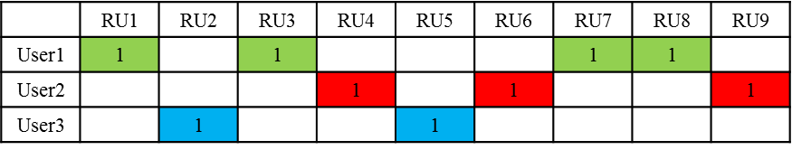
Scheduler (20 MHz)
20 MHz Numerology
Resource allocation for single RU allocation
Resource allocation for Contiguous Case
Resource Allocation for Non-contiguous Case

Slide 9
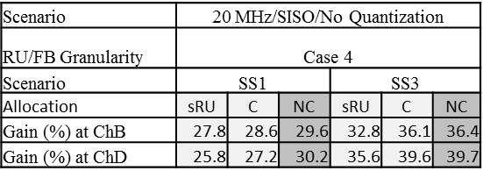
20 MHz Results (System Simulations)
bps
Legend
sRU: Single RU Allocation
C: Multiple RU Contiguous Allocation
NC: Multiple RU Non-contiguous Allocation
  Performance gains for multiple RU non-contiguous allocation over single RU and multiple RU contiguous allocation can be observed

Slide 10
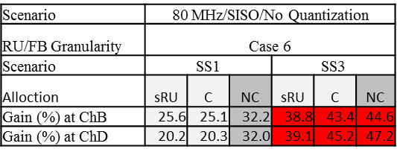
80 MHz Results (System Simulations)
bps
Legend
sRU: Single RU Allocation
C: Multiple RU Contiguous Allocation
NC: Multiple RU Non-contiguous Allocation
  Larger gains for multiple RU non-contiguous allocation over single RU and multiple RU contiguous allocation over larger bandwidth can be observed

Slide 11
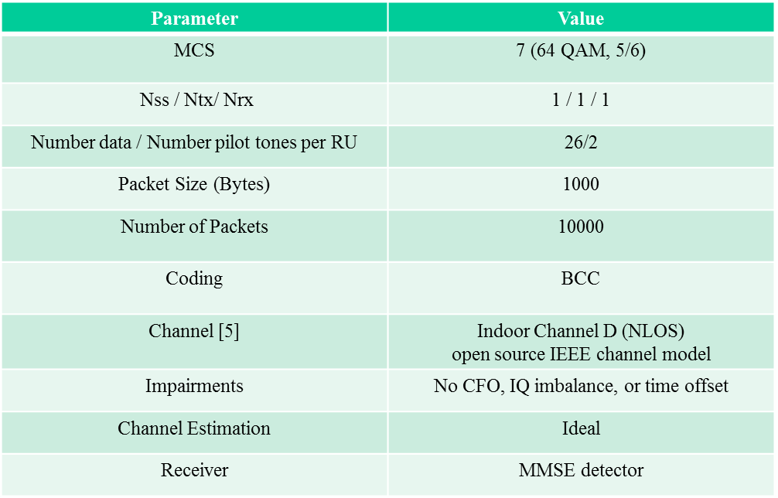
  Link Level Simulation Assumptions

Slide 12
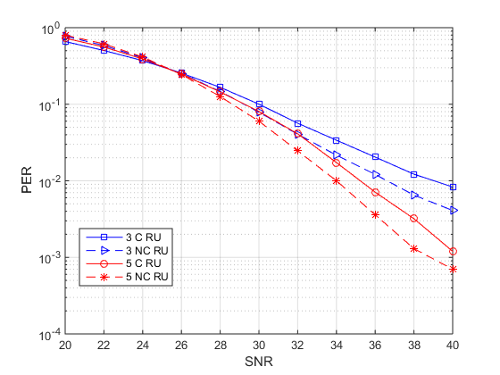
Link Level Contiguous/Non-Contiguous Allocation
  Gains observed for non-contiguous over contiguous at the link level

Slide 13
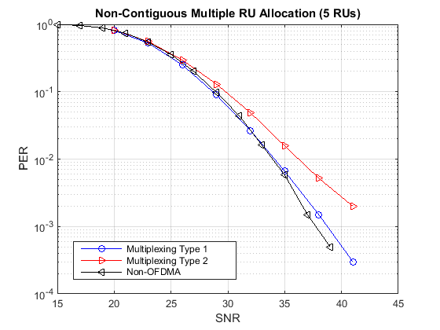
Multiple RU Interleaving
Q: How do we perform interleaving in multiple RU allocation ?
  Reuse design in [2] with a multiplexer (S/P) and de-multiplexer (P/S)

Slide 14
Conclusions
Multiple RU allocation shows benefits over single RU allocation in some system level simulation scenarios (SS3)
Non-contiguous multiple RU allocation shows benefits over contiguous multiple RU allocation
The interleaver design should be updated to allow for multiple RU allocation

Slide 15
Straw Poll #1
Do you agree to add to the TG Specification Framework?
The amendment shall allow multiple RUs to be allocated to a single user
Y/N/A

Slide 16
Straw Poll #2
Do you agree with the following?
The design of the interleaver shall be updated to allow for multiple RU allocations that are not captured in the current interleaver design
Y/N/A

Slide 17
Straw Poll #3
Do you agree to add to the TG Specification Framework?
The amendment shall allow for non-contiguous allocation of multiple RUs to a single user
Y/N/A

Slide 18
References
11-15-0330-05-00ax-ofdma-numerology-and-structure.pptx
11-15-0816-00-00ax-interleaver-and-tone-mapper-for-ofdma.pptx
11-15-0854-02-00ax-dl-ofdma-signalling.pptx
11-14-0980-14-00ax-simulation-scenarios.docx
11-14-0882-04-00ax-tgax-channel-model-document.docx

Slide 19
Additional Material

Slide 20
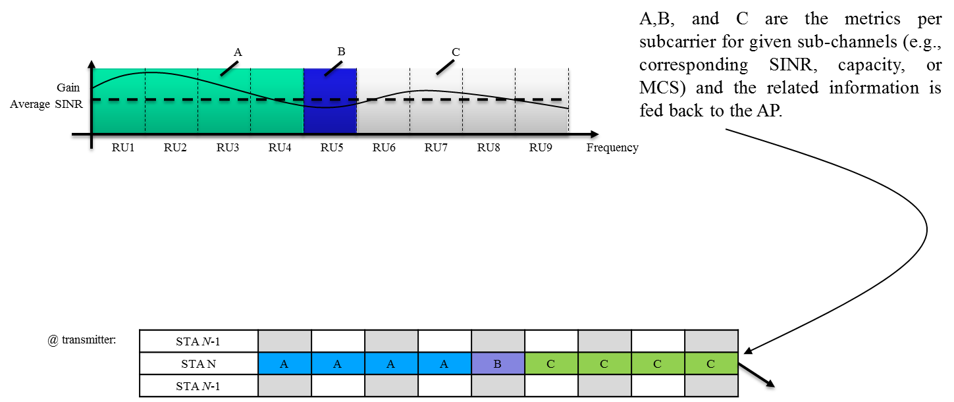
Granularity Definition
@ Receiver: Instantaneous rates on the sub-channels (based on feedback granularity (FG)) are calculated and fed back to the transmitter.
@ Transmitter: Instantaneous rates on the RUs (based on RU granularity (RG)) are calculated for each station and proportional fair scheduling is performed.
Other users may use different granularity.

Slide 21
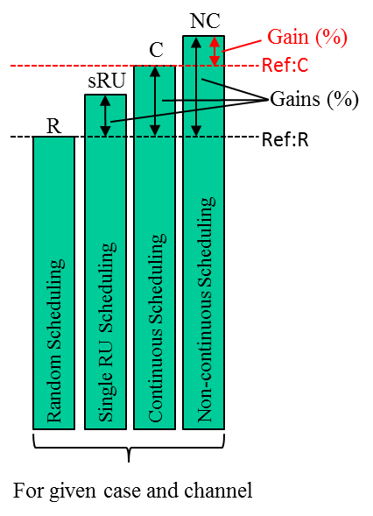
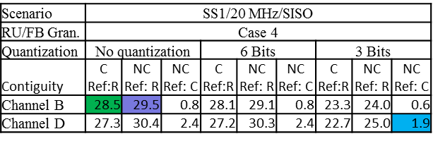
Gain Definitions
%28.5
%29.5
%1.9
Ref:C
Ref:R
NC: Non-contiguous allocation
C: Contiguous allocation
R: Random allocation

Slide 22
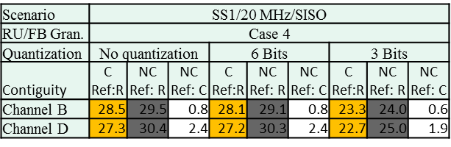
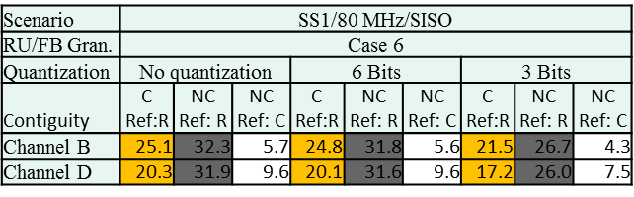
SISO Result Details
NC: Non-contiguous allocation
C: Contiguous allocation
R: Random allocation

Slide 23
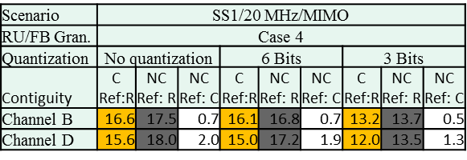
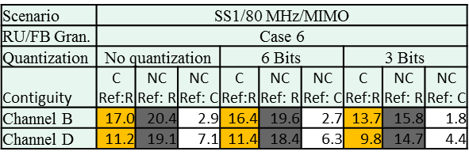
MIMO Result Details
NC: Non-contiguous allocation
C: Contiguous allocation
R: Random allocation

Slide 24
Simulation Methodology of System Throughput
Obtain per tone SINR of STAs based on path loss and shadowing of specific simulation scenario [12] and fading channel [2]
Estimate effective SINR of sub-channels based on the specific numerology using the capacity mapping in [11] at the receiver
Send these to the transmitter using the desired FG
Perform proportional fair scheduling at the transmitter based on effective SINR of different sub-channels at the desired RG [9]
Assign users to sub-channels
Estimate PHY layer system throughput based on capacity of chosen users
Average over multiple drops

