Slide 1
Clarifying Link Level Simulator Assumptions
Date: 2015-09-13
Authors:

Slide 2
  Motivation
Sept 2015
The simulation assumptions of the different types of system level simulators have been well defined in the Evaluation Methodology document [1].
  The results have also been calibrated in [2].
Link level simulation results obtained may vary widely based on the simulation assumptions and impairments such as the CFO, phase noise and timing offset models.
  We would like to clarify the assumptions used for various link level simulator parameters, impairments, assumptions and models.
  We would like to update the 802.11ac assumptions and impairments found in [3] to reflect the requirements for 802.11ax and place these in the evaluation methodology document.

Slide 3
Current 802.11ac Impairments [3]
Sept 2015
PA non-linearity
Carrier Frequency Offset :
  DL [-20,20] ppm
  UL MU-MIMO [-2,2] kHz
Timing acquisition/preamble detection on a per-packet basis
Phase Noise : Uses pole zero model at both Tx and Rx
Noise Figure : 10 dB
Antenna Configuration : ULA with ½ lambda separation
Fluorescent Lighting : Not considered
Timing : UL MU from [-100 to 100] ns
Kome Oteri (InterDigital)

Slide 4
Simulation Assumption Examples in 802.11ax
Sept 2015
DC tone design [4]
  40 ppm CFO before frequency correction
SISO 1x1, 20 MHz results [4]
  Channel estimation, CFO estimation, phase tracking all real, initial phase noise added
SISO 1x1, 80 MHz results [5]
  Channel estimation real, CFO estimation real, phase tracking is assumed present
UL OFDMA, 20 MHz: [4]
  Frequency offset of each user is uniformly distributed over +/- 235KHz and +/-100KHz
UL MU-MIMO, 20 MHz [6]
  Frequency offset of each user distributed over 400 Hz
Kome Oteri (InterDigital)

Slide 5
Typical TGax Link Level Simulations
Sept 2015
We will show how typical TGax link level simulator results can change based on differing assumptions
  Some of the assumptions can be clearly inferred from the 802.11ac assumptions [3] and the latest 80211ax specification framework [10]
  Some of the assumptions need to be further defined
Kome Oteri (InterDigital)

Slide 6
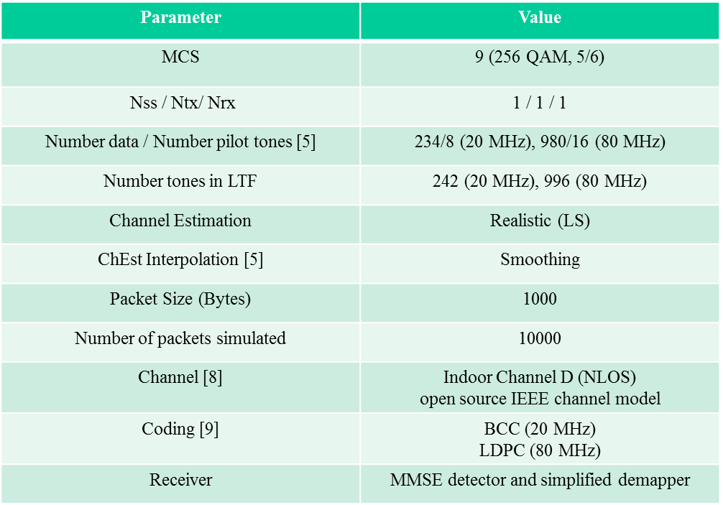
  Clearly Defined Assumptions

Slide 7
Assumptions to be Clarified
Parameter | Value
CFO Model | Residual / CFO Compensation & Tracking
 | PPM / kHz
 | Randomly distributed within [x, y] over a uniform distribution, x and y undefined
Integrated Phase Noise | None / Model [3]
Timing Acquisition | Ideal / Per-packet-basis
Timing offset | Uniform over users, [0,…, Tmax], Tmax undefined
I/Q Imbalance model | Not specified
These parameters may result in widely varying link level performances

Slide 8
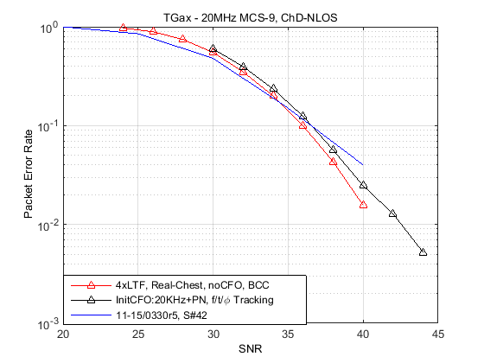
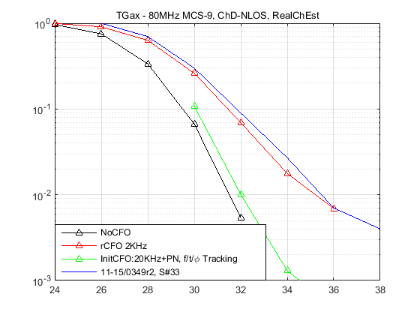
Sept 2015
  Simulator 1 Results
No Impairments
Slide 17 from 11-15/0569r1 [7]
Slide 42 from 11-15/0330r5 [4]
No CFO
Residual CFO
CFO & Phase noise with CFO, time and phase tracking
Slide 33 from 11-15/0349r2 [5]

Slide 9
Sept 2015
  Simulator 2 Assumptions
 | RU Size
 | 242 RU (234/8 data/pilot) | 996 RU (980/16 data/pilot)
MCS | 9 (256QAM, 5/6) | 9 (256QAM, 5/6)
Tx/Rx Ant. | 1x1 | 1x1
Channel Est. | real | real
Initial CFO | None / 20 kHz | None / 20 kHz
CFO Compensation & Tracking | None / Real | None / Real
Phase Noise (both at Tx and Rx) | None / 11n | None / 11n
Channel Model | Ch.D | Ch.D
APEP_LENGTH | 1000 Byte | 1000 Byte
Coding | BCC | LDPC (25 iterations)
Time Synchronization | Ideal / Real | Ideal / Real
Receiver | Linear receiver | Linear receiver (Exact LLR)

Slide 10
Sept 2015
  Simulator 2 Results

Slide 11
Conclusion
We show that the link level results may vary widely based on impairment assumptions such as CFO Model and phase noise model
We would like these assumptions to be specified in the 802.11ax evaluation methodology document

Slide 12
Straw Poll #1
Do you agree to the following?
Link level simulator assumptions and impairments shall be clarified for 802.11ax and changes from 802.11ac shall be identified
Y/N/A

Slide 13
Straw Poll #2
Do you agree with the following?
A table listing PHY impairments for 802.11ax shall be added to the EM document
Y/N/A

Slide 14
References
11-14-0571-10-00ax-evaluation-methodology.docx
11-15-0125-04-00ax-box-1-and-box-2-calibration-results.xlsx
11-09-0451-16-00ac-tgac-functional-requirements-and-evaluation-methodology.doc
11-15-0330-05-00ax-ofdma-numerology-and-structure.pptx
11-15-0349-02-00ax-he-ltf-proposal.pptx
11-15-0602-04-00ax-he-ltf-squence-for-ul-mu-mimo.pptx
11-15-0569-01-00ax-performance-of-1x-2x-and-4x-he-ltf.pptx
11-14-0882-04-00ax-tgax-channel-model-document.docx
11-15-0580-01-00ax-11ax-coding-discussion.pptx
11-15-0132-07-00ax-spec-framework.docx

Slide 15
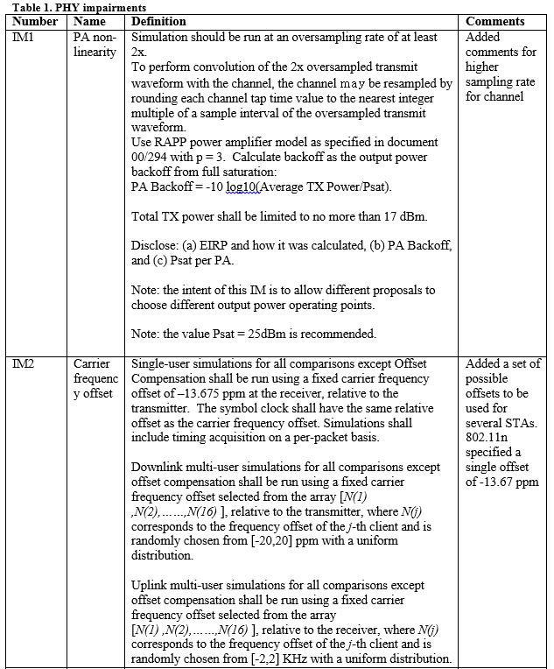
PHY Impairments for 802.11ac [3]

Slide 16
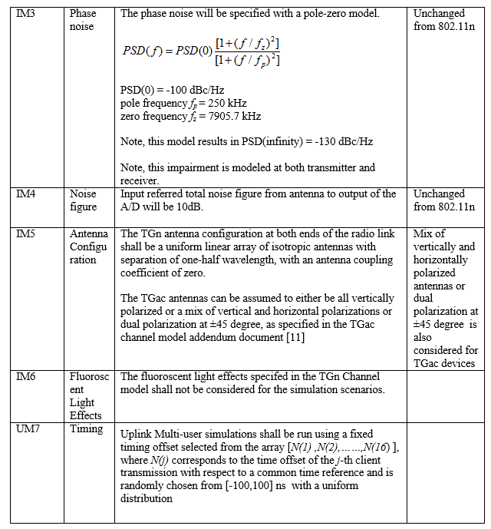
PHY Impairments for 802.11ac (ctd) [3]

