Slide 1
Implications of wrap-around for TGax Scenario 3 and Scenario 4
Date: 2015-09-14

Slide 2
Abstract
Implications of the use of Wrap-Around (WA) in TGax scenarios 3 and 4 are investigated. Simulations studies indicate significant differences in the achieved area capacity (Mbps per km2) with different number of simulated rings and also the need to reconsider some of the scenario specific simulation parameters.

Slide 3
SCE#3 and SCE#4 review
Indoor Small BSSs and Outdoor Large BSS Scenarios assume planned infrastructure network (ESS) [1]
Real deployments may consist of hundreds of BSSs (e.g. to fully cover an area of the size of London Gatwick Airport we would need approx. 1000 APs, assuming ICD of 17.32 m [2])
Hexagonal BSS layout with a frequency reuse pattern is employed to simplify simulation complexities (the aim is to simulate only a representative fraction of a network instead of the whole network)
BSS
BS
BSS
BSS
BSS
BSS
BSS
BSS
BSS
BSS
BSS
BSS
BSS
BSS
BSS
BSS
BSS
BSS
BSS
Figure 1. Layout of BSSs with Frequency reuse 1
Figure 2. Layout of BSSs using Frequency reuse 3

Slide 4
Problems with SCE#3 and SCE#4 hexagonal BSS layouts
BSSs located in the outer ring behave differently from BSSs located in the inner rings
Higher probability of poor STA-AP channel quality compared to BSSs located in the inner rings (STAs located in the inner rings have more APs to choose from when associating)
Lower contention for STAs and APs located in the outer ring compared to STAs and APs located in the inner rings (no BSSs beyond the boundaries of the layout)
Lower interference (i.e. better SINR) for STAs and APs located in the outer ring
As a result, our hexagonal BSS layout cannot be considered as a representative fraction of a real ESS deployment (i.e. we cannot generalize our result for the whole network)

Slide 5
Fixing problems with SCE#3 and SCE#4 hexagonal BSS layouts
Wrap-around (WA) to the rescue (also suggested in [3])
allows to model interference so that it is uniform for all BSSs
STAs in the outer tier will have similar behavior in associating with BSSs as those in the inner rings
STAs and APs located in the outer ring will experience similar contention as STAs and APs located in the in the inner rings
Wrap-around – introduction
Main objective: lowering the simulation complexity by using a fraction of a network to mimic a network of infinite size
Two types: Geographical distance based WA (simpler) and Radio distance based WA (more accurate) [4]
Originally developed for simulation of non-CSMA based systems
Commonly used by 3GPP and IEEE 802.16 Working Group

Slide 6
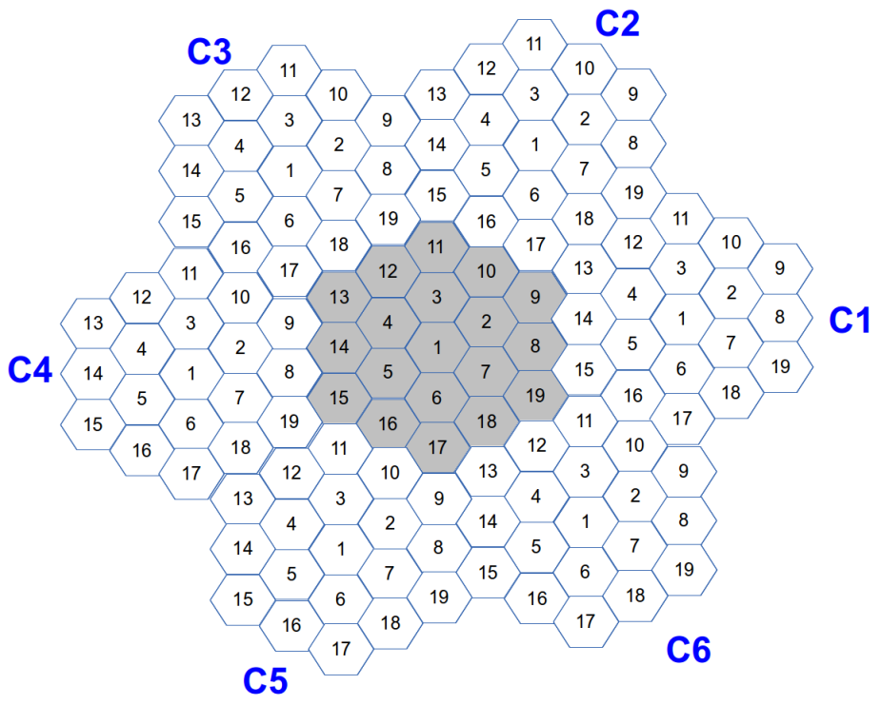
Wrap-around – basics
The original layout is extended to a cluster consisting of 6 displaced “virtual” copies of the original hexagonal network and the original hexagon network located in the center (see below)
There is a one-to-one mapping between cells of the central (original) hexagonal network and cells of each copy (each copy have the same antenna configuration, traffic, power settings, etc.)

Slide 7
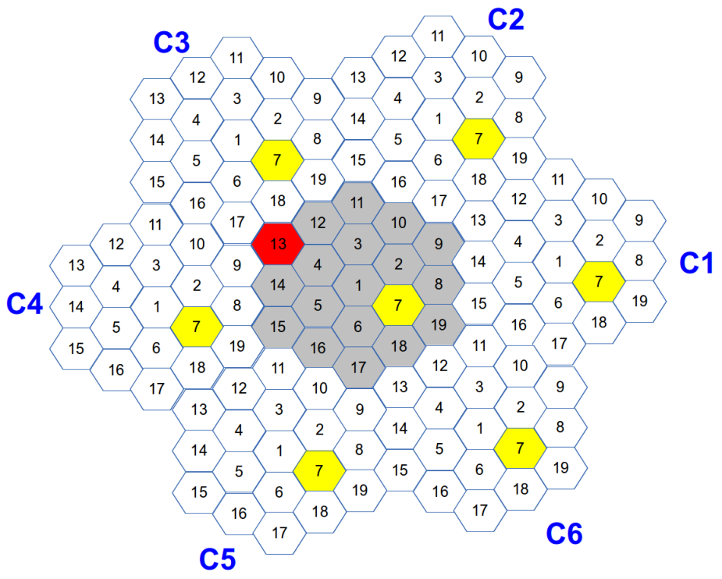
Wrap-around – basics
Simple example: AP7 transmits a beacon frame and we want to determine the RX power of this beacon at AP13
1) Determine the RX power for the beacon as if it was transmitted from all 7 locations of AP7
2) Select the max RX power which in this case corresponds to AP7 location in C3 (assuming simple, distance dependent path-loss model with no shadowing and omni-directional antennas)
Please note that for Radio distance based WA shortest distance does not always mean highest RX power!

Slide 8
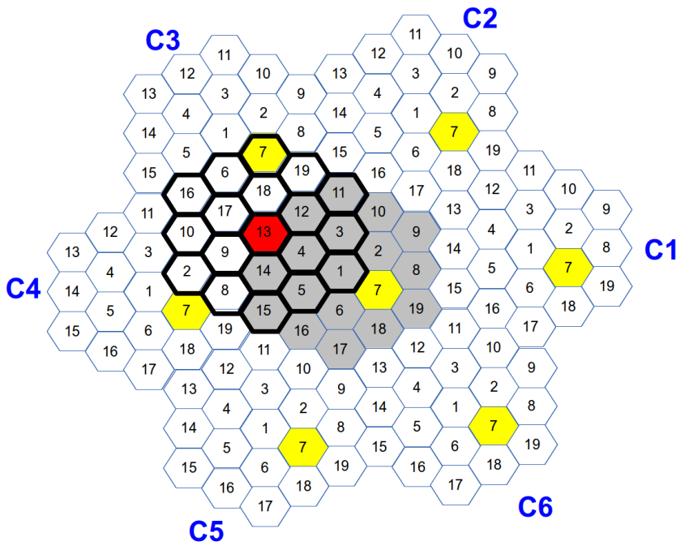
Wrap-around with simulations of CSMA based systems
Main problems related to the improper (i.e. insufficient number of rings) use of Wrap-around:
Over-estimation of spatial reuse – happens when transmitters located outside of the boundaries of our network layout may trigger reception or CCA busy event in the central cell (specific for CSMA simulations)
Over-estimation of network geometry – happens when interferers located outside of the layout boundaries have a non-negligible impact on the SINR of the receivers located in the central cell (applicable to CSMA and non-CSMA simulations)
Under-estimation of CSMA specific effect such as “capture effect”, “hidden terminal problem”, etc.
Main parameter affecting the accuracy of Wrap-around:
Number of rings of the original hexagonal network – tradeoff between simulation complexity and simulation accuracy (min value = 1, max value = infinity)
Using example from the previous slide: We need to increase number of rings if RX power at AP13 calculated from more than one location of AP7 is above CCA-SD threshold or CCA-ED threshold

Slide 9
Wrap-around with simulations of CSMA based systems
Selecting number of rings
Number of rings is scenario specific
Main parameters affecting number of rings: Inter-cell distance (ICD), CCA-SD threshold/RX sensitivity, CCA-ED threshold, TX-power, Path-loss model
Reasonable approach is to select it experimentally
we need to conduct simulations for different number of rings and determine when the impact of the additional ring on the system performance can be neglected (Stopping rule: outer-ring have a negligible effect on the system performance)
Please remember that with each additional ring we increase the simulation complexity/runtime!
(each ring brings additional N*6 BSSs, where N is the number of rings)

Slide 10
Wrap-around with SCE#3 and SCE#4 – determining proper number of rings
Main SCE#3 parameter settings as in [1]
Inter-cell distance (ICD) = 17.32m (10m radius),
AP/STA TX power = 20dBm / 15dBm
Path-loss model as defined in [1]
AP/STA antenna gain = 0.0dB / -2.0dB
AP/STA noise figure = 7.0dB / 7.0 dB
AP/STA antenna height = 3.0m / 1.5m
Main SCE#4 parameter settings as in [1]
Inter-cell distance (ICD) = 130 m (75m radius),
AP/STA TX power = 20dBm / 15dBm
Path-loss model as defined in [1]
AP/STA antenna gain = 0.0dB / -2.0dB
AP/STA noise figure = 7.0dB / 7.0 dB
AP/STA antenna height = 10.0m / 1.5m

Slide 11
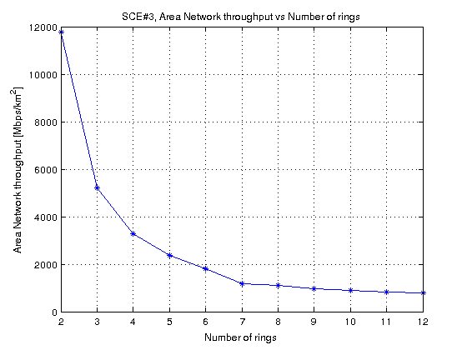
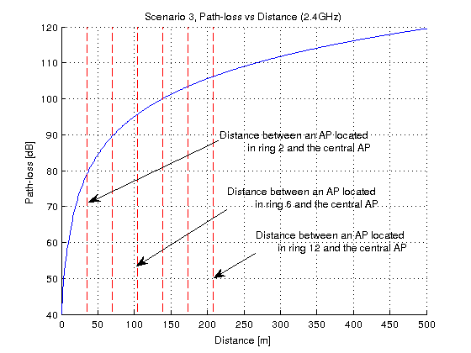
Wrap-around for SCE#3 and SCE#4 – determining proper number of rings
Scenario 3
469 BSSs
127 BSSs
331 BSSs
217 BSSs
Other simulation settings: IEEE 802.11g (DSSS switched off), Shadowing and Fast fading not considered, No rate adaptation (Data/Control rate 24Mbps/24Mbps), CCA-SD threshold/RX sensitivity = -78dBm, CCA-ED threshold = -58dBm, STA density = 2000 STAs per km2, Full buffer (non-elastic traffic), Packet size = 1500B, Downlink only, Preamble reception model not considered

Slide 12
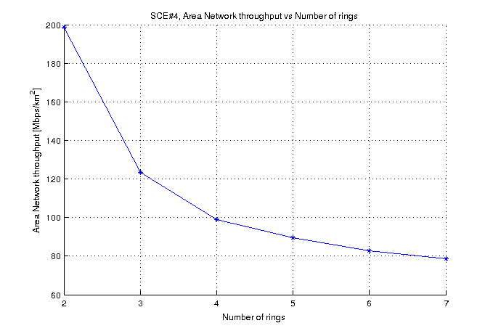
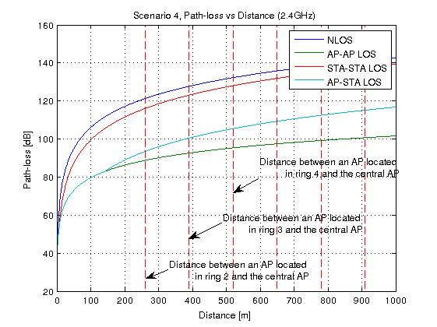
Wrap-around for SCE#3 and SCE#4 – determining proper number of rings
Scenario 4
61 BSSs
91 BSSs
127 BSSs
169 BSSs
Other simulation settings: IEEE 802.11g (DSSS switched off), Shadowing and Fast fading not considered, Rate adaptation (Minstrel), CCA-SD threshold/RX sensitivity = -88dBm, CCA-ED threshold = -68dBm, STA density = 770 STAs per km2, Full buffer (non-elastic traffic), Packet size = 1500B, Downlink only, Preamble reception model not considered

Slide 13
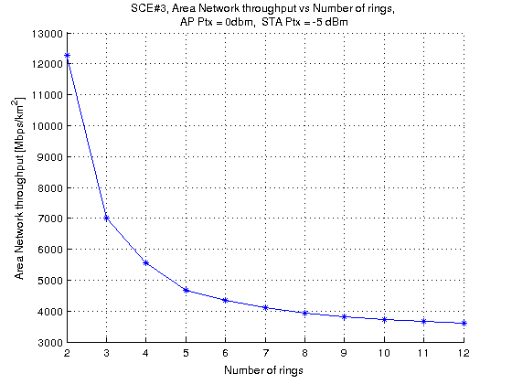
Wrap-around – potential ways for reducing number of rings for SCE#3 and SCE#4
Scenario 3
Increase Inter-Cell Distance (ICD)
Reduce power settings
If we reduce power to 0dBm for APs and -5dBm for STA, difference between results for ring 7 and ring 12 drops to 12% (Figure above), compared to 32% for the original scenario settings (see Figure on slide 11)

Slide 14
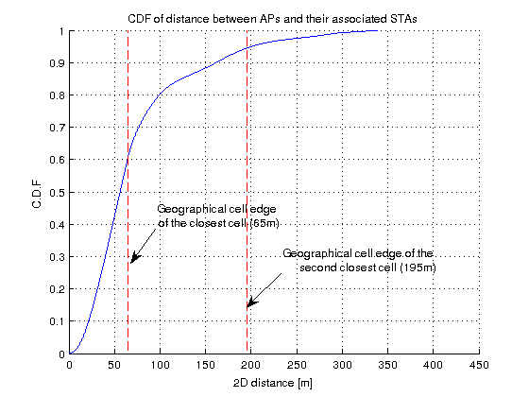
Wrap-around – potential ways for reducing number of rings for SCE#3 and SCE#4
Scenario 4
Introduce a PLOS cut-off to ensure that no two nodes can be in LOS after a certain distance (alternatively propose a new LOS probability function with a smaller tail)
Reduce power settings

Slide 15
Summary
Wrap-around is necessary for proper evaluation of SCE#3 and SCE#4 (assuming that we want to simulate just a small fraction of ESS instead of the whole network)
The accuracy of wrap-around technique depends to the size (i.e. number of rings) of the BSS layout
Number of rings for SCE#3 and SCE#4 BSS layouts need to be sufficient to provide reliable results (if used with wrap-around)

Slide 16
Recommendations
Mandatory use of Wrap-Around (Radio-distance based) for SCE#3 and SCE#4
Propose a minimal number of rings for SCE#3 and SCE#4 BSS layouts, given existing scenario settings
Reconsider AP/STA power settings for SCE#3 (or ICD/radius) to reduce simulation complexity
Consider updating SCE#4 LOS probability function to reduce simulation complexity

Slide 17
References
[1] 11-14-0980-14-00ax, TGax Simulation Scenarios
[2] http://www.gatwickairport.com/business-community/about-gatwick/at-a-glance/facts-stats/
[3] IEEE 802.11-13/1387r1, “HEW channel modeling for system level simulation”
[4] 3GPP R1-135767: Initial calibration results for 3D channel model, Ericsson, RAN1#75, November 2013

Slide 18
Backup slides

Slide 19
Simulation parameter settings
Main simulation parameters
Parameter | Value
IEEE 802.11 standard | IEEE 802.11g (DSSS switched off)
Network layout | Hexagonal grid
Wrap-around | Yes (variable number of rings)
STA/AP height | As defined in [1]
STA distribution | Random uniform distribution
Modeling of preamble reception | Not considered
Path loss model | As defined in [1]
Shadow fading model | Not considered
Fast fading model | Not considered
Mobility | Not considered
Number of orthogonal channels | 1
Carrier frequency | 2.4 GHz
Carrier bandwidth | 20.0 MHz
STA/AP Transmit power | 15.0 dBm / 20.0 dBm
STA/AP Rx sensitivity | -88.0 dBm (RA scenarios) -78.0 dBm (No RA scenarios)
STA/AP Noise Figure | 7 dB
STA/AP Antenna type | Omni-directional
STA/AP Antenna Gain | -2.0 dBi / 0.0 dBi
STA/AP CCA Mode1 threshold | -68.0 dBm (RA scenarios) -58.0 dBm (No RA scenarios)
STA-AP allocation rule | Strongest server (STAs always associate with APs with the strongest signal)
Traffic model | Full buffer (saturated model)
Traffic type | Non-elastic (UDP)
Traffic direction | Downlink only
Packet size (size of the packet transmitted on the air interface, i.e. with MAC, IP and TCP overheads) | 1500 bytes (Application layer packet size: 1424 bytes)
Other IEEE 802.11 related parameters
Parameter | Value
Beacon period | 100ms
Probe timeout /Number of probe requests send per scanned channel | 50ms / 2
Scanning period (unassociated state only) | 15s
RTS/CTS | Off
Packet fragmentation | Off
The maximum number of retransmission attempts for a DATA packet | 7
Rate adaptation algorithm | Mistrel / No Rate Adaptation (24Mbps/24Mbps)
MAC layer queue size | 1000 packets
Number of beacons which must be consecutively missed by STA before disassociation | 10
Association Request Timeout / Number of Assoc Req. before entering scanning | 0.5s / 3
Transmission failure threshold for AP disassociation procedure | 0.99

