Slide 1
On TGax Scenario 4 channel model
Date: 2015-09-14

Slide 2
Abstract
Assumptions of TGax scenarios 4 channel model are investigated. Proposal/recommendations to enhance the current channel model are provided related to minimum distance, LOS/NLOS path-loss models and LOS occurrence correlation. Simulations studies indicate that the achieved area capacity (Mbps per km2) and per STA throughputs differ if LOS occurrence correlation model is introduced.

Slide 3
SCE#4 channel model short summary
Based on ITU UMi model, with several modifications and assumptions [1]:
  LOS path-loss model extended with modified height parameters to cover STA-STA and AP-AP links
  LOS path-loss model assumed to be valid for distances below 10m (min. distance of 1m)
  NLOS path-loss model assumed to be valid for antenna heights corresponding to STA-STA and AP-AP links without any changes
  Path-loss models assumed to be valid for 3D distance

Slide 4
Minimum distance requirements for SCE#4
Purpose of minimum distance requirements:
  prevents using path-loss formulas for invalid distances (e.g. NLOS path-loss values may be negative for too small distances or may be lower than LOS path-loss values for the same distance)
  mimics service unavailability in the close proximity to Base Stations caused by negative antenna gains (most omni-directional antennas and directional antennas have characteristics for which MSs located very close to BSs with large antenna heights experience negative antenna gains)
SCE#4 defines two minimum distance requirements [1]:
  3D distance requirement of 1m applicable to all links, and
  2D distance requirement of 10m applicable for STA to AP link only

Slide 5
Minimum distance requirements for SCE#4
STA to AP link requirement seems to be an artifact from the early stage of TGax when channel models were not yet established
  Path-loss formula for distances below the breakpoint distance is the same for all links (i.e. STA-AP, STA-STA and AP-AP)
    If we assume that path-loss formula is valid for 3D distance below 10m for STA-STA link then why we cannot assume that this formula is also valid for STA-AP link below 10m? (please note that the min 3D distance between STA and AP for SCE#4 is 8.5m)
  According to UMi PLOS function used in SCE#4, all links below a 2D distance of 18m are Line of sight (LOS)
    This means that we don’t have a problem with NLOS path-loss values being negative for too small distances or being lower than LOS path-loss values for the same distance
  Poor channel condition underneath AP antennas can be properly modeled by using antenna characteristics
Recommendations:
  Remove the minimal 2D distance requirement for STA-AP links from the description of SCE#4
  Propose horizontal and vertical antenna characteristics (isotropic antennas could be used for calibration) to better model situations in which STAs are located underneath AP antennas

Slide 6




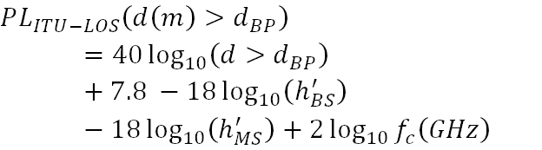
SCE#4 LOS Path-loss model discontinuity issue
ITU UMi LOS Path-loss is a two-slope model with a break point distance (d_{BP}) derived based on the Frensel zone theory
  d_{BP} is defined as the horizontal separation at which the first Frensel zone touches the ground [2]
First slope
Second slope

Slide 7

SCE#4 LOS Path-loss model discontinuity issue
In SCE#4 the ITU UMi path-loss model is extended by allowing 3D distance for path-loss calculation (UMi LOS formula was originally derived for 2D distance)
  d_{BP} is calculated using 2D distance whilst path-loss is calculated using 3D distance
  If we use formulas as defined in [3] we introduce a discontinuity between the two slopes at d_{BP} (STA-AP link only!)
To preserve the continuity we need to update the formula for distances larger than d_{BP} , as proposed below (see [2] for derivation details)
  If h_{BS} = h_{MS} , 3D distance equals 2D distance and the formula provides the same results as the original formula (i.e. STA-STA and AP-AP links),

Slide 8
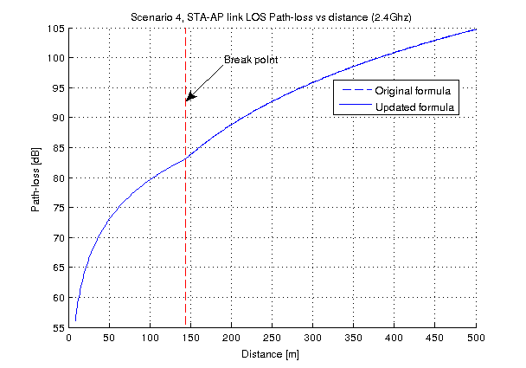
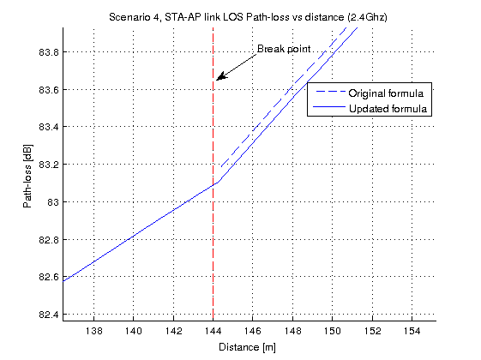
SCE#4 LOS Path-loss formula discontinuity issue
Recommendations:
  Update SCE#4 LOS path-loss formula for distances greater than the breakpoint (i.e. second slop formula) for mathematical correctness, as suggested in [2], [4]

Slide 9

SCE#4 NLOS Path-loss model with antenna height correction factor
ITU UMi model was originally developed for antenna heights of 10m (BS antenna height) and 1.5m (MS antenna height)
TGax current assumption is that NLOS path-loss formula remains valid for all link types with no modifications (i.e. STA-AP, AP-AP and STA-STA link)
Different studies/measurements indicate however that path-loss for NLOS depends on the antenna height even for antennas located below the roof tops (i.e. UMi channel model) (see e.g. [5], [6], [10], [11])
Neglecting the impact of different NLOS characteristics for STA-AP, STA-STA and AP-AP links may result in inaccurate performance results and under-estimation (or over-estimation) of CSMA specific effects such as hidden terminal problem

Slide 10
SCE#4 NLOS Path-loss model with antenna height correction factor
Antenna Height Correction Factor (AHCF) to model impact of different antenna heights for STA-STA and AP-AP links
  AHFC which models changes due to the MS antenna height has been proposed by 3GPP for UMi channel model in their study on 3D channel modeling [4] (by setting MS height to 10m we get AP-AP link)
  AHFC which models changes of the BS antenna height, when located below the rooftops, has not been extensively studied in the literature (see e.g. [10]). For simplicity, the same linear AHFC as for MS antenna height could be applied (by setting BS height to 1.5 m we get STA-STA link)
Alternative approach assumes the use of path-loss formulas specific for STA-AP, STA-STA and AP-AP links, as suggested in [5], [7], [8]

Slide 11
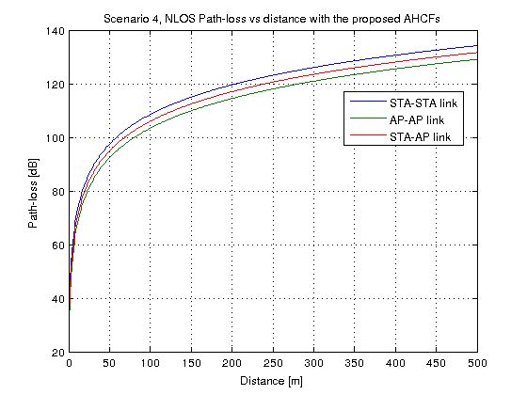
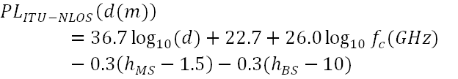
SCE#4 NLOS Path-loss model with antenna height correction factor
Recommendation
  Update NLOS path-loss formula by adding MS AHCF to model lower path-loss for AP-AP link, as proposed in the study conducted by 3GPP on 3D channel modeling [4]
  Update NLOS path-loss formula by adding BS AHCF for STA-STA link

Slide 12
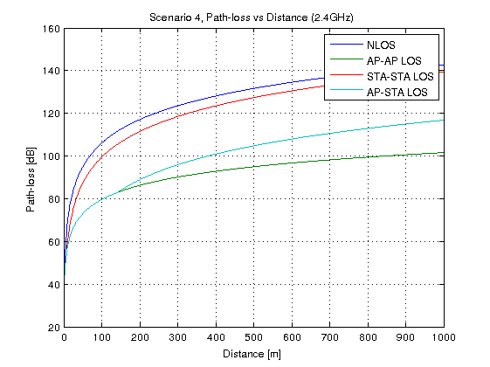
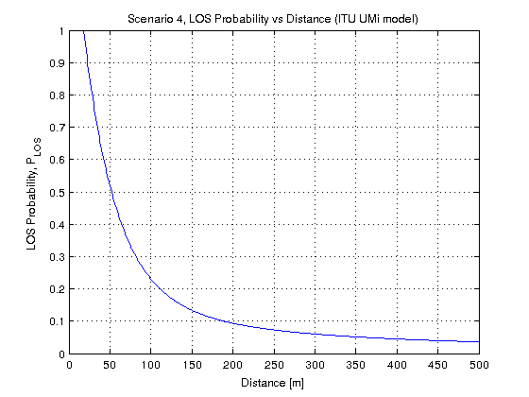
SCE#4 LOS occurrence correlation model
ITU UMi model considers LOS and NLOS path-loss models (see figure below)
LOS probability in ITU UMi is modeled as a function of distance (see figure below)
LOS occurrence correlation is not considered in ITU UMi (i.e. LOS occurrence of a link does not depend on the relative location of nodes)

Slide 13
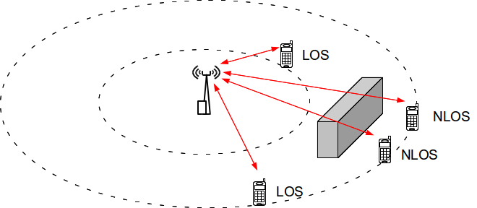
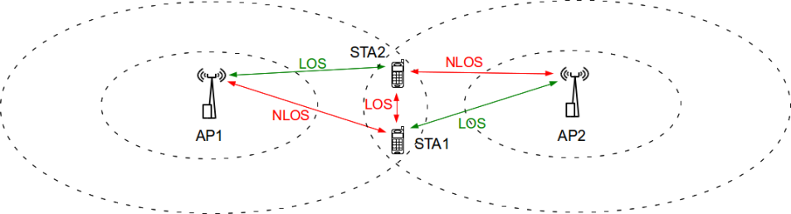
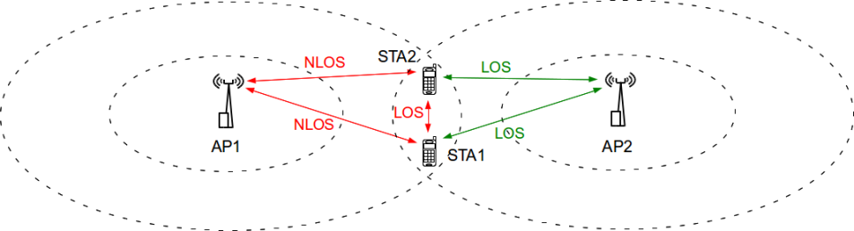
SCE#4 LOS occurrence correlation model
LOS occurrence is a slow process versus distance Δx as it is affected by buildings and/or obstacles
  LOS occurrence for STA-AP links for adjacent STAs should be correlated
Neglecting the impact of LOS occurrence correlation may result in over-estimation of CSMA specific effects such as hidden terminal problem
Without correlation (hidden terminal problem each time when one STA receives whilst other transmits)
With correlation (both stations connected to AP2, thus no hidden terminal problem)

Slide 14

SCE#4 LOS occurrence correlation model
LOS occurrence generation procedure [9]:
  Let b_{ij}(i=1,2,…N, j = 1,2,… M) be a Boolean variable representing whether the i-th STA is in LOS with j-th AP (b_{ij}=1) or in NLOS (b_{ij} = 0), where N – number of STAs and M – number of APs
  Let g_{ij}(i=1,2,…N, j = 1,2,… M) be a Gaussian random variable with σ² = 1 and µ = 0 which is spatially-correlated with de-correlation distance of d_{cor_los} (please note that g_{ij} for different j are independent, i.e. we assume no inter-AP correlation)
  Let p_{ij}(i=1,2,…N, j = 1,2,… M) be the probability of being in LOS between i-th STA and j-th AP dependent on distance d_{ij}(i=1,2,…N, j = 1,2,… M)
Transformation of Uniform RN to Gaussian RN
(erfinv - Inverse error function)

Slide 15
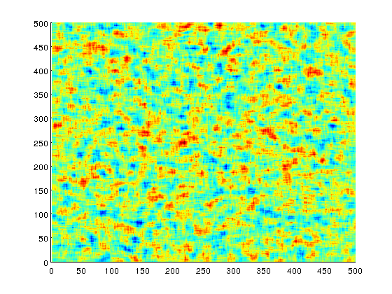
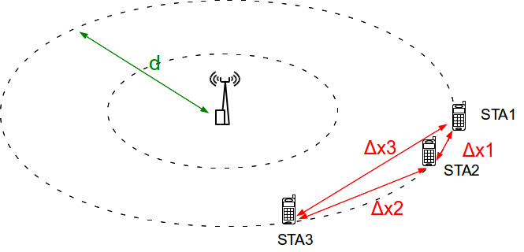
SCE#4 LOS occurrence correlation model
As shadowing and LOS occurrence are affected by the same buildings and/or obstacles,
  normalized autocorrelation function R(Δx) for LOS occurrence can be described in a similar way as in case of shadowing [9]
  de-correlation distance for LOS occurrence d_{cor_los} = d_{cor_sf} [9]
Example realization of spatially correlated Gaussian RV with d_{cor_los} = 13m

Slide 16
SCE#4 LOS occurrence correlation model
Impact of LOS occurrence correlation
  Main SCE#4 parameter settings as in [1]
    Inter-cell distance (ICD) = 130 m (65m radius),
    AP/STA TX power = 20dBm / 15dBm
    Path-loss model as defined in [4]
    AP/STA antenna gain = 0.0dB / -2.0dB
    AP/STA noise figure = 7.0dB / 7.0 dB
    AP/STA antenna height = 10.0m / 1.5m
Assumption: d_{cor_los} = 13m (the same value as ITU UMi d_{cor_sf} for NLOS [3])
Other simulation settings: IEEE 802.11g (DSSS switched off), Shadowing and Fast fading not considered, Rate adaptation (Minstrel), CCA-SD threshold/RX sensitivity = -88dBm, CCA-ED threshold = -68dBm, STA density = 770 STAs per km2, Full buffer (non-elastic traffic), Packet size = 1500B, Downlink only, Preamble reception model not considered, BSS layout with 6 rings

Slide 17
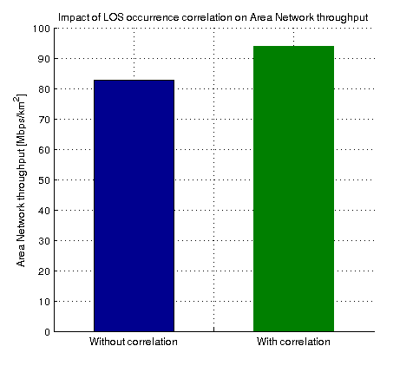
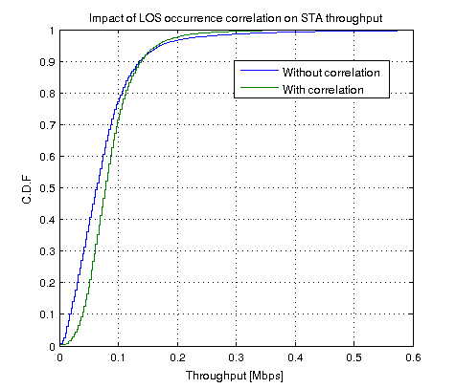
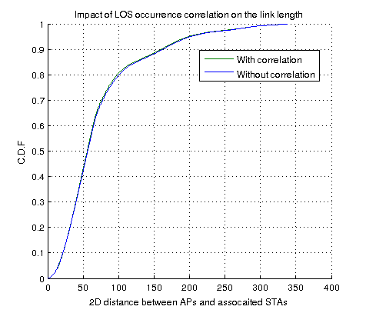
SCE#4 LOS occurrence correlation model
Impact of LOS occurrence correlation
13.6% increase in Area network throughput
Better performance of the cell edge STAs
Link lengths with no change (i.e. number of STAs in LOS and NLOS remains the same regardless correlation)

Slide 18
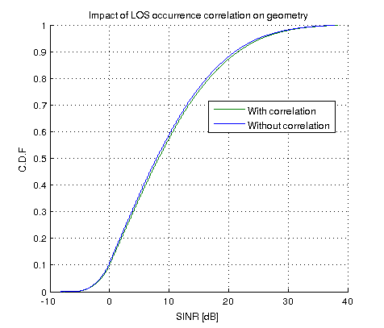
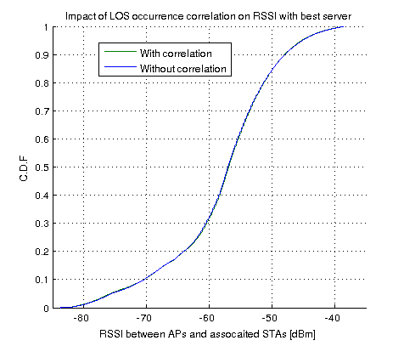
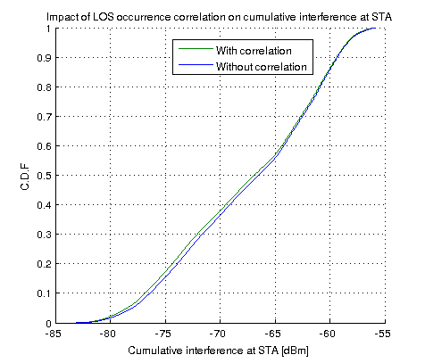
SCE#4 LOS occurrence correlation model
Impact of LOS occurrence correlation
Recommendation
  Include LOS occurrence correlation model with d_{cor_los} = 13m to SCE#4 channel model description to better model characteristics of the out-door channel
Network Geometry
Link RSSI to best server
Slightly lower cumulative interference at STA
Please note that ITU UMi already includes shadow fading spatial correlation model (see [3])

Slide 19
Summary
Two issues with existing SCE#4 channel model were highlighted and recommendations were provided
Two proposals to improve existing SCE#4 channel model were presented and appropriate recommendations were provided

Slide 20
References
[1] 11-14-0980-14-00ax, TGax Simulation Scenarios
[2] 3GPP R1-133594: Remaining details of path loss modeling for elevation beamforming and FD-MIMO, RAN1#74, Qualcomm Incorporated, August 2013
[3] Report ITU-R M.2135-1 (12/2009) Guidelines for evaluation of radio interface technologies for IMT Advanced
[4] 3GPP TR 36.873, Study on 3D channel model for LTE, v12.2.0, June 2015
[5] Z. Wang, E. Tameh and A. Nix, Statistical Peer-to-Peer Models for outdoor urban environments at 2GHz and 5GHz, Proc. Of IEEE VTC, 2004
[6] 3GPP R1-132895: Discussion on remaining path loss and LOS probability issues, RAN1#74, Huawei, HiSilicon, August 2013
[7] IEEE 802.11-14/0329r0 Channel Models for different links in Simulations (Samsung)
[8] 3GPP TR 36.828, “Further enhancements to LTE Time Division Duplex (TDD) for Downlink-Uplink (DL-UL) interference management and traffic adaptation”
[9] 3GPP R1-093486: Impact of relay site planning on LOS probability of the backhaul link, RAN1 #58, Ericsson, ST-Ericsson, Aug 2009
[10] D. Har, H. H. Xia, and H. L. Bertoni, “Path-Loss Prediction Model for Microcells,” IEEE Trans Veh. Technol., vol.48, no.5, Sep. 1999, pp.1453-1462
[11] H. H. Xia “A Simplified Model for Prediction Path Loss in Urban and Suburban Environments,” IEEE Trans Veh. Technol., vol.46, no.4, Nov. 1997, pp.1040-1046

Slide 21
Backup slides

Slide 22
Simulation parameter settings
Main simulation parameters
Parameter | Value
IEEE 802.11 standard | IEEE 802.11g (DSSS switched off)
Network layout | Hexagonal grid
Wrap-around | Yes (BSS layout with 6 rings)
STA/AP height | As defined in [1]
STA distribution | Random uniform distribution
Modeling of preamble reception | Not considered
Path loss model | As defined in [1]
Shadow fading model | Not considered
Fast fading model | Not considered
Mobility | Not considered
Number of orthogonal channels | 1
Carrier frequency | 2.4 GHz
Carrier bandwidth | 20.0 MHz
STA/AP Transmit power | 15.0 dBm / 20.0 dBm
STA/AP Rx sensitivity | -88.0 dBm
STA/AP Noise Figure | 7 dB
STA/AP Antenna type | Omni-directional
STA/AP Antenna Gain | -2.0 dBi / 0.0 dBi
STA/AP CCA Mode1 threshold | -68.0 dBm
STA-AP allocation rule | Strongest server (STAs always associate with APs with the strongest signal)
Traffic model | Full buffer (saturated model)
Traffic type | Non-elastic (UDP)
Traffic direction | Downlink only
Packet size (size of the packet transmitted on the air interface, i.e. with MAC, IP and TCP overheads) | 1500 bytes (Application layer packet size: 1424 bytes)
Other IEEE 802.11 related parameters
Parameter | Value
Beacon period | 100ms
Probe timeout /Number of probe requests send per scanned channel | 50ms / 2
Scanning period (unassociated state only) | 15s
RTS/CTS | Off
Packet fragmentation | Off
The maximum number of retransmission attempts for a DATA packet | 7
Rate adaptation algorithm | Mistrel
MAC layer queue size | 1000 packets
Number of beacons which must be consecutively missed by STA before disassociation | 10
Association Request Timeout / Number of Assoc Req. before entering scanning | 0.5s / 3
Transmission failure threshold for AP disassociation procedure | 0.99

