Slide 1
MAC Calibration Results
Date: 2015-09
Authors:
Name | Affiliation | Address | Email
Stéphane BARON | Canon | Cesson-Sevigné, France | stephane.baron@crf.canon.fr
Patrice NEZOU |  |  | patrice.nezou@crf.canon.fr
Romain GUIGNARD |  |  | romain.guignard@crf.canon.fr
Pascal VIGER |  |  | pascal.viger@crf.canon.fr

Slide 2
Abstract
This contribution summarizes our simulation results for test cases 1-3 according to 802.11ax Simulation Scenarios document (11-14-0980-12) and Evaluation Methodology (11-14-0571-9)
The results are obtained through 11 runs. Each run lasts 600 seconds.
The results are compared with previous contributions and match pretty well with previous simulation results

Slide 3
Test 1a: MAC overhead without RTS/CTS
Parameter settings
  MSDU length: [0:500:2000Bytes]
  2 MPDU limit
  RTS/CTS off
  Data MCS = [0,8]
  RTS/CTS MCS = 0
  ACK MCS = 0
  AIFS=DIFS=34us
D = 1m
MSDU Length (Bytes) | MCS0 |  |  |  | MCS8
 | 500 | 1000 | 1500 | 2000 | 500 | 1000 | 1500 | 2000
THROUGHPUT (Mbps)
Application Throughput | 4,79 | 5,55 | 5,84 | 5,99 | 22 | 34,93 | 43,26 | 48,68
Mean Throughput (for 18 other companies) | 4,7805 | 5,537895 | 5,830526 | 5,984737 | 21,88158 | 34,78842 | 42,94105 | 48,42632
Deviation | 0,20% | 0,22% | 0,16% | 0,09% | 0,54% | 0,41% | 0,74% | 0,52%
Mean Deviation (for 18 other companies) | 0,51% | 0,21% | 0,17% | 0,19% | 2,47% | 1,54% | 1,03% | 0,92%
DURATION
A-MPDU Duration | OK | OK | OK | OK | OK | OK | OK | OK
SIFS Duration | OK | OK | OK | OK | OK | OK | OK | OK
ACK Duration | OK | OK | OK | OK | OK | OK | OK | OK
Defer & backoff duration | OK | OK | OK | OK | OK | OK | OK | OK

Slide 4
Test 1b: MAC overhead with RTS/CTS
Parameter settings
  MSDU length: [0:500:2000Bytes]
  2 MPDU limit
  RTS/CTS on
  Data MCS = [0,8]
  RTS/CTS MCS = 0
  ACK MCS = 0
  AIFS=DIFS=34us
D = 1m
MSDU Length (Bytes) | MCS0 |  |  |  | MCS8
 | 500 | 1000 | 1500 | 2000 | 500 | 1000 | 1500 | 2000
THROUGHPUT (Mbps)
Application Throughput | 4,43 | 5,31 | 5,66 | 5,85 | 15,95 | 27,08 | 34,99 | 40,62
Mean Throughput (for 18 other companies) | 4,412421 | 5,293579 | 5,646895 | 5,840105 | 15,85158 | 26,94579 | 34,70947 | 40,43316
Deviation | 0,31% | 0,27% | 0,25% | 0,20% | 0,62% | 0,50% | 0,81% | 0,46%
Mean Deviation (for 18 other companies) | 0,49% | 0,29% | 0,26% | 0,20% | 1,40% | 0,90% | 0,86% | 0,84%
DURATION
A-MPDU Duration | OK | OK | OK | OK | OK | OK | OK | OK
SIFS Duration | OK | OK | OK | OK | OK | OK | OK | OK
ACK Duration | OK | OK | OK | OK | OK | OK | OK | OK
Defer & backoff duration | OK | OK | OK | OK | OK | OK | OK | OK

Slide 5
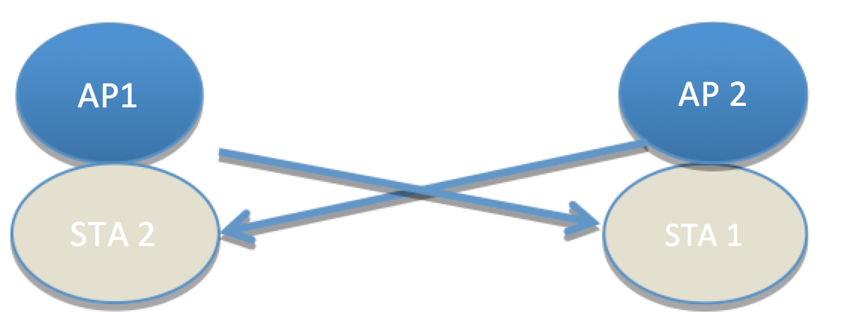
Test 2a: Deferral Test 1
Parameter settings
  MSDU length: [0:500:2000Bytes]
  2 MPDU limit
  RTS/CTS [off, on]
  Data MCS = [0]
  RTS/CTS MCS = 0
  ACK MCS = 0
  AIFS=DIFS=34us
  CWmax = 1023
D = 1m
THROUGHPUT (Mbps)
MSDU Length (Bytes) | 500 | 1000 | 1500 | 2000 | 500 | 1000 | 1500 | 2000
MCS0 | Without RTS / CTS |  |  |  | With RTS / CTS
Application Throughput | 4,6 | 5,28 | 5,54 | 5,68 | 4,47 | 5,34 | 5,68 | 5,87
Mean Throughput (for 18 other companies) | 4,594579 | 5,286316 | 5,541053 | 5,684579 | 4,449789 | 5,313474 | 5,663789 | 5,852579
Deviation | 0,11% | 0,12% | 0,02% | 0,08% | 0,45% | 0,50% | 0,29% | 0,30%
Mean Deviation (for 18 other companies) | 1,46% | 1,41% | 1,55% | 1,58% | 0,96% | 0,68% | 0,57% | 0,48%

Slide 6
Test 2b: Deferral Test 2
Parameter settings
  MSDU length:[1500Bytes]
  RTS/CTS [ OFF]
  Data MCS = [0,8]
  ACK MCS=0
  AIFS=DIFS=34us
  CWmax=1023
  2MPDU limit
D = 65m
D = 65m
THROUGHPUT (Mbps)
 | No FA | FA | No FA | FA
 | MCS0 |  | MCS8
Application Throughput | 2,29 | 0,904 | 28,112 | 37,484
Mean Throughput (from 18 other companies) | 1,74 | 1,01 | 26,94 | 34,42
Deviation | 31,61% | 10,64% | 4,35% | 8,90%
Mean Deviation (from 18 other companies) | 12,44% | 25,13% | 3,67% | 8,86%

Slide 7
Test 3: NAV Deferral
Parameter settings
  MSDU length:[1500Bytes]
  RTS/CTS [ ON]
  Data MCS = [0,8]
  RTS/CTS MCS = 0
  ACK MCS=0
  AIFS=DIFS=34us
  CWmax=1023
  2MPDU limit
D = 65m
D = 65m
THROUGHPUT (Mbps)
 | No FA | FA | No FA | FA
 | MCS0 |  | MCS8
Application Throughput | 5,141 | 5,602 | 22,116 | 34,108
Mean Throughput (from 18 other companies) | 5,146 | 5,593 | 21,817 | 33,026
Deviation | 0,10% | 0,16% | 1,37% | 3,27%
Mean Deviation (from 18 other companies) | 0,89% | 1,95% | 3,39% | 9,26%

Slide 8
Test 4: Deferral Test for 20 and 40MHz BSSs
Parameter settings
  MSDU length: 2000Bytes
  RTS/CTS [off, on]
  MCS = [0]
  channel bandwidth:
    BSS1: 40MHz
    BSS2: 20MHz (the secondary channel of BSS1)
  traffic model:
    BSS1: full buffer
    BSS2: Poisson distribution with lamda=100
D = 1m
RTS/CTS | BW mode | Application Length (B) | MSDU Length (B) | PER(%) | Simulated Application Layer Throughput (Mbps) | Simulated MAC Layer Throughput (Mbps) | TX Time (%) 20MHz/40MHz
Off | Adapt. | 1964 | 2000 | 2,847 | 8,719722 | 8,879554 | 50,34088 | 49,65912
Off | Fixed | 1964 | 2000 | 7,769 | 1,555112 | 1,583617 | 100 | 0
On | Adapt. | 1964 | 2000 | 0,000 | 8,486177 | 8,641728 | 52,88736 | 47,11263
On | Fixed | 1964 | 2000 | 0,000 | 1,555450 | 1,583961 | 100 | 0

Slide 9
Conclusion
  MAC calibration simulation results for Tests 1a, 1b, 2a, 2b, 3 and 4 were mostly similar to other contribution results.

Slide 10
References
R. Porat et al, “Evaluation Methodology”, IEEE 11-14/571r10.
S. Merlin et al, “Simulation Scenarios”, IEEE 11-14/980r14.

Slide 11
Backup Slides

Slide 12
Test 1a: MAC overhead w/out RTS/CTS
Parameter settings
  MSDU length: [0:500:2000Bytes]
  2 MPDU limit
  RTS/CTS off
  Data MCS = [0,8]
  RTS/CTS MCS = 0
  ACK MCS = 0
  AIFS=DIFS=34us
D = 1m

Slide 13
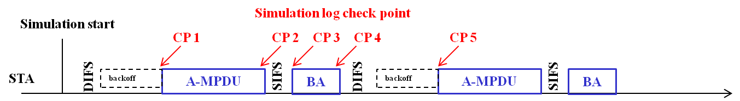
Test 1a: Time trace of transmitting/receiving event
MSDU Length (B) | 500 | 1000 | 1500 | 2000 | 500 | 1000 | 1500 | 2000
MCS | 0 | 0 | 0 | 0 | 8 | 8 | 8 | 8
CP1: start of A-MPDU (s) | 0,000534021 | 0.000534021 | 0,000534021 | 0,000534021 | 0,000493021 | 0,000493021 | 0,000493021 | 0,000493021
CP2: end of A-MPDU (s) | 0,001898024 | 0.003126024 | 0.004358024 | 0.005590024 | 0,000645024 | 0,000749024 | 0,000849024 | 0,000953024
CP2-CP1 (us) | 1364,003 | 2592,003 | 3824,003 | 5056,003 | 152,003 | 256,003 | 356,003 | 460,003
CP3: start of BA (s) | 0.001914024 | 0.003142024 | 0.004374024 | 0.005606024 | 0,000661024 | 0,000765024 | 0,000865024 | 0,000969024
CP3-CP2 (us) | 16 | 16 | 16 | 16 | 16 | 16 | 16 | 16
CP4: end of BA (s) | 0.001982027 | 0.003210027 | 0.004442027 | 0.005674027 | 0,000729027 | 0,000833027 | 0,000933027 | 0,001037027
CP4-CP3 (us) | 68,003 | 68,003 | 68,003 | 68,003 | 68,003 | 68,003 | 68,003 | 68,003
CP5: start of new A-MPDU (s) | 0.002088027 | 0.003334027 | 0.004503027 | 0.005780027 | 0,000817027 | 0,000984027 | 0,000994027 | 0,001152027
CP5-CP4 (us) (Nb slots) | 106 8 slots | 124 10 slots | 61 3 slots | 106 8 slots | 88 6 slots | 151 13 slots | 61 3 slots | 115 9 slots

Slide 14
Test 1a: Check Points
Test Items | Standard definition | Check points (MCS 0) |  |  |  | Matching?
MSDU Length (B) |  | 500 | 1000 | 1500 | 2000
A-MPDU duration (us) | ceil((FrameLength*8)/rate/OFDMsymbolduration) * OFDMsymbolduration + PHY Header | Tcp2 - Tcp1 = 1364us | Tcp2 - Tcp1 = 2592us | Tcp2 - Tcp1 = 3824us | Tcp2 - Tcp1 = 5056us | ok
SIFS (us) | 16 | Tcp3 - Tcp2 = 16us | Tcp3 - Tcp2 = 16us | Tcp3 - Tcp2 = 16us | Tcp3 - Tcp2 = 16us | ok
ACK duration (us) | ceil((ACKFrameLength*8)/rate/OFDMsymbolduration) * OFDMsymbolduration + PHY Header | Tcp4 - Tcp3 = 68us | Tcp4 - Tcp3 = 68us | Tcp4 - Tcp3 = 68us | Tcp4 - Tcp3 = 68us | ok
Avg. Defer & backoff duration (us) | DIFS(34 us)+backoff (CWmin) =34+n*9/2 | Tcp5 - Tcp4 = 101.5us | Tcp5 - Tcp4 = 101.5us | Tcp5 - Tcp4 = 101.5us | Tcp5 - Tcp4 = 101.5us | ok

Slide 15
Test 1a: Throughput Results
MCS index | Application data size, [Bytes] | MSDU size, [Bytes] | Numerical L4 Throughput, [Mbit/s] | Simulated L4 Throughput, [Mbit/s] | Numerical MAC Throughput, [Mbit/s] | Simulated MAC Throughput, [Mbit/s]
0 | 464 | 500 | 4.79112 | 4,79111 | 5.16296 | 5,16284
0 | 964 | 1000 | 5.55320 | 5,55318 | 5.76058 | 5,76056
0 | 1464 | 1500 | 5.84212 | 5,84215 | 5.98578 | 5,98581
0 | 1964 | 2000 | 5.99523 | 5,99518 | 6.10512 | 6,10507
8 | 464 | 500 | 21.99704 | 21,99578 | 23.70370 | 23,70235
8 | 964 | 1000 | 34.93545 | 34,93368 | 36.24009 | 36,23826
8 | 1464 | 1500 | 43.25762 | 43,25773 | 44.32133 | 44,32144
8 | 1964 | 2000 | 48.68164 | 48,68053 | 49.57397 | 49,57284

Slide 16
Test 1a: Application Throughput Comparison (Mbps)
Company | Contribution # | MCS0 (6.5Mbps) |  |  |  | MCS8 (78Mbps)
Packet Size (Bytes) |  | 500 | 1000 | 1500 | 2000 | 500 | 1000 | 1500 | 2000
Huawei | 11-14/1191r0 | 4,79 | 5,55 | 5,84 | 6 | 21,98 | 34,91 | 43,24 | 48,67
LGE | 11-14/1175r1 | 4,81 | 5,55 | 5,84 | 5,99 | 22,4 | 35,2 | 43,25 | 48,9
Qualcomm | 11-14/1192r6 | 4,76 | 5,53 | 5,82 | 5,98 | 21,45 | 34,26 | 42,57 | 48,02
MediaTek | 11-14/1230 | 4,76 | 5,53 | 5,82 | 5,98 | 21,71 | 34,65 | 42,71 | 48,15
Intel | 11-14/1192r6 | 4,76 | 5,53 | 5,82 | 5,98 | 21,53 | 34,46 | 42,58 | 48,14
Ericsson | 11-14/1192r6 | 4,75 | 5,52 | 5,82 | 5,97 | 21,53 | 34,47 | 42,57 | 48,09
Nokia | 11-14/1217r1 | 4,76 | 5,52 | 5,83 | 5,97 | 21,19 | 34,22 | 41,93 | 47,74
NTT | 11-14/1147r0 | 4,79 | 5,54 | 5,84 | 6 | 22 | 35 | 43,2 | 48,4
Samsung | 11-14/1192r6 | 4,76 | 5,53 | 5,82 | 5,97 | 21,54 | 34,48 | 42,6 | 48,15
Broadcom | 11-14/1192r6 | 4,76 | 5,53 | 5,83 | 5,98 | 21,4 | 34,2 | 42,5 | 48
ZTE | 11-14/1192r6 | 4,76 | 5,53 | 5,82 | 5,98 | 21,42 | 34,23 | 42,55 | 48,01
Toshiba | 11-14/1192r6 | 4,79 | 5,54 | 5,83 | 5,99 | 21,94 | 34,87 | 43,19 | 48,62
Newracom | 11-14/1449r1 | 4,85 | 5,55 | 5,84 | 5,99 | 23,8 | 36,64 | 43,87 | 49,73
ETRI | 11-14/1342r1 | 4,79 | 5,55 | 5,84 | 5,99 | 21,99 | 34,94 | 43,27 | 48,68
WILUS Institute | 11-15/0080r0 | 4,8 | 5,55 | 5,84 | 6 | 22,06 | 35,17 | 43,26 | 48,83
InterDigital Communications | 11-15/0022r1 | 4,79 | 5,55 | 5,84 | 6 | 21,94 | 34,87 | 43,19 | 48,66
Apple | 11-15/370r0 | 4,8 | 5,55 | 5,84 | 5,99 | 21,96 | 34,7 | 43,4 | 48,5
Sony | 11-14/1402r0 | 4,76 | 5,52 | 5,81 | 5,96 | 21,91 | 34,78 | 42,74 | 48,13
Mean Value |  | 4,7805 | 5,537895 | 5,830526 | 5,984737 | 21,88158 | 34,78842 | 42,94105 | 48,42632
Mean Deviation |  | 0,51% | 0,21% | 0,17% | 0,19% | 2,47% | 1,54% | 1,03% | 0,92%
Canon |  | 4,79 | 5,55 | 5,84 | 5,99 | 22 | 34,93 | 43,26 | 48,68
Canon Deviation |  | 0,20% | 0,22% | 0,16% | 0,09% | 0,54% | 0,41% | 0,74% | 0,52%

Slide 17
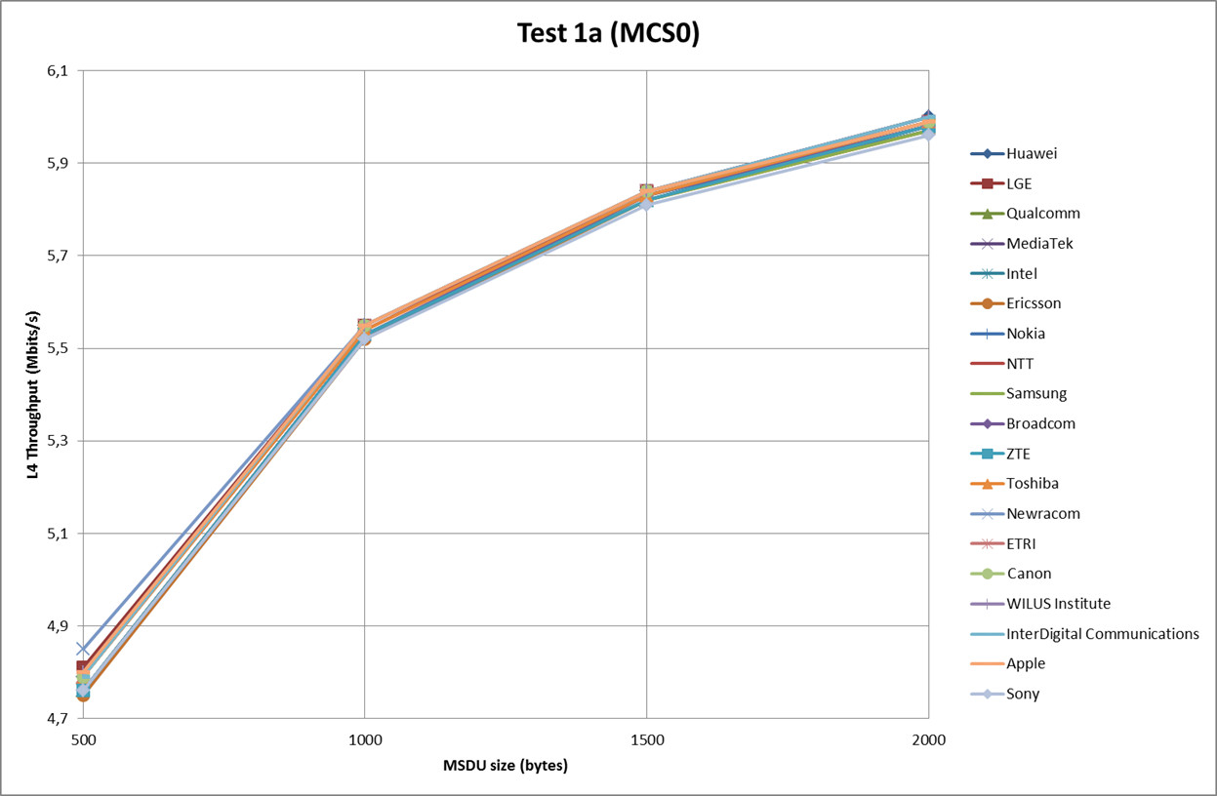
Test 1a: Application Throughput Comparison (Mbps)

Slide 18
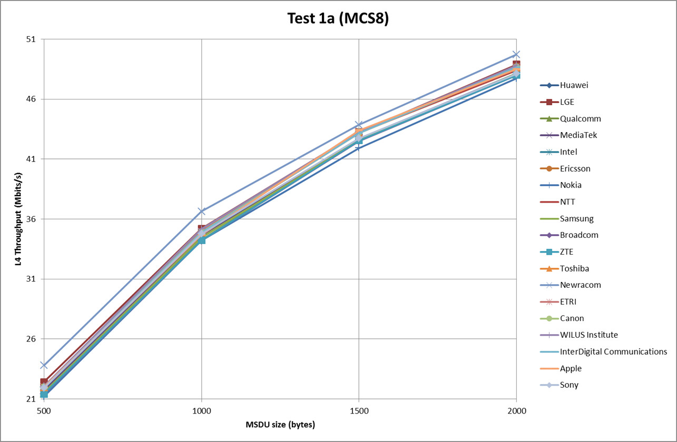
Test 1a: Application Throughput Comparison (Mbps)

Slide 19
Test 1b: MAC overhead w RTS/CTS
Parameter settings
  MSDU length: [0:500:2000Bytes]
  2 MPDU limit
  RTS/CTS on
  Data MCS = [0,8]
  RTS/CTS MCS = 0
  ACK MCS = 0
  AIFS=DIFS=34us
D = 1m

Slide 20
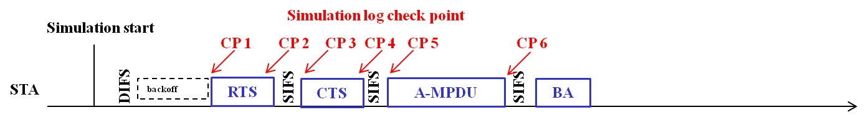
Test 1b: Time trace of transmitting/receiving event
MSDU Length (B) | 500 | 1000 | 1500 | 2000 | 500 | 1000 | 1500 | 2000
MCS | 0 | 0 | 0 | 0 | 8 | 8 | 8 | 8
CP1: start of RTS (s) | 0.000534021 | 0.000534021 | 0,000534021 | 0,000534021 | 0,000493021 | 0,000493021 | 0,000493021 | 0,000493021
CP2: end of RTS (s) | 0.000586024 | 0.000586024 | 0.000586024 | 0.000586024 | 0,000545024 | 0,000545024 | 0,000545024 | 0,000545024
CP2-CP1 (us) | 52,003 | 52,003 | 52,003 | 52,003 | 52,003 | 52,003 | 52,003 | 52,003
CP3: start of CTS (s) | 0.000602024 | 0.000602024 | 0.000602024 | 0.000602024 | 0,000561024 | 0,000561024 | 0,000561024 | 0,000561024
CP4: end of CTS (s) | 0.000646027 | 0.000646027 | 0.000646027 | 0.000646027 | 0,000605027 | 0,000605027 | 0,000605027 | 0,000605027
CP4-CP3 (us) | 44,003 | 44,003 | 44,003 | 44,003 | 44,003 | 44,003 | 44,003 | 44,003
CP5: start of A-MPDU (s) | 0.000662027 | 0.000662027 | 0.000662027 | 0.000662027 | 0,000621027 | 0,000621027 | 0,000621027 | 0,000621027
CP6: end of A-MPDU (s) | 0.002026031 | 0.003254031 | 0.004486031 | 0.005718031 | 0,000773031 | 0,000877031 | 0,000977031 | 0,001081031
CP6-CP5 (us) | 1364,004 | 2592,004 | 3824,004 | 5056,004 | 152,004 | 256,004 | 356,004 | 460,004

Slide 21
Test 1b: Check Points
Test Items | Standard definition | Check points (MCS 0) |  |  |  | Matching?
MSDU Length (B) |  | 500 | 1000 | 1500 | 2000
RTS duration (us) | ceil((RTSFrameLength*8)/rate/OFDMsymbolduration) * OFDMsymbolduration + PHY Header | Tcp2 - Tcp1 = 52us | Tcp2 - Tcp1 = 52us | Tcp2 - Tcp1 = 52us | Tcp2 - Tcp1 = 52us | ok
CTS duration (us) | ceil((CTSFrameLength*8)/rate/OFDMsymbolduration) * OFDMsymbolduration + PHY Header | Tcp4 – Tcp3 = 44us | Tcp4 – Tcp3 = 44us | Tcp4 – Tcp3 = 44us | Tcp4 – Tcp3 = 44us | ok
Frame Duration (us) | ceil((FrameLength*8)/rate/OFDMsymbolduration) * OFDMsymbolduration + PHY Header | Tcp6 – Tcp5 = 1364us | Tcp6 – Tcp5 = 2592us | Tcp6 – Tcp5 = 3824us | Tcp6 – Tcp5 = 5056us | ok

Slide 22
Test 1b: Throughput Results
MCS index | Application data size, [Bytes] | MSDU size, [Bytes] | Numerical L4 Throughput, [Mbit/s] | Simulated L4 Throughput, [Mbit/s] | Numerical MAC Throughput, [Mbit/s] | Simulated MAC Throughput, [Mbit/s]
0 | 464 | 500 | 4.42563 | 4,42550 | 4.76900 | 4,76886
0 | 964 | 1000 | 5.30855 | 5,30850 | 5.50680 | 5,50674
0 | 1464 | 1500 | 5.66139 | 5,66140 | 5.80060 | 5,80062
0 | 1964 | 2000 | 5.85231 | 5,85227 | 5.95959 | 5,95955
8 | 464 | 500 | 15.94844 | 15,94726 | 17.18582 | 17,18454
8 | 964 | 1000 | 27.08341 | 27,08165 | 28.09482 | 28,09299
8 | 1464 | 1500 | 34.98730 | 34,98741 | 35.84765 | 35,84776
8 | 1964 | 2000 | 41.37039 | 40,62548 | 41.37039 | 41,37014

Slide 23
Test 1b: Application Throughput Comparison (Mbps)
Company | Contribution # | MCS0 (6.5Mbps) |  |  |  | MCS8 (78Mbps)
Packet Size (Bytes) |  | 500 | 1000 | 1500 | 2000 | 500 | 1000 | 1500 | 2000
Huawei | 11-14/1191r0 | 4,42 | 5,31 | 5,66 | 5,85 | 15,94 | 27,07 | 34,97 | 40,61
LGE | 11-14/1175r1 | 4,45 | 5,31 | 5,66 | 5,86 | 16,2 | 27,3 | 35 | 40,8
Qualcomm | 11-14/1192r6 | 4,4 | 5,29 | 5,64 | 5,84 | 15,67 | 26,7 | 34,56 | 40,18
MediaTek | 11-14/1230 | 4,4 | 5,29 | 5,64 | 5,84 | 15,79 | 26,9 | 34,62 | 40,24
Intel | 11-14/1192r6 | 4,4 | 5,29 | 5,64 | 5,84 | 15,7 | 26,8 | 34,55 | 40,26
Ericsson | 11-14/1192r6 | 4,36 | 5,26 | 5,62 | 5,82 | 15,36 | 26,33 | 34,02 | 40,45
Nokia | 11-14/1217r1 | 4,4 | 5,28 | 5,64 | 5,83 | 15,52 | 26,66 | 34,12 | 39,96
NTT | 11-14/1147r0 | 4,42 | 5,3 | 5,67 | 5,85 | 16 | 27,1 | 34,97 | 40,4
Samsung | 11-14/1192r6 | 4,4 | 5,28 | 5,63 | 5,83 | 15,94 | 27,09 | 34,59 | 40,35
Broadcom | 11-14/1192r6 | 4,4 | 5,29 | 5,65 | 5,84 | 15,6 | 26,7 | 34,5 | 40,14
ZTE | 11-14/1192r6 | 4,39 | 5,28 | 5,64 | 5,83 | 15,61 | 26,61 | 34,45 | 40,08
Toshiba | 11-14/1192r6 | 4,42 | 5,3 | 5,65 | 5,85 | 15,92 | 27,04 | 34,94 | 40,58
Newracom | 11-14/1449r1 | 4,43 | 5,27 | 5,62 | 5,82 | 16,29 | 27,06 | 34,5 | 39,99
ETRI | 11-14/1342r1 | 4,42 | 5,31 | 5,66 | 5,85 | 15,94 | 26,97 | 34,99 | 40,63
WILUS Institute | 11-15/0080r0 | 4,43 | 5,31 | 5,66 | 5,85 | 15,98 | 27,23 | 34,99 | 40,73
InterDigital Communications | 11-15/0022r1 | 4,43 | 5,31 | 5,66 | 5,85 | 15,95 | 27,09 | 35 | 40,57
Apple | 11-15/370r0 | 4,45 | 5,31 | 5,66 | 5,84 | 15,94 | 27,1 | 34,9 | 41,43
Sony | 11-14/1402r0 | 4,39 | 5,28 | 5,63 | 5,82 | 15,88 | 27,14 | 34,82 | 40,21
Mean Value |  | 4,412421 | 5,293579 | 5,646895 | 5,840105 | 15,85158 | 26,94579 | 34,70947 | 40,43316
Mean Deviation |  | 0,49% | 0,29% | 0,26% | 0,20% | 1,40% | 0,90% | 0,86% | 0,84%
Canon |  | 4,43 | 5,31 | 5,66 | 5,85 | 15,95 | 27,08 | 34,99 | 40,62
Canon Deviation |  | 0,31% | 0,27% | 0,25% | 0,20% | 0,62% | 0,50% | 0,81% | 0,46%

Slide 24
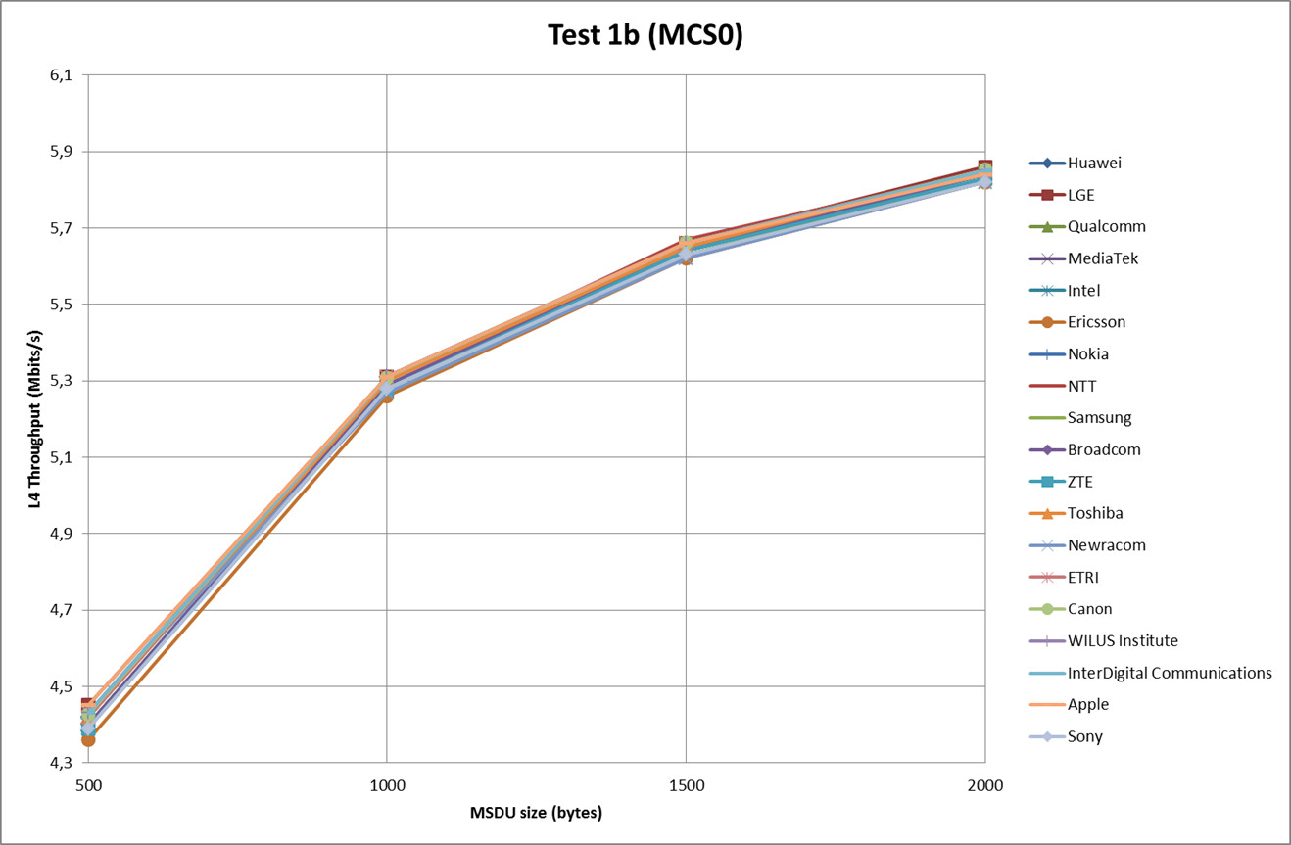
Test 1b: Application Throughput Comparison (Mbps)

Slide 25
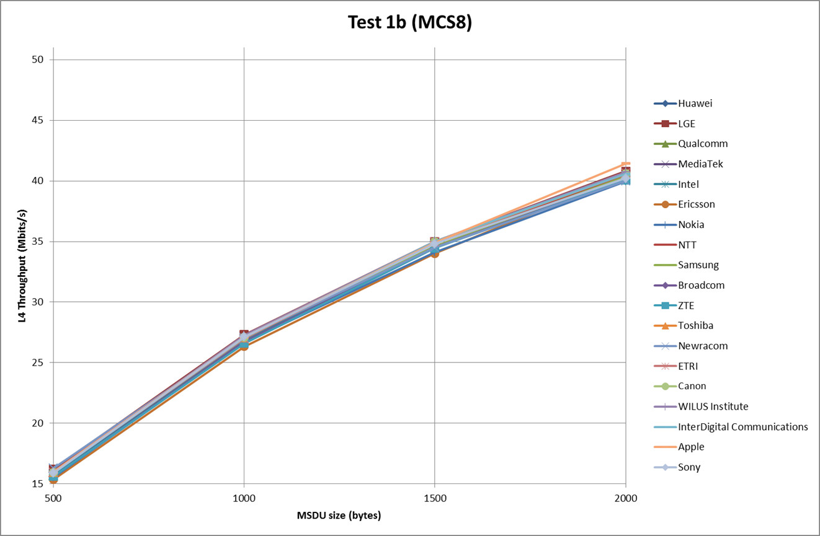
Test 1b: Application Throughput Comparison (Mbps)

Slide 26
Test 2a: Deferral Test 1
Parameter settings
  MSDU length: [0:500:2000Bytes]
  2 MPDU limit
  RTS/CTS [off, on]
  Data MCS = [0]
  RTS/CTS MCS = 0
  ACK MCS = 0
  AIFS=DIFS=34us
  CWmax = 1023
D = 1m

Slide 27
Test 2a: Throughput Results
RTS/CTS | Application Length (B) | MSDU Length (B) | PER(%) | Simulated Application Layer Throughput (Mbps) | Simulated MAC Layer Throughput (Mbps)
Off | 464 | 500 | 10,7 | 4,597 | 4,954
Off | 964 | 1000 | 10,9 | 5,284 | 5,481
Off | 1464 | 1500 | 10,9 | 5,542 | 5,679
Off | 1964 | 2000 | 10,8 | 5,678 | 5,783
On | 464 | 500 | 0 | 4,466 | 4,812
On | 964 | 1000 | 0 | 5,336 | 5,536
On | 1464 | 1500 | 0 | 5,682 | 5,822
On | 1964 | 2000 | 0 | 5,868 | 5,976

Slide 28
Test 2a: Application Throughput Comparison (Mbps)
Company | Contribution # | Without RTS/CTS |  |  |  | With RTS/CTS
Packet Size (Bytes) |  | 500 | 1000 | 1500 | 2000 | 500 | 1000 | 1500 | 2000
Huawei | 11-14/1191r0 | 4,56 | 5,25 | 5,51 | 5,66 | 4,46 | 5,33 | 5,68 | 5,87
LGE | 11-14/1175r1 | 4,62 | 5,28 | 5,54 | 5,66 | 4,5 | 5,34 | 5,68 | 5,88
Qualcomm | 11-14/1192r6 | 4,57 | 5,26 | 5,53 | 5,67 | 4,45 | 5,32 | 5,67 | 5,86
MediaTek | 11-14/1230 | 4,71 | 5,48 | 5,78 | 5,94 | 4,35 | 5,24 | 5,62 | 5,81
Intel | 11-14/1192r6 | 4,52 | 5,22 | 5,48 | 5,62 | 4,44 | 5,31 | 5,67 | 5,86
Ericsson | 11-14/1192r6 | 4,53 | 5,21 | 5,48 | 5,63 | 4,42 | 5,3 | 5,65 | 5,85
Nokia | 11-14/1217r1 | 4,58 | 5,29 | 5,56 | 5,71 | 4,48 | 5,32 | 5,67 | 5,85
NTT | 11-14/1147r0 | 4,58 | 5,25 | 5,45 | 5,66 | 4,49 | 5,35 | 5,7 | 5,88
Samsung | 11-14/1192r6 | 4,58 | 5,27 | 5,53 | 5,67 | 4,45 | 5,31 | 5,67 | 5,86
Broadcom | 11-14/1192r6 | 4,52 | 5,23 | 5,47 | 5,61 | 4,44 | 5,32 | 5,67 | 5,86
ZTE | 11-14/1192r6 | 4,56 | 5,25 | 5,51 | 5,65 | 4,39 | 5,29 | 5,63 | 5,82
Toshiba | 11-14/1192r6 | 4,52 | 5,21 | 5,48 | 5,62 | 4,42 | 5,3 | 5,66 | 5,85
Newracom | 11-14/1449r1 | 4,8 | 5,49 | 5,77 | 5,93 | 4,39 | 5,22 | 5,57 | 5,77
ETRI | 11-14/1342r1 | 4,59 | 5,28 | 5,55 | 5,68 | 4,47 | 5,31 | 5,65 | 5,87
WILUS Institute | 11-15/0080r0 | 4,61 | 5,29 | 5,55 | 5,65 | 4,52 | 5,37 | 5,71 | 5,89
InterDigital Communications | 11-15/0022r1 | 4,64 | 5,29 | 5,55 | 5,7 | 4,47 | 5,36 | 5,71 | 5,87
Apple | 11-15/370r0 | 4,64 | 5,28 | 5,48 | 5,66 | 4,51 | 5,34 | 5,68 | 5,86
Sony | 11-14/1402r0 | 4,57 | 5,33 | 5,52 | 5,61 | 4,43 | 5,29 | 5,64 | 5,82
Mean Value |  | 4,594579 | 5,286316 | 5,541053 | 5,684579 | 4,449789 | 5,313474 | 5,663789 | 5,852579
Mean Deviation |  | 1,46% | 1,41% | 1,55% | 1,58% | 0,96% | 0,68% | 0,57% | 0,48%
Canon |  | 4,60 | 5,28 | 5,54 | 5,68 | 4,47 | 5,34 | 5,68 | 5,87
Canon Deviation |  | 0,11% | 0,12% | 0,02% | 0,08% | 0,45% | 0,50% | 0,29% | 0,30%

Slide 29
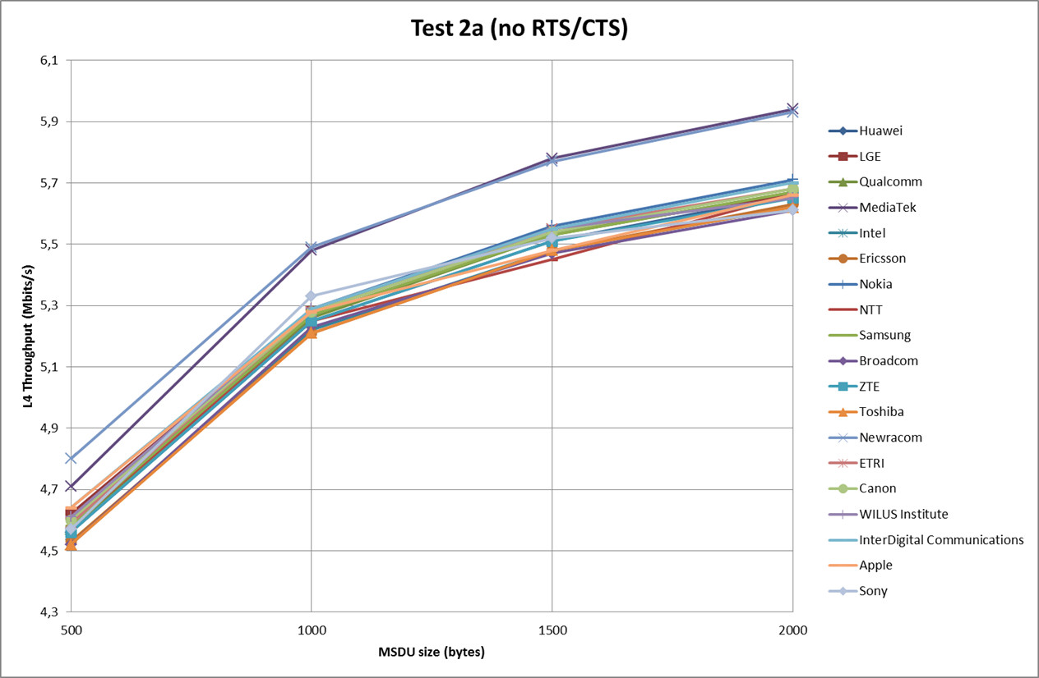
Test 2a: Application Throughput Comparison (Mbps)

Slide 30
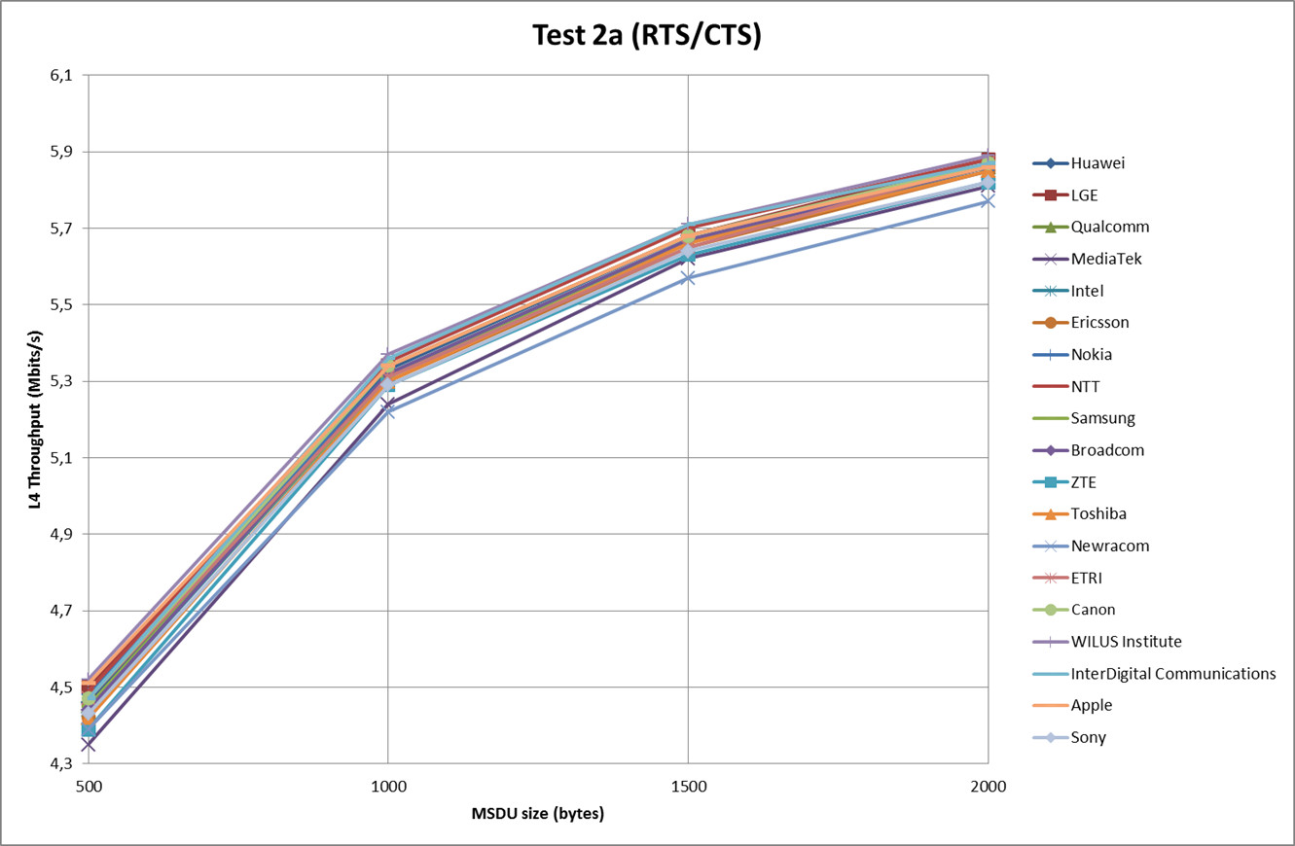
Test 2a: Application Throughput Comparison (Mbps)

Slide 31
Test 2b: Deferral Test 2
Parameter settings
  MSDU length:[1500Bytes]
  RTS/CTS [ OFF]
  Data MCS = [0,8]
  ACK MCS=0
  AIFS=DIFS=34us
  CWmax=1023
  2MPDU limit
D = 65m
D = 65m

Slide 32
Test 2b: Throughput
RTS/CTS | MCS | FA | MSDU Length (B) | PER(%) | Simulated Application Layer Throughput (Mbps) | Simulated MAC Layer Throughput (Mbps)
Off | 0 | No | 1500 | 0,66 | 2,299 | 2,355
Off | 8 | No | 1500 | 0,12 | 28,112 | 28,804
Off | 0 | Yes | 1500 | 0,87 | 0,904 | 0,926
Off | 8 | Yes | 1500 | 0,19 | 37,484 | 38,406

Slide 33
Test 2b: Application Throughput Comparison (Mbps)
Company | Contribution # | MCS0 |  | MCS8
 |  | noFA | FA | noFA | FA
Huawei | 11-14/1191r0 | 1,62 | 1,01 | 26,54 | 34,75
LGE | 11-14/1175r1 | 1,7 | 1,02 | 26,8 | 35
Qualcomm | 11-14/1192r6 |  | 0,98
MediaTek | 11-14/1230 |  | 0,03631
Intel | 11-14/1192r6 | 1,61 | 1,01 | 26,66 | 35,2
Ericsson | 11-14/1192r6 | 1,78 | 1,22 | 25,49 | 33,52
Nokia | 11-14/1217r1 |  | 1,2 |  | 35,66
NTT | 11-14/1147r0 | 1,71 | 1,06 | 26,77 | 35,27
Samsung | 11-14/1192r6 |  | 1,01 |  | 37,22
Broadcom | 11-14/1192r6 |  | 1,05 |  | 34,3
ZTE | 11-14/1192r6 |  | 1,2
Toshiba | 11-14/1192r6 |  | 1,01 |  | 35,11
Newracom | 11-14/1449r1 |  | 1,03 |  | 34,21
ETRI | 11-14/1342r1 | 1,62 | 0,95 | 28,85 | 33,96
WILUS Institute | 11-15/0080r0 |  | 1,02 |  | 34,3
InterDigital Communications | 11-15/0022r1 |  | 1,38 |  | 23,61
Apple | 11-15/370r0 | 1,59 | 1,08 | 26,3 | 33,67
Sony | 11-14/1402r0 |  | 1,05 |  | 37,44
Mean |  | 1,74 | 1,011595 | 26,94025 | 34,419
Deviation |  | 12,44% | 25,13% | 3,67% | 8,86%
Canon |  | 2,29 | 0,904 | 28,112 | 37,484
Canon Deviation |  | 31,61% | 10,64% | 4,35% | 8,90%

Slide 34
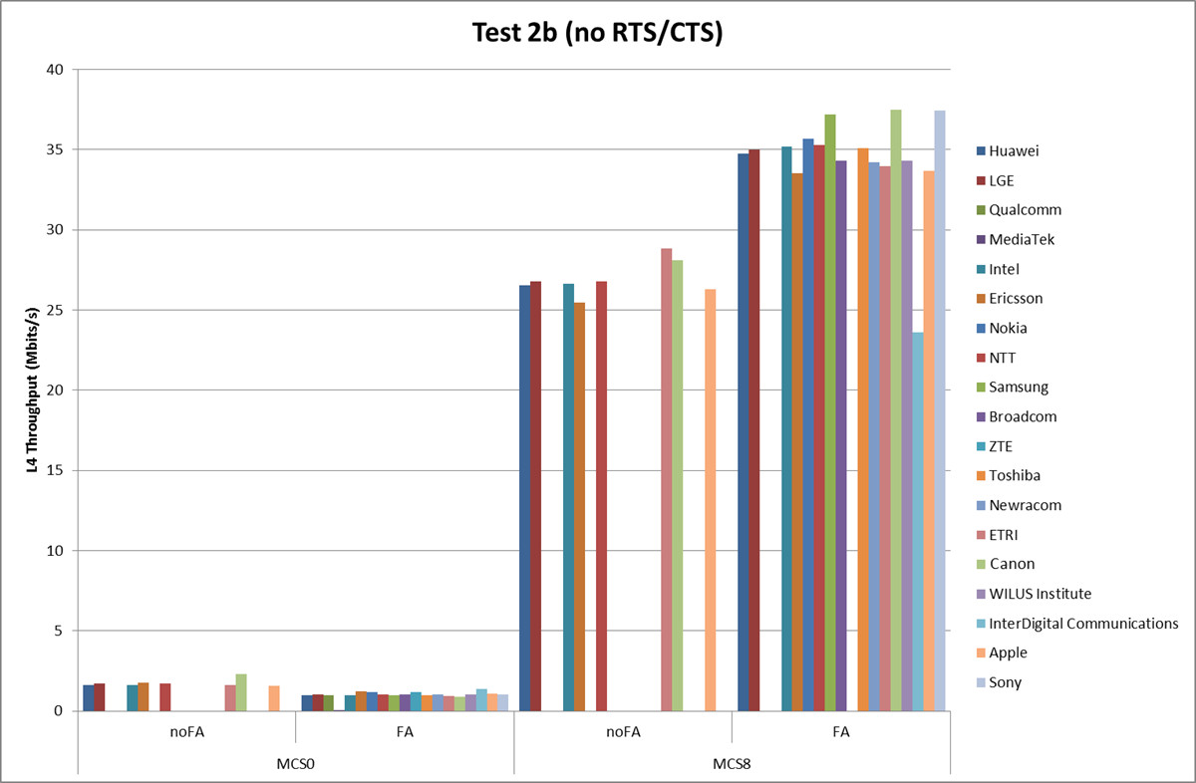
Test 2b: Application Throughput Comparison (Mbps)

Slide 35
Test 3: NAV Deferral
Parameter settings
  MSDU length:[1500Bytes]
  RTS/CTS [ ON]
  Data MCS = [0,8]
  RTS/CTS MCS = 0
  ACK MCS=0
  AIFS=DIFS=34us
  CWmax=1023
  2MPDU limit
D = 65m
D = 65m

Slide 36
Test 3: Throughput
RTS/CTS | MCS | FA | MSDU Length (B) | PER(%) | Simulated Application Layer Throughput (Mbps) | Simulated MAC Layer Throughput (Mbps)
On | 0 | No | 1500 | 0 | 5,141 | 5,267
On | 8 | No | 1500 | 0 | 22,116 | 22,660
On | 0 | Yes | 1500 | 0 | 5,602 | 5,740
On | 8 | Yes | 1500 | 0 | 34,108 | 34,946

Slide 37
Test 3: Application Throughput Comparison (Mbps)
Company | Contribution # | MCS0 |  | MCS8
 |  | noFA | FA | noFA | FA
Huawei | 11-14/1191r0 | 5,15 | 5,58 | 22,04 | 34,05
LGE | 11-14/1175r1 | 5,14 | 5,58 | 22,4 | 34,2
Qualcomm | 11-14/1192r6 |  | 5,55
MediaTek | 11-14/1230 |  | 5,63933
Intel | 11-14/1192r6 | 5,06 | 5,57 | 20,35 | 31,93
Ericsson | 11-14/1192r6 | 5,21 | 5,63 | 22,84 | 34,41
Nokia | 11-14/1217r1 |  | 5,59 |  | 31,35
NTT | 11-14/1147r0 | 5,18 | 5,6 | 22,1 | 34,01
Samsung | 11-14/1192r6 |  | 5,41 |  | 33,55
Broadcom | 11-14/1192r6 |  | 5,32 |  | 30,45
ZTE | 11-14/1192r6 |  | 5,58
Toshiba | 11-14/1192r6 |  | 5,61 |  | 33,81
Newracom | 11-14/1449r1 |  | 5,78 |  | 34,24
ETRI | 11-14/1342r1 | 5,19 | 5,61 | 21,64 | 33,82
WILUS Institute | 11-15/0080r0 |  | 5,74 |  | 38,16
InterDigital Communications | 11-15/0022r1 |  | 5,8 |  | 22,92
Apple | 11-15/370r0 | 5,1 | 5,59 | 21,05 | 33,86
Sony | 11-14/1402r0 |  | 5,49 |  | 33,56
Mean Value |  | 5,146375 | 5,593228 | 21,817 | 33,02675
Mean Deviation |  | 0,89% | 1,95% | 3,39% | 9,26%
Canon Value |  | 5,141 | 5,602 | 22,116 | 34,108
Canon Deviation |  | 0,10% | 0,16% | 1,37% | 3,27%

Slide 38
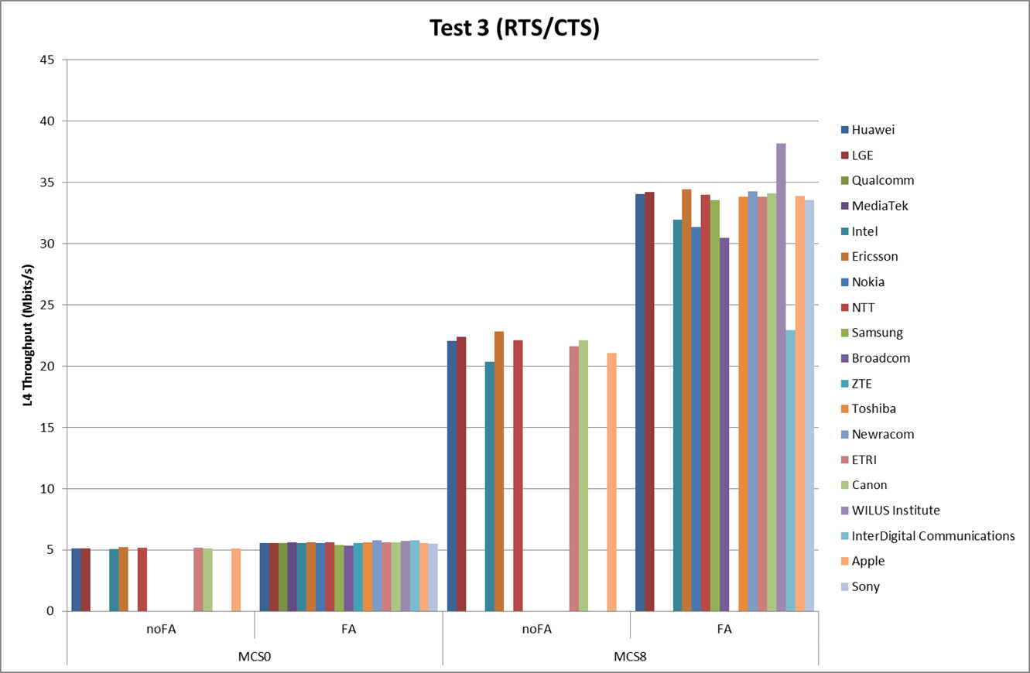
Test 3: Application Throughput Comparison (Mbps)

Slide 39
Test 4: Deferral Test for 20 and 40MHz BSSs
Parameter settings
  MSDU length: 2000Bytes
  RTS/CTS [off, on]
  MCS = [0]
  channel bandwidth:
    BSS1: 40MHz
    BSS2: 20MHz (the secondary channel of BSS1)
  traffic model:
    BSS1: full buffer
    BSS2: Poisson distribution with lamda=100
D = 1m

Slide 40
Test 4: Throughput Results
RTS/CTS | BW mode | Application Length (B) | MSDU Length (B) | PER(%) | Simulated Application Layer Throughput (Mbps) | Simulated MAC Layer Throughput (Mbps) | TX Time (%) 20MHz/40MHz
Off | Adapt. | 1964 | 2000 | 2,847 | 8,719722 | 8,879554 | 50,34088 | 49,65912
Off | Fixed | 1964 | 2000 | 7,769 | 1,555112 | 1,583617 | 100 | 0
On | Adapt. | 1964 | 2000 | 0,000 | 8,486177 | 8,641728 | 52,88736 | 47,11263
On | Fixed | 1964 | 2000 | 0,000 | 1,555450 | 1,583961 | 100 | 0

