Slide 1
Further Study of 11ax Multicast
Date: 2015/09/14
Authors:

Slide 2
Agenda
Background & recap
Further study item for 11ax Multicast
  BAR destination selection
  Bitmap management
  Limitation on aggregation for non-HT protection
Conclusion
Straw poll

Slide 3
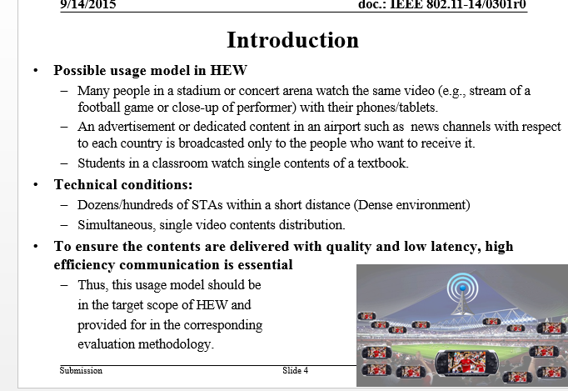
Background
As discussed in [6], multicast enhancement should be taken into account as a part of 802.11ax
  Multicast enable new applications

Slide 4
Recap: what is discussed in MU ad-hoc
The TGax Spec Framework Document (SFD)[1] includes mention of BA/ACK multiplexing, as follows;
  The amendment shall include a mechanism to multiplex BA/ACK responses to DL MU transmission. [MU Motion #4, March 2015]
The TGax SFD also includes a definition, as follows;
  MU features include UL and DL OFDMA and UL and DL MU-MIMO.
Data Transmission Phase
Response Phase
DL MU PPDU
AP
AP
STA x
STA x
BA/ACK
STA y
STA y
BA/ACK
STA z
STA z
BA/ACK
DL MU(OFDMA/MU-MIMO) PPDU
UL multiplexed BA/ACK

Slide 5
Recap: what is discussed in MU ad-hoc
  The contribution[2] showed Multiplexing of acknowledgements can be applied for Multicast PPDU.
  Multiplexing of acknowledgements can reduce overheads of BA/ACKs from multiple multicast receivers.
  It included a straw poll for a general proposal of multiplexing of acknowledgements as follows, and it received no objection.
    Do you agree that multiplexing of acknowledgements can work effectively for Multicast PPDU in a similar manner as DL-MU(OFDMA/MU-MIMO) PPDU? (Results = Yes:35 /No:0 /Abstain:28)

Slide 6
Further study item for 11ax Multicast
  This contribution discusses 3 additional issue to improve 11ax Multicast that need to be considered and some ideas to solve them.
  The three items are as follows
    BAR destination selection
    Bitmap management
    Limitation on aggregation for non-HT

Slide 7
1. BAR destination selection
AP need to select adequate BAR destinations.
  To leverage GCR-BA defined in 802.11aa with larger number of devices (multicast subscribers), HE BSS should selectively use BAR for multicast subscribers
  To limit the number of destinations (BA responders) for MU resource limitation.
  To identify underperforming STAs and improve system performance by managing retransmission.
Selecting BAR destination based on throughput may be beneficial.
  Compering to other method for selecting BAR destination (e.g. random selection), throughput based selection is promising method to achieve PLR requirement.[3][4]

Slide 8


1. BAR destination selection with MD Report
AP can collect throughput information with MD Report.
  MD Report (Multicast Diagnostic Report) has been introduced in 802.11v.
  MD Report is one of solution to collect throughput information, but this frame exchange itself could be overhead to degrade performance (e.g. latency etc.)
Therefore, method to reduce MD Report overhead is beneficial.
MD request
MD report overhead
Data frames
BAR
BAR
AP
STA 1
STA 2
STA 3
BA
MD report
STA N-2
BA
STA N-1
STA N

Slide 9
1. BAR destination selection with enhanced MD Report
To reduce overhead of MD Report, MD Request may announce threshold information to response MD Reports.
  With legacy MD Report mechanism, even well-performing STAs send back MD report, but these STAs need not to be BAR destinations.
  Threshold information can be PER for example and STAs may send back MD Reports when one’s performance is worse than that. Therefore only underperforming STAs may send back MD reports to AP.
MD request
MD report overhead
MD request +threshold
AP
AP
STA 1
STA 1
STA 2
STA 2
STA 3
STA 3
Reducing overhead
MD report
STA N-2
STA N-2
MD report
STA N-1
STA N-1
STA N
STA N

Slide 10
1. BAR destination selection with enhanced MD Report
Simulation results
  30 STAs receive Multicast Data, # of BARD = 6, more 10 STA transmit UL interference
  Threshold is Packet Error Rate. With threshold=0.2, STAs send MDR if their PER are higher (worse) than the threshold.
  Reference is in the same condition but ALL STAs send MD Report.
  Selecting Adequate threshold, MD Report overhead can be reduced with almost no degradation of PLR.
MD Report overhead
Packet Loss Rate
Reference
Reducing 50%
MDR overhead
Reference
Almost no degradation of
Packet Loss Rate

Slide 11
1. BAR destination selection with enhanced MD Report
Modification of Multicast Diagnostic Request field.
  Add field that contains performance threshold for STAs to send back Multicast Diagnostic Report frames.
  Add field that contains traffic information for STAs to calculate their performance. (e.g. the number of transmitted packets)

Slide 12
2. Bitmap management
Current specifications[5] allows to manage combinations of frames as follows in the same single bitmap of sequence number(SN).
  Multicast data frame and Broadcast management frame
  Multicast data frames transmitted to different Multicast addresses
This rule causes a problem as follows.
  Frames that does not need to be received are managed with consecutive sequence numbers, so the sequence numbers are incomplete even if all valid data are received.
  For example, if a STA fails to receive a Broadcast frame and succeeds to receive Multicast data frame, STA will wait for retransmission of the Broadcast frame and does not carry up the Multicast data frame to upper layer.
SN=1
SN=2
SN=3
Multicast
Broadcast
Multicast
AP
STA
Success
Fail
Success
SN=1
SN=2
SN=3

Slide 13
2. Bitmap management
Some options to avoid the problem caused by current bitmap management for Multicast and Broadcast sequence number(SN).
  Option1: To manage Multicast and Broadcast frames in different bitmaps of Sequence Number individually corresponding to multicast or broadcast addresses.
  Option2: To notice sequence numbers that can be carried up to upper layer by special frames.
SN=1
for Multicast Address
SN=1
for Broadcast Address
SN=2
for Multicast Address
Multicast
Broadcast
Multicast
AP
STA
Success
Fail
Success
SN=1
for Multicast Address
SN=1
for Broadcast Address
SN=2
for Multicast Address
SN=1
SN=2
SN=3
Notice that SN=1&3 are
valid enough to carry them up
Multicast
Broadcast
Multicast
Flush
AP
STA
SN=1
Success
SN=2
Fail
SN=3
Success
SN=1 & 3can be carried up to upper layer
and flushed from bitmap

Slide 14
3. Limitation on aggregation for non-HT protection
IEEE 802.11 2012[5] includes specifications as follows.
  “9.12.4 A-MPDU aggregation of group addressed data frames
  An HT AP and an HT mesh STA shall not transmit an A-MPDU containing group addressed MPDUs if the HT Protection field is equal to non-HT mixed mode.”
This specification can be modified because of following reasons.
  This specification prohibits AP from sending aggregated multicast frame when only one non-HT(pre-11n) device is associated although it DOES NOT intend to receive the multicast traffic.
  This is a minor case to give up any other enhancement.

Slide 15
3. Limitation on aggregation for non-HT protection
We can modify the specifications as follows.
  “9.12.4 A-MPDU aggregation of group addressed data frames
  An HE AP and an HE mesh STA shall not transmit an A-MPDU containing group broadcast addressed MPDUs if the HT Protection field is equal to non-HT mixed mode.
  An HE AP and an HE mesh STA shall not transmit an A-MPDU containing multicast addressed MPDUs if [TBD]”
  Here, TBD is the situation that all STAs addressed multicast group address do not satisfy the condition that HT Protection field may be set to no protection mode, nonmember protection mode or 20 MHz protection mode. (refer appendix)

Slide 16
Conclusion
  This contribution showed three items to improve 11ax Multicast that need to be considered and some ideas to solve them.

Slide 17
Straw poll 1
  (not SFD proposal)
Do you agree that modification of Multicast Diagnostic Request is beneficial field to reduce Multicast Diagnostic Report overhead ?
  Yes: /No: /Abstain:

Slide 18
Straw poll 2
  (not SFD proposal)
  Do you agree to improve any mechanism to avoid the problem caused by current bitmap management for Multicast and Broadcast sequence number?
  Yes: /No: /Abstain:

Slide 19
Straw poll 3
(not SFD proposal)
  Do you agree that modification of the limitation on aggregation
  for non-HT protections is beneficial to enhance 11ax multicast?
  Yes: /No: /Abstain:

Slide 20
Reference
[1] 15/0132r7 “Specification Framework for TGax”
[2] 15/0800r0 “Multiplexing of Acknowledgements for Multicast Transmission”
[3] 15/0046r0 “11aa GCR-BA Performance in OBSS”
[4] 15/0320r1 “GCR-BA Performance with Measurement Report in OBSS”
[5] IEEE Std. 802.11 -2012
[6] 14/0301r0 “Multicast Considerations for HEW”

Slide 21
Appendix

Slide 22
1. BAR destination selection with enhanced MD Report
For more enhancement Multicast Diagnostic Request can be modified as follows.
  Multicast Diagnostic Request contains Randomization Interval field.
    The intent of this is to randomize measurement start times and to avoid traffic storms.
  However, start times should not be randomized to ensure the measurement results as statistical data. Transmission times of measurement results should be randomized instead.
802.11-2012 10.11.3 Measurement Start Time, pp. 1058
STA1
Measurement
Transmit
STA1
Measurement
Transmit
STA2
Measurement
Transmit
STA2
Measurement
Transmit
STA3
Measurement
Transmit
STA3
Measurement
Transmit
Randomize
Aligned
Randomize

Slide 23
9.23.3 Protection mechanisms for transmissions of HT PPDUs
9.23.3.1 General
The HT Protection field may be set to no protection mode only if the following are true:
  All STAs detected (by any means) in the primary or the secondary channel are HT STAs, and
  All STAs that are known by the transmitting STA to be a member of this BSS are either
    20/40 MHz HT STAs in a 20/40 MHz BSS, or
    20 MHz HT STAs in a 20 MHz BSS.
The HT Protection field may be set to nonmember protection mode only if the following are true:
  A non-HT STA is detected (by any means) in either the primary or the secondary channel or in both the primary and secondary channels, that is not known by the transmitting STA to be a member of this BSS, and
  All STAs that are known by the transmitting STA to be a member of this BSS are HT STAs.
The HT Protection field may be set to 20 MHz protection mode only if the following are true:
  All STAs detected (by any means) in the primary channel and all STAs detected (by any means) in the secondary channel are HT STAs and all STAs that are members of this BSS are HT STAs, and
  This BSS is a 20/40 MHz BSS, and
  There is at least one 20 MHz HT STA associated with this BSS.
The HT Protection field is set to non-HT mixed mode otherwise.

Slide 24
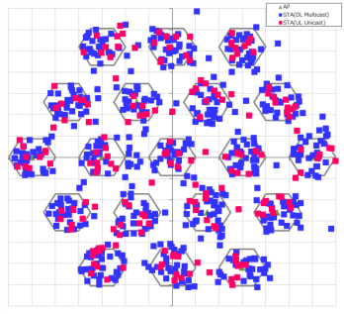
Simulation conditions
Node | AP x 19, STA x 30 x19 (multicast), STA x 10 x 19
Num of Drops [times] | 1
Traffic Model & Load | DL: CBR UDP 3 Mbps (multicast) UL(Interference): CBR UDP 10 Mbps, from single cell (unicast)
Traffic Duration [sec] | 39 sec (approx. 10,000 packet transmission at app)
Access Category | AC_BE (unicast), CWmin=15, CWmax=1023, AIFSN=3, TXOP limit=0 AC_xx (Multicast), CWmin=127, CWmax=1023, AIFSN=3, TXOP limit=0
Tx Power [dBm] | +23(AP), +15(STA)
MCS | 7 (HT80, 2SS)
Link Adaptation | Off
Packet Length [byte] | (MPDU, MSDU, APP)=(1530, 1500, 1472) Fixed
L2 Retry | 10 (multicast)/ 10 (unicast)
BAR/Ack Rate | Lowest (MCS0:6Mbps)
RTS Threshold | ∞(Disabled)
Aggregation | (A-MPDU, A-MSDU)=(64KB, NA)
NF [dB] | 7
Channel | (Dist, Shadow, Fading)=(TGn, σ=5dB, K=12dB-Rice)
Detect Th [dBm] | (PD, ED) = (-82, -62)
Channel Setting [MHz] | (CenterFreq, BW)=(5180, 80)
Antenna Gain [dBi] | 0(AP), -2(STA)
Antenna Height [m] | 3(AP), 1.5(STA)
Tx buffer size [Byte] | 375k [default=∞] (size that can hold 1 sec data size)
Wraparound | Enabled
TTL [sec] | 1 sec
PLCP Header Error Det | Enabled
The Number of Multiplexing BA Users | 1(No-multiplexing),
Leader Selection | Throughput based(with MD Report)
MSDU Count Duration [sec] | 1
Rx MSDU Threshold to determine send Report | PER :0.02 – 0.8 (No duplication check)
Statistics start delay max time [sec] | 0 (All STA start measurement at the same time)
Report transmission delay max time [sec] | 1 (Same as MSDU count Duration)
Topology (followed ss3)

