Slide 1
Spatial Reuse Measurements
Date: 2015-08-07
Authors:
Name | Affiliations | Address | email
Chuck Lukaszewski | Aruba Networks, an HP Company | Sunnyvale, CA | chuck@arubanetworks.com
Liang Li |  |  | liangli@arubanetworks.com
Partha Narasimhan |  |  | partha@arubanetworks.com

Slide 2
Abstract
The SR ad hoc has defined a calibration scenario in [1], and nine companies have presented initial findings in [2] & [3].
This contribution adds empirical, open air measurements using modified ED & preamble detect (PD) thresholds.
We find that spatial reuse using manually fixed PD controls on AP and STA is real for very short AP-STA distances (3 meters)
Results for 2 concurrent BSS are provided at four different inter-BSS distances, for both 2 STA and 6 STA cases
Results for 3 concurrent BSS are provided, for 2 STA case
When taken together with simulation results, TGax should pursue development of SR techniques.

Slide 3
Linear Reuse Testbed
40m
3m
S5-A
S5-B
BSS5
Based on 15/0652r1
5 BSS
Each BSS has 3 nodes:
(1) 802.11ac 3SS AP
(2) 802.11ac 2SS laptop
10m inter-BSS distance
3m STA – AP distance
1m inter-STA distance
Manual fixing of ED/PD thresholds on all nodes
30m
3m
A4
S4-A
S4-B
BSS4
20m
3m
A3
S3-A
S3-B
BSS3
10m
3m
A2
S2-A
S2-B
BSS2
0m
3m
A1
S1-A
S1-B
BSS1

Slide 4
Reference Deployment Scenario in 15/0652r1
STA1
STA3
3m
30m
3m
AP1
AP2
STA2
STA4

Slide 5
Key Differences from Calibration Scenario
Testing in this contribution differs from 15/0652r1 in the following ways:
VHT20 (vs. VHT80)
AP EIRP = 15 dBm (vs. 20) / STA EIRP = 15 dBm (vs. 13)
Floating data MCS (vs. fixed MCS5)
Up to 64 MPDUs per A-MPDU (vs. 32)
Bidirectional (vs. UL only)
SGI enabled
Beacons enabled
RTS/CTS enabled
PD thresholds -85 / -75 / -65 / -55 (vs. -76 / -66 / -56)

Slide 6
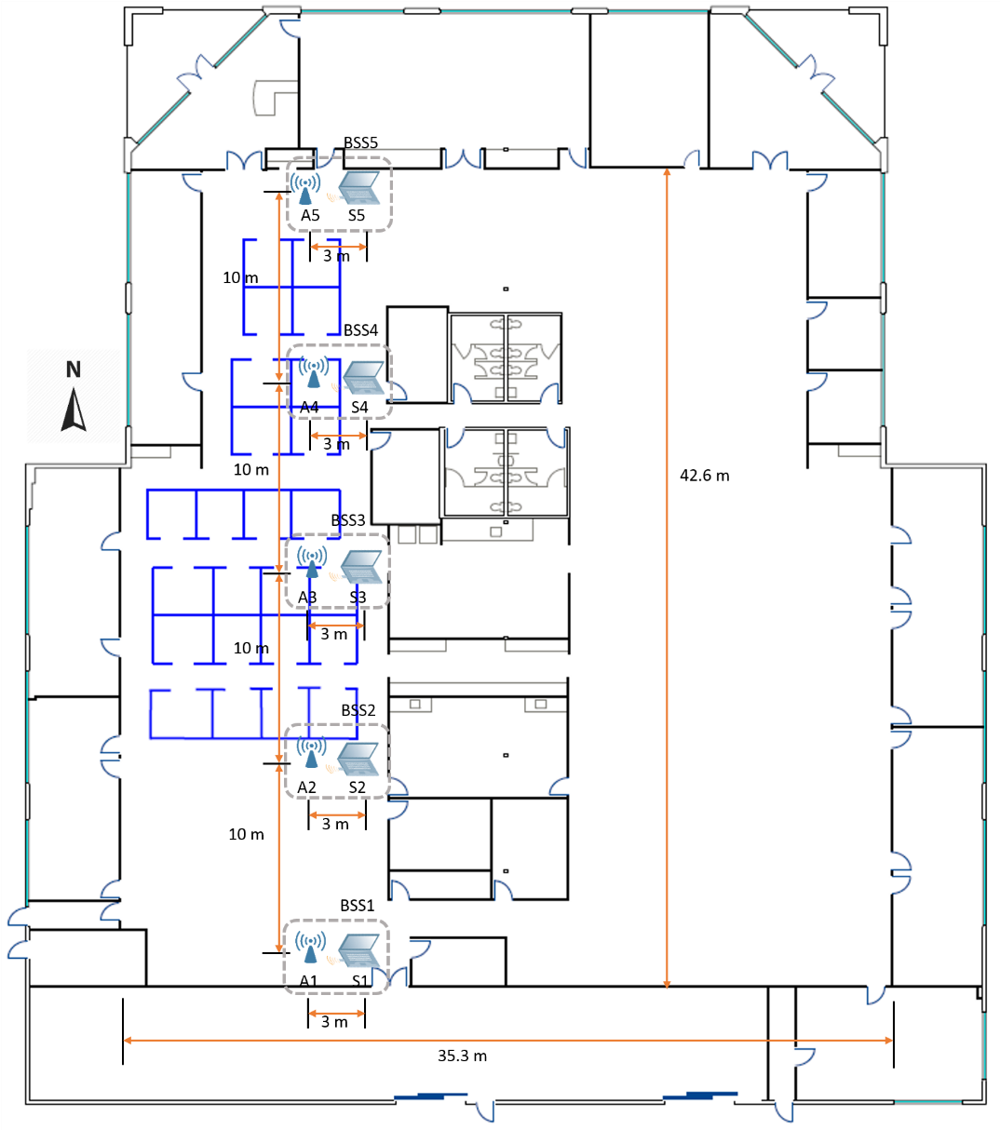
Lab Building Floor Plan with AP/STA Locations
BSS5
BSS4
BSS3
BSS2
BSS1

Slide 7
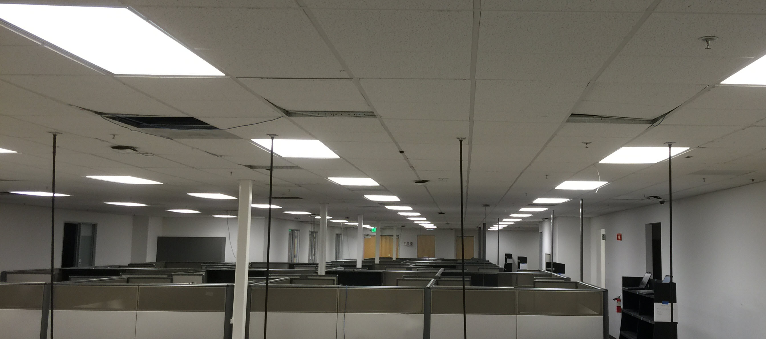
Viewing BSS2 – BSS5 from BSS1
STA5
AP2
STA4
STA3
AP3
STA2
AP4
3m
AP5

Slide 8
Testbed Configuration
BSS & RF:
** 15/0652r1 calls for VHT80. VHT20 used in this contribution.
Test Automation:
Channel | 120
Modulation | VHT20**
STA EIRP | 15 dBm
AP EIRP | 15 dBm
Control Rate | 6 Mbps
Traffic generation platform | IxChariot 8.1
Traffic type | UDP (payload 1460 bytes)
Traffic direction | DL and UL
Send data rate (per STA) | Unlimited (DL), 75 per STA Mbps(UL)
Number of data flows | 2 data flows, Unlimited send rate (DL) 5 data flows, 15 Mbps per flow (UL)
Link between each STA and Wired Endpoint | 1 Gbps

Slide 9
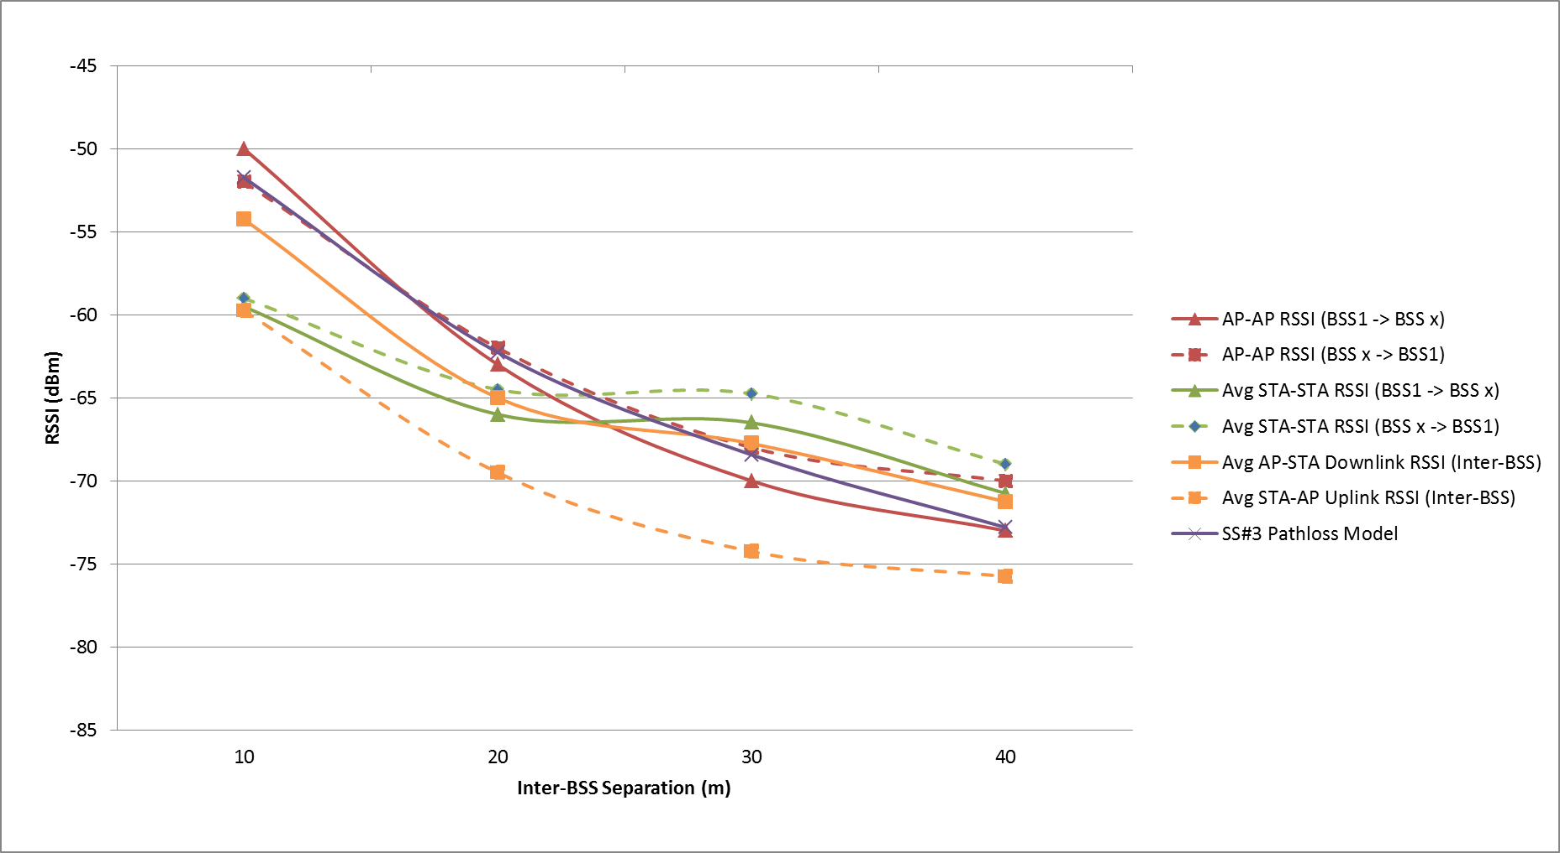
Inter-BSS RSSI Calibration

Slide 10
Intra-BSS RSSI Calibration (Typical)
AP
 | AP | STA A | STA B
AP |  | -37 dBm | -39 dBm
STA A | -47 dBm |  | -35 dBm
STA B | -44 dBm | -38 dBm
3m
3m
1m
Station A
Station B

Slide 11
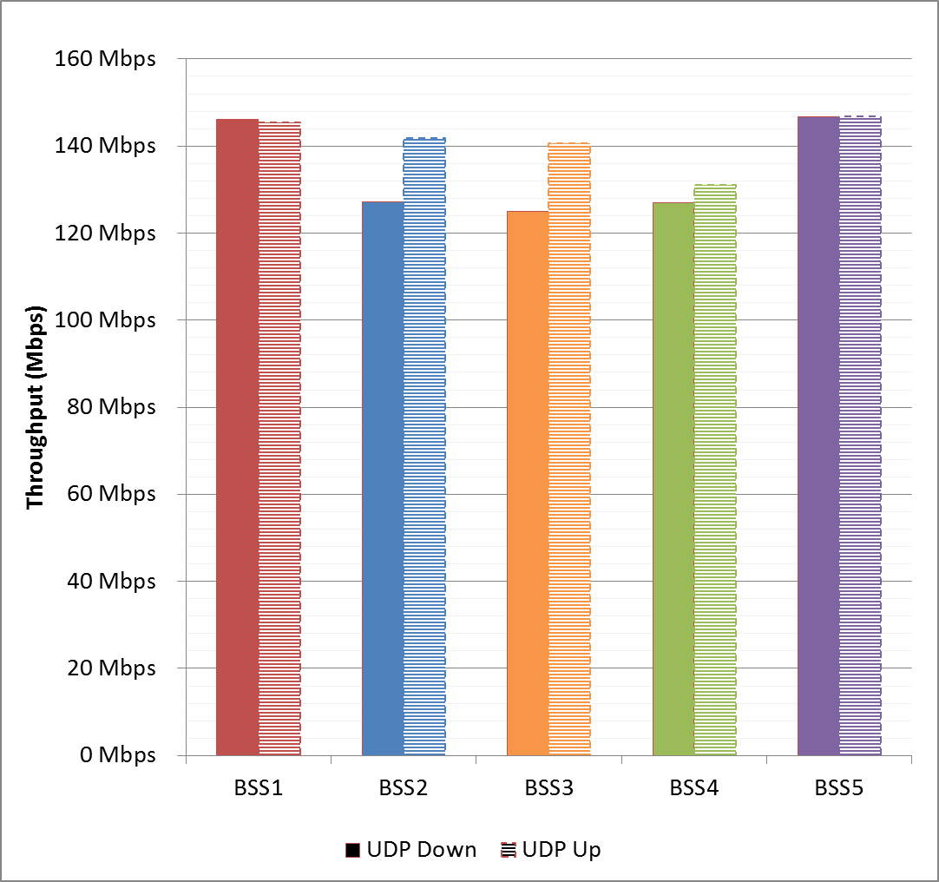
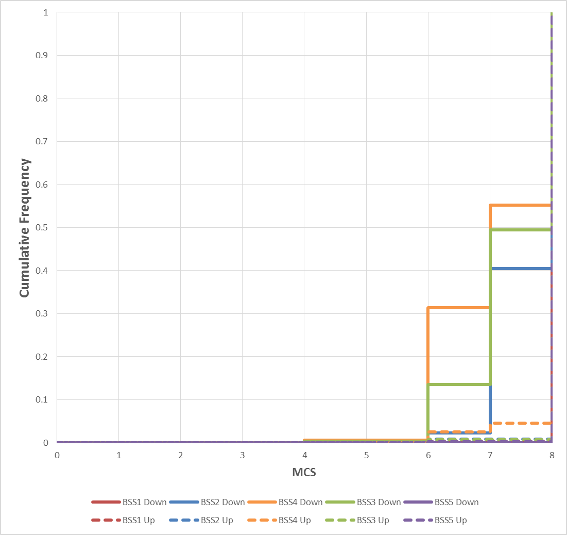
Single BSS Calibration – PD= -85 / ED = -62 (UDP Goodput & MCS Distribution)

Slide 12
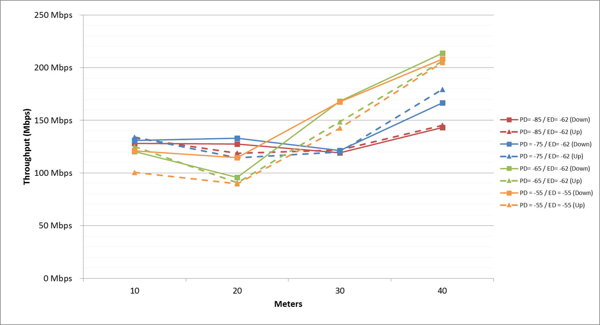
2 BSS / 2 STA Goodput (VHT20) D = 10m/20m/30m/40m PD = -55 / -65 / -75 / -85

Slide 13
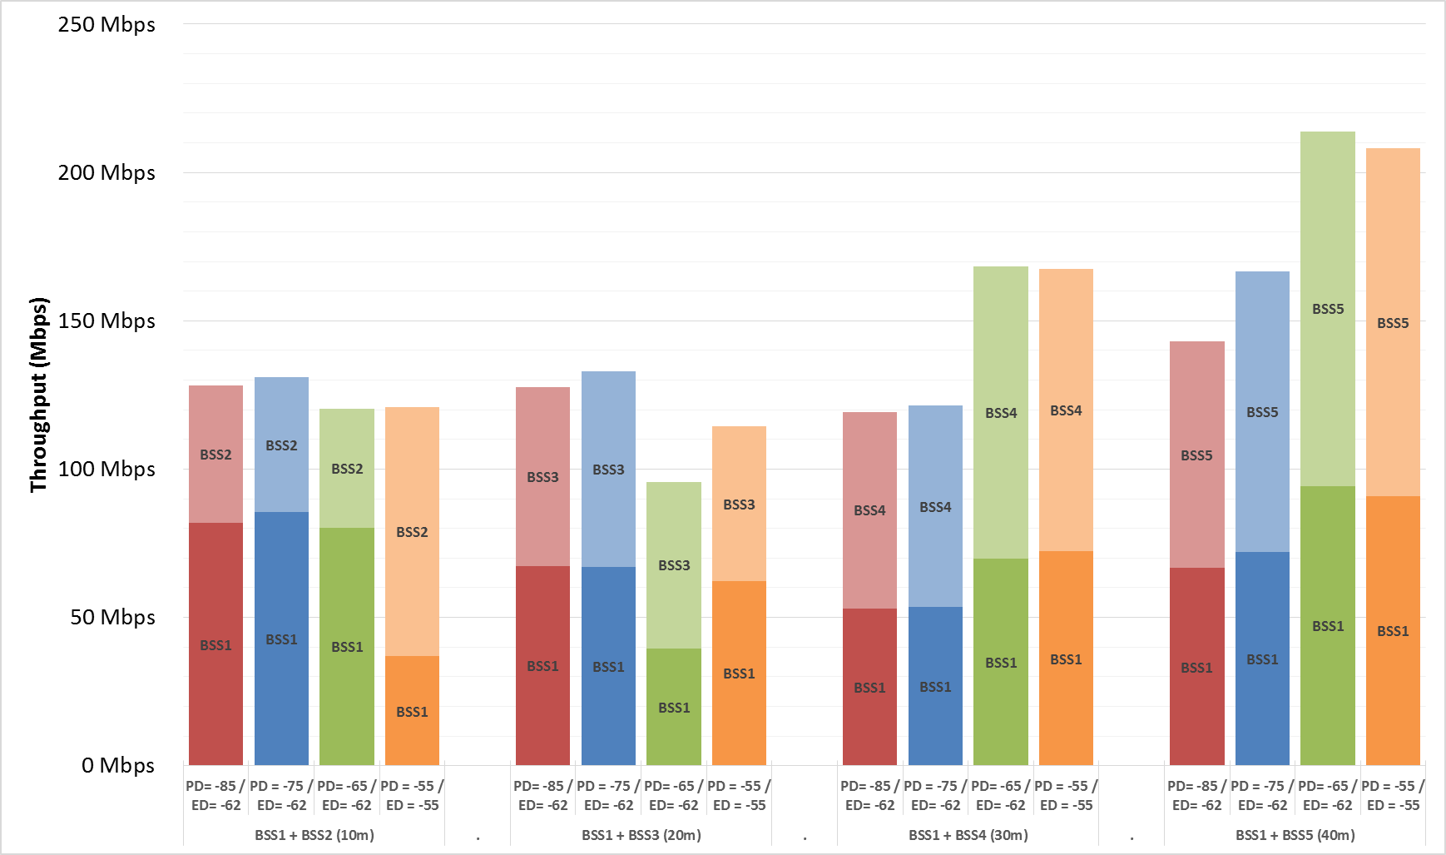
2 BSS / 2 STA Goodput (Downstream VHT20) D = 10m/20m/30m/40m PD = -55 / -65 / -75 / -85

Slide 14
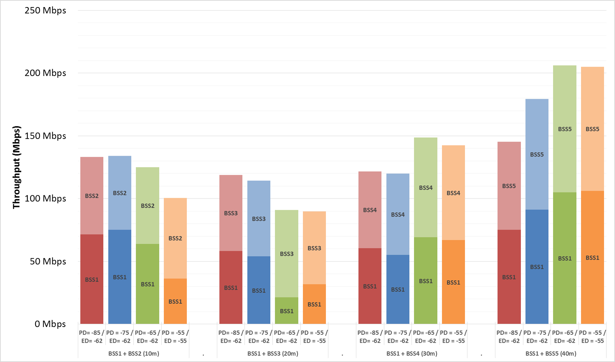
2 BSS / 2 STA Goodput (Upstream VHT20) D = 10m/20m/30m/40m PD = -55 / -65 / -75 / -85

Slide 15
Linear Reuse Testbed
40m
3m
S5-A
S5-B
BSS5
Based on 15/0652r1
5 BSS
Each BSS has 3 nodes:
(1) 802.11ac 3SS AP
(2) 802.11ac 2SS laptop
10m inter-BSS distance
3m STA – AP distance
1m inter-STA distance
Manual fixing of ED/PD thresholds on all nodes
30m
3m
A4
S4-A
S4-B
BSS4
20m
3m
A3
S3-A
S3-B
BSS3
10m
3m
A2
S2-A
S2-B
BSS2
0m
3m
A1
S1-A
S1-B
BSS1

Slide 16
2 BSS / 6 STA Tests
Increase STA counts in each BSS from 2 STAs to 6 STAs
Repeat sweep of PD/ED settings at 10m / 20m / 30m / 40m
Characterize per-STA fairness in up & down directions

Slide 17
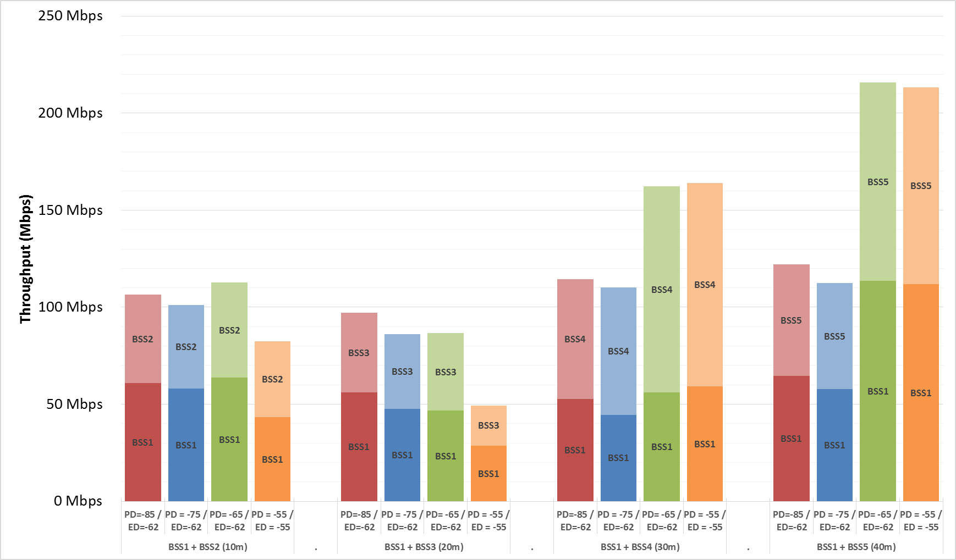
2 BSS / 6 STA Goodput (Downstream VHT20) D = 10m/20m/30m/40m PD = -55 / -65 / -75 / -85

Slide 18
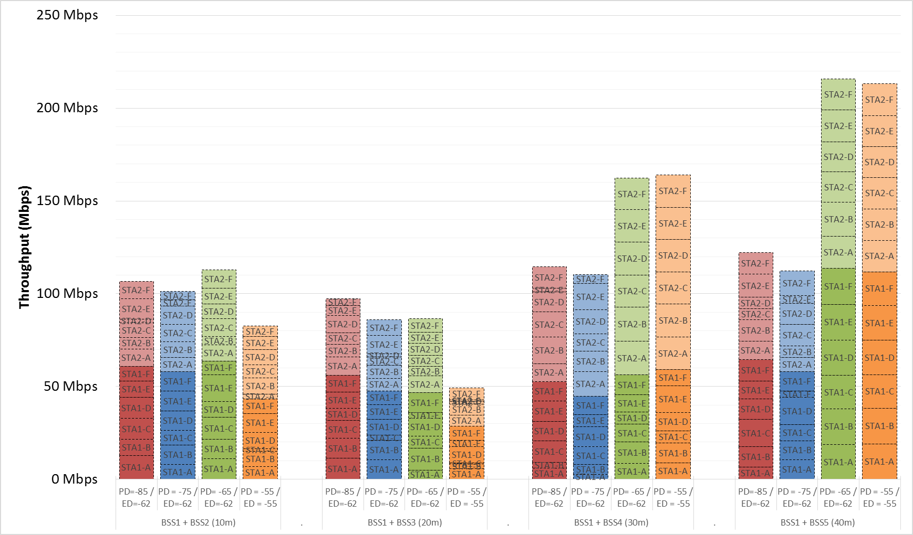
2 BSS / 6 STA Fairness (Downstream VHT20) D = 10m/20m/30m/40m PD = -55 / -65 / -75 / -85

Slide 19
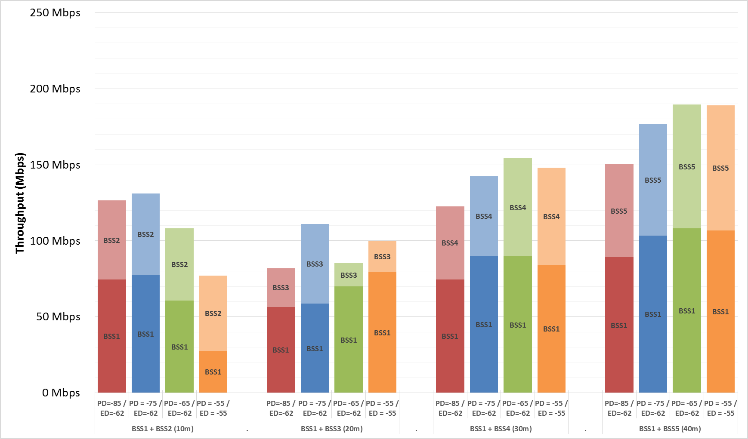
2 BSS / 6 STA Goodput (Upstream VHT20) D = 10m/20m/30m/40m PD = -55 / -65 / -75 / -85

Slide 20
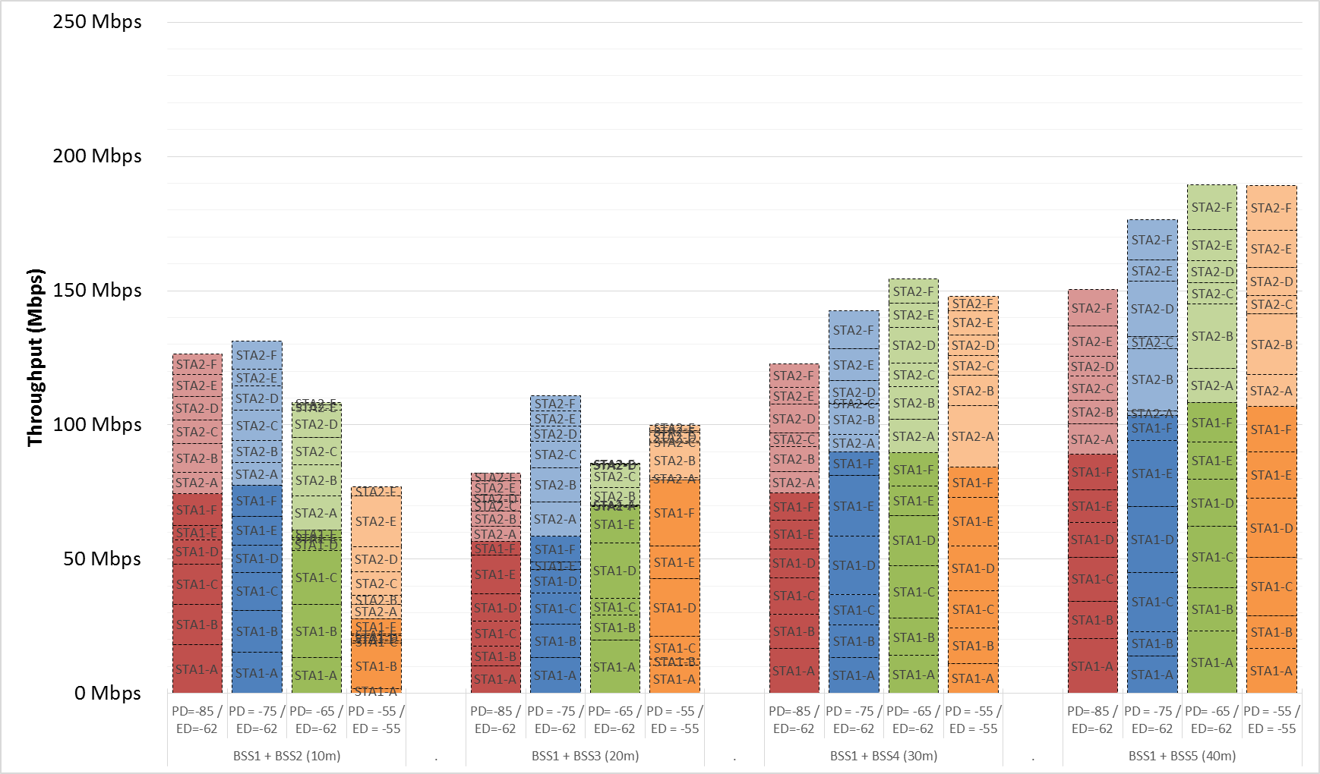
2 BSS / 6 STA Fairness (Upstream VHT20) D = 10m/20m/30m/40m PD = -55 / -65 / -75 / -85

Slide 21
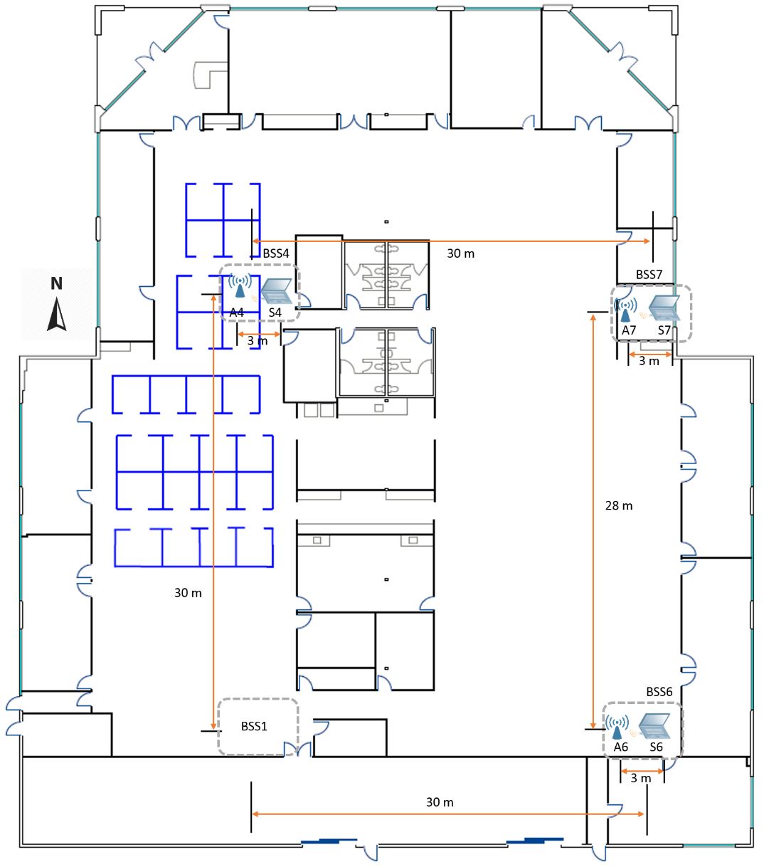
Test Design – 3 BSS / 2 STA
BSS4
BSS7
BSS6

Slide 22
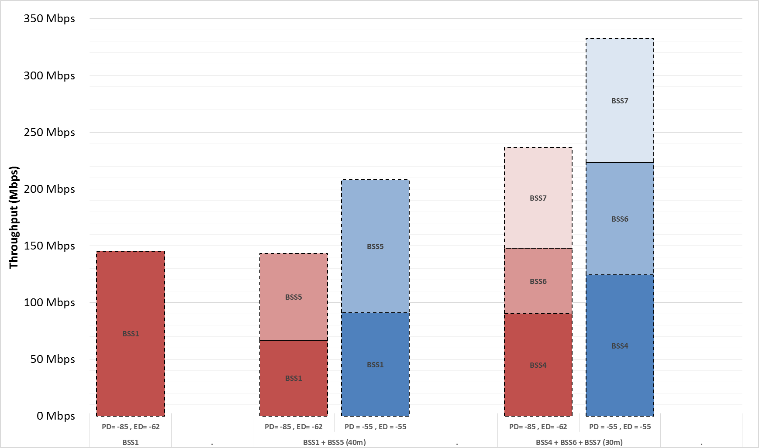
Results: 3 BSS / 2 STA (Down)

Slide 23
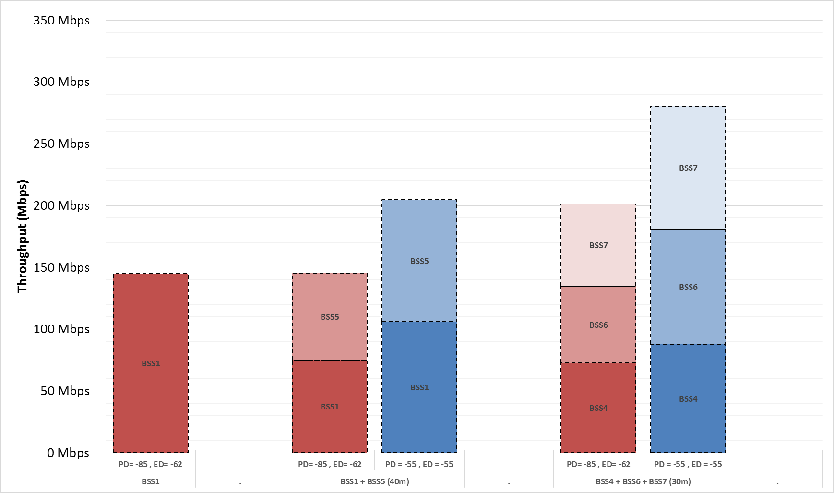
Results: 3 BSS / 2 STA (Up)
TBD

Slide 24
Conclusions
Spatial reuse via PD threshold tuning is real.
Improvement scales with BSS count, but linearity depends on many factors including inter-BSS distance, intra-BSS distance and supportable MCS.
Per-STA and Per-BSS fairness appears to be generally good in presence of OBSS noise.
Minimum viable SR distance is ~30m in free space.
Diminishing or no return at smaller distances
Possibly due to SINR compression reducing maximum supportable MCS rate
Should the calibration scenario be increased to sweep longer distances?

Slide 25
References
[1] 15/0652r1 – “Reference Simulation Model for Dynamic CCA / DSC Calibration”, M Mori, Y Morioka et al (Sony, SR, Nokia, MediaTek, Broadcom), May 2015
[2] 15/0801r0 - “DCCA/DSC Reference Simulation Results”, M Mori, Y Morioka et al (Sony, WILUS, NTT, SR, Broadcom, LG, MediaTek), July 2015
[3] 15/886r0 - “DSC Calibration Result”, C Yu, F Hsu et al (MediaTek), July 2015

