Slide 1
Data field in HE PPDU
Date: 2015-09-13
Authors:

Slide 2
Introduction
From 802.11ac SFD,
  6.3.7 A-MPDU format
  The VHT A-MPDU format is an extension of the 802.11n A-MPDU as shown in Figure 19. The extension (shaded in the figure) consists of zero or more delimiters with MPDU length zero and a possible final MAC Pad of less than 4 octets. The A-MPDU of a VHT PPDU fills the available octets in the payload.
  The PSDU of a VHT PPDU shall be a VHT A-MPDU.
Figure 19--A-MPDU format for VHT PPDU

Slide 3
Introduction
Similar to 802.11ac, 802.11ax needs to determine a baseline of a Data field format
As an unified form for supporting a DL/UL multi-user transmission, a PSDU of a HE PPDU shall be an A-MPDU
  But, a Length indication in PHY header (such as a Length field of VHT-SIG-B in IEEE 802.11ac) is not needed in 802.11ax

Slide 4
A-MPDU Contents in HE PPDU
Current A-MPDU can be transmitted by a TXOP holder or an RD responder
In 802.11ax, because an UL MU responder can transmit A-MPDU, A-MPDU Contexts (refer Table 8-409 in 802.11mc) should be changes as the following
Name of Context | Definition of Context
Data Enabled Immediate Response | The A-MPDU is transmitted outside a PSMP sequence by a TXOP holder or an RD responder or an UL MU responder including potential immediate responses.
Data Enabled No Immediate Response | The A-MPDU is transmitted outside a PSMP sequence by a TXOP holder or an UL MU responder that does not include or solicit an immediate response.
Control Response | The A-MPDU is transmitted by a STA that is neither a TXOP holder nor an RD responder or an UL MU initiator that also needs to transmit one of the following immediate response frames: Ack, BlockAck frame with a TID for which an HT-immediate block ack agreement exists

Slide 5
A-MPDU Contents in HE PPDU
Also, current 802.11ax SFD specifies that a unicast Trigger frame for a single user may be included in A-MPDU (refer MAC Motion 20 in 802.11ax SFD)
In that sense, a Trigger frame is included in A-MPDU contents of 1) Data Enabled Immediate Response, 2) Data Enabled No Immediate Response and 3) Control Response contexts

Slide 6
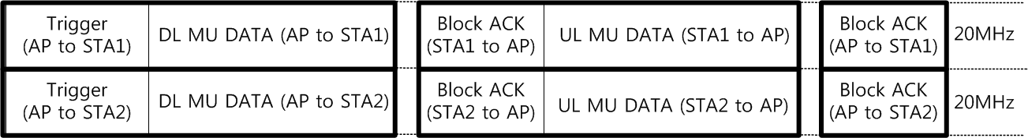
A-MPDU Contents in HE PPDU
Scenario 1) A Trigger frame is included in A-MPDU contents of Data Enabled Immediate Response context
  A DL MU data frame enables an immediate response
  A Trigger frame specifies a resource allocation information for an immediate response and a following UL MU data frame

Slide 7
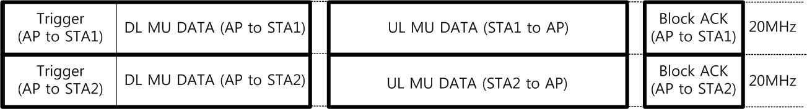
A-MPDU Contents in HE PPDU
Scenario 2) A Trigger frame is included in A-MPDU contents of Data Enabled No Immediate Response context
  A DL MU data frame enables no immediate response
  A Trigger frame specifies a resource allocation information for a following UL MU data frame

Slide 8
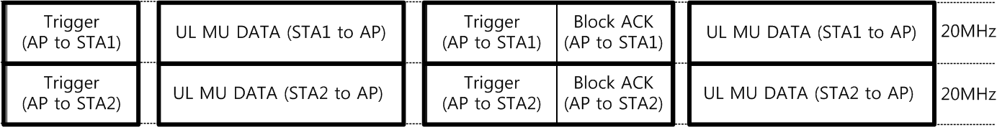
A-MPDU Contents in HE PPDU
Scenario 3) A Trigger frame is included in A-MPDU contents of Control Response context
  A Trigger frame specifies a resource allocation information for a following UL MU data frame
  A Block ACK frame acknowledges a preceding UL MU data frame

Slide 9
A-MPDU Contents in HE PPDU
802.11ac has introduced a VHT single MPDU for a data frame transmission with no Block Ack agreement (such as a Management frame)
For the same purpose, 802.11ax may need a HE single MPDU
  Additional consideration is whether a HE single MPDU can solicits an Ack frame response carried in an UL MU PPDU

Slide 10
A-MPDU Operation in HE PPDU
From 802.11ac SFD,
  6.8 Rules for using VHT PPDU
  In a downlink MU PPDU, at most one A-MPDU is allowed to contain one or more MPDUs that solicit an immediate response
But, because an UL MU PPDU of 802.11ax can be used for one or more immediate responses, the rules for using HE PPDU should be modified as the following
  In a downlink MU HE PPDU, at most one A-MPDU is allowed to contain one or more MPDUs that solicit an immediate response, except when an immediate response is carried in UL MU PPDU. In such case, one or more A-MPDUs are allowed to contain one or more MPDUs that solicit an immediate response carried in UL MU PPDU.

Slide 11
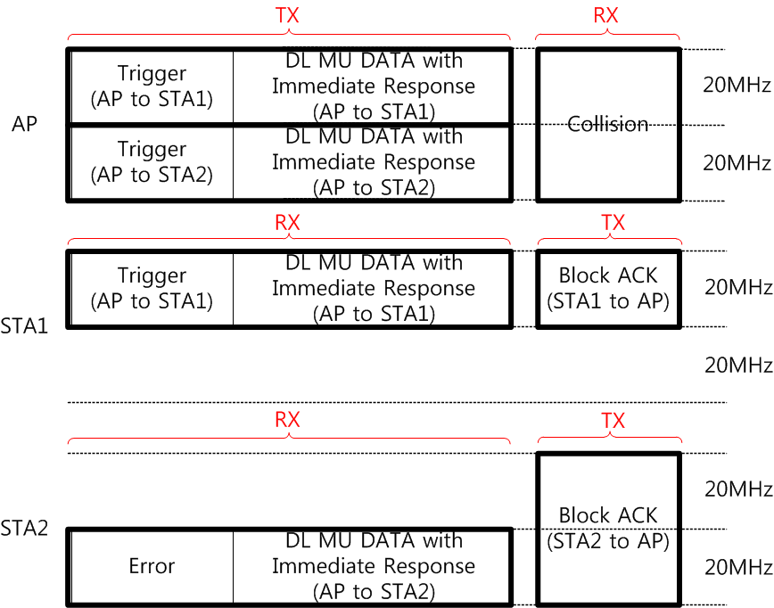
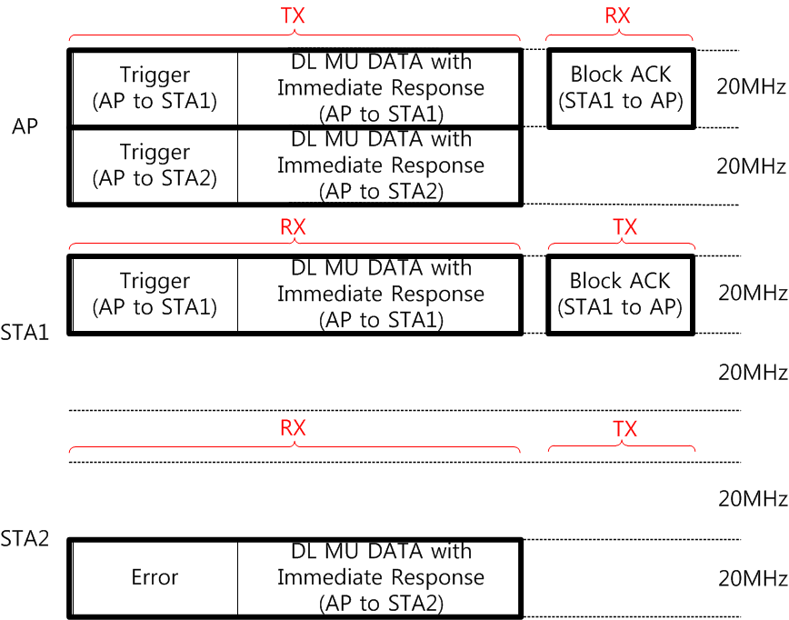
A-MPDU Operation in HE PPDU
The addressed recipient that receives a frame soliciting an immediate response carried in UL MU PPDU but it does not receive a Trigger frame takes no action upon a receipt of an A-MPDU

Slide 12
Conclusion
In this presentation, the following items have been addressed
  Data field format in HE PPDU
  A-MPDU contents in HE PPDU
  A-MPDU operation of HE STA

Slide 13
Straw Poll 1
Do you agree to add the TGax SFD:
  6.1 General
  A PSDU of a HE PPDU shall be an A-MPDU.

Slide 14
Straw Poll 2
Do you agree to add the TGax SFD:
  6.1 General
  An A-MPDU is transmitted in one of the below contexts
  A Trigger frame is included in A-MPDU contents of Data Enabled Immediate Response, Data Enabled No Immediate Response, Control Response and HE single MPDU contexts
Name of Context | Definition of Context
Data Enabled Immediate Response | The A-MPDU is transmitted outside a PSMP sequence by a TXOP holder or an RD responder or an UL MU responder including potential immediate responses.
Data Enabled No Immediate Response | The A-MPDU is transmitted outside a PSMP sequence by a TXOP holder or an UL MU responder that does not include or solicit an immediate response.
Control Response | The A-MPDU is transmitted by a STA that is neither a TXOP holder nor an RD responder or an UL MU initiator that also needs to transmit one of the following immediate response frames: Ack, BlockAck frame with a TID for which an HT-immediate block ack agreement exists
HE single MPDU context | The A-MPDU is transmitted within a HE PPDU and contains a HE single MPDU.

Slide 15
Straw Poll 3
Do you agree to add the TGax SFD:
  6.1 General
  In a downlink MU HE PPDU, at most one A-MPDU is allowed to contain one or more MPDUs that solicit an immediate response, except when an immediate response is carried in UL MU PPDU. In such case, one or more A-MPDUs are allowed to contain one or more MPDUs that solicit an immediate response carried in UL MU PPDU.

Slide 16
Straw Poll 4
Do you agree to add the TGax SFD:
  6.1 General
  The addressed recipient that receives a frame soliciting an immediate response carried in UL MU PPDU but that does not receive a Trigger frame takes no action upon the receipt of the A-MPDU

