Slide 1
Proxy ARP in 802.11ax
Date: 2015-08-25
Authors:

Slide 2
Abstract
Submission [1] proposes the implementation of Proxy ARP with 802.11ax AP. The submission was presented during the July 2015 meeting but attendees asked for more time to review the Proxy ARP mechanism. Further information about Proxy ARP and IPv6 was asked for. The present submission intends to provide according explanations.

Slide 3
Address Resolution Protocol
What is the Address Resolution Protocol (ARP)?
  The Internet Protocol (IP) layer does not assume/know anything about lower layers
  In a Local Area Network (LAN) devices talk in peer-to-peer mode to each other
The MAC (layer 2) address space is flat
  No hierarchy like in IP
  How do devices learn about each others MAC address?
ARP glues MAC and IP addresses
  More precisely: ARP glues MAC and IPv4
  IPv6 is different …

Slide 4
Example network
Example LAN consisting of router and clients
Router operates on IP layer
  Has routing knowledge
  Knows paths to “all” destinations

Slide 5
Without ARP
Client PC intends to communicate with printer
W/o ARP, client PC does not know how to communicate with printer
  Sends data to router
  Router =
  default gateway =
  first hop for all unknown destinations

Slide 6
With ARP
Client PC intends to communicate with server
  Client uses subnet mask to identify that server is on same subnet
    Src: 10101100.00010000.00010011.01001010
    Dst: 10101100.00010000.00010011.00101010
    Mask: 11111111.11111111.11111111.00000000
    Match indicates destination is immediately reachable
  ARP message to find destination MAC address
    Broadcast message sent to everyone …
Broadcast message:
Who has 172.16.19.42?

Slide 7
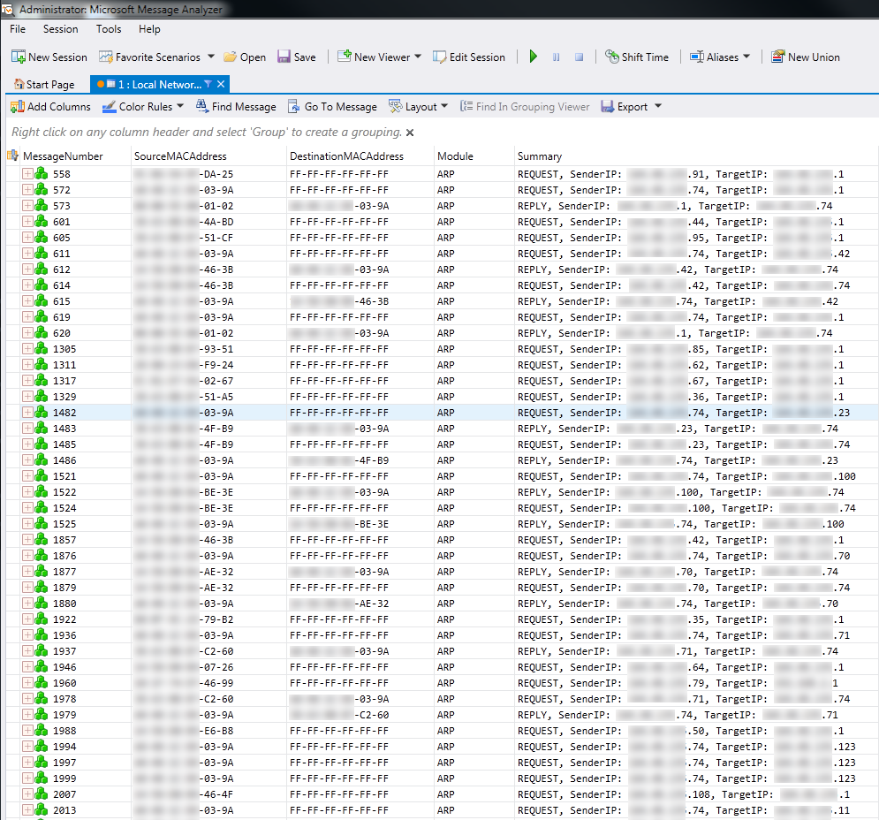
Example
Event 611:
172.16.19.74 (xx:xx:xx:xx:03:9a) sends message to broadcast address (ff:ff:ff:ff:ff:ff), asking
“Who has 172.16.19.42?”
Event 612:
xx:xx:xx:xx:46:3b directly replies to xx:xx:xx:xx:03:9a, indicating
“I am 172.16.19.42”
172.16.19.74 adds entry to its local ARP cache:
C:\windows\system32>arp –a
Interface: 172.16.19.74
Internet Address Physical Address
172.16.19.42 xx-xx-xx-xx-46-3b

Slide 8
How does ARP hurt WLANs?
AP extends wired segment (“transparent bridge”)
  All broadcast frames on LAN side copied to WLAN
  ARP requests are broadcast messages
    All ARP requests forwarded to WLAN
  In WLAN, broadcast messages transmitted at most robust MCS

Slide 9
Solution: Proxy ARP
The AP knows all associated STA’s MAC address
  AP acts as central “manager” in BSS
AP acts on behalf of STAs
  Power save relies on AP buffering data for STAs
Proxy ARP easy to implement at AP
Advantages
  Less low MCS broadcast traffic on wireless medium
  STA benefits from extended power save in sleep mode as ARP requests are replied to by AP

Slide 10
Proxy ARP in 802.11-REVmc/D4.1 [2]
When the AP supports Proxy ARP “[…] the AP shall maintain a Hardware Address to Internet Address mapping for each associated station, and shall update the mapping when the Internet Address of the associated station changes. When the IPv4 address being resolved in the ARP request packet is used by a non-AP STA currently associated to the BSS, the proxy ARP service shall respond on behalf of the STA to an ARP request or an ARP Probe”
  Keeps ARP frames off the wireless medium
  See 10.24.14 in [2]

Slide 11
ARP and IPv6?
IPv6 doesn’t need ARP
  IPv6 uses Neighbor Discovery Protocol (NDP) instead [3]
Every IPv6 node subscribes to special multicast address
  Neighbor-Solicitation message replaces ARP
NDP may be used to request additional information
  Maximum Transmission Unit
  Router Solicitation
  Router Advertisement, etc.
NDP messages are sent as group addressed (broadcast) frames in 802.11

Slide 12
IPv6 support in 802.11-REVmc/D4.1 [2]
“When an IPv6 address is being resolved, the Proxy Neighbor Discovery service shall respond with a Neighbor Advertisement message […] on behalf of an associated STA to an [ICMPv6] Neighbor Solicitation message […]. When MAC address mappings change, the AP may send unsolicited Neighbor Advertisement Messages on behalf of a STA.”
  802.11 Proxy ARP prepared for IPv6
  Keep NDP messages off the wireless medium
  See 10.24.14 in [2]

Slide 13
Why mandatory?
Today, many issues arise from “broken” implementations
  In dense deployments, which 802.11ax is designed for, a “broken” implementation is not just your neighbor’s issue
  In dense deployments, inefficient medium usage hurts everyone
802.11ax focuses at system level, not only at entity level
  Efficient airtime use is “everybody’s duty”
  For robustness, broadcast frames use low(est) MCS
Proxy ARP is important and simple to prevent unnecessary traffic from reaching the BSS

Slide 14
Straw Poll

Slide 15
Straw Poll
Do you agree to add the following to the IEEE 802.11 TGax Specification Framework?
  Add to the end of Clause 6 (MAC): “The amendment shall define a HE AP to implement Proxy ARP capability.”

Slide 16
MOtion
Transform successful straw poll into a motion

Slide 17
Motion
Moved to add to the end of Clause 6 (MAC) of the IEEE 802.11 TGax Specification Framework:
  “The amendment shall define a HE AP to implement Proxy ARP capability.”
  Moved by:
  Seconded:

Slide 18
References
G. R. Hiertz et al., “Efficiency enhancement for 802.11ax,” Jul. 2015. [Online]. Available: https://mentor.ieee.org/802.11/dcn/15/11-15-0871
IEEE 802.11, “IEEE P802.11-REVmc/D4.1”
T. Narten et al., “Neighbor Discovery for IP version 6 (IPv6),” IETF RFC 4861, Sep. 2007. [Online]. Available: https://tools.ietf.org/html/rfc4861

