Slide 1
802.11ae & 802.11ax
Date: 2015-08-25
Authors:

Slide 2
Abstract
802.11ae introduces a prioritization scheme for management frame. Submission [7] proposes to mandate support for 802.11ae with 802.11ax. The submission was presented during the July 2015 meeting but attendees asked for more time to review the principles of 802.11ae. The present submission intends to provide further explanations about 802.11ae.

Slide 3
IEEE 802.11ae-2012
IEEE 802.11ae-2012 [2] is the first amendment of IEEE 802.11-2012
IEEE 802.11ae describes “Prioritization of Management Frames”
  The amendment consists of a grand total of 52 pages
    38 pages of normative text
  The PAR was approved 2009-12-09
  The final amendment was approved 2012-03-01
  The project had five Letter Ballots and four Sponsor Ballots
  The first draft had 81% approval rate and the final draft 100% approval rate without any non-satisfied comments remaining [1]

Slide 4
History
Because the first 802.11 letter ballot received >75% approval rate, the ballot group was closed
  [3] contains the list of voters
LB181 is the last 802.11 letter ballot on P802.11ae
  182 affirmative votes
  7 negative votes
  35 abstention votes
Negative votes must be accompanied by comments, the latter are documented in [4]
  Zero comments in LB181, last comments in LB180
  A total of eight 802.11 voting members provided comments

Slide 5
Why 802.11ae?
The 802.11ae press release [5] explains
  “Wireless LANs increasingly carry more management traffic. Management traffic is currently transmitted at a single priority that is higher than most data traffic.”
Without 802.11ae, all management frames use highest Access Category (Voice, AC VO) parameters
  Not necessarily queued with Data frames
  Not all management frames need high priority handling
  Previous studies reveal that management traffic is severe in dense deployments [6]

Slide 6
Management frame traffic problem
Various contributions outline that in dense deployments 60% or more can be management traffic
  Many management frames are sent at the most robust Modulation and Coding Scheme (MCS)
    1 Mb/s @ 2.4 GHz, 6 Mb/s @ 5 GHz
    Substantial airtime killer
Access Category Voice (AC_VO) uses very aggressive default settings
  AIFSN = 2, CWmin = 3, CWmax = 7
Management frames severely impact VoIP transmissions
  Threatening market opportunity for “Wi-Fi calling”

Slide 7
What is 802.11ae?
The 802.11ae press release [5] explains
  “This amendment defines a new mechanism for the prioritization of management frames and a protocol to communicate management frame prioritization policy. The new protocol allows IEEE 802.11™ devices to define and communicate a local management frame prioritization policy for the Wireless LAN. The mechanism allows IEEE 802.11™ devices to prioritize management frames against other management and data traffic.
  […] IEEE 802.11ae™ allows devices to communicate a prioritization policy for management frames, and a mechanism for transmitting management frames at different priorities according to that policy.”

Slide 8
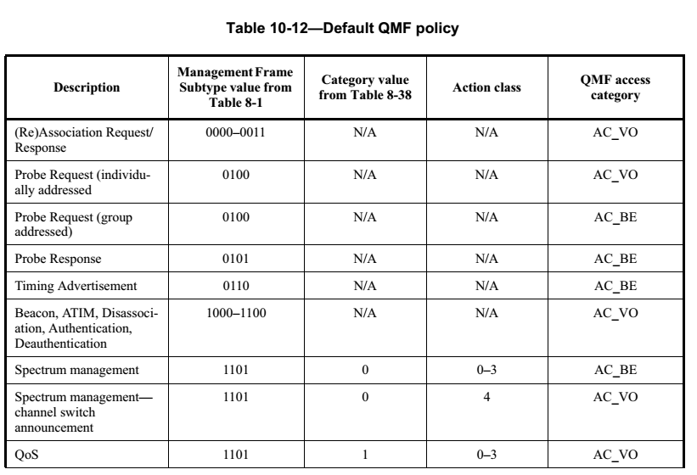
Default QMF policy (1)
Group addressed (Broadcast) Probe requests are assigned to the Best Effort category
  Individually addressed Probe requests remain in AC_VO

Slide 9
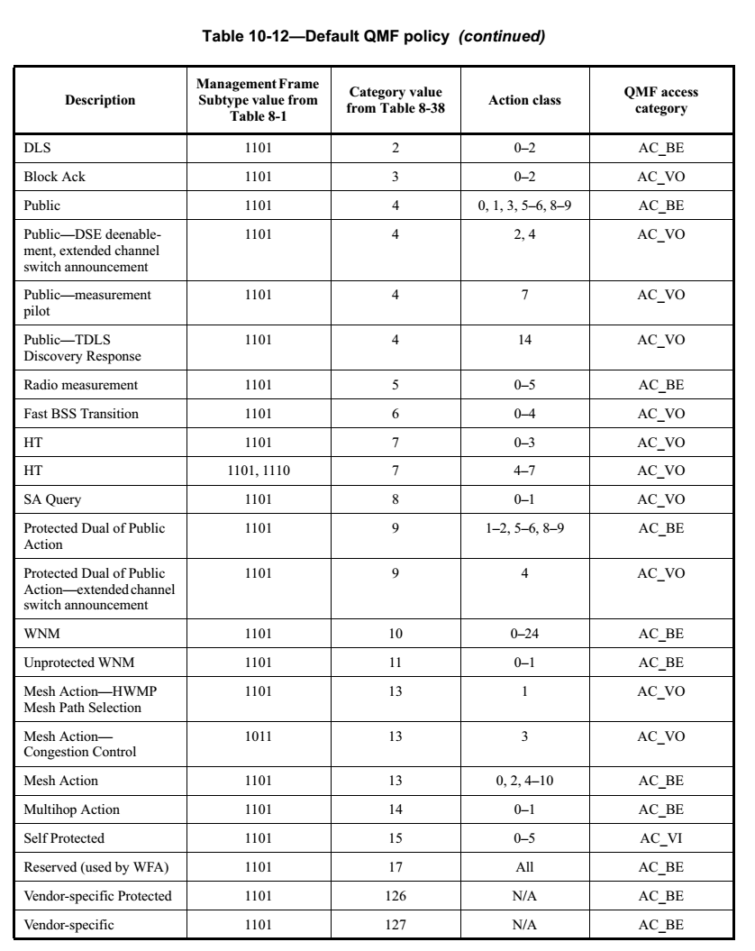
Default QMF policy (2)
Mobility related management frames remain in AC_VO
  Enable timely handling

Slide 10
Summary
802.11ae prevents overloading the highest priority
The default table covers most aspects
  Time critical management frames remain in AC_VO
A management frame prioritization policy can be locally adjusted
  However, there is no requirement for an AP to use this mechanism
Implementation of 802.11ae requires little (high level) changes

Slide 11
Straw Poll

Slide 12
Straw Poll
Do you agree to add the following to the IEEE 802.11 TGax Specification Framework?
  Add to the end of Clause 6 (MAC): “The amendment shall define a HE STA to be a QMF STA.”

Slide 13
Motion
Transform successful straw poll into a motion

Slide 14
Motion
Moved to add to the end of Clause 6 (MAC) of the IEEE 802.11 TGax Specification Framework:
  “The amendment shall define a HE STA to be a QMF STA.”
  Moved by:
  Seconded:

Slide 15
References
M. Montemurro and B. Kramer, “P802.11ae report to EC on in support of approval to proceed to RevCom,” Jan. 2012. [Online]. Available: https://mentor.ieee.org/802.11/dcn/12/11-12-0030
IEEE, “IEEE Standard for Information technology—Telecommunications and information exchange between systems—Local and metropolitan area networks—Specific requirements Part 11: Wireless LAN Medium Access Control (MAC) and Physical Layer (PHY) Specifications Amendment 1: Prioritization of Management Frames,” Apr. 2012. [Online]. Available: http://standards.ieee.org/getieee802/download/802.11ae-2012.pdf
“Voters List for Recirculation Letter Ballot 181 (TGae Draft 5.0) And previous Ballots: 169, 172, 176 and 180,” [Online]. Available: http://www.ieee802.org/11/LetterBallots/LB181ae/LB181_voters_list.xls
M. Montemurro, “TGae LB180 Comment Resolutions,” Jun. 2011. [Online]. Available: https://mentor.ieee.org/802.11/dcn/11/11-11-0888
B. Kramer and M. Montemurro, “P802.11ae Press Release,” Apr. 2012. [Online]. Available: https://mentor.ieee.org/802.11/dcn/12/11-12-0478
K. Yunoki et al., “Understanding Current Situation of Public Wi-Fi Usage— Possible Requirements for HEW,” [Online]. Available: https://mentor.ieee.org/802.11/dcn/13/11-13-0523
G. R. Hiertz et al., “Efficiency enhancement for 802.11ax,” Jul. 2015. [Online]. Available: https://mentor.ieee.org/802.11/dcn/15/11-15-0871

